Slide 1

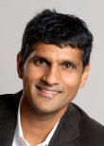
Approximating metrics by tree metrics
Kunal Talwar
Microsoft Research Silicon Valley
Joint work with
Jittat Fakcharoenphol
Kasetsart University Thailand
Satish Rao
UC Berkeley

Slide 2
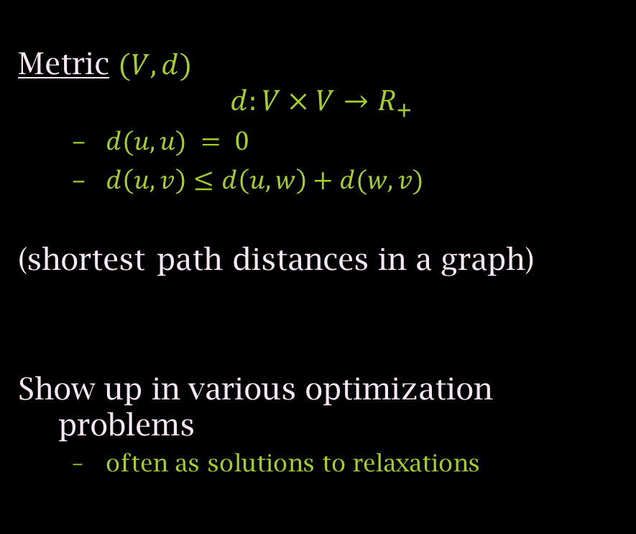
Metric
Metric $(V,d)$
$$d:V×V→R_{+}$$
  $d(u,u) = 0$
  $d\left(u,v\right)≤d\left(u,w\right)+d(w,v)$
(shortest path distances in a graph)
Show up in various optimization problems
  often as solutions to relaxations
0 | 10 | 15 | 5
 | 0 | 25 | 15
 |  | 0 | 20
 |  |  | 0
a
10
b
15
25
5
d
20
c
15

Slide 3

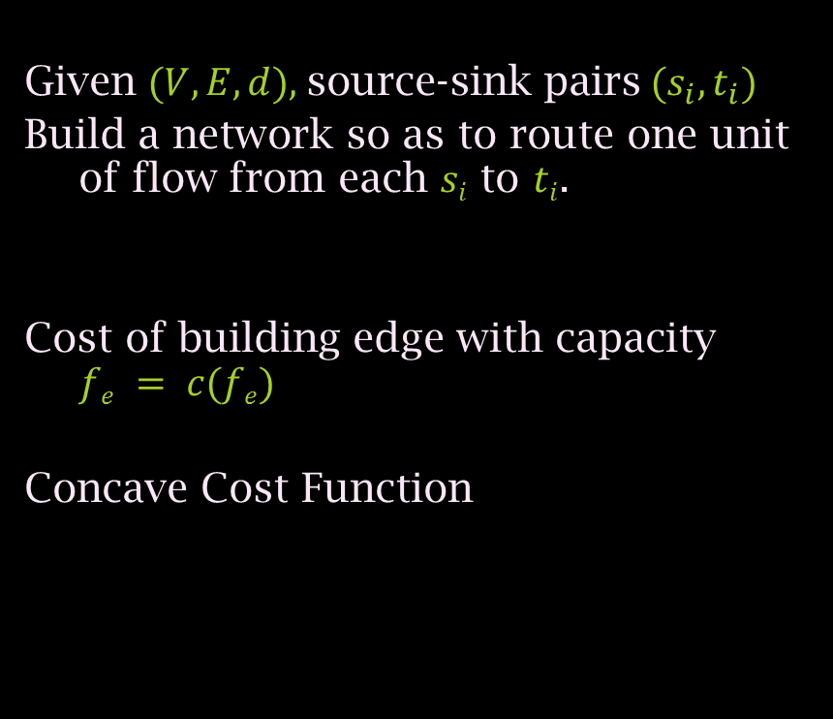

BatB Network design
Given $(V,E,d),$source-sink pairs$(s_{i},t_{i})$
Build a network so as to route one unit of flow from each $si$ to $ti$.
Cost of building edge with capacity $fe = c(fe)$
Concave Cost Function
$$c(f)$$
Optical fiber
T1
$$f$$

Slide 4
Tree metrics
Shortest path metric on a weighted tree
Simple to reason about
Easier to design algorithms
which are simple and/or fast.
a
10
b
15
5
d
c

Slide 5
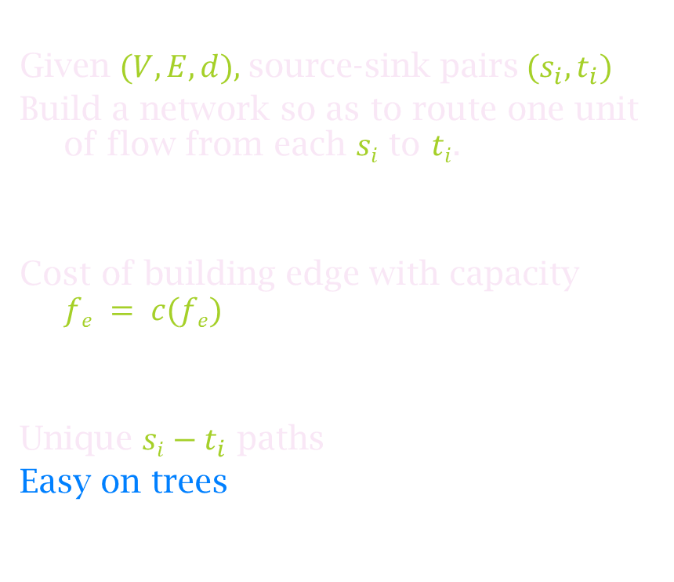
BatB Network design
Given $(V,E,d),$source-sink pairs$(s_{i},t_{i})$
Build a network so as to route one unit of flow from each $si$ to $ti$.
Cost of building edge with capacity $fe = c(fe)$
Unique $si−t_{i}$ paths
Easy on trees
$$c(f)$$
Optical fiber
T1
$$f$$

Slide 6
BatB Network design
Given $(V,E,d),$source-sink pairs$(s_{i},t_{i})$
Build a network so as to route one unit of flow from each $si$ to $ti$.
Cost of building edge with capacity $fe = c(fe)$
Unique $si−t_{i}$ paths
Easy on trees
$$c(f)$$
Optical fiber
T1
$$f$$

Slide 7
Question
Can any metric be approximated by a tree metric?
Approximately optimal solution
Approximately
Easy solution

Slide 8
The cycle
Shortest path metric on a cycle.
1
1
1
1
1
1
1
1

Slide 9

The cycle
Shortest path metric on a cycle.
[Rabinovich-Raz98, Gupta01]
Any embedding of this metric into
a tree incurs distortion $(n)$.
1
1
1
1
1
1
1

Slide 10

The cycle
Shortest path metric on a cycle.
[Rabinovich-Raz98, Gupta01]
Any embedding of this metric into
a tree incurs distortion $(n)$.
Extra edges don’t help
1
1
1
1
1
1
1
1
2
1
3
3
4
1

Slide 11

The cycle
Shortest path metric on a cycle.
[Rabinovich-Raz98, Gupta01]
Any embedding of this metric into
a tree incurs distortion $(n)$.
Extra vertices don’t help either
1
1
1
1
1
1
1
2
2
2
2
2
2
2
2

Slide 12
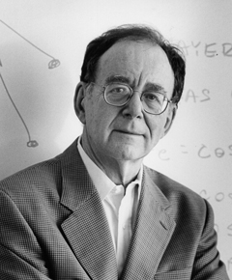
…but Dice help
[Karp 89] Cut an edge at random !
1
1
1
1
1
1
1
1
v
u

Slide 13
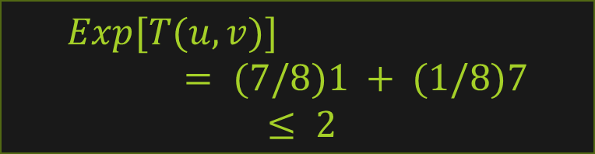
…but Dice help
[Karp 89] Cut an edge at random !
Expected stretch of any
fixed edge is at most 2.
1
1
1
1
1
1
1
1
v
u
$$Exp[T(u,v)] = (7/8)1 + (1/8)7$$
$$≤ 2$$

Slide 14

Probabilistic Embedding
Probabilistic Embedding
Embed $(V,d)$into a probability distribution over trees
such that:
For each tree $Ti, T_{i} (u,v)≥ d(u,v)$
Expected value of $T\left(u,v\right)≤ α d(u,v)$
1
1
1
1
1
1
1
1
v
u
Distortion

Slide 15
Question
Can any metric be probabilistically approximated by a tree metric?
Approximately optimal solution
(in Expectation)
Approximately
Easy solution

Slide 16
Why?
Several problems are easy (or easier) on trees:
Network design, Group Steiner tree, k-server, Metric labeling, Minimum communication cost spanning tree, metrical task system, Vehicle routing, etc.

Slide 17
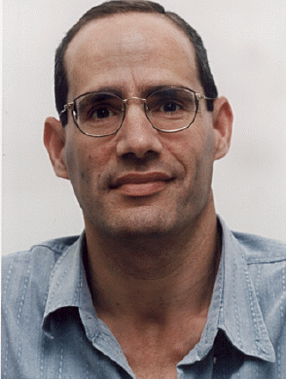
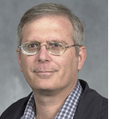
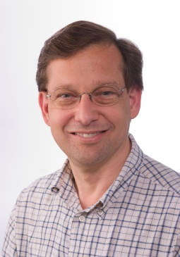


History
[Alon-Karp-Peleg-West-92] Defined the problem; $e^{\sqrt{\log{n\log{\log{n}}}}{ }}$upper bound; $(log⁡n)$lower bound.
[Bartal96] $O(log2 n)$ upper bound; several applications
[Bartal98] $O(\log{n}\log{\log{n}})$upper bound
[Fakcharoenphol-Rao-T-03] $O(\log{n})$ upper bound

Slide 18
Approximating by tree metrics
High level outline:
Hierarchically decompose the points in the metric
  Geometrically decreasing diameters
Convert clustering into tree

Slide 19

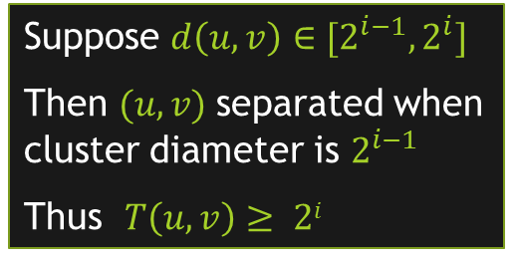




Distances Increase
Dia $2^{i}$
High level outline:
Hierarchically decompose the points in the metric
  Geometrically decreasing diameters
Convert clustering into tree
$$2^{i−1}$$
Dia $2^{i−1}$
$$2^{i−2}$$
Suppose $d\left(u,v\right)∈[2^{i−1}, 2^{i}]$
Then $(u,v)$separated when cluster diameter is $2^{i−1}$
Thus $T\left(u,v\right)≥ 2i$
Dia $2^{i−2}$

Slide 20

Bounding Distortion
Dia $2^{i}$
If $(u,v)$separated at level $i$
$$T\left(u,v\right)≤2i$$
$$E\left[T\left(u,v\right)\right]≤ Σ_{i}Pr⁡[\left(u,v\right)cut at level i]⋅2i$$
$$2^{i−1}$$
Dia $2^{i−1}$
$$2^{i−2}$$
Dia $2^{i−2}$

Slide 21

Low Diameter Decomposition
Thus main problem: decomposition
Given a set $X$ of points, break into clusters of diameter at most $2^{i}$
Ensure $Pr⁡[(u,v) separated]$small compared to $\frac{d(u,v)}{2^{i}}$

Slide 22
Our techniques
Techniques used in approximating 0-extension problem by [Calinscu-Karloff-Rabani-01]
Improved algorithm and analysis used in [Fakcharoenphol-Harrelson-Rao-T.-03]

Slide 23
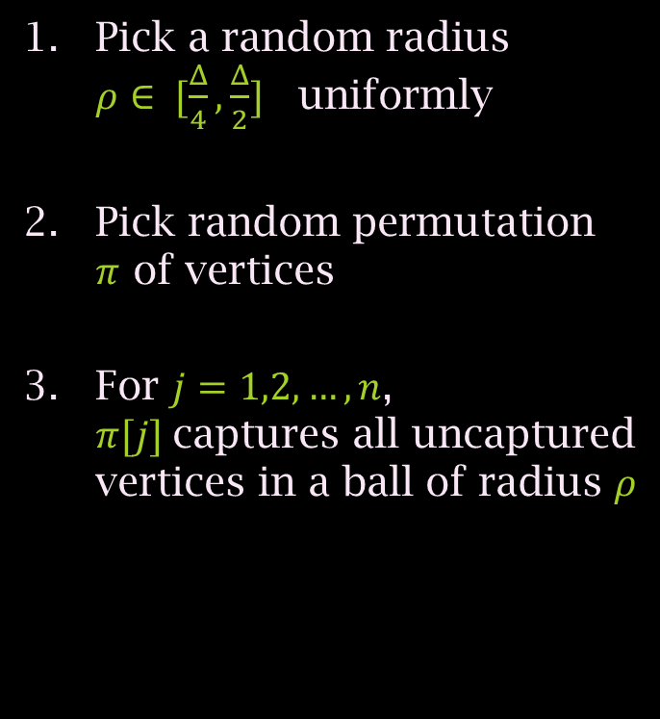
Decomposition algorithm
Pick a random radius $ρ∈ [\frac{Δ}{4}, \frac{Δ}{2}]$uniformly
Pick random permutation $π$ of vertices
For $j=1,2,…,n$, $π[j]$captures all uncaptured vertices in a ball of radius $ρ$
Notes:
PICTURE

Slide 24
Decomposition algorithm
Pick a random radius $ρ∈ [\frac{Δ}{4}, \frac{Δ}{2}]$uniformly
Pick random permutation $π$ of vertices
For $j=1,2,…,n$, $π[j]$captures all uncaptured vertices in a ball of radius $ρ$
Notes:
PICTURE

Slide 25
Decomposition algorithm
Pick a random radius $ρ∈ [\frac{Δ}{4}, \frac{Δ}{2}]$uniformly
Pick random permutation $π$ of vertices
For $j=1,2,…,n$, $π[j]$captures all uncaptured vertices in a ball of radius $ρ$
Notes:
PICTURE

Slide 26
Decomposition algorithm
Pick a random radius $ρ∈ [\frac{Δ}{4}, \frac{Δ}{2}]$uniformly
Pick random permutation $π$ of vertices
For $j=1,2,…,n$, $π[j]$captures all uncaptured vertices in a ball of radius $ρ$
Notes:
PICTURE

Slide 27

Decomposition algorithm
Pick a random radius $ρ∈ [\frac{Δ}{4}, \frac{Δ}{2}]$uniformly
Pick random permutation $π$ of vertices
For $j=1,2,…,n$, $π[j]$captures all uncaptured vertices in a ball of radius $ρ$
Notes:
PICTURE

Slide 28
Decomposition algorithm
Pick a random radius $ρ∈ [\frac{Δ}{4}, \frac{Δ}{2}]$uniformly
Pick random permutation $π$ of vertices
For $j=1,2,…,n$, $π[j]$captures all uncaptured vertices in a ball of radius $ρ$
Notes:
PICTURE

Slide 29
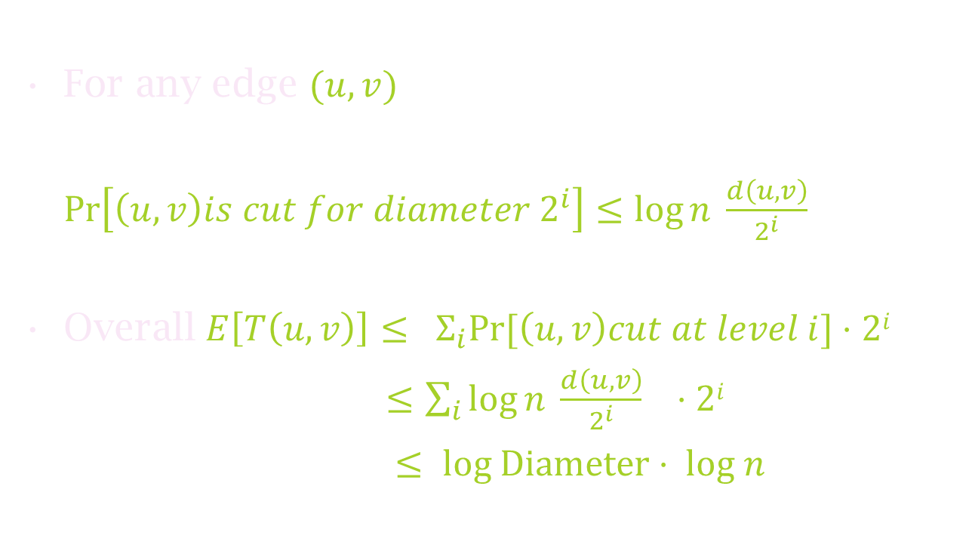
Bounding Distortion
For any edge $(u,v)$
$\operatorname{Pr}\left[\left(u,v\right)is cut for diameter 2^{i}\right]≤\log{n} \frac{d\left(u,v\right)}{2^{i}}$
Overall $E\left[T\left(u,v\right)\right]≤ Σ_{i}Pr⁡[\left(u,v\right)cut at level i]⋅2i$
$≤\sum_{i}{\log{n} \frac{d\left(u,v\right)}{2^{i}} }⋅2i$
$≤ log Diameter⋅ log n$

Slide 30



The blaming game
Suppose $(u,v)$cut at level $i$
It blames the first center $t$ which captured $u$ but not $v$
$$u$$
$$v$$

Slide 31











$$v$$
$$u$$
$$t1$$
$$t2$$
$$\frac{Δ}{4}$$
$$tk$$
$$\frac{Δ}{2}$$
$$ρ$$
For $tk$ to cut $(u,v)$
  $ρ$ falls in a range of length $d(u,v)$( Pr. $\frac{d(u,v)}{Δ}$ )
$$u$$
$$v$$

Slide 32
$$v$$
$$u$$
$$t1$$
$$t2$$
$$\frac{Δ}{4}$$
$$tk$$
$$\frac{Δ}{2}$$
$$ρ$$
For $tk$ to cut $(u,v)$
  $ρ$ falls in a range of length $d(u,v)$( Pr. $\frac{d(u,v)}{Δ}$ )
$$u$$
$$v$$

Slide 33

$$v$$
$$u$$
$$t1$$
$$t2$$
$$\frac{Δ}{4}$$
$$tk$$
$$\frac{Δ}{2}$$
$$ρ$$
For $tk$ to cut $(u,v)$
  $ρ$ falls in a range of length $d(u,v)$( Pr. $\frac{d(u,v)}{Δ}$ )
  $tk$ should occur before $t1,t2,…t_{k−1}$in π ( Pr. $\frac{1}{k}$ )
$$u$$
$$v$$

Slide 34
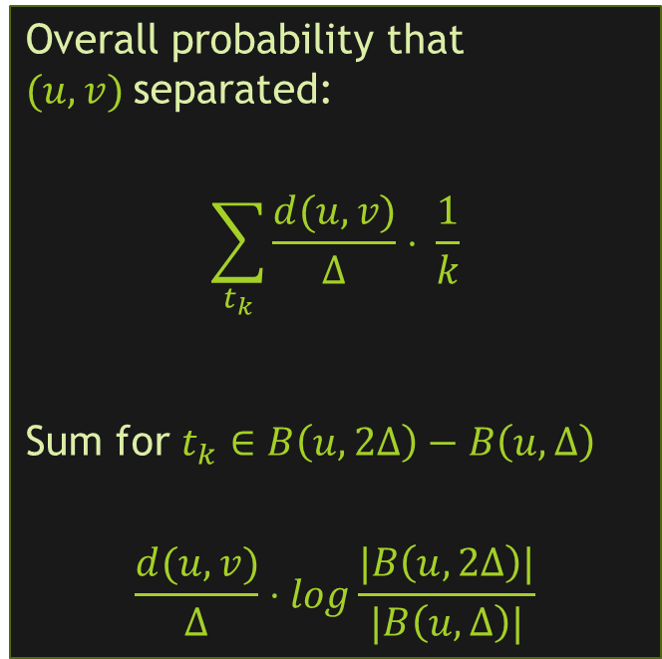
$$v$$
$$u$$
$$t1$$
$$t2$$
$$\frac{Δ}{4}$$
$$tk$$
$$\frac{Δ}{2}$$
$$ρ$$
Overall probability that $(u,v)$separated:
$$\sum_{t_{k}}{\frac{d(u,v)}{Δ}⋅ \frac{1}{k}}$$
Sum for $t_{k}∈B\left(u,2Δ\right)−B\left(u,Δ\right)$
$$\frac{d(u,v)}{Δ}⋅log\frac{|B\left(u,2Δ\right)|}{|B\left(u,Δ\right)|}$$
For $tk$ to cut $(u,v)$
  $ρ$ falls in a range of length $d(u,v)$( Pr. $\frac{d(u,v)}{Δ}$ )
  $tk$ should occur before $t1,t2,…t_{k−1}$in π ( Pr. $\frac{1}{k}$ )

Slide 35

Thus…
$E\left[T\left(u,v\right)\right]≤ Σ_{i}\operatorname{Pr}\left[\left(u,v\right)cut at level i\right]⋅2i$
$≤\sum_{i}{\frac{d\left(u,v\right)}{2^{i}}⋅log\frac{\left|B\left(u,2^{i+1}\right)\right|}{\left|B\left(u, 2^{i}\right)\right|}⋅2^{i}}$
$=d\left(u,v\right)⋅\sum_{i}{log\frac{\left|B\left(u,2^{i+1}\right)\right|}{\left|B\left(u, 2^{i}\right)\right|}}$
Any metric can be $O(log⁡n)−$probabilistically approximated by tree metrics.

Slide 36
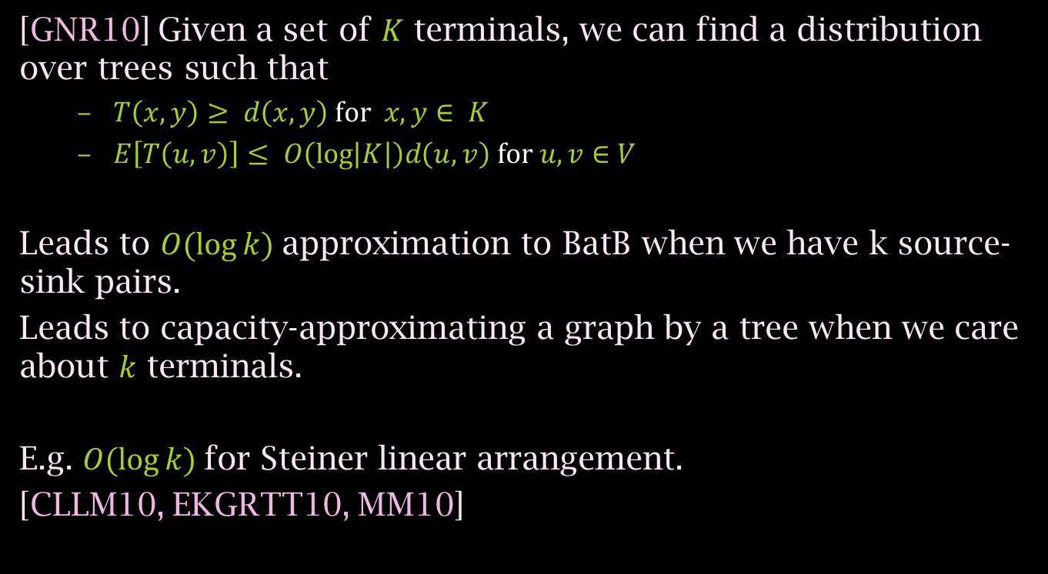
Few terminals case
[GNR10] Given a set of $K$ terminals, we can find a distribution over trees such that
  $T\left(x,y\right)≥ d\left(x,y\right) \text{for} x,y∈ K$
  $E\left[T\left(u,v\right)\right]≤ O\left(\log\left|K\right|\right)d\left(u,v\right) \text{for} u,v∈V$
Leads to $O(\log{k)}$approximation to BatB when we have k source-sink pairs.
Leads to capacity-approximating a graph by a tree when we care about $k$ terminals.
E.g. $O(\log{k)}$for Steiner linear arrangement.
[CLLM10, EKGRTT10, MM10]

Slide 37
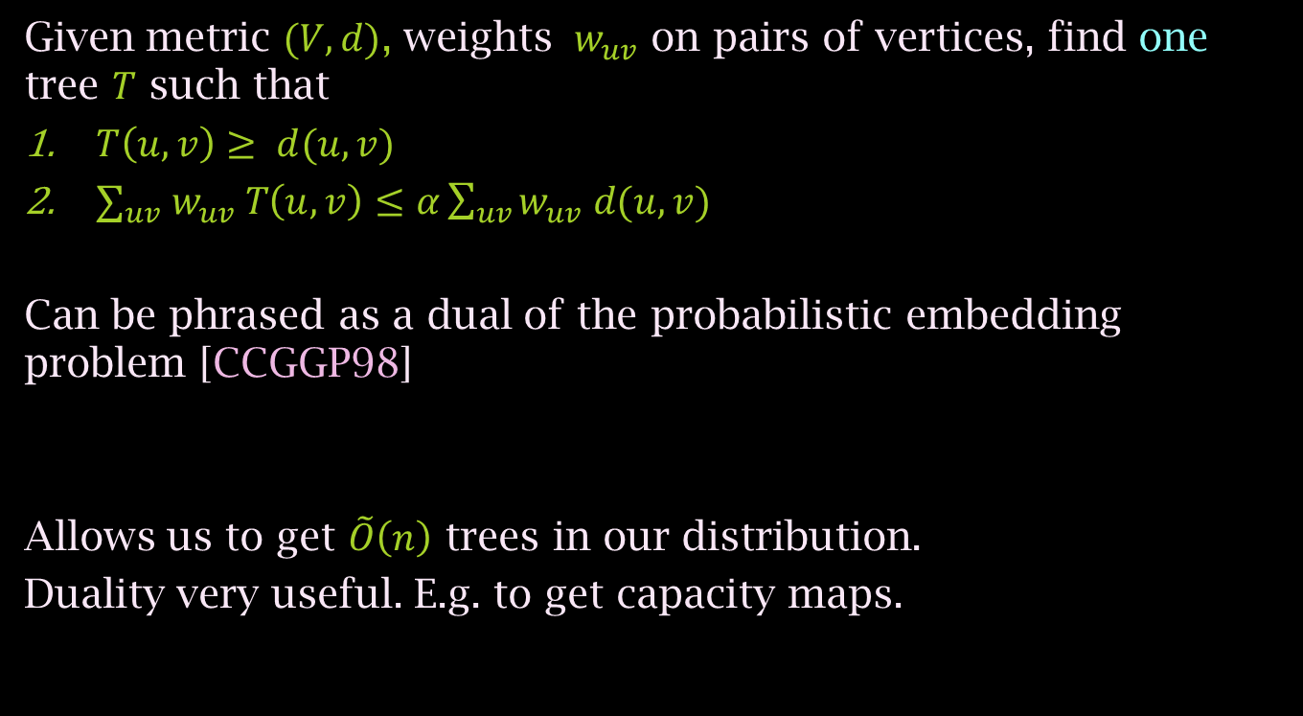
Remarks
Given metric $(V,d)$, weights $w_{uv}$ on pairs of vertices, find one tree $T$ such that
$T\left(u,v\right)≥ d(u,v)$
$∑_{uv} w_{uv} T\left(u,v\right)≤α\sum_{uv}{w_{uv} d(u,v) }$
Can be phrased as a dual of the probabilistic embedding problem [CCGGP98]
Allows us to get $\tilde{O}\left(n\right)$ trees in our distribution.
Duality very useful. E.g. to get capacity maps.

Slide 38
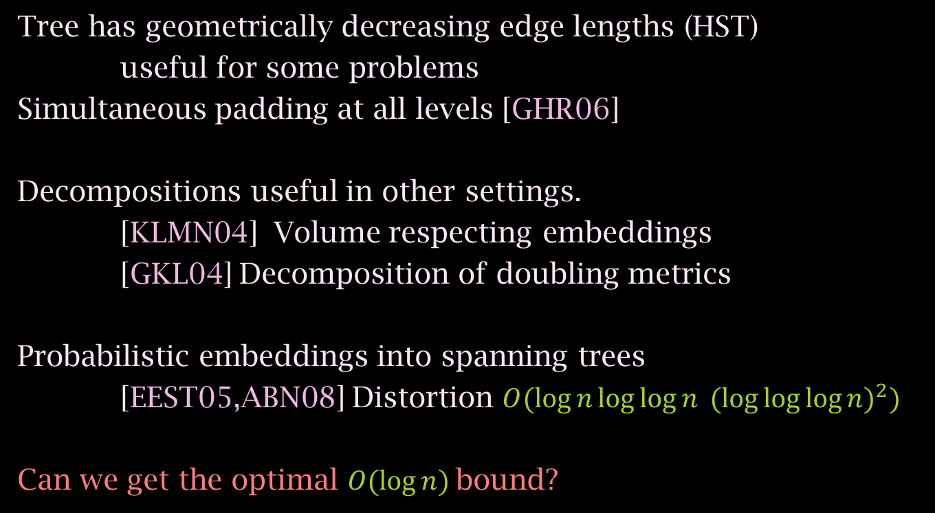
More remarks
Tree has geometrically decreasing edge lengths (HST)
useful for some problems
Simultaneous padding at all levels [GHR06]
Decompositions useful in other settings.
[KLMN04] Volume respecting embeddings
[GKL04] Decomposition of doubling metrics
Probabilistic embeddings into spanning trees
[EEST05,ABN08] Distortion $O(\log{n\log{\log{n} }}{(\log{\log{\log{n)}}}}^{2})$
Can we get the optimal $O(log⁡n)$bound?

Slide 39
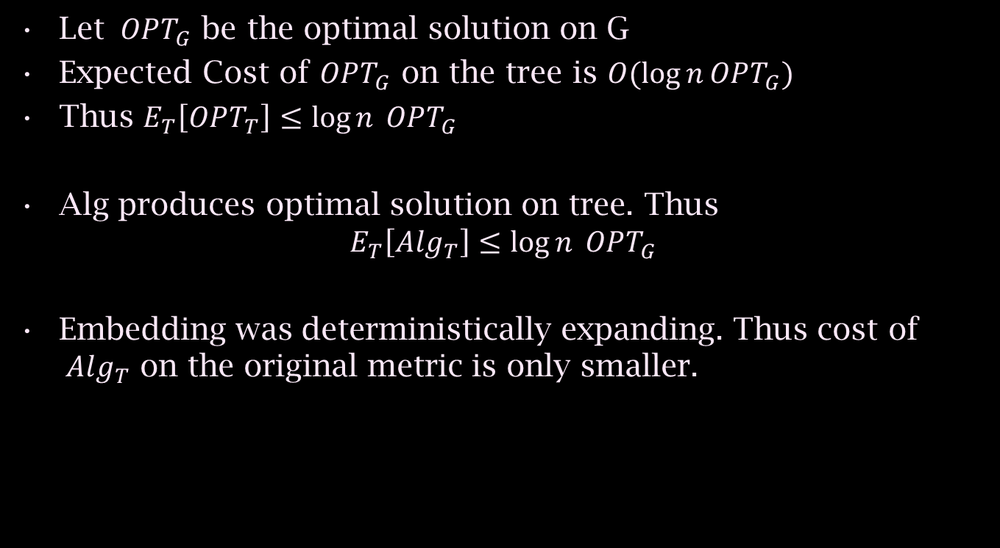
BatB Network Design
Let $OPT_{G}$ be the optimal solution on G
Expected Cost of $OPT_{G}$ on the tree is $O(\log{n}OPT_{G})$
Thus $E_{T}\left[OPT_{T}\right]≤\log{n} OPT_{G}$
Alg produces optimal solution on tree. Thus
$$E_{T}\left[Alg_{T}\right]≤\log{n} OPT_{G}$$
Embedding was deterministically expanding. Thus cost of $Alg_{T}$ on the original metric is only smaller.

Slide 40
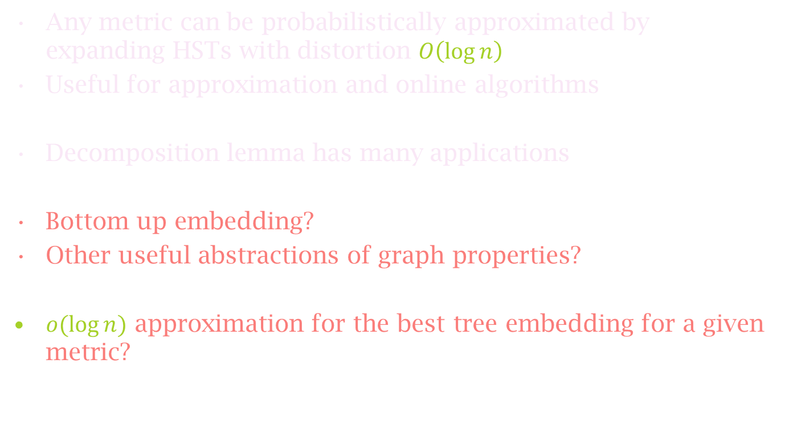
Summary
Any metric can be probabilistically approximated by expanding HSTs with distortion $O\left(\log{n}\right)$
Useful for approximation and online algorithms
Decomposition lemma has many applications
Bottom up embedding?
Other useful abstractions of graph properties?
$o(log⁡n)$ approximation for the best tree embedding for a given metric?

