Slide 1
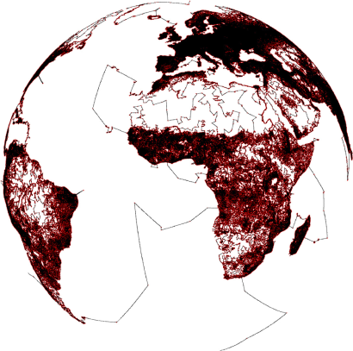
Beyond Planar Graphs: Minors, Bidimensionality, & Decomposition
Erik Demaine
MIT
r
r

Slide 2
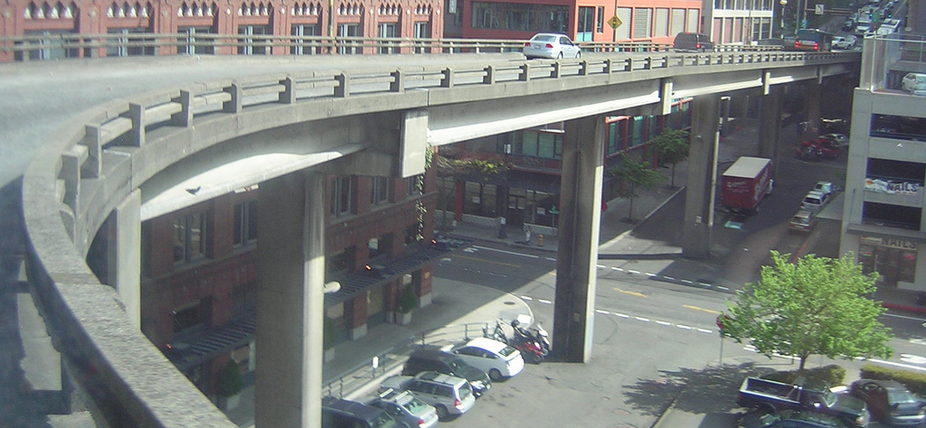
Goals
How far beyond planar graphs can we go?
Graphs excluding a fixed minor
Powers thereof
Build general approximation frameworks applying to many problems simultaneously
Bidimensionality
Contraction decomposition
© 2008 Russ Brown
Notes:
http://www.flickr.com/photos/imperialfistcommander/2519774539/

Slide 3
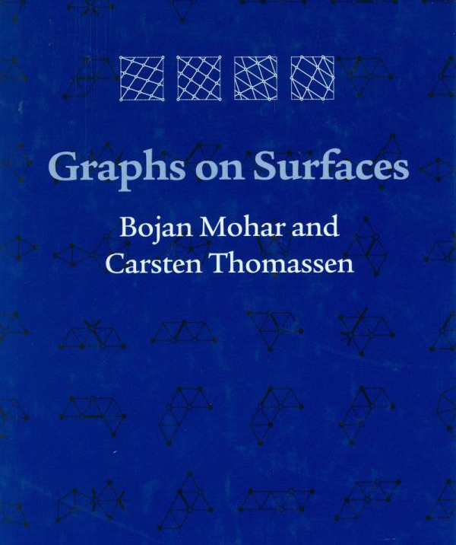
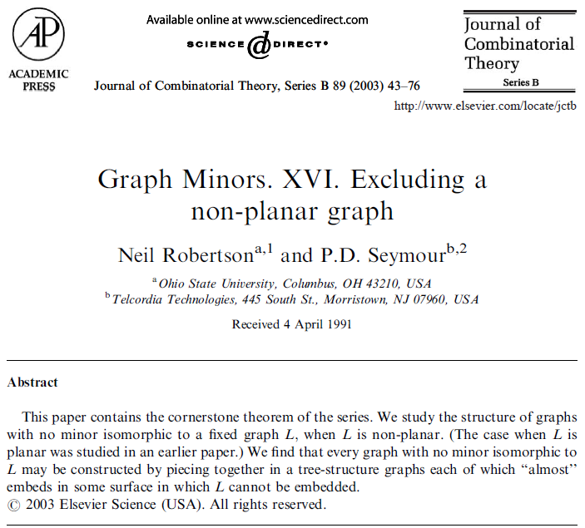
Tools
Graph structure theory
Graphs on surfaces
Graph Minors
Decompositions
Algorithms
Lipton-Tarjan separator approximation
Baker approximation
Fixed-parameter algorithms
Bounded-treewidth algorithms

Slide 4
Sample Result [Demaine, Hajiaghayi, Kawarabayashi 2011]
PTAS for Traveling Salesman Problem in weighted H-minor-free graphs, for any fixed graph H
© 2008 Russ Brown
Notes:
http://www.flickr.com/photos/imperialfistcommander/2519774539/

Slide 5
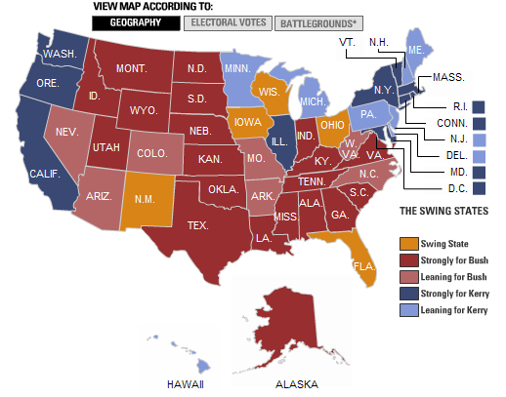
Minors
H is a minor of G if G can reach H via
edge deletions
edge contractions
v
w
delete
v
w
v
w
contract
is a minor of
K_{3,3}
delete
contract
New York Times

Slide 6
H-Minor-Free Graphs [Robertson & Seymour 2003]
H-minor-free graph looks like a tree of “almost embeddable” graphs:
Base graph drawn on surface of genus f(H)
f(H) vortex faces filled with graphs of pathwidth f(H)
f(H) apex vertices connected to anything
Polynomial algorithm [Demaine, Hajiaghayi, Kawarabayashi 2005]

Slide 7
Bidimensionality

Slide 8
Bidimensionality (version 1) [Demaine, Fomin, Hajiaghayi, Thilikos 2004]
Parameter k = k(G) is bidimensional if
Closed under minors: k only decreases when deleting or contracting edges
and
Large on grids: For the r × r grid, k = Ω(r²)
v
w
delete
v
w
v
w
contract
r
r

Slide 9
Example 1: Vertex Cover
k = minimum number of vertices required to cover every edge (on either endpoint)
Closed under minors:
v
w
v
w
v
w
v
w
cover
⇒ still a cover
(only fewer edges)
v
w
delete
v
w
⇒ still a cover, possibly 1 smaller
v
w
contract

Slide 10
Example 1: Vertex Cover
k = minimum number of vertices required to cover every edge (on either endpoint)
Large on grids:
Matching of size Ω(r²)
Every edge must be covered by a different vertex
v
w
v
w
v
w
v
w
cover
r
r

Slide 11
Example 2: Feedback Vertex Set
k = minimum number of vertices required to cover every cycle (on some vertex)
Closed under minors:
…
v
w
v
w
v
w
v
w
cover
u
u
u
u
⇒ still a cover
(only break cycles)
v
w
delete
v
w
⇒ still a cover, possibly 1 smaller
v
w
contract

Slide 12
Example 2: Feedback Vertex Set
k = minimum number of vertices required to cover every cycle (on some vertex)
Large on grids:
Ω(r²) vertex-disjoint cycles
Every cycle must be covered by a different vertex
…
v
w
v
w
v
w
v
w
cover
u
u
u
u
r
r

Slide 13
Bidimensional ⇒ Relate Parameter & Treewidth
&
Theorem 2: If a parameter k is bidimensional, then it satisfies parameter-treewidth bound treewidth = O(√‾) in any graph family excluding some minor [Demaine, Fomin, Hajiaghayi, Thilikos 2004; Demaine & Hajiaghayi 2005]
Proof sketch: Treewidth w ⇒ Ω(w) × Ω(w) grid minor ⇒ k = Ω(w²) [bidimensional]
k

Slide 14
Bidimensional ⇒ EPTAS
&
Theorem 3: If a parameter is
bidimensional,
fixed-parameter tractable on graphs of bounded treewidth: h(treewidth) n^{O(1)} time,
O(1)-approximable in polynomial time, and
satisfies the “separation property”
then it has an efficient PTAS: (1+ε)-approximation in h(O(1/ε)) n^{O(1)} time in any graph family excluding some minor [Demaine & Hajiaghayi 2005]

Slide 15
Bidimensional ⇒ EPTAS
v
w
v
w
u
Corollary 3: Vertex cover and feedback vertex set have efficient PTASs in any graph family excluding some minor [Demaine & Hajiaghayi 2005]
Previously known for vertex cover (and many other problems) on planar graphs
E.g., feedback vertex set result is new, even for planar graphs

Slide 16
Bidimensional ⇒ EPTAS
…
…
…
…
&
Proof sketch of Theorem 3:
Repeatedly remove O(√‾‾‾)-vertex balanced separator (cf. Lipton-Tarjan’s O(√‾))
Treewidth = O(√‾‾‾) [bidimensionality]
Approximate tree decomposition [Amir 2001]
Use O(1)-approx. to find roughly balanced cut
Combine pieces using separation property:
Solution on disconnected graph = union of solutions of each connected component
Given solution to G − C, can compute solution to G at an additional cost of ± O(|C|)
Solution S of G induced on connected component X of G − C has size |S ∩ X| ± O(|C|)
OPT
…
…
…
…
n
OPT

Slide 17
Bidimensionality (version 3) [Fomin, Golovach, Thilikos 2009]
Parameter k is contraction- bidimensional if
Closed under contractions: k only decreases when contracting edges
and
Large on Γ graphs: For naturally triangulated r × r grid graphs, k = Ω(r²)
v
w
v
w
contract

Slide 18
Contraction-Bidimensional Problems
Minimum maximal matching
Face cover (planar graphs)
Dominating set
Edge dominating set
R-dominating set
Connected … dominating set
Unweighted TSP tour
Chordal completion (fill-in)
v
w
v
w
contract

Slide 19
Contraction-Bidimensional ⇒ Good
Theorem: As before, obtain
parameter-treewidth bound
efficient PTASs
for contraction-bidimensional parameters in any graph family excluding an apex minor [Demaine, Fomin, Hajiaghayi, Thilikos 2004; Demaine & Hajiaghayi 2005 & 2005; Fomin, Golovach, Thilikos 2009; Fomin, Lokshtanov, Saurabh, Thilikos 2009]

Slide 20
Possible Extensions
Conjecture: Algorithms for contraction-bidimensional problems generalize to non-apex-minor-free graphs [Demaine, Fomin, Hajiaghayi, Thilikos 2004; Fomin, Golovach, Thilikos 2009]
Conjecture: Most of bidimensionality generalizes to fixed powers of H-minor- free graphs, e.g., map graphs [Demaine, Hajiaghayi, Kawarabayashi 2009; Demaine, Fomin, Hajiaghayi, Thilikos 2003]
New York Times

Slide 21
Beyond Bidimensionality
Nontrivial weights
Min-weight k disjoint paths?
Directed graphs
Useful notion of treewidth?
Subset problems
Steiner tree, subset TSP, etc. have PTASs up to bounded-genus graphs [Borradaile, Mathieu, Klein 2007; Borradaile, Demaine, Tazari 2009]
Steiner forest has PTAS in planar graphs [Bateni, Hajiaghayi, Marx 2010]
Wanted: A more general framework
k = 3

Slide 22
Decompositions

Slide 23
Graph Decomposition
Separator Decomposition | Simplifying Decomposition
Small separator | Large interaction
Small pieces | Simple pieces (e.g. bounded treewidth)
…
…
…
…
…
…
…
…
[Lipton & Tarjan 1980; …]
…
…
…
…
…
…
…
…

Slide 24
Simplifying Graph Decomposition [Demaine, Hajiaghayi, Kawarabayashi 2010]
Theorem: Odd H-minor-free graphs can have their vertices or edges partitioned into two pieces such that each induced graph has bounded treewidth
Previously for planar graphs [Baker 1994], apex-minor-free [Eppstein 2000], H-minor-free [DeVos et al. 2004; Demaine, Hajiaghayi, Kawarabayashi 2005]

Slide 25
Example: Graph Coloring [Demaine, Hajiaghayi, Kawarabayashi 2005/2010]
2-approximation for chromatic number in odd-H-minor-free graphs using decomposition into two bounded-treewidth pieces:
General graphs: Inapprox. within n^{1−ε} unless ZPP = NP

Slide 26
Simplifying Graph Decompositions [DeVos et al. 2004; Demaine, Hajiaghayi, Kawarabayashi 2005]
Generalization to k pieces: H-minor-free graphs can have their vertices or edges partitioned into k pieces such that deleting any one piece results in bounded treewidth
Useful for PTASs (where k ~ 1/ε)
(Not true for K_{n,n} nor odd-minor-free)

Slide 27
Example: Independence [Baker 1994; Demaine, Hajiaghayi, Kawarabayashi 2005]
Independent Set: Find most vertices not connected by any edges
PTAS in H-minor-free graph using decomposition into k pieces:
For each i, compute maximum independent set on all but piece i, using bounded-treewidth algorithm
Return largest solution, which is an independent set
Dropping piece i from OPT is a candidate ⇒ one i loses ≤ OPT/k

Slide 28
Many Problems Closed Under Contractions but not Deletions
Dominating set
Edge dominating set
R-dominating set
Connected … dominating set
Face cover (planar graphs)
Minimum maximal matching
Chordal completion (fill-in)
Traveling Salesman Problem
…

Slide 29
Contraction Decomposition [Demaine, Hajiaghayi, Kawarabayashi 2011]
Theorem: H-minor-free graphs can have their edges partitioned into k pieces such that contracting any one piece results in bounded treewidth
Polynomial-time algorithm
Previously known for planar [Klein 2005, 2006], bounded-genus [Demaine, Hajiaghayi, Mohar 2007], apex-minor-free [Demaine, Hajiaghayi, Kawarabayashi 2009]

Slide 30
Approximation Algorithms via Contraction Decomposition
Theorem: Any minimization problem with the following properties has a PTAS on H-minor-free graphs:
Closed under contractions
Polynomial on graphs of bounded treewidth
Spanner: Map weighted graph G → G’ such that weight(G’) = O(OPT(G’)) and OPT(G’) ≤ (1+ε) OPT(G)
Map OPT(G with edges in S contracted) → solution to G with additional cost O(weight(S))
[Demaine, Hajiaghayi, Kawarabayashi 2011 / Demaine, Hajiaghayi, Mohar 2007]

Slide 31
Application to TSP
Corollary: PTAS for Traveling Salesman Problem in weighted H-minor-free graphs [Demaine, Hajiaghayi, Kawarabayashi 2011]
Existing bounded-treewidth algorithm [Dorn, Fomin, Thilikos 2006]
Existing spanner [Grigni, Sissokho 2002]
Decontraction:
Euler tour (cost ≤ 2 weight) + perfect matching on odd-degree vxs (cost ≤ weight)

Slide 32
Graph TSP History
PTAS for unweighted planar [Grigni, Koutsoupias, Papadimitriou 1995]
PTAS for weighted planar [Arora, Grigni, Karger, Klein, Woloszyn 1998]
Linear PTAS for weighted planar [Klein 2005]
QPTAS (n^{(1/ε) O(log log n)} time) for weighted bounded-genus / unweighted H-minor-free [Grigni 2000]
PTAS for weighted bounded genus [Demaine, Hajiaghayi, Mohar 2007]
PTAS for unweighted apex-minor-free [Demaine, Hajiaghayi, Kawarabayashi 2009]
PTAS for weighted H-minor-free [DHK 2011]

Slide 33
Application Beyond TSP
Corollary: PTAS for minimum-weight c-edge-connected submultigraph in H-minor-free graphs [Demaine, Hajiaghayi, Kawarabayashi 2011]
Previous results:
PTASs for 2-edge-connected in planar graphs [Klein 2005] (linear) [Berger, Czumaj, Grigni, Zhao 2005] [Czumaj, Grigni, Sissokho, Zhao 2004]
PTAS for c-edge-connected in bounded-genus graphs [Demaine, Hajiaghayi, Mohar 2007]

Slide 34
Fixed-Parameter Algorithmic Applications: k-cut
k-cut: Remove fewest edges to make at least k connected components
FPT in H-minor-free graphs:
Average degree c_{H} = O(H lg H )
⇒ OPT ≤ c_{H} k
⇒ Contraction decomposition with c_{H} k + 1 layers avoids OPT in some contraction
⇒ Solve in 2^{Õ(k)} n + n^{O(1)} time
Generalization to arbitrary graphs [Kawarabayashi & Thorup 2011]
√‾‾‾

Slide 35
Proof Sketch
H-minor-free graph = “tree” of “almost-embeddable graphs” [Graph Minors]
Each almost-embeddable graph has contraction decomposition:
Bounded genus done
Apices easy: increase treewidth of anything by O(1)
Vortices similar
[Demaine, Hajiaghayi, Mohar 2007]

Slide 36
Radial Coloring for Bounded Genus
Color edge at radial distance r as r mod k
Radial graph ≈ primal graph + dual graph
Any k consecutive layers have bounded treewidth, provided first k do

Slide 37
Neighborhoods of Shortest Paths have Bounded Treewidth

Slide 38
Contraction Decomposition [Demaine, Hajiaghayi, Kawarabayashi 2011]
Theorem: H-minor-free graphs can have their edges partitioned into k pieces such that contracting any one piece results in bounded treewidth
Polynomial-time algorithm
Seems a powerful tool for approximation & fixed-parameter algorithms
Let’s find more applications!

Slide 39
Beyond Planar Graphs: Minors, Bidimensionality, & Decomposition
Erik Demaine
MIT
r
r

