Slide 1
Catching the Microburst Culprits with Snappy
Xiaoqi Chen, Shir Landau Feibish, Yaron Koral, Ori Rottenstreich and Jennifer Rexford
SIGCOMM SelfDN Workshop
August 24th, 2018
Budapest, Hungary

Slide 2
Microbursts: Short Lived Traffic Bursts
Normal traffic rates are much lower than queue throughput
Buildup is normally minimal

Slide 3
Microbursts: Short Lived Traffic Bursts
Occasional short lived traffic spikes
Cause significant queue buildup

Slide 4
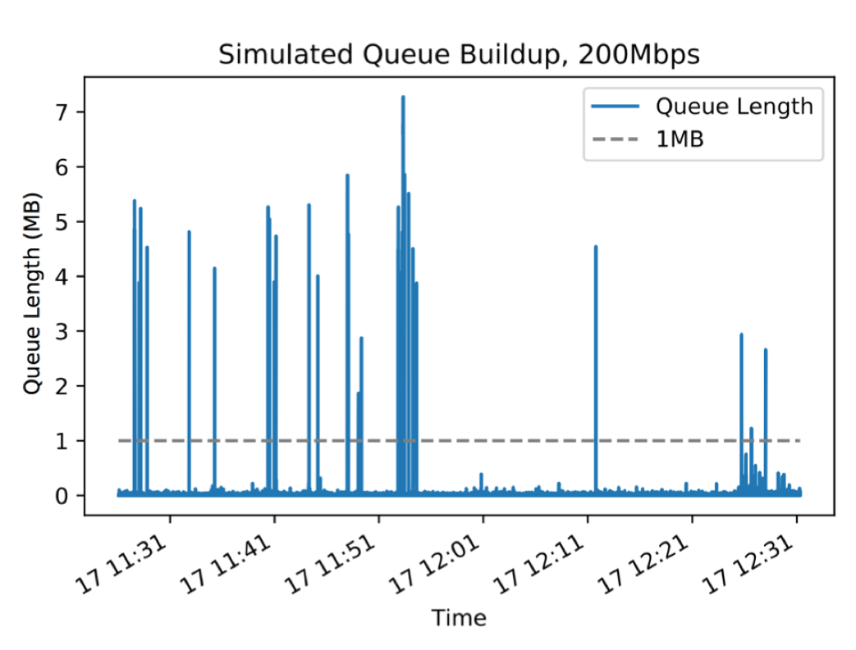
Queue Buildup in Data Centers

Slide 5
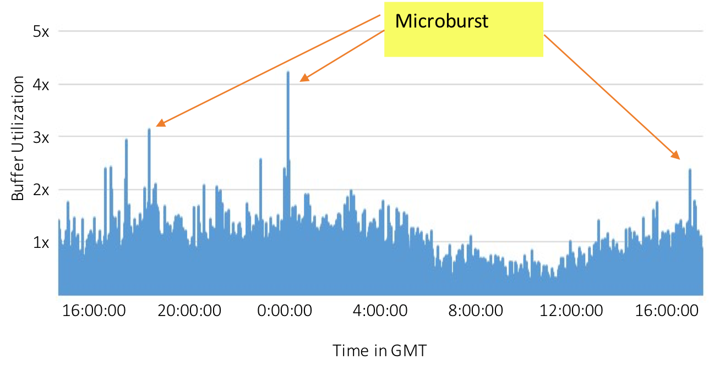
Queue Buildup in Carrier Networks

Slide 6

Microbursts are expensive…
Network admins want to:
  avoid packet loss
  use cheap switches
  high link utilizations
  support bursty workloads

Slide 7
Who caused the microburst?
The General Queue Occupancy Problem:
What’s the size of each flow in the queue?
Snappy solves:
    If a packet belongs to a heavy flow
    When queue is long
Key | Count
 | 1
 | 5
 | 1
 | 1
 | 2
 | 1

Slide 8
Queue Occupancy Problem
The problem is hard! Simultaneous add and delete.
3
Key
Count
1
1
1

Slide 9
Queue Occupancy Problem
The problem is hard! Simultaneous add and delete.
Key
Count
1
Update both for arrivals and departures
1
1
2

Slide 10
Solution: snapshots
Snappy maintains snapshots for short periods of incoming traffic.
We then combine snapshots to estimate entire queue’s content.
Observation 1: when queue is long, low relative error
Observation 2: we care about heavy flows, not everyone
?
S1 | S2 | S3 | S4 | …
 | 1
 | 5
Key
~Count

Slide 11
Round-Robin between Snapshots
Observation 3: limited #snapshots needed.
Read
Read
Write
Clean
Read
Read
Read

Slide 12
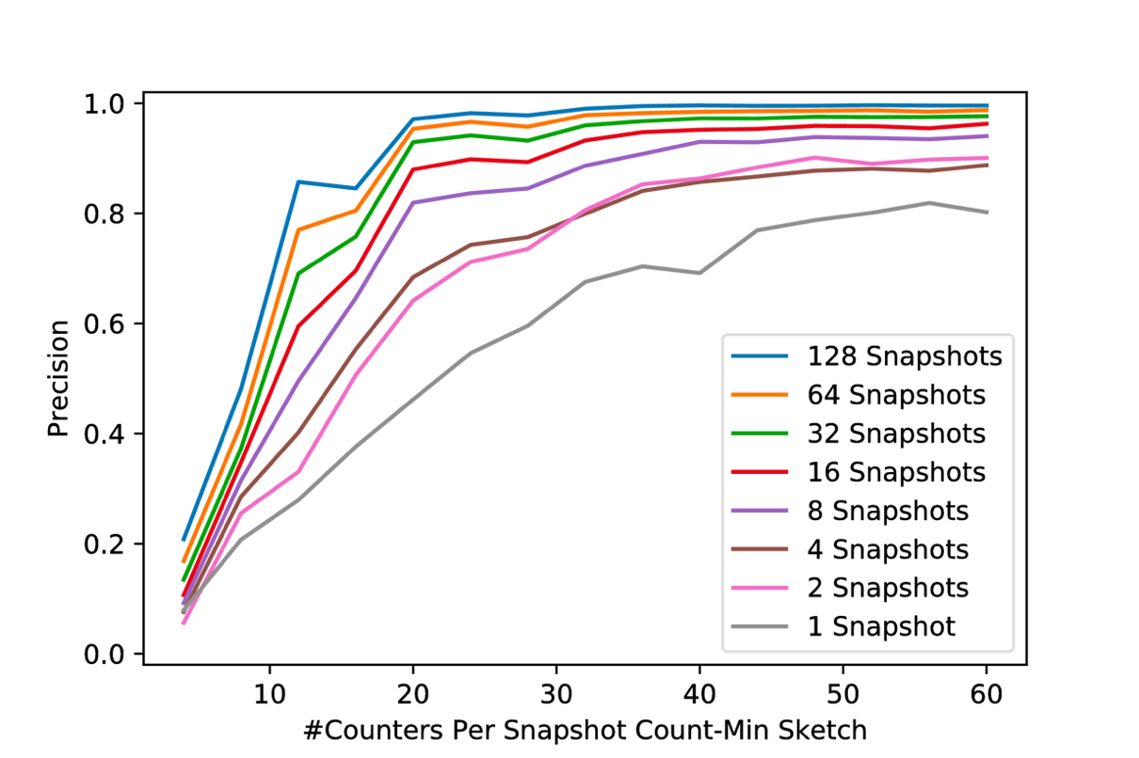
Precision vs. Snapshot Size
Catching heavy flows:
Using 4~8 snapshots is sufficient.

Slide 13
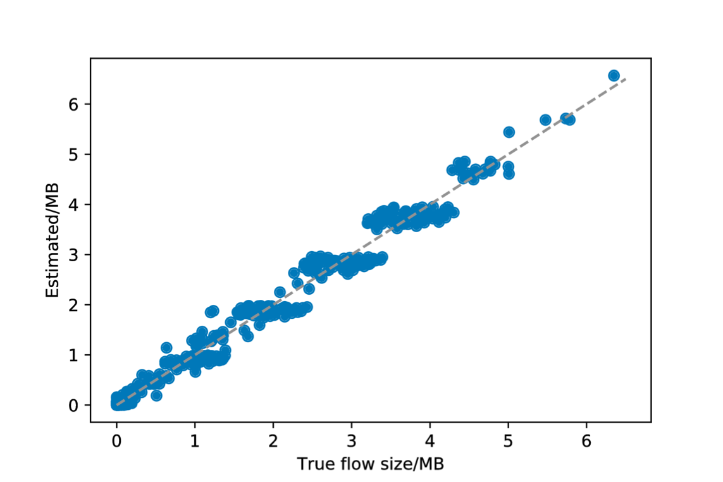
In Queue Flow Size Estimation
Flow-size estimate:
Low absolute error
(~50kb)

Slide 14
Summary & Future work
Problem
OUR Solution
Can’t add/delete simultaneously
Restricted computation in data plane
Microburst is short
Use snapshot to avoid deletion, combine snapshots
Use sketch
Immediate action in data plane
Future Work
  Deployment on Backbone
  Variations on the queue model (Priority, non-FIFO)
  Variations on the flow statistics (heavy flow groups)
  Weighted actions

Slide 15
Backup Slides

Slide 16
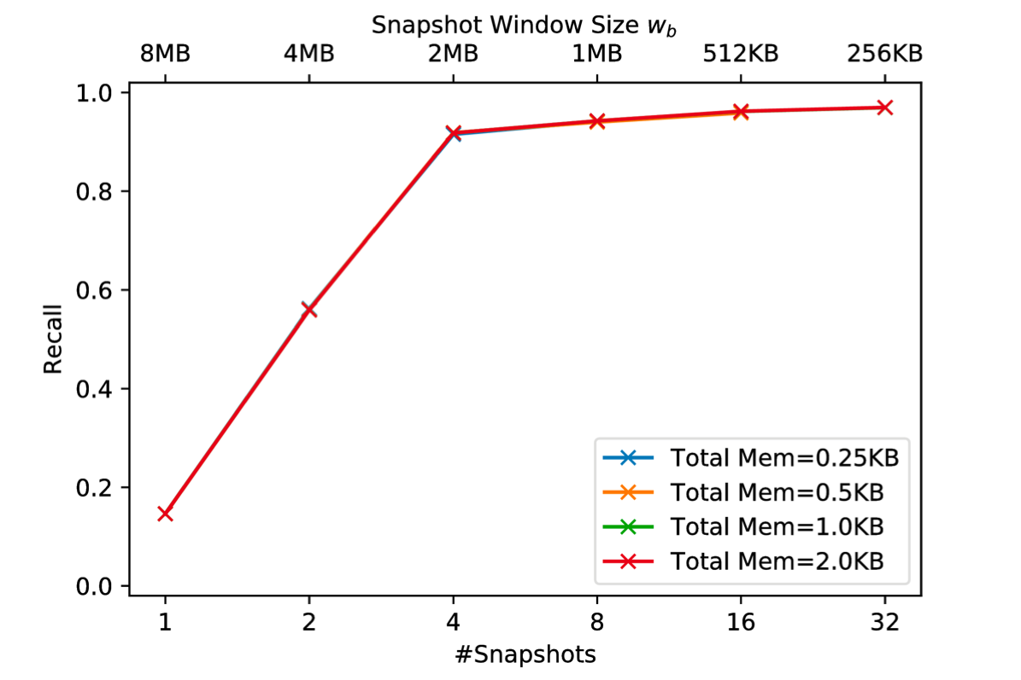
Evaluation – Window size

Slide 17
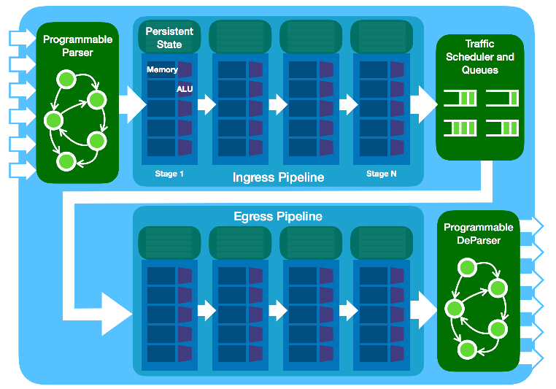
Protocol Independent Switch Architecture
Queuing metadata becomes available
R
R
W
C
R
Snappy snapshots
live here

Slide 18
Queuing and processing
Parser
Ingress Pipe
Traffic Manager
Queuing
Egress Pipe
Deparser
Queue Depth info
becomes available
Snappy resides here

Slide 19
Implementing Snappy on PISA:
Approximation Using CM Sketch
Count-Min Sketch [CM ‘05]
Register Arrays
+1
B Counters
+1
+1
f
C columns

Slide 20
Backup: Snapshot Data Structure Residing in the data plane
Stage 1
Stage 2
Stage 3
Stage 4
Snap 1 Row 1
+1
Snap 1 Row 2
+1
Snap 2 Row 1
Read
Snap 2 Row 2
Read
Packet

