Slide 1

Rococo: Extract more concurrency from distributed transactions
Shuai Mu, Yang Cui, Yang Zhang,
Wyatt Lloyd, Jinyang Li
Tsinghua University, New York University,
University of Southern California, Facebook

Slide 2



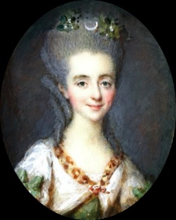
What Large Web Sites Need
36.8 million sold/day
170 million sold/day
$169 billion trade/day
Scalable Storage w/ Transactions!
……

Slide 3


What is a Distributed Transaction？
BEGIN_TX
if (iphone > 0) {
iphone--;
}
if (case > 0) {
case--;
}
END_TX
Item | Stock
iPhone 6 Plus | 1
iPhone Case | 1
if (iphone > 0) {
iphone--;
}
if (case > 0) {
case--;
}
iPhone=1
Case=1
Transactions should be strictly serializable!
Otherwise…

Slide 4
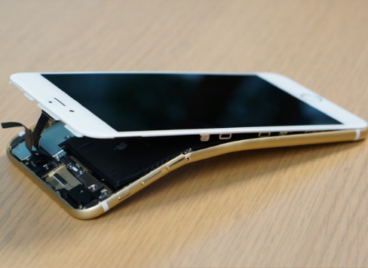
Loss of serializability = angry customer

Slide 5
Serializability is Costly under Contention

Slide 6
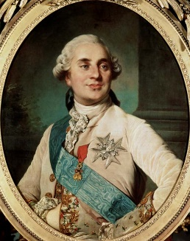
OCC Aborts Contended Transactions
if (iphone > 0) {
iphone--;
}
if (case > 0) {
case--;
}
if (iphone > 0) {
iphone--;
}
if (case > 0) {
case--;
}
Two-Phase Commit
(2PC)
Execute
If (iphone > 0) {
iphone--;
}
if (case > 0) {
case--;
}
iPhone=1
Case=1
If (iphone > 0) {
iphone--;
}
if (case > 0) {
case--;
}

Slide 7




2PL Blocks Contended Transactions
if (iphone > 0) {
iphone--;
}
if (case > 0) {
case--;
}
if (iphone > 0) {
iphone--;
}
if (case > 0) {
case--;
}
2PC
Execute
If (iphone > 0) {
iphone--;
}
if (case > 0) {
case--;
}
iPhone=1
Case=1
If (iphone > 0) {
iphone--;
}
if (case > 0) {
case--;
}

Slide 8


Achieve serializability
w/o aborting or blocking*
  * for common workloads

Slide 9

Rococo’s Approach
if (iphone > 0) {
iphone--;
}
if (case > 0) {
case--;
}
if (iphone > 0) {
iphone--;
}
if (case > 0) {
case--;
}
If (iphone > 0) {
iphone--;
}
if (case > 0) {
case--;
}
iPhone=1
Case=1
If (iphone > 0) {
iphone--;
}
if (case > 0) {
case--;
}
Defer piece execution to enable reordering

Slide 10
Rococo Overview: Key techniques
Enable piece reordering for serializability
Two-phase protocol
  Most pieces are executed at the second (commit) phase
Decentralized dependency tracking
  Servers track pieces’ arrival order
  Identify non-serializable orders
  Deterministically reorder pieces
Offline workload checking
  Identifies safe workloads (common)
  Identifies small parts that need traditional approaches (rare)
Avoid aborts for common workloads

Slide 11
#1 Two-phase protocol
Start Phase
Commit Phase
Send pieces to servers w/o executing them
Establish a final order and execute pieces
Set up a provisional order
Reorder for serializability

Slide 12
#2 Dependency Tracking: Start Phase
dep
dep
T1:
T2:
T2
T1
if ...iphone--
if ... iphone--
if ... case--
T1
if ... case--
T1
T2
T2
dep
dep
if ... iphone--
T1
if ... case--
T2
if ... iphone--
T2
if ... case--
T1
iPhone=1
Case=1

Slide 13
#2 Dependency Tracking: Commit Phase
dep
dep
T2
T1
T1
T2
Sort the cycle by any deterministic order
T2
T2
dep
dep
T1
T1
if ... iphone--
T1
T1
if ... case--
T1
T2
if ... iphone--
if ... case--
T1
T2
T2
T2
iPhone=1
Case=1

Slide 14

Problem: Not Every Piece is Deferrable
oid = next_oid ++
if ... iphone--
if ... case--
orderline.insert(oid, …)
Intermediate Results Calls for Immediate Execution
next_oid
iPhone
Case
orderline
orderline.insert(
oid,
……)
oid = next_oid ++
if ... iphone--
if ... case--
oid

Slide 15
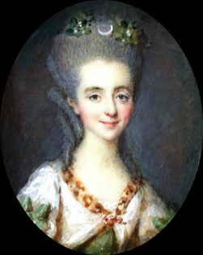
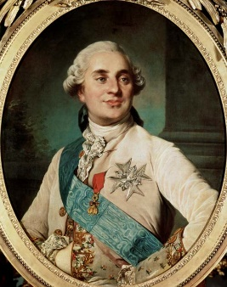
Immediate Pieces are Naughty!
a = next_a++;
b = next_b++;
ol_a.insert(a, …);
ol_b.insert(b, …);
a = next_a++;
b = next_b++;
ol_a.insert(a, …);
ol_b.insert(b, …);
next_a = 0
next_b = 0
a = next_a++
b = next_b ++
a = next_a++
b = next_b ++
1. Common workloads have few immediate pieces
2. Pre-known workload → Offline check

Slide 16
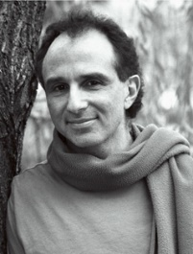
#3: Offline Checking: Basic
S(ibling)-edge linking pieces within a transaction
iphone
Item_Table
case
T₁
Item_Table
T₁
T₁
T₁
C(onflict)-edge linking pieces w/ conflicting access
An SC-cycle consists of both S-edge and C-edge
T₂
T₂
iphone
Item_Table
case
Item_Table
SC-cycles represent potential non-serializable executions that require 2PL/OCC

Slide 17
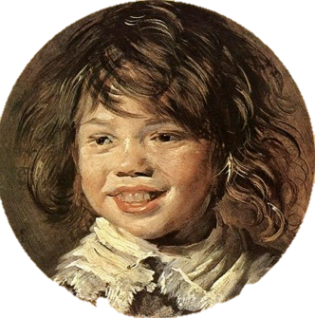
#3: Offline Checking: Enhanced
T₁
OidTable
ItemTable
ItemTable
Immediate
Deferrable
T₂
OidTable
ItemTable
ItemTable
SC-cycles with deferrable pieces can be safely reordered!

Slide 18
Incorporating Immediate Pieces
oid
oid
Every cycle contains deferrable pieces, ensured by offline checking
A cycle with deferrable pieces is safe to reorder
iphone
iphone
case
case
orderline
orderline
oid
iphone
case
orderline
oid
iphone
case
orderline
dep
dep
dep
dep
T2
T1
T1
T2
T2
T1
T1
T2
Immediate dependency
Deferrable dependency
next_oid
iPhone
Case
orderline
18

Slide 19

Deferred Execution
Decentralized Dependency Tracking
Offline Checking
Merged Pieces
Read-only Transactions
Reducing Dep. Size
Fault Tolerance
Overlapping Trans.
……

Slide 20
Evaluation
How does Rococo perform under contention?
How does Rococo scale?

Slide 21
Workload: Scaled TPC-C
One warehouse, many districts
Partitioned by districts - all transactions distributed
5~15
5~15
5~15
5~15
New order
(45%)
5~15
5~15
5~15
5~15
Payment
(43%)
Delivery (4%)
Read-only: OrderStatus(4%), StockLevel (4%)

Slide 22
Rococo Has Higher Throughput
Increasing graph size
Aborts due to deadlock detection
Aborts due to conflicts in validation
8 servers, 10 districts per server → Main source of contention is next_oid of each district

Slide 23
Rococo Avoids Aborts
61~66ms
152~392ms
173~645ms

Slide 24
Rococo Scales Out
Almost Linear
Blocking
Aborts
10 districts per server, fixed # of items → contention grows slowly

Slide 25
Related Work
Decentralized dependency tracking
 | Isolation Level | Concurrency Control Mech.
Rococo | Strict-Serial. | Rococo
Calvin [SIGMOD’12] | Strict-Serial. | Pre-ordered Locking
Spanner [OSDI’12] | Strict-Serial. | 2PL
HStore [VLDB’07] | Strict-Serial. | OCC
Centralized sequencing layer, difficult to scale
Lynx [SOSP’13] | Serial. | Origin Ordering
Granola [SIGMOD’10] | Serial. | Timestamp based
Percolator [OSDI’10] | S.I. | OCC
Walter [SOSP’11] | P.S.I. | W-W Preclusion
COPS [SOSP’11] | Causal | Dependency Tracking

Slide 26
Conclusion
Traditional protocols perform poorly w/ contention
  OCC aborts & 2PL blocks
Rococo defers execution to enable reordering
  Strict serializability w/o aborting or blocking for common workloads
Rococo outperforms 2PL & OCC
  With growing contention
  Scales out

Slide 27



Thank you!
Questions?
https://github.com/msmummy/rococo
Poster tonight!

