Slide 1
Gryff: Unifying Consensus and Shared Registers
Matthew Burke Audrey Cheng Wyatt Lloyd
Cornell University Princeton University

Slide 2
Applications Rely on Geo-Replicated Storage
Fault tolerant: data is safe despite failures
Client

Slide 3
Applications Rely on Geo-Replicated Storage
Fault tolerant: data is safe despite failures
Linearizable: intuitive for application developers
≡

Slide 4
Linearizable Replicated Storage Systems
Cloud Spanner

Slide 5
Status Quo: Consensus or Shared Registers
Given the desire for fault tolerance and linearizability
 | Consensus | Shared Registers
Strong Synchronization | ✔ | ✘
Low Read Tail Latency | ✘ | ✔
Unify consensus and shared registers?

Slide 6
Consensus & State Machine Replication (SMR)
Generic interface: Command(c(.))
Stable ordering: all preceding log positions are assigned commands
Used in etcd, CockroachDB, Spanner, Azure Storage, Chubby
c₁
c₂
c₃
c₄

Slide 7
SMR Requires Stable Order
Allow for strong synchronization primitives like read-modify-writes
High tail latency in practice (e.g., by serializing through a leader)
 | Consensus
Strong Synchronization | ✔
Low Read Tail Latency | ✘

Slide 8
Shared Registers
Simple interface: Read()/Write(v)
Unstable ordering: total order without pre-defined positions
Similar to Cassandra, Dynamo, Riak
w₁
<
w₂
<
w₃
<
w₄
<
<
w₅

Slide 9
Shared Registers Use Unstable Order
Cannot implement strong synchronization primitives [Herlihy91]
Flexibility of unstable order provides favorable tail latency
 | Consensus | Shared Registers
Strong Synchronization | ✔ | ✘
Low Read Tail Latency | ✘ | ✔

Slide 10
Shared Objects: Interface for Unification
Interface: Read()/Write(v)/RMW(f(.))
RMW(f(.)) → read base v, compute new value f(v), write f(v)
Examples: etcd, Redis, BigTable
Unify consensus and shared registers?
RMWs with low read tail latency?

Slide 11
Consensus-after-Register Timestamps (Carstamps)
Unstable Order
Stable
Order
w₁
<
w₂
<
w₃
w₅
w₄
<
<
<
w₆
rmw₁
rmw₃
rmw₄
rmw₂

Slide 12
Carstamps
Tuple with three fields: (ts, id, rmwc)
ts and id basis for unstable ordering of writes
rmwc is set to 1 greater than rmwc of base to ensure stable ordering
(3,1,0)
w₁
<
w₂
(4,1,0)
rmw₁
rmw₃
(4,1,1)
(3,1,1)
rmw₂
(3,1,2)

Slide 13
Gryff Unifies Consensus and Shared Registers
Only uses consensus when necessary, for strong synchronization
 | Consensus | Shared Registers | Gryff
Strong Synchronization | ✔ | ✘ | ✔
Low Read Tail Latency | ✘ | ✔ | ✔

Slide 14
Gryff Design
Combine multi-writer [LS97] ABD [ABD95] & EPaxos [MAK13]
Modifications needed for safety:
Carstamps for proper ordering
Synchronous Commit phase for rmws
Modifications for better read tail latency:
Early termination for reads (fast path)
Proxy optimization for reads (fast path more often)
See the paper for details!

Slide 15
Gryff in Action
w₁
→ (3,1,0)
c₁
Write1Reply (1,0,0)
Write1
Writes always terminate in 2 phases
(2,3,0)
(2,3,0)
(1,0,0)
(2,3,0)

Slide 16
Gryff in Action
w₁
→ (3,1,0)
c₁
Write2 (3,1,0)
Writes always terminate in 2 phases
(2,3,0)
(1,0,0)
(3,1,0)
(3,1,0)
(2,3,0)

Slide 17
Gryff in Action
c₁
PreAccept (3,1,0)
PreAcceptOK (3,1,0)
Writes always terminate in 2 phases
RMW carstamps directly after base
rmw₁
RMW
(3,1,0)
(3,1,0)
(2,3,0)
c₂

Slide 18
Gryff in Action
c₁
Commit (3,1,0)
Executed (3,1,1)
Writes always terminate in 2 phases
RMW carstamps directly after base
rmw₁
→ (3,1,1)
(3,1,1)
(3,1,0)
(3,1,0)
(3,1,1)
(2,3,0)
c₂

Slide 19
Gryff in Action
r
→ (3,1,1)
c₁
Read1Reply (3,1,1)
Read1
Read
Writes always terminate in 2 phases
RMW carstamps directly after base
(3,1,1)
(3,1,1)
(2,3,0)
Reads often terminate in 1 phase
c₂

Slide 20
Evaluation
Relative to state-of-the-art-consensus protocols:
How do Gryff’s read/write protocols affect read tail latency?
What is the latency distribution of Gryff’s reads, writes, and rmws?
What maximum throughput does Gryff achieve?
How does Gryff perform in tail-at-scale workloads?

Slide 21
Evaluation
Relative to state-of-the-art-consensus protocols:
How do Gryff’s read/write protocols affect read tail latency?
What is the latency distribution of Gryff’s reads, writes, and rmws?
What maximum throughput does Gryff achieve?
How does Gryff perform in tail-at-scale workloads?

Slide 22
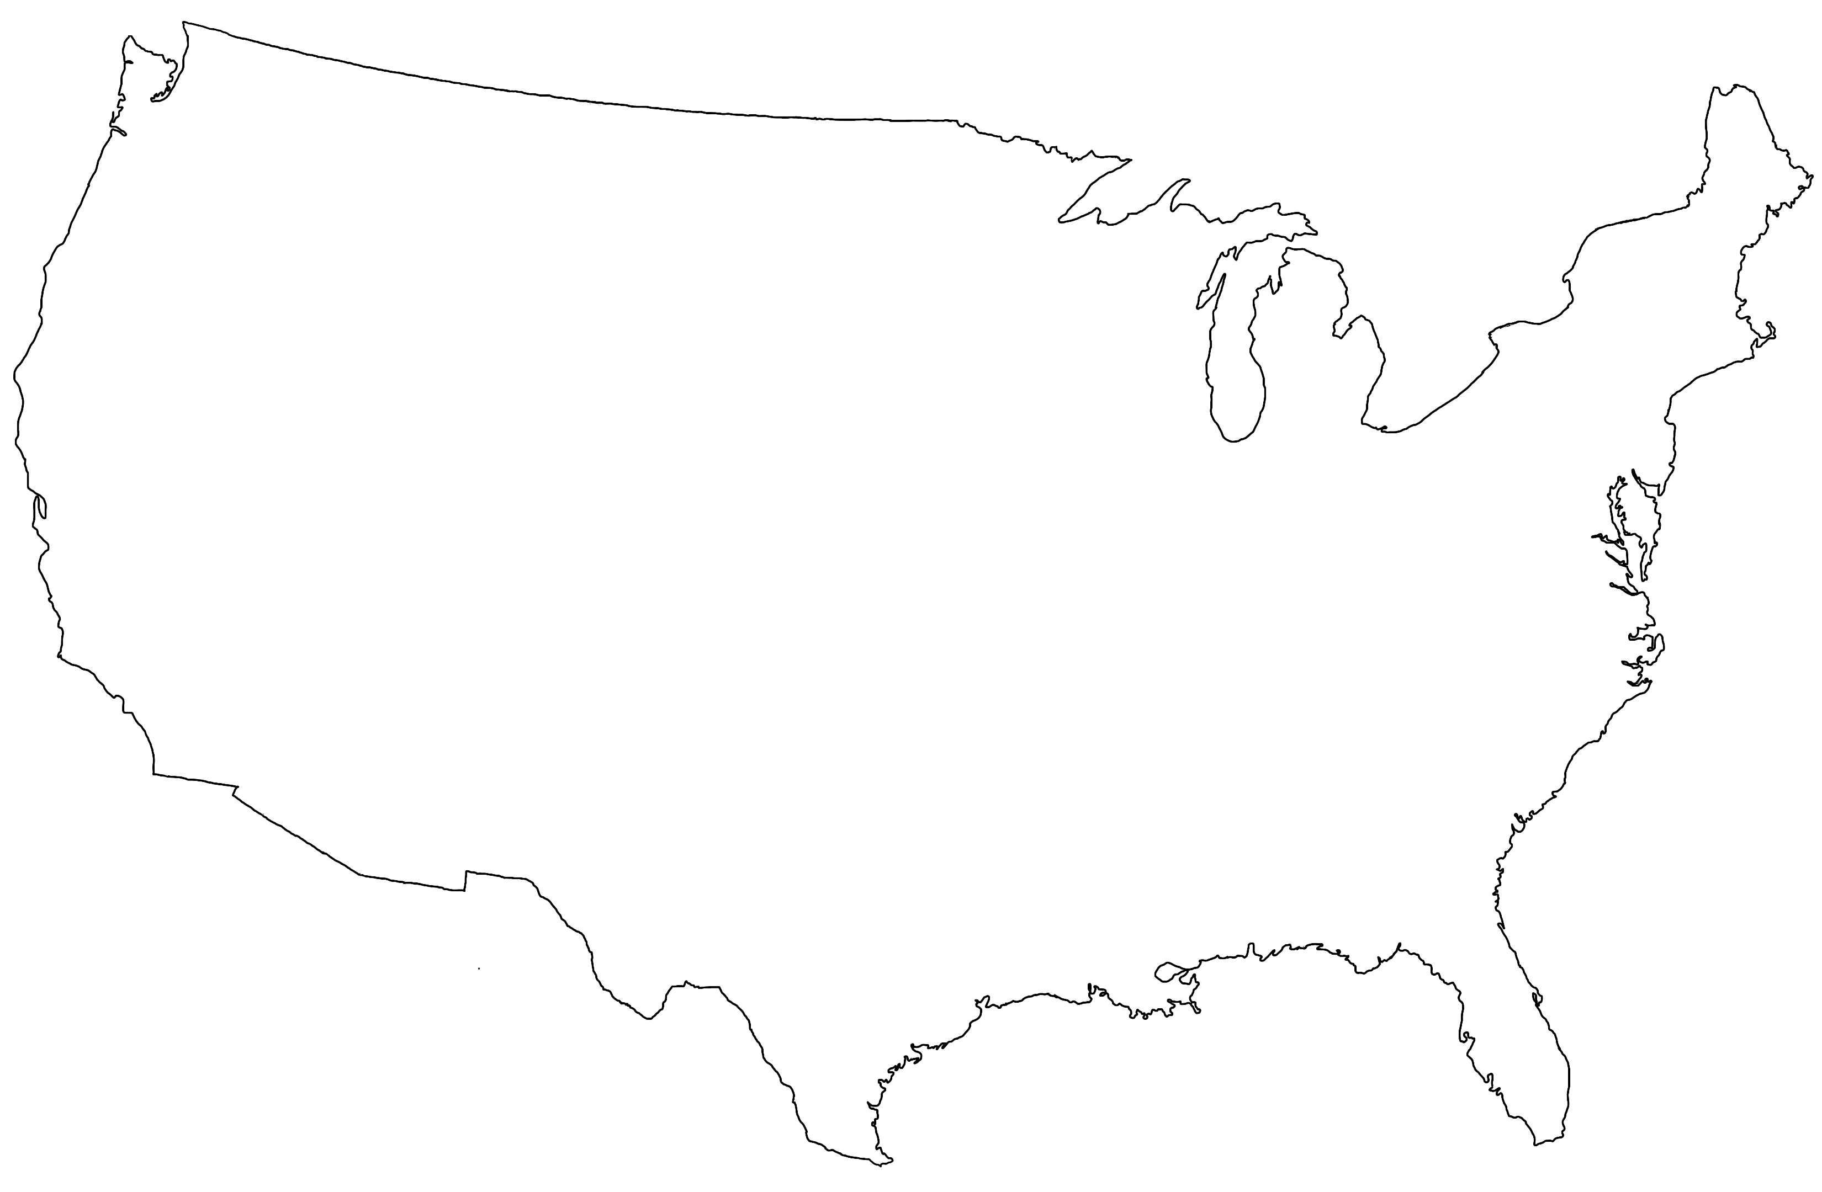
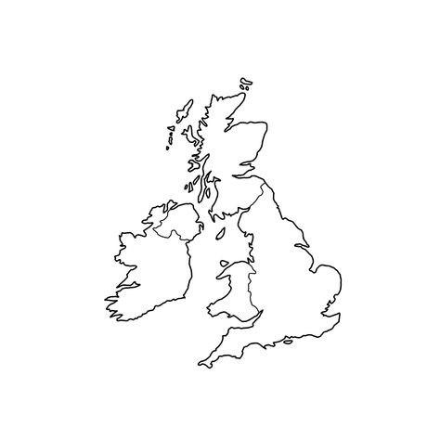
Evaluation Setup
Geo-replication with 3 regions
Baselines: MultiPaxos (industry standard), EPaxos (leaderless)
72ms
88ms
not-to-scale ocean

Slide 23
Read Tail Latency (94.5% R, 4.5% W, 1% RMW, 25% Conflicts)

Slide 24
Read Tail Latency (94.5% R, 4.5% W, 1% RMW, 25% Conflicts)
serializing through far-away leader

Slide 25
Read Tail Latency (94.5% R, 4.5% W, 1% RMW, 25% Conflicts)
delaying reads that conflict with concurrent writes

Slide 26
Read Tail Latency (94.5% R, 4.5% W, 1% RMW, 25% Conflicts)
1 round to nearest majority in tail

Slide 27
Summary
Consensus: strong synchronization w/ high tail latency Shared registers: low tail latency w/o strong synchronization
Carstamps stably order read-modify-writes within a more efficient unstable order for reads and writes
Gryff unifies an optimized shared register protocol with a state-of-the-art consensus protocol using carstamps
Gryff provides strong synchronization w/ low read tail latency

Slide 29
Image Attribution
Griffin by Delapouite / CC BY 3.0 Unported (modified)
etcd
CockroachDB
Spanner by Google / CC BY 4.0

