Slide 2
f4: Facebook’s Warm BLOB Storage System
Subramanian Muralidhar*, Wyatt Lloyd*ᵠ, Sabyasachi Roy*, Cory Hill*, Ernest Lin*, Weiwen Liu*, Satadru Pan*, Shiva Shankar*, Viswanath Sivakumar*, Linpeng Tang*⁺, Sanjeev Kumar*
*Facebook Inc., ᵠUniversity of Southern California, ⁺Princeton University
1

Slide 3
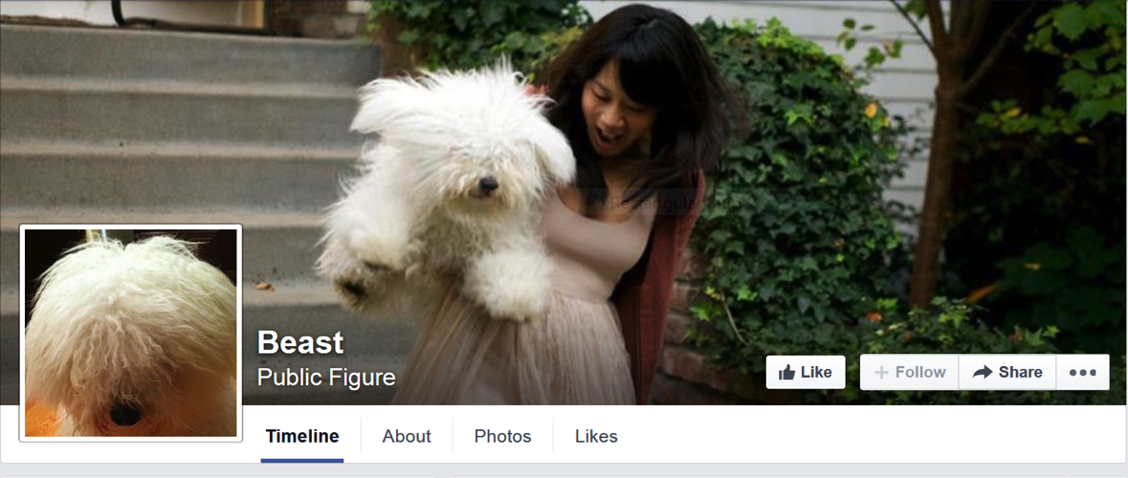
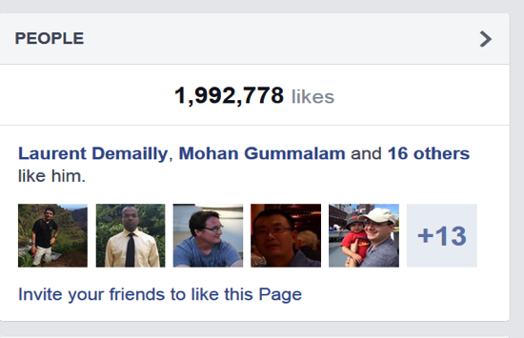
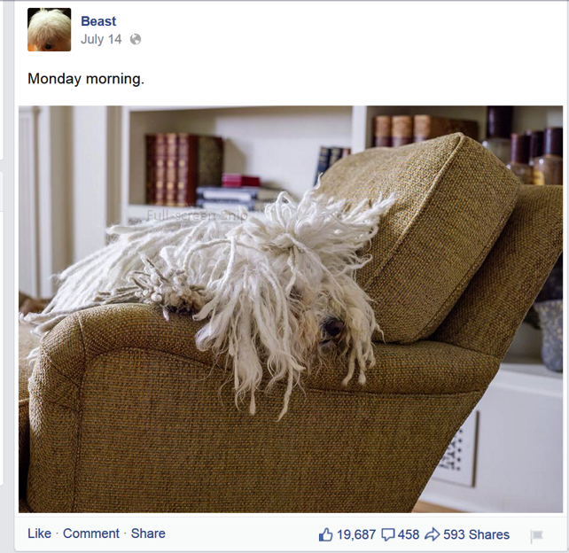
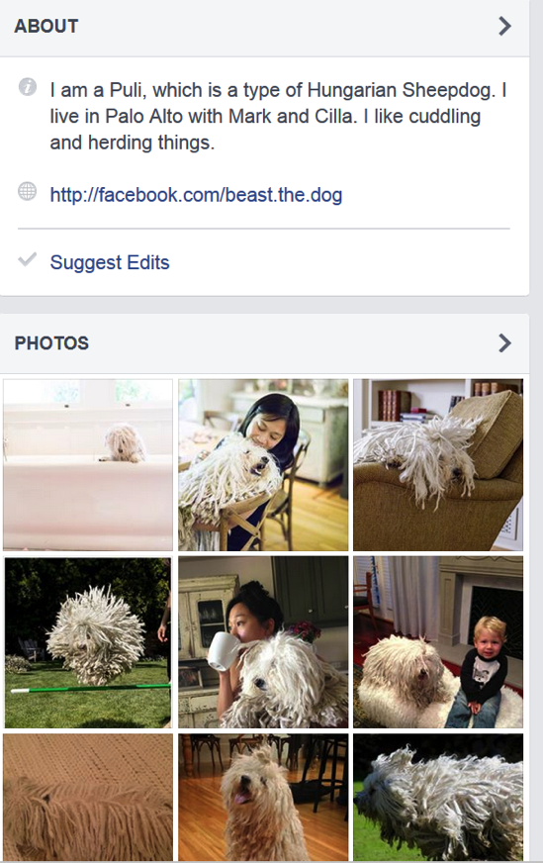
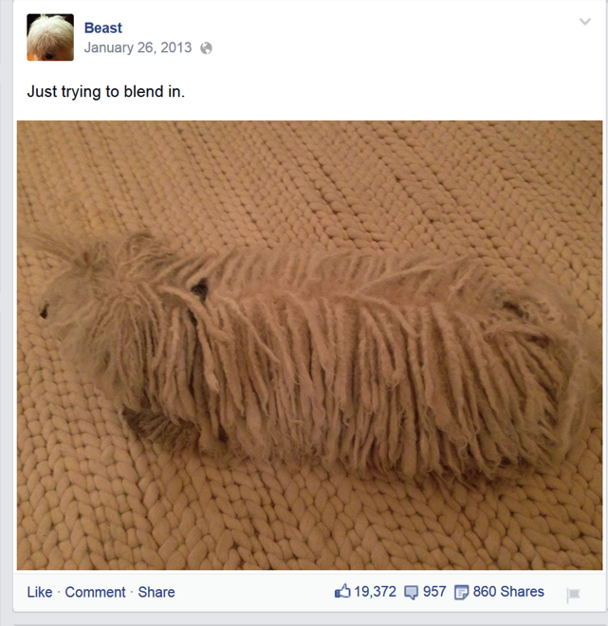
BLOBs@FB
Cover Photo
Profile Photo
Immutable
&
Unstructured
Feed Photo
Diverse
A LOT of them!!
Feed Video
2

Slide 4

590X
510X
HOT DATA
WARM DATA
Data cools off rapidly
98X
68X
30X
16X
14X
7X
6X
2X
1X
1X
< 1 Days
1 Day
1 Week
1 Month
3 Months
1 Year
3

Slide 5
Handling failures
3 Host failures
9 Disk failures
3 DC failures
3 Rack failures
DATACENTER
DATACENTER
DATACENTER
RACKS
RACKS
RACKS
HOST
HOST
HOST
1.2
Replication:
* 3 = 3.6
4

Slide 6
Handling load
HOST
HOST
HOST
HOST
HOST
HOST
HOST
6
Reduce space usage
AND
Not compromise reliability
5

Slide 7
Background: Data serving
  CDN protects storage
  Router abstracts storage
  Web tier adds business logic
User Requests
Writes
Reads
CDN
Web Servers
Router
BLOB
Storage
6

Slide 8
Background: Haystack [OSDI2010]
  Volume is a series of BLOBs
  In-memory index
Header
BID1: Off
BLOB1
BID2: Off
Footer
Header
BIDN: Off
BLOB1
In-Memory Index
Footer
Header
BLOB1
Footer
Volume
7

Slide 9
Introducing f4: Haystack on cells
Rack
Rack
Rack
Data+Index
Cell
Compute
8

Slide 10
Data splitting
10G Volume
Reed Solomon Encoding
4G parity
Stripe1
Stripe2
BLOB4
BLOB1
BLOB4
BLOB6
BLOB8
BLOB10
BLOB5
RS
BLOB2
BLOB5
=>
BLOB2
BLOB11
BLOB7
BLOB9
BLOB3
BLOB4
RS
=>
BLOB2
9

Slide 11
Data placement
10G Volume
4G parity
Stripe1
Stripe2
RS
RS
Cell with 7 Racks
  Reed Solomon (10, 4) is used in practice (1.4X)
  Tolerates 4 racks (→ 4 disk/host ) failures
10

Slide 12
Reads
Router
Storage Nodes
Index
Read
Index
User
Request
Data
Read
Compute
Cell
2-phase: Index read returns the exact physical location of the BLOB
11

Slide 13
Reads under cell-local failures
Router
Storage Nodes
Index
Read
Index
User
Request
Data
Read
Compute (Decoders)
Decode
Read
Cell
Cell-Local failures (disks/hosts/racks) handled locally
12

Slide 14
Reads under datacenter failures (2.8X)
Router
User
Request
Compute (Decoders)
Proxying
Cell in Datacenter1
Compute (Decoders)
Mirror Cell in Datacenter2
2 * 1.4X = 2.8X
13

Slide 15
Cross datacenter XOR
(1.5 * 1.4 = 2.1X)
67%
Index
Cell in
Datacenter1
33%
Index
Cell in
Datacenter2
Index
Cell in
Datacenter3
Cross –DC
index copy
14

Slide 16
Reads with datacenter failures (2.1X)
Router
Index
Data
Read
User
Request
Router
XOR
Index
Index
Read
Data
Read
Index
Index
Router
15

Slide 17
Haystack v/s f4 2.8 v/s f4 2.1
 | Haystack with 3 copies | f4 2.8 | f4 2.1
Replication | 3.6X | 2.8X | 2.1X
Irrecoverable Disk Failures | 9 | 10 | 10
Irrecoverable Host Failures | 3 | 10 | 10
Irrecoverable Rack failures | 3 | 10 | 10
Irrecoverable Datacenter failures | 3 | 2 | 2
Load split | 3X | 2X | 1X
16

Slide 18
Evaluation
What and how much data is “warm”?
Can f4 satisfy throughput and latency requirements?
How much space does f4 save
f4 failure resilience
17

Slide 19
Methodology
CDN data: 1 day, 0.5% sampling
BLOB store data: 2 week, 0.1%
Random distribution of BLOBs assumed
The worst case rates reported
18

Slide 20
Hot and warm divide
HOT DATA
WARM DATA
< 3 months → Haystack
> 3 months → f4
80 Reads/Sec
19

Slide 21
It is warm, not cold
Haystack (50%)
F4 (50%)
HOT DATA
WARM DATA
20

Slide 22
f4 Performance: Most loaded disk in cluster
Peak load on disk: 35 Reads/Sec
Reads/Sec
21

Slide 23
f4 Performance: Latency
P80 = 30ms
P99 = 80ms
22

Slide 24
Concluding Remarks
Facebook’s BLOB storage is big and growing
BLOBs cool down with age
  ~100X drop in read requests in 60 days
Haystack’s 3.6X replication over provisioning for old, warm data.
f4 encodes data to lower replication to 2.1X
23

