Slide 1
Experiences with Tracing Causality in Networked Services
Rodrigo Fonseca, Brown
Michael Freedman, Princeton
George Porter, UCSD
April 2010
INM/WREN
San Jose, CA

Slide 2
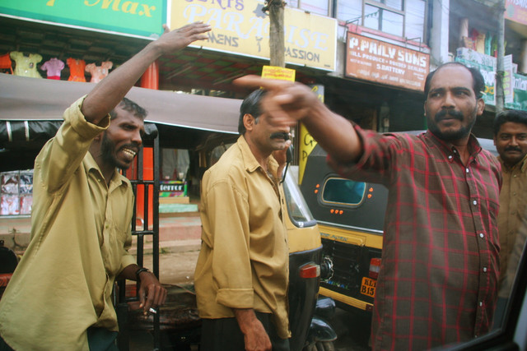
Which way to Bangalore?
Notes:
This is a picture I took in Mysore, when our driver was asking how to get to Bangalore.
If you manage or develop networked systems you may have felt the way I did here when trying to troubleshoot or find faults in these systems.

Slide 3
Troubleshooting Networked Systems
Hard to develop, debug, deploy, troubleshoot
No standard way to integrate debugging, monitoring, diagnostics

Slide 4
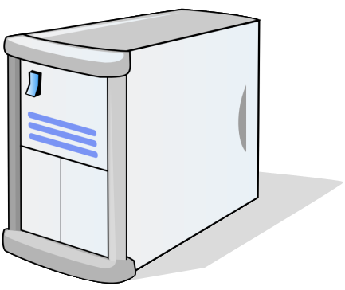
Status quo: device centric
Web 1
Load
Balancer
Firewall
Database
...
...
[04:03:23 2006] [notice] Dispatch s1...
[04:03:23 2006] [notice] Dispatch s2...
[04:04:18 2006] [notice] Dispatch s3...
[04:07:03 2006] [notice] Dispatch s1...
[04:10:55 2006] [notice] Dispatch s2...
[04:03:24 2006] [notice] Dispatch s3...
[04:04:47 2006] [crit] Server s3 down...
...
...
...
...
72.30.107.159 - - [20/Aug/2006:09:12:58 -0700] "GET /ga
65.54.188.26 - - [20/Aug/2006:09:13:32 -0700] "GET /rob
65.54.188.26 - - [20/Aug/2006:09:13:32 -0700] "GET /rob
65.54.188.26 - - [20/Aug/2006:09:13:32 -0700] "GET /gal
65.54.188.26 - - [20/Aug/2006:09:13:32 -0700] "GET /gal
66.249.72.163 - - [20/Aug/2006:09:15:04 -0700] "GET /ga
66.249.72.163 - - [20/Aug/2006:09:15:07 -0700] "GET /ga
66.249.72.163 - - [20/Aug/2006:09:15:10 -0700] "GET /ro
66.249.72.163 - - [20/Aug/2006:09:15:11 -0700] "GET /ga
...
...
...
...
28 03:55:38 PM fire...
28 03:55:38 PM fire...
28 03:55:38 PM fire...
28 03:55:38 PM fire...
28 03:55:38 PM fire...
28 03:55:38 PM fire...
28 03:55:38 PM fire...
28 03:55:39 PM fire...
28 03:55:39 PM fire...
28 03:55:39 PM fire...
28 03:55:39 PM fire...
28 03:55:39 PM fire...
28 03:55:39 PM fire...
28 03:55:39 PM fire...
28 03:55:39 PM fire...
...
...
...
LOG: statement: select oid...
LOG: statement: SELECT COU...
LOG: statement: SELECT g2_...
LOG: statement: select oid...
LOG: statement: SELECT COU...
LOG: statement: SELECT g2_...
LOG: statement: select oid...
LOG: statement: SELECT COU...
LOG: statement: SELECT g2_...
LOG: statement: select oid...
LOG: statement: select oid...
LOG: statement: SELECT COU...
LOG: statement: SELECT g2_...
LOG: statement: select oid...
LOG: statement: SELECT COU...
LOG: statement: SELECT g2_...
LOG: statement: select oid...
...
...
Web 2
...
...
72.30.107.159 - - [20/Aug/2006:09:12:58 -0700] "GET /ga
65.54.188.26 - - [20/Aug/2006:09:13:32 -0700] "GET /rob
65.54.188.26 - - [20/Aug/2006:09:13:32 -0700] "GET /rob
65.54.188.26 - - [20/Aug/2006:09:13:32 -0700] "GET /gal
65.54.188.26 - - [20/Aug/2006:09:13:32 -0700] "GET /gal
66.249.72.163 - - [20/Aug/2006:09:15:04 -0700] "GET /ga
66.249.72.163 - - [20/Aug/2006:09:15:07 -0700] "GET /ga
66.249.72.163 - - [20/Aug/2006:09:15:10 -0700] "GET /ro
66.249.72.163 - - [20/Aug/2006:09:15:11 -0700] "GET /ga
...
...
Notes:
Most of the solutions to monitoring, diagnosing and troubleshooting networked systems are device centric: NAGIOS, OpenView, SNMP.
For troubleshooting, one has to resort to distributed logs. These are hard to piece together, if at all possible.

Slide 5
Status quo: device centric
Determining paths:
Join logs on time and ad-hoc identifiers
Relies on
well synchronized clocks
extensive application knowledge
Requires all operations logged to guarantee complete paths

Slide 6
This talk
Causality Tracking: an alternative
Many previous frameworks:
X-Trace, PIP, Whodunit, Magpie, Google’s Dapper…
Experiences integrating and using X-Trace
Notes:
This talks is about explicitly tracing causality in networked systems.
There have been several proposals on how to do this, this talk is not about new techniques: it’s about our experiences integrating X-Trace into three quite diverse networked systems.

Slide 7
Outline
Tracing causality with X-Trace
Case studies
802.1X Authentication Service
CoralCDN and OASIS anycast service
Challenges
Conclusion

Slide 8
Outline
Tracing causality with X-Trace
Case studies
802.1X Authentication Service
CoralCDN and OASIS anycast service
Challenges
Conclusion

Slide 9
X-Trace
X-Trace records events in a distributed execution and their causal relationship
Events are grouped into tasks
Well defined starting event and all that is causally related
Each event generates a report, binding it to one or more preceding events
Captures full happens-before relation

Slide 10
X-Trace Output
HTTP
Client
HTTP
Proxy
HTTP
Server
TCP 1
Start
TCP 1
End
TCP 2
Start
TCP 2
End
IP
IP
Router
IP
IP
IP
Router
IP
Router
IP
Task graph capturing task execution
Nodes: events across layers, devices
Edges: causal relations between events

Slide 11
Basic Mechanism
a
g
n
HTTP
Client
[T, a]
HTTP
Proxy
[T, g]
HTTP
Server
[T, a]
f
h
m
b
X-Trace Report
TaskID: T
EventID: g
Edge: from a, f
TCP 1
Start
TCP 1
End
TCP 2
Start
TCP 2
End
c
d
e
i
j
k
l
IP
IP
Router
IP
IP
IP
Router
IP
Router
IP
Each event uniquely identified within a task: [TaskId, EventId]
[TaskId, EventId] propagated along execution path
For each event create and log an X-Trace report
Enough info to reconstruct the task graph

Slide 12
X-Trace Library API
Handles propagation within app
Threads / event-based (e.g., libasync)
Akin to a logging API:
Main call is logEvent(message)
Library takes care of event id creation, binding, reporting, etc
Implementations in C++, Java, Ruby, Javascript

Slide 13
Outline
Tracing causality with X-Trace
Case studies
802.1X Authentication Service
CoralCDN and OASIS anycast service
Challenges
Conclusion

Slide 14
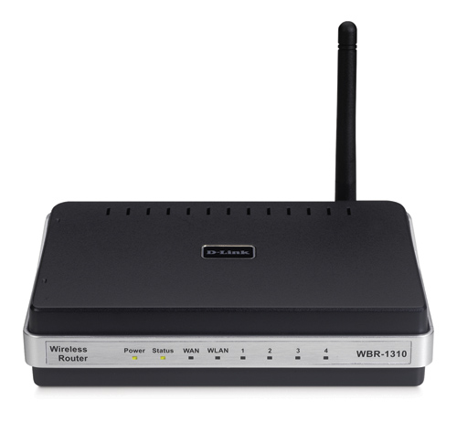
802.1X Authentication Service
Authenticator
e.g. Acc. Point
Auth Server
RADIUS
Identity Store
e.g. LDAP
Client
EAP
L2
RADIUS
Over UDP
LDAP
Identified 5 common authentication issues from vendor logs
Added a few X-Trace instrumentation points sufficient to differentiate these faults
Introduced faults in a test environment

Slide 15
802.1X Authentication Service
Instrumentation was easy:
Nested invocations
No in-task concurrency
Extensible protocols (RADIUS, LDAP)
Modular, request-oriented server software

Slide 16
802.1X Example Faults
Misconfigured Firewall: no LDAP
Miscalibrated Timeout Value
Key: multiple correlated vantage points
Can help tune timeout values

Slide 17
CoralCDN and OASIS
Instrumented production deployment
Heavy use of sampling:
0.1% of requests to CoralCDN traced
Leveraged libasync, libarpc X-Trace instrumentation
Much more complex program flow
E.g. windowed parallel RPC calls, variable timeouts
Found bugs, performance problems, clock skews…

Slide 18
CoralCDN
CoralCDN Distributed
HTTP Cache

Slide 19
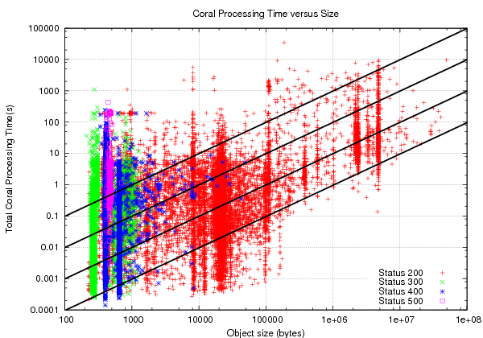
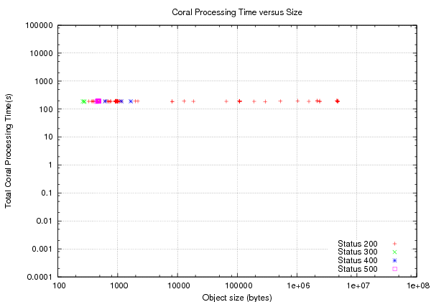
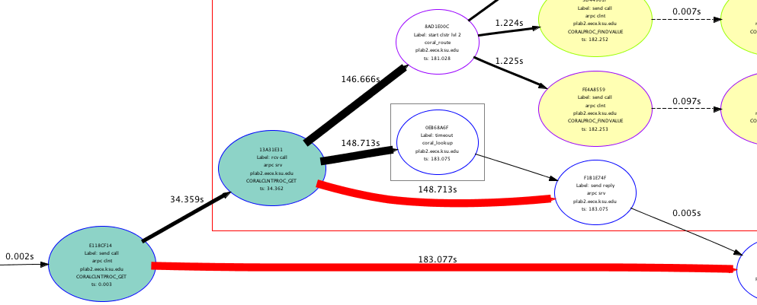
CoralCDN Response Times
189s: Linux TCP Timeout connecting to origin
Slow connection Proxy -> Client
Slow connection Origin -> Proxy
Timeout in RPC, due to slow Planetlab node!
1KB/s
10KB/s
189 seconds
100KB/s
1MB/s
Same symptoms, very different causes
Notes:
This graph shows…
First: 4 orders of magnitude variation.
This is the dilemma of the developer or the operator: what is happening?
To make this more concrete, I will focus on a cluster of requests that took around 190 seconds to complete.
X-Trace allows us to examine each point in this graph.

Slide 20
Outline
Brief X-Trace Intro
Case studies
802.1X Authentication Service
CoralCDN
OASIS Anycast Service
Challenges
Conclusion

Slide 21
Hidden Channels
Example: CoralCDN DNS Calls
Tasks
DNS Resolver
A
resolve(foo,*)
B
Send
C
foo
*
DNS resolve
Receive
In general: deferral structures
E.g., queues, thread pools, continuations
Store metadata with the structure
Often encapsulated in libraries, high leverage

Slide 22
Incidental vs. Semantic Concurrency
Forks and joins tricky for naïve instrumentation
Non-intuitive fork
Incorrect join
done(1)
done(2)
done(3)
start
do(1)
do(2)
do(3)
end

Slide 23
Incidental vs. Semantic Concurrency
Extra code annotation fixes the problem
Manually change parent of do() events
Manually add edges from done() to end
do(1)
done(1)
start
do(2)
done(2)
end
do(3)
done(3)

Slide 24
Dealing with Black Boxes
client
proxy
server
Ideal scenario: all components instrumented with X-Trace
Log all events

Slide 25
Dealing with Black Boxes
client
proxy
server
Gray-box proxy: passes X-Trace metadata on
Log events on the client and server
Layering does this automatically

Slide 26
Dealing with Black Boxes
client
proxy
server
Black box proxy: drops X-Trace metadata
No X-Trace events on proxy or server
Can always trace around black box, in client

Slide 27
Outline
Brief X-Trace Intro
Case studies
802.1X Authentication Service
CoralCDN
OASIS Anycast Service
Challenges
Conclusion

Slide 28
Revisiting Troubleshooting
Device-centric Logs
Task-centric traces
Depends on well sync’d clocks
Joins on ad-hoc identifiers
Needs all ops logged for complete traces
No modifications to existing code
Does not depend on clocks (can actually fix them)
Deterministic joins on standardized ids
Sample-based tracing possible
Requires instrumentation

Slide 29
X-Trace Instrumentation
Instrumenting is easy in most cases
A few key libraries go a long way
Can be done iteratively
Refining expectations (a la Pip)
Partial annotation still useful
Independent instrumentation feasible
Huge benefits

Slide 30
Conclusions
Simple, uniform task graphs useful in debugging, troubleshooting, diagnostics
Instrumentation is feasible
Causal tracing should be a first-class concept in networked systems

Slide 31
Thank you
More details on paper
For more info:
www.x-trace.net
www.coralcdn.org

