Slide 1

TRODS
Transparent Recovery for
Object Delivery Services
Presented at DSN-DCCS 2011 in Hong Kong on 6/28/11
Wyatt Lloyd, Michael J. Freedman
Princeton University

Slide 2



Slide 3





Slide 4
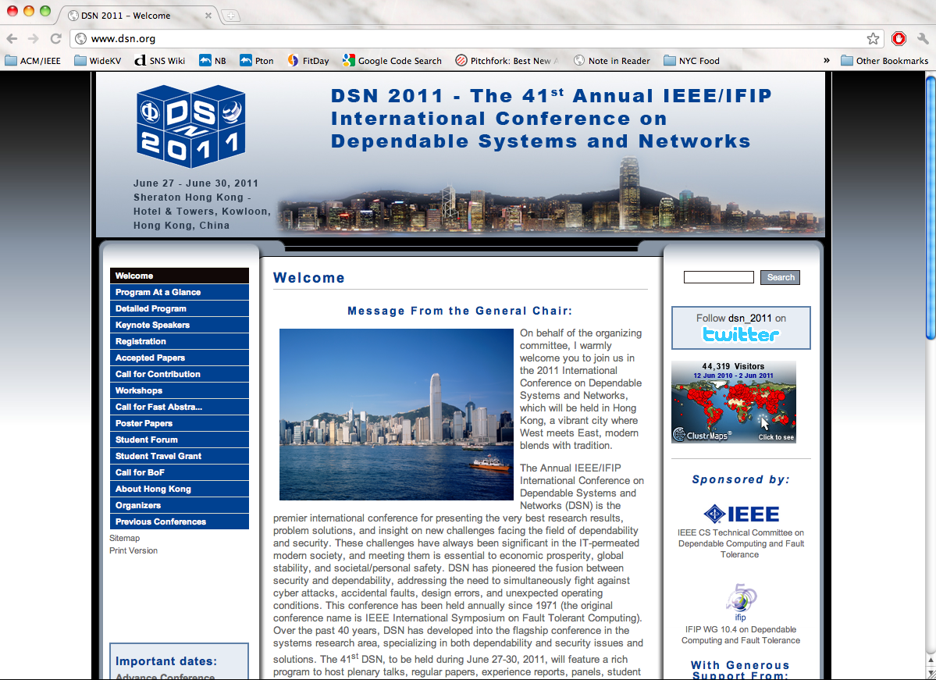

Slide 5
Service
Server
Client
Server
Connection
Recovered!
Server
Server

Slide 6
Object Delivery Services
Read-Only
Static Content
Webpages, Images, Videos

Slide 7









Work Now
Can’t Modify Clients

Slide 8
Key Idea
Coerce client to help
  To identify connections that need recovery
  To reliably store information
Yet client is unmodified and unaware
  Exploit TCP spec to control client’s stack

Slide 9
Object Delivery Cluster
Service
Server
Liveness Monitor
Load Balancer
Server
Server
Server

Slide 10
Failure
Service
Server
Liveness Monitor
Load Balancer
Server
Server
Server

Slide 11
TRODS
Service
Liveness Monitor
?
Load Balancer
Server
Client
Server
Server

Slide 12
TRODS
Service
Liveness Monitor
?
Load Balancer
Server
Client
Server
Store
Server

Slide 13
Road to Recovery
Step Technique
Redirect to live server ………………. Liveness monitor updates load balancer
Induce client to send packet……… Coerce client’s TCP stack
Continue Connection
Determine Phase………………… Use packet + stored info
Identify Object……………………. Stored Info
Find Offset ………………………….. Use packet + stored info
New
New

Slide 14
Coercing Clients
Always Leave A Packet Unacknowledged
Exploit TCP Spec for Recovery Initiation!
Client
Server
SYN
ACK
Request
ACK
ACK
FIN/ACK
ACK
SYN/ACK
Response₁
Response₂
Response₃
FIN
ACK
Retransmit Queue
Retransmit Queue
Request
SYN
FIN/ACK
SYN/ACK
Response₁
Response₂
Response₃
FIN
Always Something Here

Slide 15
Continuing the Connection
Determine Phase:
  TCP Setup
  HTTP Setup
  HTTP Download
  TCP Teardown
TRODS Saves Info

Slide 16
Continuing the Download
HTTP ObjectID
Offset
= TCP Ack – HTTP ObjectISN
HTTP ObjectISN
TCP Ack
SYN
HTTP
Resp
Header
HTTP
Object
TCP ISN

Slide 17
Continuing the Download
HTTP ObjectID
Offset
= TCP Ack – HTTP ObjectISN
HTTP ObjectISN
TCP Ack
SYN
HTTP
Resp
Header
HTTP
Object
TCP ISN

Slide 18
Persistent Store
Key-Value Store
  + Corner Cases Handled
  + Unlimited Objects
  Still Efficient (1 save only)
TCP Timestamp
  + Very Efficient (1 machine only)
  1 Million Object Limit
  Corner Cases
KV
IP
TCP
Payload
TS
Exploit TCP Spec for Persistence!
18

Slide 19
Recover the Connection
Initiate New Connection
  GET ObjectID …
  Range: bytes=Offset-
Splice Connections Together
Works with Unmodified Servers!

Slide 20

TRODS
Packet Manipulation
Server
IP
TCP
…
TCP
TRODS
IP
TCP’
…
IP

Slide 21
TRODS
Packet Manipulation
Protocol Inspection
Server
Response₁
TCP
TRODS
Request
ObjISN
ObjID
IP
Request

Slide 22
TRODS
Packet Manipulation
Protocol Inspection
Blocks Connection
Server
TCP
ObjID
ObjISN
TRODS
Response₁
IP

Slide 23
TRODS
Packet Manipulation
Protocol Inspection
Blocks Connection
State Injection
Server
IP
TCP
…
TCP
TRODS
IP
TCP
TS
…
IP

Slide 24
TRODS
Packet Manipulation
Protocol Inspection
Blocks Connection
State Injection
Recovery Initiation
Server
?
TCP
TRODS
IP
Ack

Slide 25
Failure Walkthrough
Service
Server
Response₁
Liveness Monitor
SYN/ACK
TCP
ID
ISN
TRODS
IP
Load Balancer
Server
Client
SYN
ACK
Request
TCP
TRODS
IP
KV Store
Server
TCP
TRODS
IP
25

Slide 26
Failure Walkthrough
Service
Liveness Monitor
!
Load Balancer
Response₂
Server
Client
Response₃
Response₄
ACK
FIN
?
ACK
ACK
TCP
FIN
TRODS
ACK
IP
KV Store
ID
ISN
Server
TCP
TRODS
IP
26

Slide 27
Related Work
New Transport
  Trickles, SCTP, TCP Migrate, …
TCP
  FT-TCP, ST-TCP, Backdoors, …
HTTP
  CoRAL, …

Slide 28
Implementation
Linux Kernel Module
3,000 lines of C
~CoRAL
  Optimistic subset of CoRAL

Slide 29
Experiments
Additional Latency
  Normal
  Failure
Throughput
  Lighttpd @ Princeton
  Apache @ Emulab
  Hybrid TS & KV Throughput
  Failure

Slide 30
Normal Case Latency
TRODS-TimeStamp (TS)
  Median: + 0.009 ms
  99th: + 0.012 ms
TRODS-Key-Value (KV)
  Median: + 0.137 ms
  99th: + 0.148 ms

Slide 31
Recovery Latency
~15%
~35%
~50%
Blink of an eye

Slide 32
ThroughPut Per Server
120 ops/s
Raw
120 ops/s
30 ops/s
Frontend
30 ops/s
30 ops/s/server
TPPS
20 ops/s/server

Slide 33





Lighttpd
9%
38%
KV/Server: 1/8
KV/Server: 1/4
7%
KV/Server: 1/34
66%
KV/Server: 1/2

Slide 34
Apache

Slide 35
Summary
Recover Object Delivery Connections
Exploit TCP Specification to Coerce Clients
  To send recovery-starting packets
  To provide persistent storage
Evaluation
  Low Latency
  High Throughput Per Server
Unmodified
Unmodified
^
^

Slide 36
Summary
Recover Object Delivery Connections
Exploit TCP Specification to Coerce Clients
  To send recovery-starting packets
  To provide persistent storage
Evaluation
  Low Latency
  High Throughput Per Server
Unmodified
^
Questions?

