Slide 1



Be Fast, Cheap and in Control
with SwitchKV
Xiaozhou Li
Raghav Sethi
Michael Kaminsky
David G. Andersen
Michael J. Freedman

Slide 2





Goal: fast and cost-effective key-value store
Target: cluster-level storage for modern cloud services
  Massive number of small key-value objects
  Highly skewed and dynamic workloads
  Aggressive latency and throughput performance goals
This talk: scale-out flash-based storage for this setting

Slide 3
Key challenge: dynamic load balancing
time t
time t+x
How to handle the highly skewed and dynamic workloads?
Today’s solution: data migration / replication
  system overhead
  consistency challenge

Slide 4
Fast, small cache can ensure load balancing
Need only cache O(nlogn) items to provide good load balance, where n is the number of backend nodes. [Fan, SOCC’11]
less-hot queries, better-balanced loads
hottest queries
flash-based backend nodes
frontend cache node
E.g., 100 backends with hundreds of billions of items + cache with 10,000 entries
How to efficiently serve queries with cache and backend nodes?
How to efficiently update the cache under dynamic workloads?

Slide 5
High overheads with traditional caching architectures
clients
clients
miss
failure point
miss
backends
cache
backends
cache (load balancer)
Look-aside
Look-through
Cache must process all queries and handle misses
In our case, cache is small and hit ratio could be low
  Throughput is bounded by the cache I/O
  High latency for queries for uncached keys

Slide 6
SwitchKV: content-aware routing
clients
controller
OpenFlow Switches
cache
backends
Switches route requests directly to the appropriate nodes
Latency can be minimized for all queries
Throughput can scale out with # of backends
Availability would not be affected by cache node failures

Slide 7
Exploit SDN and switch hardware
Clients encode key information in packet headers
  Encode key hash in MAC for read queries
  Encode destination backend ID in IP for all queries
Switches maintain forwarding rules and route query packets
L2 table
hit
Packet In
exact match rule per cached key
Packet Out
to the cache
miss
TCAM table
match rule per physical machine
Packet Out

Slide 8
Keep cache and switch rules updated
New challenges for cache updates
  Only cache the hottest O(nlogn) items
  Limited switch rule update rate
  Goal: react quickly to workload changes with minimal updates
switch rule update
top-k <key, load> list
(periodic)
cache
fetch <key, value>
backend
controller
bursty hot <key, value>
(instant)

Slide 9
Evaluation
How well does a fast small cache improve the system load balance and throughput?
Does SwitchKV improve system performance compared to traditional architectures?
Can SwitchKV react quickly to workload changes?

Slide 10
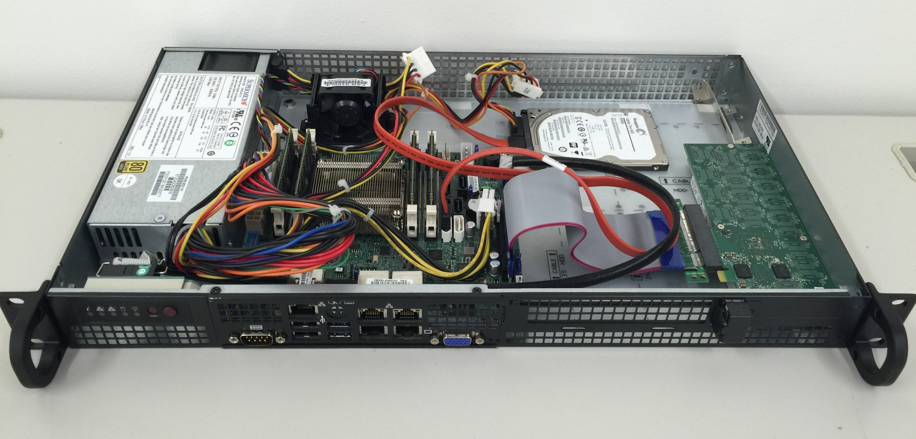
Evaluation Platform
Reference backend
1 Gb link
Intel Atom C2750 processor
Intel DC P3600 PCIe-based SSD
RocksDB with 120 million 1KB objects
99.4K queries per second

Slide 11
Evaluation Platform
Xeon Server 1
Xeon Server 2
# of backends | 128
backend tput | 100 KQPS
keyspace size | 10 billion
key size | 16 bytes
value size | 128 bytes
query skewness | Zipf 0.99
cache size | 10,000 entries
Client
Cache
Ryu
40 GbE
40 GbE
40 GbE
Pica8 P-3922
(OVS 2.3)
40 GbE
40 GbE
40 GbE
40 GbE
40 GbE
Backends
Backends
Xeon Server 3
Xeon Server 4
Default settings in this talk
  Use Intel DPDK to efficiently transfer packets and modify headers
Client adjusts its sending rate, keep loss rate between 0.5% and 1%

Slide 12
Throughput with and without caching
Backends aggregate (without cache)
Backends aggregate (with cache)
Cache (10,000 entries)

Slide 13
Throughput vs. Number of backends
backend rate limit: 50KQPS, cache rate limit: 5MQPS

Slide 14
End-to-end latency vs. Throughput

Slide 15
Throughput with workload changes
Traditional cache update method
Periodic top-k updates only
Periodic top-k updates + instant bursty hot key updates
Make 200 cold keys become the hottest keys every 10 seconds

Slide 16
Conclusion
SwitchKV: high-performance and cost-efficient KV store
Fast, small cache guarantees backend load balancing
Efficient content-aware OpenFlow switching
  Low (tail) latency
  Scalable throughput
  High availability
Keep high performance under highly dynamic workloads

