Slide 1
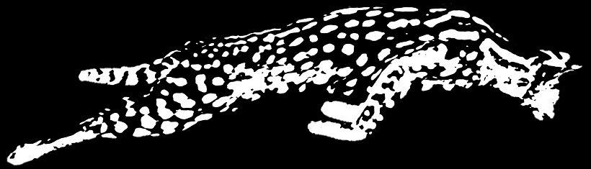
Serval: An End-Host Stack for Service-Centric Networking
serval-arch.org
Erik Nordström
David Shue, Prem Gopalan, Rob Kiefer,
Mat Arye, Steven Ko, Jen Rexford, Mike Freedman
Princeton University

Slide 2
The Internet of the 1970s
Killer Apps:
telnet, ftp
IMP 2
SRI
IMP 4
Utah
IMP 3
UCSB
IMP 1
UCLA
Network designed for accessing hosts

Slide 3





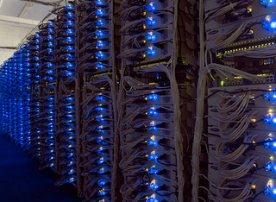


The Internet of the 2000s
Datacenter
Datacenter
Users agnostic of actual service location and host

Slide 4
What does Service Access Involve?
Locate a nearby service datacenter
  Map service name to location
Connect to service
  Establish data flow to instance
  Load balance between pool of replicas
Maintain connectivity to service
  Migrate between interfaces and networks

Slide 5
Today’s (Overloaded) Abstractions
Service is IP + port
  Exposes location
  Specifies app. protocol
  One service per IP
Flow is “five tuple”
  Binds flow to interface and location
  Cannot migrate between interfaces or networks
TCP/IP
connect (IP + port)
Application
demux (IP + port)
Transport
Network

Slide 6
Service Access Today
Datacenter
Enterprise
Network
Transit
Provider
4G
Cellular
Provider
Datacenter

Slide 7
Finding a Service Location
Enterprise
Network
Transit
Provider
DNS
4G
Cellular
Provider
Load-Balanced
Web Service
DNS binds service to location at client (early binding)
  Caching and ignoring TTL exacerbates the problem
  Slow failover when instance or load balancer fail

Slide 8
Connecting to Service
Enterprise
Network
Transit
Provider
4G
Cellular
Provider
Load-Balanced
Web Service
Datacenter LB maps single IP to multiple servers
  Must do this for every packet on path -> fate sharing
  Increases complexity and cost

Slide 9
Maintaining Connectivity to Service
Enterprise
Network
VM
Migration
Transit
Provider
4G
Cellular
Provider
Datacenter
Migrate VMs to balance load in the cloud
  Requires flat addressing or tunneling within datacenter

Slide 10
Maintaining Connectivity to Service
Datacenter
Enterprise
Network
Transit
Provider
Multi-
Homing
4G
Cellular
Provider
Datacenter
Physical
Mobility
Flows break when switching networks or interfaces

Slide 11
Contributions
Naming abstractions
  Services, flows
  Clean role separation in the network stack
Software architecture for services (Serval)
  Service-level control/data plane split
  Service-level events

Slide 12
Naming Abstractions

Slide 13
Today’s (Overloaded) Abstractions
TCP/IP
connect (IP + port)
Application
demux (IP + port)
Transport
forward (IP)
Network

Slide 14
Serval Abstractions
Serval cleans the slate
  (But not completely)
Network layer unmodified!
Service Access Layer (SAL)
  Connects to services
  Maintains connectivity
Serval
Application
Transport
Service
Access
forward (IP)
Network

Slide 15
Serval Abstractions
Service = ServiceID
  Group of processes with identical functionality
Flow = FlowID
  Invariant demux key
  Host-local, ephemeral
Location = IP address
  Location, interface
  Can change dynamically
Serval
connect (serviceID)
Application
Transport
demux ( )
Service
Access
serviceID
flowID
forward (IP)
Network

Slide 16
A Clean Role Separation in the Stack
What you access (serviceID), over which flows (flowIDs), and at which service instance (IP address)
TCP/IP
Serval
Application
connect (IP + port)
connect (serviceID)
Transport
demux (IP + port)
Service
Access
demux ( )
serviceID
flowID
Network
forward (IP)
forward (IP)

Slide 17
Service Names (ServiceIDs)
Provider prefix
Provider-specific
Self-certifying
ServiceIDs allocated in blocks
  Prefix ensures global uniqueness
  Prefix-based aggregation and LPM
A ServiceID late binds to service instance
  ServiceID in first packet of connection
  Service-level routing and forwarding

Slide 18
A Service-Aware Network Stack
bind(sock, serviceID)
listen(sock)
connect(sock, serviceID)
Network stack must resolve service to instance for client
Network stack must advertise service for server

Slide 19
Software Architecture

Slide 20
Serval End-host Architecture
Application
Service Controller
Service
Control API
FlowID | Socket
ServiceID | Action | Sock/Addr
Flow Table
Service Table
Dest Address | Next Hop
IP Forwarding Table

Slide 21
Data Plane: The Service Table
ServiceID | Action | Rule State
Prefix A | FORWARD | Send to addr A1
Prefix B | FORWARD | Send to [A2, A3, A4]
Prefix C | DEMUX | Send to listening sock s
Prefix D | DELAY | Queue and notify service controller
Prefix E | DROP
default | FORWARD | Send to A5

Slide 22
Data Plane: The Service Table
ServiceID | Action | Rule State
Prefix A | FORWARD | Send to addr A1
Prefix B | FORWARD | Send to [A2, A3, A4]
Prefix C | DEMUX | Send to listening sock s
Prefix D | DELAY | Queue and notify service controller
Prefix E | DROP
default | FORWARD | Send to A5

Slide 23
Data Plane: The Service Table
ServiceID | Action | Rule State
Prefix A | FORWARD | Send to addr A1
Prefix B | FORWARD | Send to [A2, A3, A4]
Prefix C | DEMUX | Send to listening sock s
Prefix D | DELAY | Queue and notify service controller
Prefix E | DROP
default | FORWARD | Send to A5

Slide 24
Data Plane: The Service Table
ServiceID | Action | Rule State
Prefix A | FORWARD | Send to addr A1
Prefix B | FORWARD | Send to [A2, A3, A4]
Prefix C | DEMUX | Send to listening sock s
Prefix D | DELAY | Queue and notify service controller
Prefix E | DROP
default | FORWARD | Send to A5

Slide 25
Data Plane: The Service Table
ServiceID | Action | Rule State
Prefix A | FORWARD | Send to addr A1
Prefix B | FORWARD | Send to [A2, A3, A4]
Prefix C | DEMUX | Send to listening sock s
Prefix D | DELAY | Queue and notify service controller
Prefix E | DROP
default | FORWARD | Send to A5

Slide 26
Service Access with Serval
X
Service
Router
d
Internet
c
X
a
Datacenter
e

Slide 27
Adding a Service Instance
Application
Service Controller
Register
Service X
bind(X)
listen()
S
FlowID | Socket
ServiceID | Action | Sock/Addr
X
DMX
s
Add DEMUX rule

Slide 28
Removing a Service Instance
Application
Service Controller
Unregister
Service X
close()
S
FlowID | Socket
ServiceID | Action | Sock/Addr
X
DMX
s
Remove DEMUX rule

Slide 29

Control Plane: The Service Controller
Service Controller
Service X
@ address a
Service Controller
DNS

Slide 30
Control Plane: The Service Controller
Service Controller
Service X
@ address d
FlowID | Socket
ServiceID | Action | Sock/Addr
X
FWD
d
Add FORWARD rule

Slide 31
Service Access with Serval
X
bind(X)
Service
Router
X | d,e
X@d
X/24 | c
d
Internet
X/24@c
c
X@e
X
bind(X)
a
Datacenter
e

Slide 32
Connecting to Service X
Application
Service Controller
socket()
S
FlowID | Socket
ServiceID | Action | Sock/Addr
2
s
X
FWD
c
Allocates local flowID
a

Slide 33
Connecting to Service X
Application
connect(X)
S
FlowID | Socket
ServiceID | Action | Sock/Addr
2
s
X
FWD
c
a
To c
a
c
2
-
X
SYN

Slide 34
Load Balancing in Service Router
FlowID | Socket
ServiceID | Action | Sock/Addr
X
FWD
d,e
From a
To e
c
f
a
c
2
-
X
SYN
a
e
2
-
X
SYN

Slide 35
Service Instance Providing Service X
Application
S
FlowID | Socket
ServiceID | Action | Sock/Addr
X
DMX
s
From a
e
a
e
2
-
X
SYN

Slide 36
Service Instance Providing Service X
Application
accept()
S_{c}
S
FlowID | Socket
ServiceID | Action | Sock/Addr
3
s_{c}
X
DMX
s
To a
e
e
a
3
2
SYN-ACK

Slide 37
Service Access with Serval
X
a
e
X
SYN
a
c
X
SYN
Service
Router
X | d,e
d
Internet
c
X
a
e
a
SYN-ACK
Datacenter
e
e
a
data

Slide 38
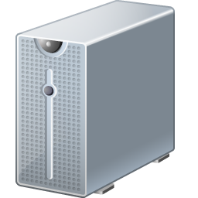
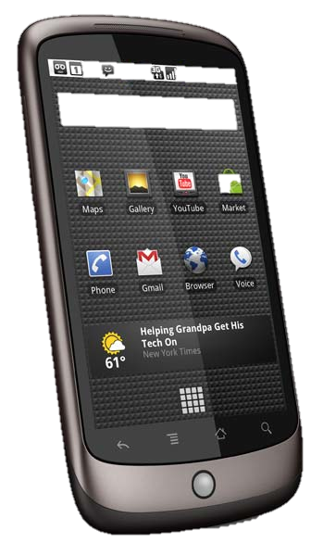
Ad hoc Service Discovery
Accessing service X
connect(X)
X
b
a
SYN-ACK
b
a
*
X
SYN
a
c
a
SYN-ACK
X
ServiceID | Action | Rule State
default | FORWARD | “broadcast”
c

Slide 39
What does Service Access Involve?
Locating a nearby service datacenter
  Map service name to location
Connecting to service
  Establish data flow to instance
  Load balance between pool of replicas
Maintaining connectivity to service
  Migrate between interfaces and networks

Slide 40
Migration of Flows
f_{C1}
f_{S1}
a1
a3
s_{C}
s_{S}
a2
a4
Host C
Host S
Migrate flow
a1 -> a2
RSYN
RSYN-ACK
ACK

Slide 41
Multipath with Multiple Subflows
f_{C1}
f_{S1}
a1
a3
s_{C}
s_{S}
f_{C2}
f_{S2}
a2
a4
Host C
Host S
Add flow
a2 <-> a4
SYN
SYN-ACK
ACK

Slide 42
Prototype
End-host network stack (28,000 LOC)
  Linux kernel module
  BSD sockets with AF_SERVAL protocol family
  AF_INET sockets can be accessed simultaneously
Legacy middleboxes / NATs handled via encap.
Translator for incremental deployment
  Unmodified apps and end-hosts
  Serval apps with unmodified services

Slide 43
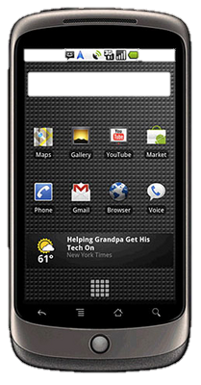
Incremental Deployment
App
Translator
TCP/IP
Serval

Slide 44
Incremental Deployment
Translator
App
Translator
Serval
TCP/IP
TCP/IP

Slide 45
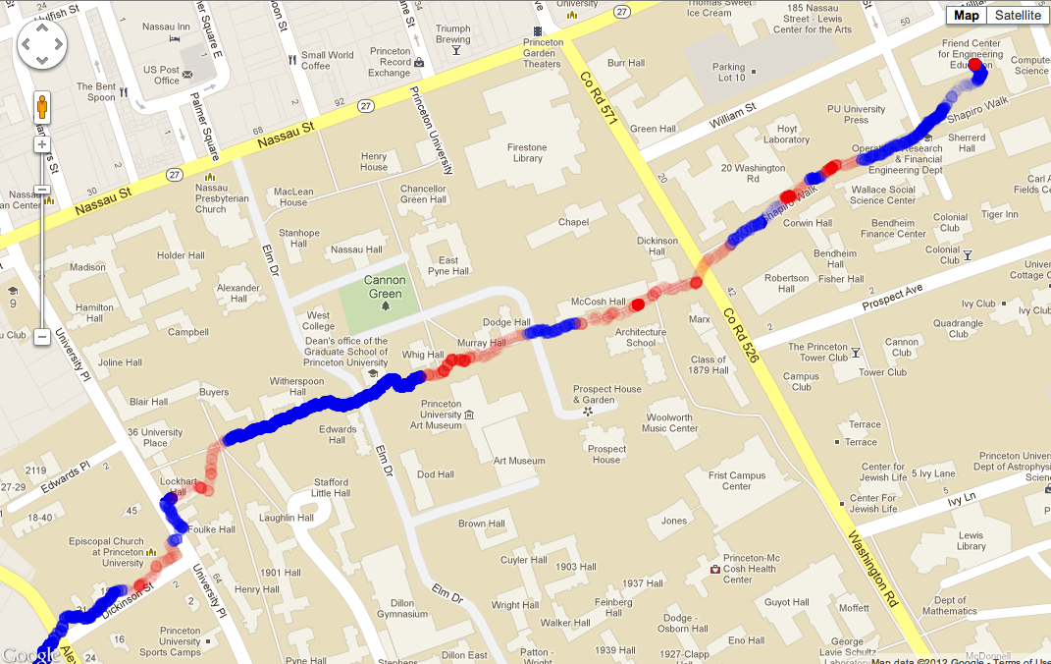
Use of Migration on Clients
WiFi
Cellular
Saves > 900 MB cellular data per month
Single Serval TCP connection that never breaks

Slide 46
Uses of Migration on Servers
Load balancing across NICs
Flow 1
moved to eth1
Both flows use eth0

Slide 47
Uses of Migration on Servers
Migrating VMs across subnets
VM migrates flow to new address
VM changes subnet, acquiring new address

Slide 48
Competitive Performance
TCP Throughput
 | Mean (Mbit/s)
TCP/IP | 934.5
Serval | 933.8
Translator | 932.1
Service Table Throughput
 | Mbit/s | Kpkt/s
IP forwarding | 987 | 388.4
Serval | 872 | 142.8

Slide 49
Applications are Easy to Port
Application | Codebase | Changes
Iperf | 5,934 | 240
TFTP | 3,452 | 90
wget | 87,164 | 207
Elinks browser | 115,224 | 234
Firefox browser | 4,615,324 | 70
Mongoose webserver | 8,831 | 425
Memcached server | 8,329 | 159
Memcached client | 12,503 | 184

Slide 50
SDN to the Edges!
SDN about network-wide visibility and control
  Today’s “SDN” (OpenFlow) primarily focuses on layer-2 / layer-3 abstractions
Serval extends SDN model to the network edge
  New programming abstractions for services, flows, hosts, and interfaces
  Service-level control/data plane split
Joint service and network control

Slide 51
Summary of Contributions
New naming abstractions
  Clean role separation in the stack
  Makes it easier to build and manage services
Software architecture for services
  Flexible service resolution and discovery
  Maintains robust connectivity
  Joint service and network management

Slide 52


serval-arch.org
@servalnetwork
Papers, demos, source code (GPL) online

Slide 53
Related Work
Locator/identifier separation
  HIP, i3, HAIR, DOA, LISP, LNA
Data-oriented networking
  DONA, CCNx
Support for mobility and migration
  TCP Migrate, Mobile IP, ROAM
Multipath and multi-homing
  MPTCP, SCTP, Shim6

