Slide 1




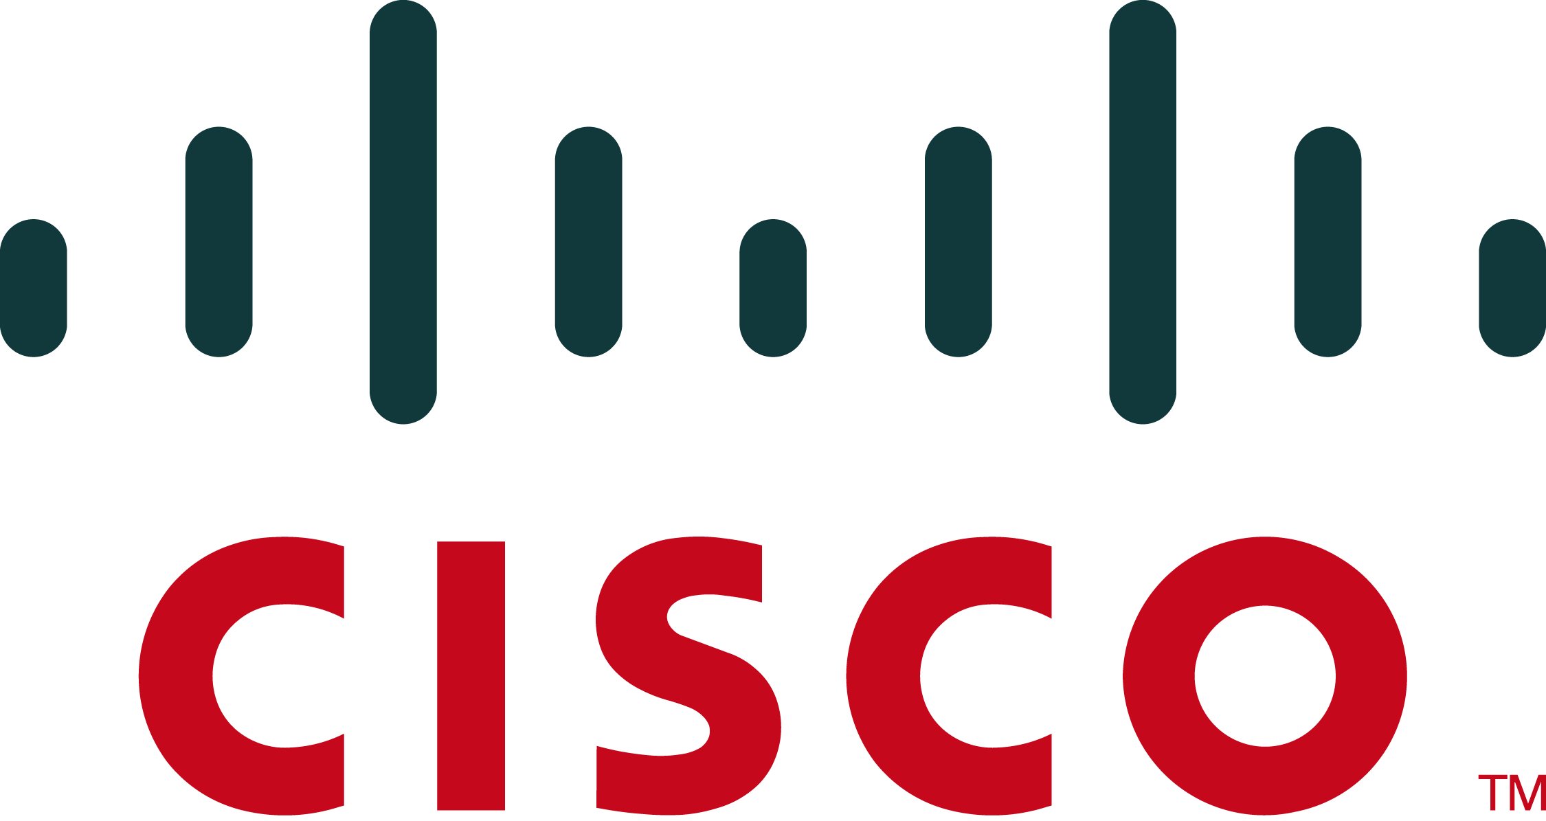


A Service Access Layer, at Your Service
David Shue, Matvey Arye, Prem Gopalan
Erik Nordström, Steven Y. Ko, Michael J. Freedman, Jennifer Rexford
Princeton University
Serval (Service Access Layer) for IP networks
Wide-area Service Resolution
Client
Service Instance
DNS
AS 1
Service System α
Server
(Authoritative)
Service Router
ASR
X
Network
Router
Resolve Z
Register Z
Net 4
3
1
AS 2
New Layering Model
SR
Internet
SR
Application
SR
4
SR
Transport
Service Access
2
AS 3
Z
Y
Z
Network
Link
Problem with Status Quo
  Internet fundamentally designed for host-to-host communication
  But users want services, agnostic of hosts
  Existing ad-hoc solutions are inadequate
    Baroque combo of layer-7 switching, HTTP redirection, DNS with short TTLs, IP anycast, VIP/DIP load balancers, ARP spoofing, …
Service-Centric Architecture
  From topology-dependent addresses to topology-independent service names
  Multiplicity: Of replicas, paths, interfaces, ...
  Dynamism: Of replicas, paths, interfaces, …
  Service-level anycast for stateful connections to service instances, associated IP addresses can change over time as replicas join, move, fail, …
Applications
  Replicated web services
  Content distribution networks
  Distributed storage services
Environments
  VM-based cloud platforms
  Legacy enterprise applications
  Mobile users and devices
Serval Features
Serval Resolution: Successive Refinement
f_{C1}
a1
a3
f_{S1}
SYN
flowID
2
SYN
SR@g
3
SYN
s_{C}
f_{C2}
f_{S2}
s_{S}
1
addr
srvID
a
1
a
1
4
SYN
a2
a4
SRC
a
1
g
X
f
X
a
1
X
Host C
Host S
DST
e
X
SR @e
SR@f
b
Support for dynamism and multiple interfaces
  Communication on serviceIDs that are resolved to IPs
  Transport demux on flowIDs, multi-home/path support
  Service Access Layer (SAL) establishes and maintains connections, maps flowIDs to (changing) IPs
  Transparent flow redirection upon migration / failover with in-band signaling
X
Address a
5
SYN-ACK
Address b
Y
Z
6
ACK
SRC
b
2
X
Address d
DST
a
1
Address c
Components
Implementation
Demo
Service Access Layer
  (Un)registers services & hosts with net
  New division of labor between layers
    Transport protocols do data delivery
    SAL manages connections
Service Router
  Resolves serviceID→instance address
  Service routers form resolution overlay
  DNS can be leveraged for wide-area
Serval end-host stack
  BSD sockets API with PF_SERVAL
  Binds to serviceIDs instead of IP/port
  Datagram and stream sockets
  Kernel and user-space versions
Network elements
  Overlay of service routers
  Support for anycast and extensible header processing
1
connect(X)
4
Service table maps serviceIDs to IP addrs of resolvers, services
Without local service router, default rule broadcasts on local segment
Ad-hoc mode allows Serval to operate w/o infrastructure, can be used for bootstrapping
Client
SYN-ACK
X
3
SYN
SYN
4
SYN-ACK
X
Service table
Prefix | Bits | IP
A | 14 | 192.168.1.2
0 | 0 | 192.168.1.255
2

