Slide 1
Bridging the Theory-Practice Gap in Multi-Commodity Flow Routing
Siddhartha Sen, DISC 2011
Joint work with Sunghwan Ihm, Kay Ousterhout, and Mike Freedman
Princeton University

Slide 2
Routing flows in data center networks
A
B

Slide 3
Network utilization suffers when flows collide…
A
B
E
D
F
C

Slide 4
… but there is available capacity!
A
B
E
D
F
C

Slide 5
… but there is available capacity!
Must compute routes repeatedly:
real workloads are dynamic (∼ms)!
A
B
E
D
F
C

Slide 6
Multi-commodity flow problem
Input: Network G = (V,E) of switches and links Flows K = {(s_{i},t_{i},d_{i})} of source, target, demand tuples
Goal: Compute flow that maximizes minimum fraction of any d_{i} routed
Requires fractionally splitting flows, otherwise no O(1)-factor approximation

Slide 7
Prior solutions
Sequential model
Theory: [Vaidya89, PlotkinST95, GargK07, …]
Practice: [BertsekasG87, BurnsOKM03, Hedera10, …]
Billboard model
Theory: [AwerbuchKR07, AwerbuchK09, …]
Practice: [MATE01, TeXCP05, MPTCP11, ...]
Routers model
Theory: [AwerbuchL93, AwerbuchL94, AwerbuchK07, …]
Practice: [REPLEX06, COPE06, FLARE07, …]
more decentralized

Slide 8
Prior solutions
Sequential model
Theory: [Vaidya89, PlotkinST95, GargK07, …]
Practice: [BertsekasG87, BurnsOKM03, Hedera10, …]
Billboard model
Theory: [AwerbuchKR07, AwerbuchK09, …]
Practice: [MATE01, TeXCP05, MPTCP11, ...]
Routers model
Theory: [AwerbuchL93, AwerbuchL94, AwerbuchK07, …]
Practice: [REPLEX06, COPE06, FLARE07, …]

Slide 9
Prior solutions
Sequential model
Theory: [Vaidya89, PlotkinST95, GargK07, …]
Practice: [BertsekasG87, BurnsOKM03, Hedera10, …]
Billboard model
Theory: [AwerbuchKR07, AwerbuchK09, …]
Practice: [MATE01, TeXCP05, MPTCP11, ...]
Routers model
Theory: [AwerbuchL93, AwerbuchL94, AwerbuchK07, …]
Practice: [REPLEX06, COPE06, FLARE07, …]
Theory-practice gap:
Models unsuitable for dynamic workloads
Splitting flows difficult in practice

Slide 10
Contributions
Demonstrate why prior solutions fail, both theoretically and practically
Propose theoretical + practical fixes
Devise algorithms in new framework
Goal: Provably optimal + practical
multi-commodity flow routing

Slide 11
Problems
Solutions
Dynamic workloads
Fractionally splitting flows
Switch ≠ end host
Limited processing, high-speed matching on packet headers
Routers Plus Preprocessing (RPP) model
Poly-time preprocessing is free
In-band messages are free
Splitting technique
Group flows by target, split aggregate flow
Group contiguous packets into flowlets to reduce reordering
Add forwarding table rules to programmable switches
Match TCP seq num header, use bit tricks to create flowlets

Slide 12
Sequential solutions don’t scale
Controller

Slide 13
Sequential solutions don’t scale
Controller

Slide 14
Billboard solutions require link utilization information…
in-band message
A
B

Slide 15
… and use path-based (exponential) representations
A
B

Slide 16
Routers solutions are local and hence scalable…

Slide 17
… but lack knowledge of global routes
A
B

Slide 18
Problems
Solutions
Dynamic workloads
Fractionally splitting flows
Switch ≠ end host
Limited processing, high-speed matching on packet headers
Routers Plus Preprocessing (RPP) model
Poly-time preprocessing is free
In-band messages are free
Splitting technique
Group flows by target, split aggregate flow
Group contiguous packets into flowlets to reduce reordering
Add forwarding table rules to programmable switches
Match TCP seq num header, use bit tricks to create flowlets

Slide 19
Problems
Solutions
Dynamic workloads
Splitting flows
Switch ≠ end host
Limited processing, high-speed matching on packet headers
Routers Plus Preprocessing (RPP) model
Poly-time preprocessing is free
In-band messages are free
Splitting technique
Group flows by target, split aggregate flow
Group contiguous packets into flowlets to reduce reordering
Add forwarding table rules to programmable switches
Match TCP seq num header, use bit tricks to create flowlets

Slide 20
No splitting + collisions
A
B
E
D
F
C

Slide 21
Proactive splitting
A
B
E
D
F
C

Slide 22
Proactive splitting
Problems:
Split every flow?
Inefficient
What granularity to split at?
Per-packet ⇒ too much reordering
A
B
E
D
F
C

Slide 23
Problems
Solutions
Dynamic workloads
Splitting flows
Switch ≠ end host
Limited processing, high-speed matching on packet headers
Routers Plus Preprocessing (RPP) model
Poly-time preprocessing is free
In-band messages are free
Splitting technique
Group flows by target, split aggregate flow
Group contiguous packets into flowlets to reduce reordering
Add forwarding table rules to programmable switches
Match TCP seq num header, use bit tricks to create flowlets

Slide 24
Conclusion
Both theoretical and practical innovations needed to bridge theory-practice gap
LocalFlow: optimal algorithm in new framework for data center networks

Slide 25
Additional slides

Slide 26
Granularity of splitting
Optimal routing
High reordering
Suboptimal routing
Low reordering
flowlets
Per-Packet
Per-Flow

Slide 27
Line rate splitting
Flow | TCP seq num | Link
A → B | *…0***** | 1
A → B | *…10**** | 2
A → B | *…11**** | 3
1/2
1/4
1/4
flowlet =
16 packets

Slide 28
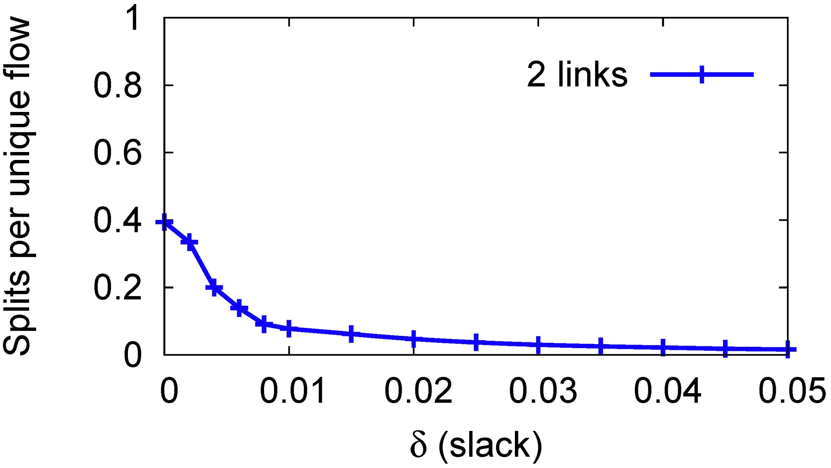
LocalFlow: Frequency of splitting
Group flows by target

Slide 29
LocalFlow: Frequency of splitting
δ-approximate splitting

