Slide 1

Social Networking with Frientegrity:
Privacy and Integrity with an Untrusted Provider
Ariel J. Feldman
Princeton
UPenn
Joint work with:
Aaron Blankstein, Michael J. Freedman, and Edward W. Felten

Slide 2

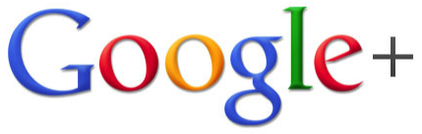
Online social networks are centralized
Pro: Availability, reliability, global accessibility, convenience
Con: 3rd party involved in every social interaction
Must trust provider for confidentiality & integrity

Slide 3


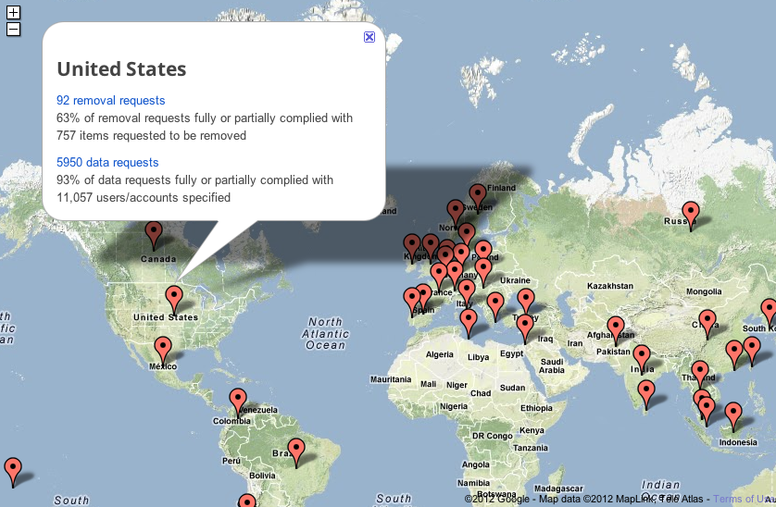

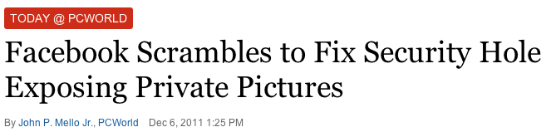

Threats to confidentiality
Theft by attackers
Accidental leaks
Privacy policy changes
Government pressure
Ars Technica. Mar. 11, 2011
EFF. Apr. 28, 2010
PC World. Dec. 6, 2011
WSJ. Feb. 22, 2012
Google Transparency Report Jan. – Jun. 2011

Slide 4

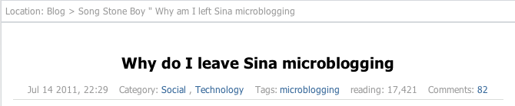
Threats to integrity
Server
Simple: Corrupting messages
Complex: Server equivocation
1
2
3
1
3
2
Alice
Bob
Equivocation in the wild:
(e.g to disguise censorship)
http://songshinan.blog.caixin.com/archives/22322 (translated by Google)

Slide 5
Limits of prior work
Cryptographic
Decentralized
Don’t protect integrity
Run your own server
Trust a provider
OR
(sacrifice availability, convenience, etc.)
(who you may not know either)

Slide 6
Frientegrity’s approach
Benefit from a centralized provider
Provider
Support common features
(e.g. walls, feeds, friends, FoFs, followers)
Server
Server
Server
Server
Assume untrusted provider
Client
Client
Client

Slide 7


Enforce confidentiality
Provider
Provider only observes encrypted data
(Need dynamic access control and key distribution)
Server
State
Server
Encrypted
state
Client
Client
Client

Slide 8

Verify integrity
Provider
Clients verify that the provider:
Hasn’t corrupted individual updates
Hasn’t equivocated
Enforced access control on writes
Server
Server
Client
Client
Client

Slide 9
Scalability challenges
Long histories; only want tail
…
Don’t verify whole history each time
Many objects (walls, comment threads, photos, etc.)
Support sharding
Many friends and FoFs
O(log n) “(un)friending”

Slide 10
Frientegrity overview
Server 1
Alice’s profile
Server 2
Server n
Checked for equivocation
Alice’s photo album
Alice’s ACL
Comment thread
Alice’s wall
Bob’s profile
Optionally entangled
Read Alice’s wall
Latest updates
Proof of no equivocation
Bob
Proof of ACL enforcement
Decryption keys
Verify & decrypt

Slide 11
Detecting equivocation
Enforce fork* consistency [LM07]
Server
Honest server: linearizability
Malicious server: Alice and Bob detect equivocation after exchanging 2 messages
Compare histories
1
2
3
1
3
2
Alice
Bob
Provider can still fork the clients, but can’t unfork

Slide 12
Comparing histories
Previously: use a hash chain
op₀
op₁
op₂
op₃
op₄
op₅
op₆
op₇
h_{n}= H(h_{n-1} || op_{n})
Hash chains are O(n)
(and must download the whole history)

Slide 13
Objects in Frientegrity
h_{root} commits to entire history
Let C₁₅ be a server-signed commitment to h_{root} up to op₁₅
h_{i} = H(h_{leftChild(i)} || h_{rightChild(i)})
op₀
op₁
op₂
op₃
op₄
op₅
op₆
op₇
op₈
op₉
op₁₀
op₁₁
op₁₂
op₁₃
op₁₄
op₁₅
History tree [CW09]

Slide 14
Objects (cont.)
Is C₈ consistent with C₁₅?
C₁₅
op₀
op₁
op₈
op₉
op₁₄
op₁₅

Slide 15
Verifying an object
Alice’s ops
Bob’s ops
Charlie’s ops
Clients collaborate to verify the history
op₀
op₁
op₂
op₃
op₄
op₅
op₆
op₇
op₈
op₉
op₁₀
op₁₁
op₁₂
op₁₃
op₁₄
op₁₅
C₀
C₄
C₈
C₁₁
Is C₁₁ consistent with C₁₅?

Slide 16
Tolerating malicious users
Alice’s ops
Bob’s ops
Bob’s ops
Charlie’s ops
Tolerate up to f malicious users
op₀
op₁
op₈
op₉
op₁₀
op₁₁
op₁₂
op₁₃
op₁₄
op₁₅
op₁₅
C₉
C₁₁
C₁₁

Slide 17
Access control
Server
Prove ACL enforcement
Efficient key distribution
O(log n) “(un)friending”
Alice’s photo album
Alice’s ACL
Comment thread
Alice’s wall
Bob
Verify & decrypt

Slide 18
Proving ACL enforcement
h_{i} = H(h_{leftChild(i)} || h_{rightChild(i)})
Server
h_{root} signed by Alice
Alice’s photo album
Alice’s ACL
David
Comment thread
Alice’s wall
Bob
Sean
Alice
Charlie
Emma
Persistent authenticated dictionary
[AGT01]
Bob
Verify & decrypt

Slide 19
Efficient key distribution
Server
E_{k3}(k₁) || E_{k4}(k₁)
k₀ = k_{alice_friend}
Alice’s photo album
Alice’s ACL
David
David, k₀
Comment thread
Alice’s wall
Bob
Sean
Bob, k₁
Sean, k₂
Alice, k₃
Charlie, k₄
Emma, k₅
Alice
Charlie
Emma
E_{charlie_pk}(k₄)
Bob
Key graph
[WGL98]
Verify & decrypt

Slide 20
Adding a friend
E_{k5}(k₂) || E_{k6}(k₂)
Server
Alice’s photo album
Alice’s ACL
David, k₀
Comment thread
Alice’s wall
Bob, k₁
Sean, k₂
Alice, k₃
Charlie, k₄
Emma, k₅
Zack, k₆
E_{zack_pk}(k₆)
Bob
Verify & decrypt

Slide 21
Removing a friend
Server
k₀’ = k_{alice_friend}’
Alice’s photo album
Alice’s ACL
David, k₀
David, k₀’
Comment thread
Alice’s wall
Bob, k₁
Sean, k₂
Bob, k₁’
Alice, k₃
Charlie, k₄
Emma, k₅
Zack, k₆
Bob
Verify & decrypt

Slide 22
Efficient enough in practice?
Setup
Java client & server
Simulate basic Facebook features (each user has wall & ACL)
2048-bit RSA sign & verify batched via spliced signatures [CW10]
Experiments on LAN (8-core 2.4 GHz Intel Xeon E5620s, Gigabit network)
Measurements
Latency of reads & writes to objects
Latency of ACL changes
Throughput (in paper)
Effect of tolerating malicious users

Slide 23
Object read & write latency
Constant cost of signatures dominates
Frientegrity
(collaborative verification)
Hash chain

Slide 24
Latency of ACL changes

Slide 25
Tolerating malicious users
50 writers
5000 operations

Slide 26
Summary
Both confidentiality & integrity need protection
Benefit from centralization, but provider is untrusted
Clients collaborate to defend against equivocation
Scalable, verifiable access control & key distribution

Slide 27
Thank you
Questions?
http://arifeldman.com
ariel.feldman@cis.upenn.edu

