Slide 1


Bringing P2P to the Web: Security and Privacy in the Firecoral Network
Jeff Terrace
Sean Stern
Hao Eric Liu
Harold Laidlaw
Michael Freedman
Notes:
- Jeff Terrace
Firecoral, p2p network for web content
Joint Work

Slide 2
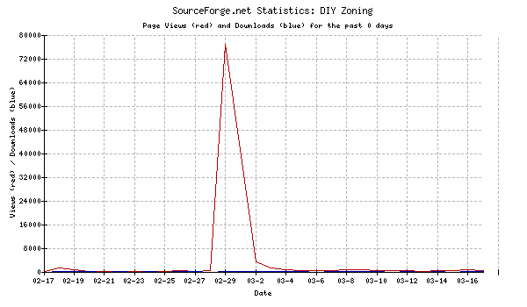
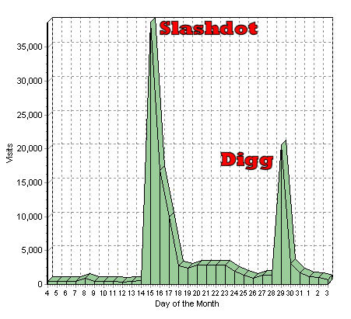
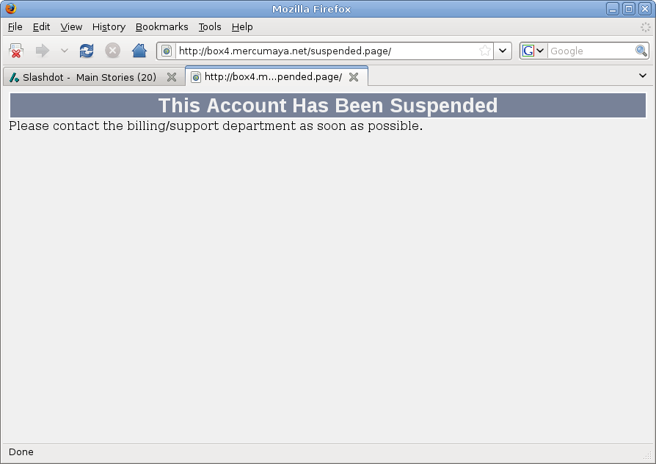
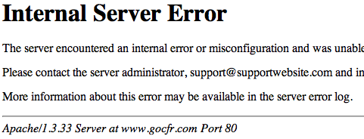
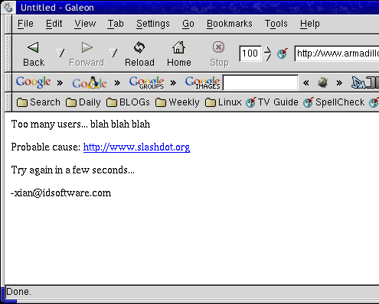
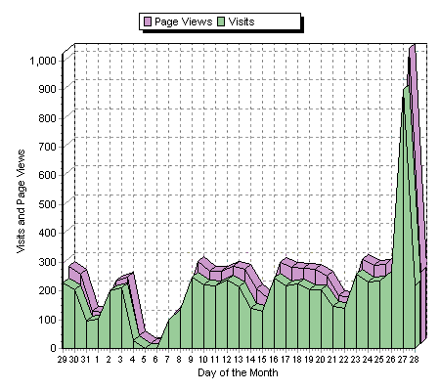
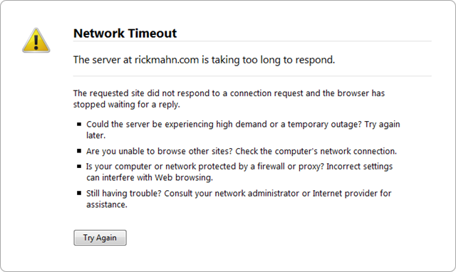
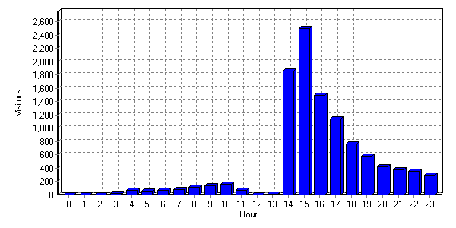
Slashdot Effect

Slide 3






Existing Commerical CDNs
Build your own solution
  Expensive to set up
  Only cost effective at massive
  scale
Purchase from provider
  Expensive
  Requires prior knowledge of
  demand

Slide 4



Existing Free CDNs
Peer-to-peer CDNs
  Easy to use
  Free!
  Automatic redirection
Unfortunately…
  Over-subscribed
  Under-provisioned
  Scalability limited due to trust

Slide 5





Existing P2P Networks
Leverage file-sharing networks
  Demonstrated to provide scalability,
  fairness, and high-performance
Design Mismatch
  Not easily integrated into web browsers
  High latency cost for small files

Slide 6

Introducing Firecoral
What is Firecoral?
  A peer-to-peer network for the web
  Integrates directly into a user’s web browser
  Ensures authenticity of content
  Preserves user privacy
  Backwards compatible
This talk’s focus
  Security
  Privacy
  Usability
Not focused on
  P2P Algorithms
  Incentives
  Evaluation

Slide 7
Firecoral Goals
Content Providers
  Easily integrate into existing web servers
  Backwards compatibility
  Not interfere with advertisements and analytics
End Users
  Easy to install and transparent to use
  Provide content integrity
  Respect privacy/sharing policies

Slide 8



Modified Content Provider
Content Provider
  Acts as tracker
  Ensures authenticity
Content
Provider
<URL>
Client
<Content Hash>
<Peer List>
Peer
URL
Peer
URL
But content provider
  Still handles every request
URL
Peer

Slide 9
External Tracker
Tracker
Content
Provider
<URL>
URL
Client
<Content Hash>
<Peer List>
Peer
URL
Content provider
  Still needs to provide authenticity
  Still requires modification
Peer
URL
URL
?
Peer

Slide 10
Signing Service
Tracker
Content
Provider
URL
Sig_{SS}<Content Hash>
Client
<Peer List>
URL
Peer
URL
Signing
Service
Peer
URL
URL
Peer
✓
Private Key = SS
Computes
Sig_{SS}<Content Hash>

Slide 11

When to Use Firecoral
Content to avoid
  HTTPS
    Banking
    Online Shopping
  POST Requests
    Web mail
    Feedback forms
  Other private content?

Slide 12
When to Use Firecoral
Simply list domains
  Too coarse grained
  Requires site lists be known
Use HTTP referrer header
  Captures 3rd party advertisements
  Interferes with analytics

Slide 13
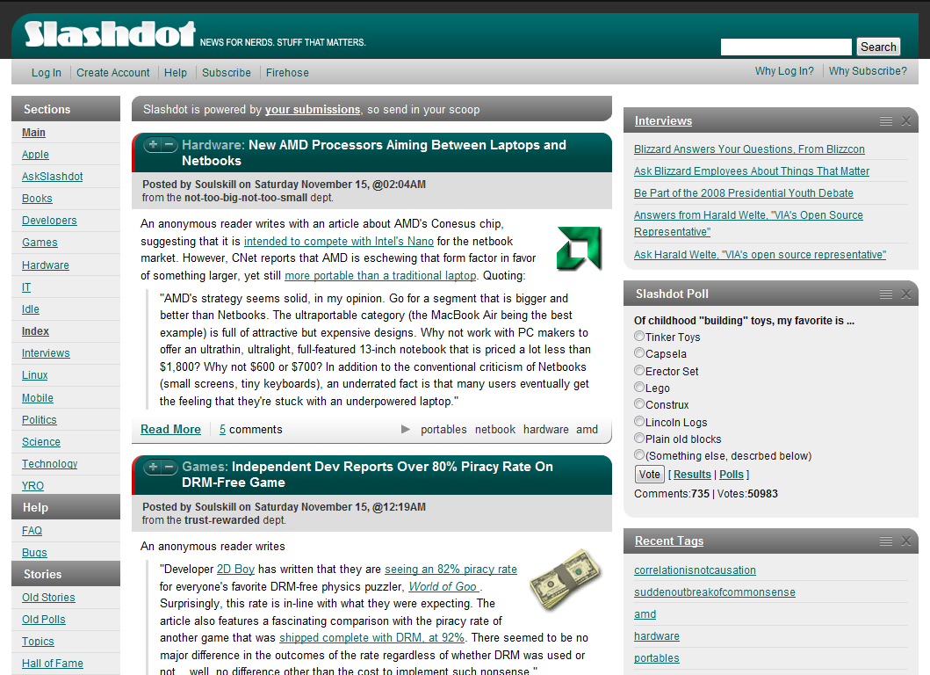
Configuration Example

Slide 14
Configuration Solution
HTML Text
  Difficult to parse
  Requires maintenance
Web standards!
  XML Path Language (XPath)
  Queries can select XML nodes from HTML
  XPath rules are simple and easy to write
  Firefox executes XPath very quickly

Slide 15
XPath Example
Query for digg.com used to be:
  //div[@class='news-summary']
  /descendant::a[starts-with(@href, 'http://')
  and not(contains(@class, 'thumb'))]/@href
Digg releases “DiggBar” feature which changes HTML
New query only changes one word:
  //div[@class='news-summary']
  /descendant::a[starts-with(@href, 'http://')
  and not(contains(@class, 'thumb'))]/@title

Slide 16
Subscriptions
List of Domain/XPath pairs
Whitelist
  Use Firecoral
  Contains popular news aggregators
Blacklist
  Don’t use Firecoral
  Contains known well-provisioned sites
Notes:
Make clear this is in browser
Only urls selected are used

Slide 17
Implementation
Tracker
  1000 lines of PHP running on Apache
  Uses MySQL, Memcachedb, and Memcached
Signing Service
  700 lines of Python
Firefox Extension
  7000 lines of JavaScript, XUL, and CSS
  Runs an HTTP proxy server within Firefox
  Uses Mozilla XPConnect API for access to low-level network functions
  Cross platform

Slide 18
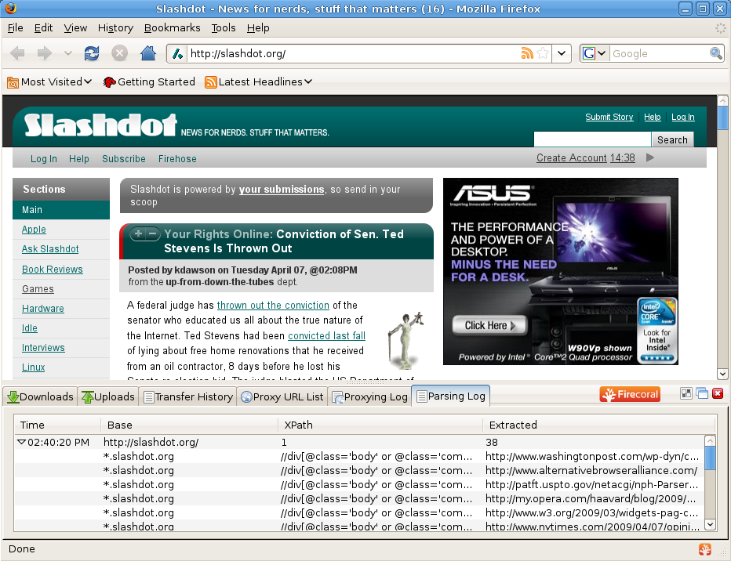
Demo

Slide 19
Conclusions
Firecoral brings P2P to the web
Firecoral provides
  Security
  Privacy
  Usability
Allows content providers to easily support Firecoral
Allows users to easily configure sharing and privacy policy

Slide 20
Future Work
Implementation
  NAT traversal
  Apache plug-in for signing and redirection
Design
  Incentives
  Peer selection
  Measurement study

Slide 21
Thank You
Questions?
http://firecoral.net/

