Slide 1
Commensal Cuckoo: Secure Group Partitioning for Large-Scale Services
Siddhartha Sen and Mike Freedman
Princeton University

Slide 2
Peer-to-peer service
Scalable peer-to-peer service
untrusted participants
Shard data/ functionality
Clients

Slide 3
How do we make it reliable?
Scalable peer-to-peer service
Byzantine Fault Tolerant (BFT)
f < 1/3
Mask failures with replication
untrusted participants
Observe:
F ≤ f
Want small groups
F < 1/4
f < 1/3
Clients
f < 1/3

Slide 4
Prior work using many small groups
Systems:
  [Rampart95], [SecureRing98], [OceanStore00], [Farsite02], [CastroDGRW02], [Rosebud03], [Myrmic06], [Fireflies06], [Salsa06], [SinghNDW06], [Halo08], [Flightpath08], [Shadowwalker09], [Census09]
Theory:
  [HildrumK03], [NaorW07]
Problem:
Assume randomly or perfectly distributed faults (i.e., static)

Slide 5
Rosebud [RL03]
1 0
BFT group
Consistent hashing ring

Slide 6
Rosebud [RL03]
1 0
Unrealistic:
Don’t know faulty nodes
Best case is uniformly random
⇒ ω(1) faults per group
Real adversary is dynamic!
BFT group
F = f < 1/3

Slide 7
Join-leave attack
1 0
f > 1/3
Vanish system compromised by join-leave attack (2010)
join
leave

Slide 8
Prior work tolerating join-leave attacks
[FiatSY05], [AwerbuchS04], [Scheideler05]
State-of-the-art is cuckoo rule [AwerbuchS06, AwerbuchS07]
Problems:
Impractical (large constant factors)
Groups must be impractically large or F trivially low

Slide 9
Goal: Provably secure + practical group partitioning scheme
Contributions:
  Demonstrate failures of prior work
  Analyze and understand failures
  Devise algorithm that overcomes them
Assumptions
  Correct nodes randomly distributed and stable
  Adversary controls global fraction F of nodes in system, rejoins them maliciously
  System fails when one group fails, i.e. f ≥ 1/3

Slide 10
Cuckoo rule (CR) [AS06]
1 0
1
2
F < f < 1/3
3
4

Slide 11
Cuckoo rule (CR) [AS06]
1 0
primary join
random location in [0,1)
random locations in [0,1)
1
2
k-region
For poly(n) rounds, all regions of size O(log n)/n have:
O(log n) nodes
f < 1/3
Adversary strategy: rejoin from least faulty group
join
3
4
secondary join
secondary join
leave

Slide 12
Cuckoo rule (CR) [AS06]
In summary:
  On primary join, cuckoo (evict) nodes in immediate k-region to selected random ID
  Select new random IDs for cuckood nodes, join them as secondary joins (i.e., no subsequent cuckoos)
Ignore implementation issues:
  Route messages securely
  Verify messages from other groups
  Bootstrap the system, handle heavy churn

Slide 13
CR tolerates very few faults in practice
N | Global fault % (F)
512 | 2.84
1024 | 1.44
2048 | 0.79
4096 | 0.37
8192 | 0.20
Group size = 64, Rounds = 100,000

Slide 14
What if we allow larger groups?
N | Group size F = 10% | Group size F = 20%
512 | 256 | 512
1024 | 512 | 1024
2048 | 256 | 1024
4096 | 512 | 1024
8192 | 512 | 1024
Increased group size in powers of 2

Slide 15
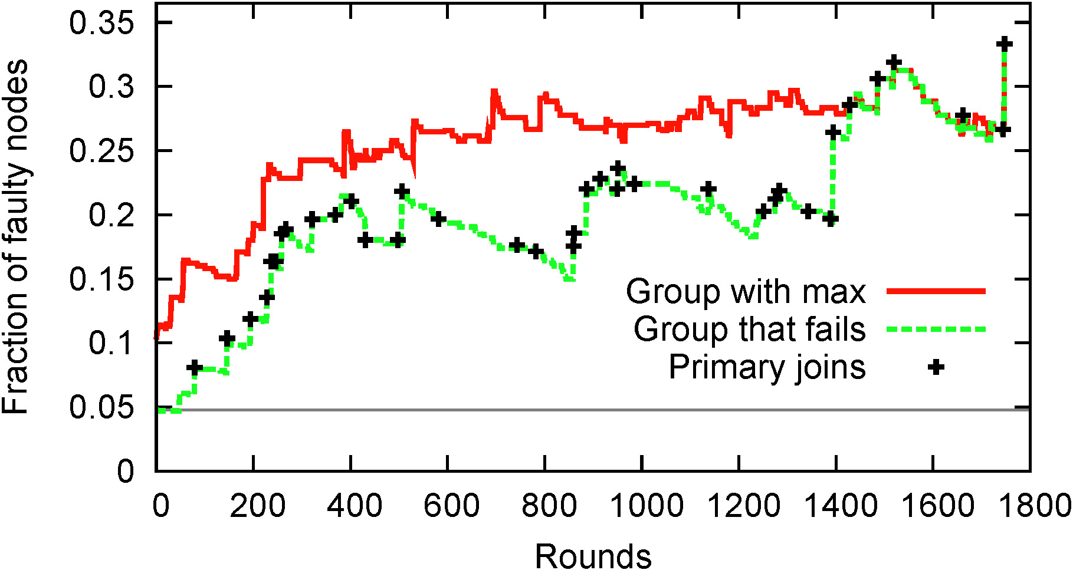
CR: Evolution of a faulty group
Expected faulty fraction per group
N = 4096, F ∼ 5%, Group size = 64, k = 4

Slide 16
Why does this happen?
1 0
closely-spaced primary joins = bad news
primary joins create holes
faulty group!
1
2
3
4
empty k-regions cuckoo less

Slide 17
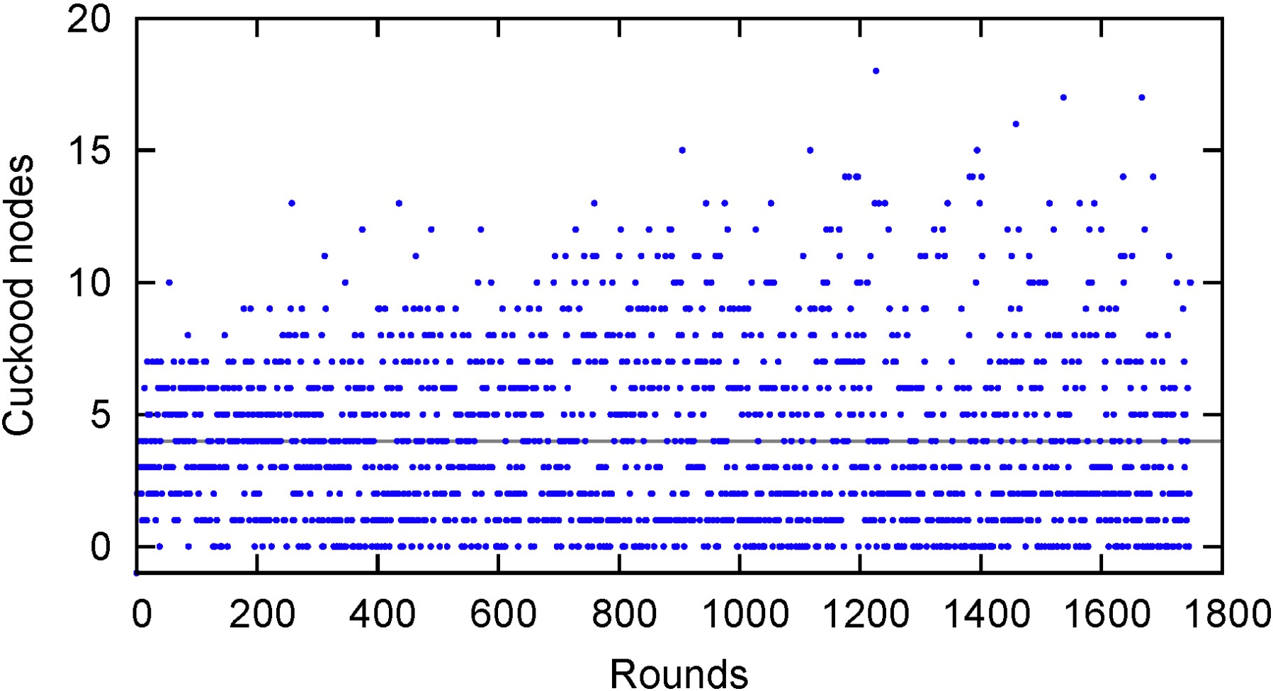
CR: Cuckoo size is erratic
clumps
Expected cuckoo size
holes
N = 4096, F ∼ 5%, Group size = 64, k = 4

Slide 18
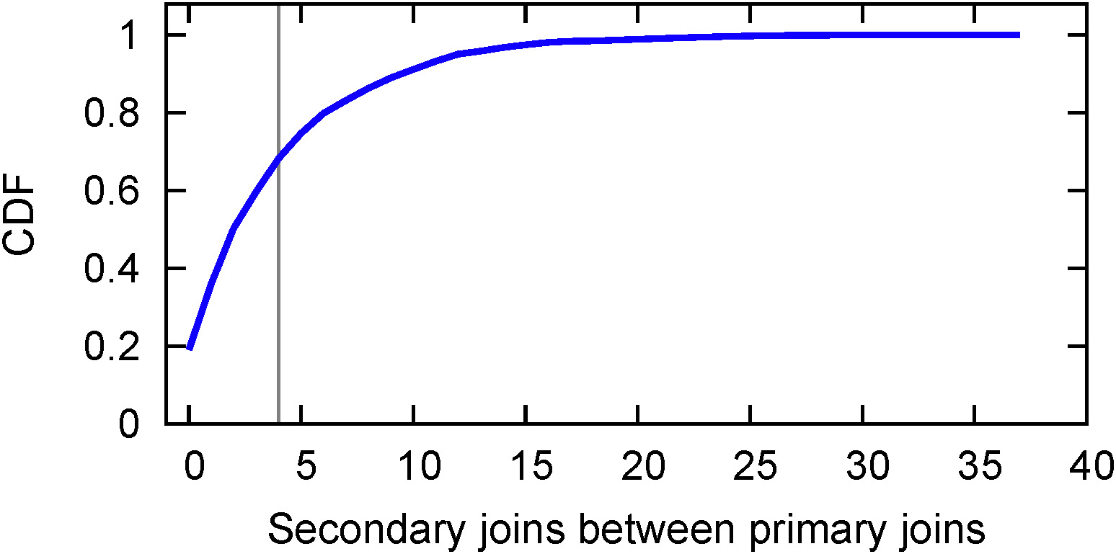
CR: Primary join spacing is erratic
Expected secondary joins
N = 4096, F ∼ 5%, Group size = 64, k = 4

Slide 19
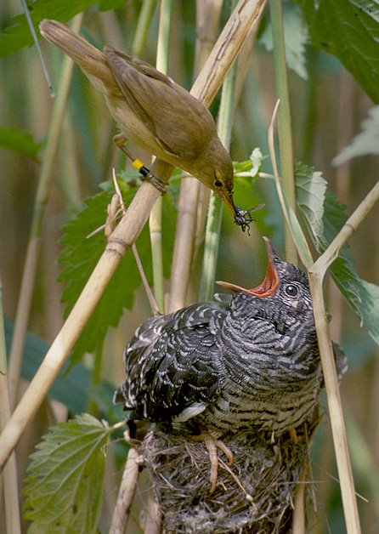
Cuckoo rule is “parasitic”

Slide 20
New algorithm (Fixing CR)
Holes and clumpiness:
  Cuckoo k nodes chosen randomly from group
  Scale k relative to average group size (larger groups cuckoo more, smaller groups cuckoo less)
Inconsistently spaced primary joins:
  Group vets join attempt, deny if insufficient secondary joins since last primary join

Slide 21

“Commensal” cuckoo rule
Com⋅men⋅sal⋅ism. A symbiotic relationship in which one organism derives benefit while causing little or no harm to the other.

Slide 22
Commensal cuckoo rule (CCR)
1 0
received secondary join!
too few secondary joins
cuckoo k random nodes
primary join accepted
1
2
3
holes don’t matter
4
(recall CR cuckood only 1 node)

Slide 23
Commensal cuckoo rule (CCR)
In summary:
  On primary join to selected random ID, if fewer than ∼k secondary joins since last primary join, start over with new random ID
  Otherwise, cuckoo k nodes weighted by group size, join them as secondary joins (i.e., no subsequent cuckoos)

Slide 24
Techniques are synergistic
Join vetting forces adversary to join distinct groups ⇒ all groups joined (roughly)
Weighted cuckoos ensure sufficient secondary joins ⇒ O(1) join attempts needed

Slide 25
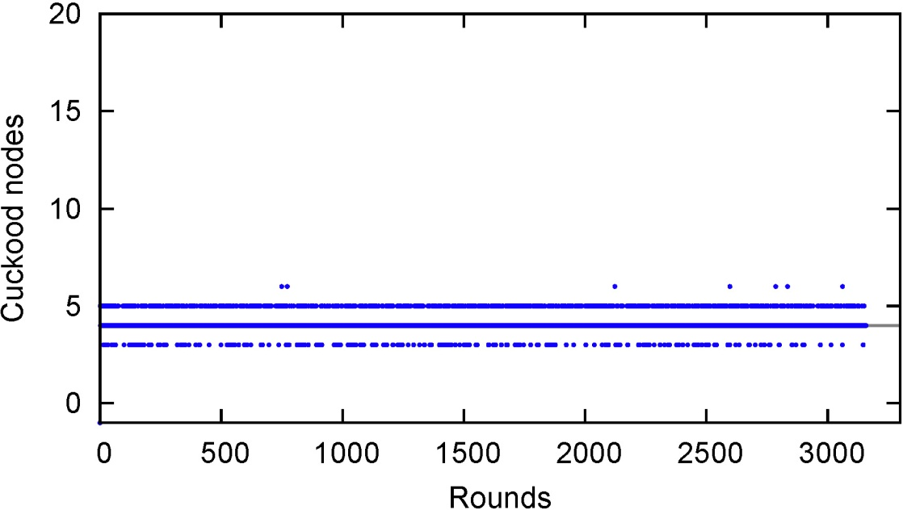
Cuckoo size is consistent
CR:
CCR:

Slide 26
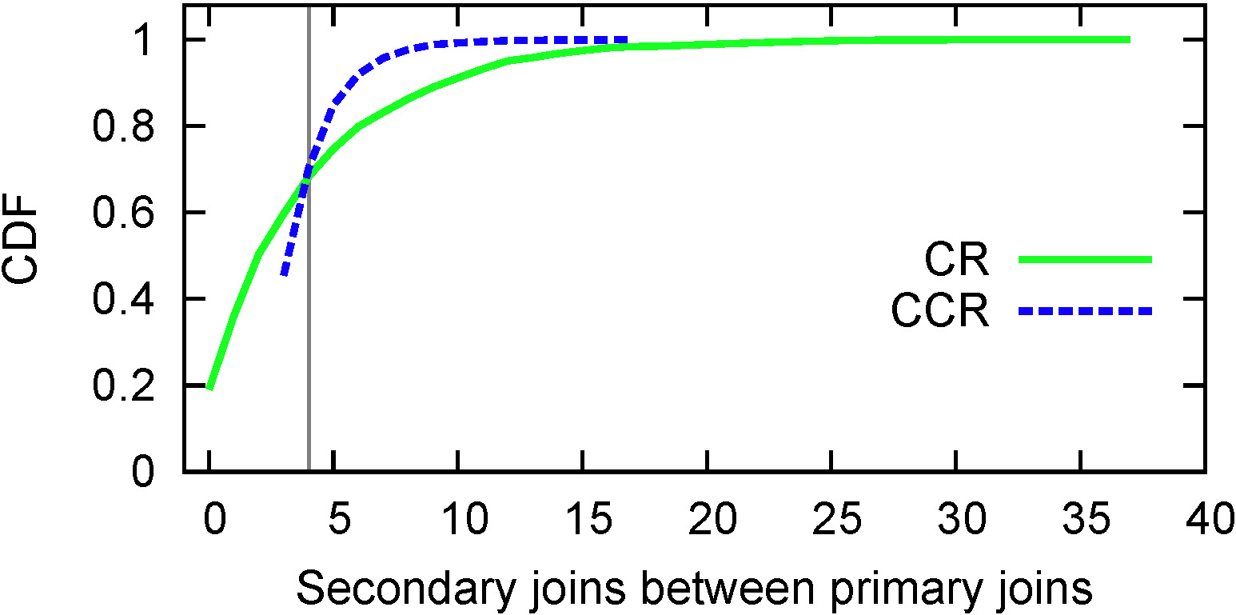
CCR: Primary join spacing is consistent

Slide 27
CCR tolerates significantly more faults
N | Global fault % (CR) | Global fault % (CCR) | Gain
512 | 2.84 | 7.39 | 2.6x
1024 | 1.44 | 7.57 | 5.3x
2048 | 0.80 | 6.95 | 8.7x
4096 | 0.36 | 6.93 | 19.0x
8192 | 0.20 | 6.51 | 32.4x
f < 1/3

Slide 28
CCR tolerates significantly more faults
N | Global fault % (CR) | Global fault % (CCR) | Gain
512 | 5.34 | 18.54 | 3.5x
1024 | 2.93 | 17.59 | 6.0x
2048 | 1.44 | 18.03 | 12.5x
4096 | 0.80 | 16.47 | 20.6x
8192 | 0.40 | 16.60 | 41.4x
How to use BFT with f < 1/2?
Idea: Separate correctness from availability
Group is correct, but unresponsive
Use other groups to revive group!
f < 1/2

Slide 29
Join vetting has deeper benefits
Security vulnerability in CR: adversary retries a primary join (w/o causing cuckoos) until gets location it likes
CCR avoids problem: group won’t accept primary join if insufficient secondary joins
  Don’t care how many previous attempts or where

Slide 30
Summary
CR suffers from random bad events, which CCR avoids by derandomizing
  Cuckoos weighted by group size
  Primary join attempts vetted by groups
CCR tolerates F ∼ 7% for f < 1/3
F ∼ 18% for f < 1/2

Slide 31
Extensions (A complete solution)
Route messages securely
  O(1)-hop routing
Verify messages from other groups
  Distributed key generation, threshold signatures ⇒ constant public/private key per group
Bootstrap the system, handle heavy churn
  Choose target group size at onset (e.g. 64);
  Split/merge locally
Handle DoS and data layer attacks
  Reactive approach, e.g. reactive replication

Slide 32
Conclusion
Secure group membership partitioning for open P2P systems
Most previous systems assumed (impossible) perfect distribution, ignored join-leave attacks
CCR can handle much higher fractions of faulty nodes than prior algorithms

