Slide 1
A Principled Approach to Managing
Routing in Large ISP Networks
FPO
Yi Wang
Advisor: Professor Jennifer Rexford
5/6/2009

Slide 2
The Three Roles An ISP Plays
As a participant of the global Internet
  Has the obligation to keep it stable and connected
As bearer of bilateral contracts with its neighbors
  Select and export routes according to biz relationships
As the operator of its own network
  Maintain and manage it well with minimum disruption

Slide 3
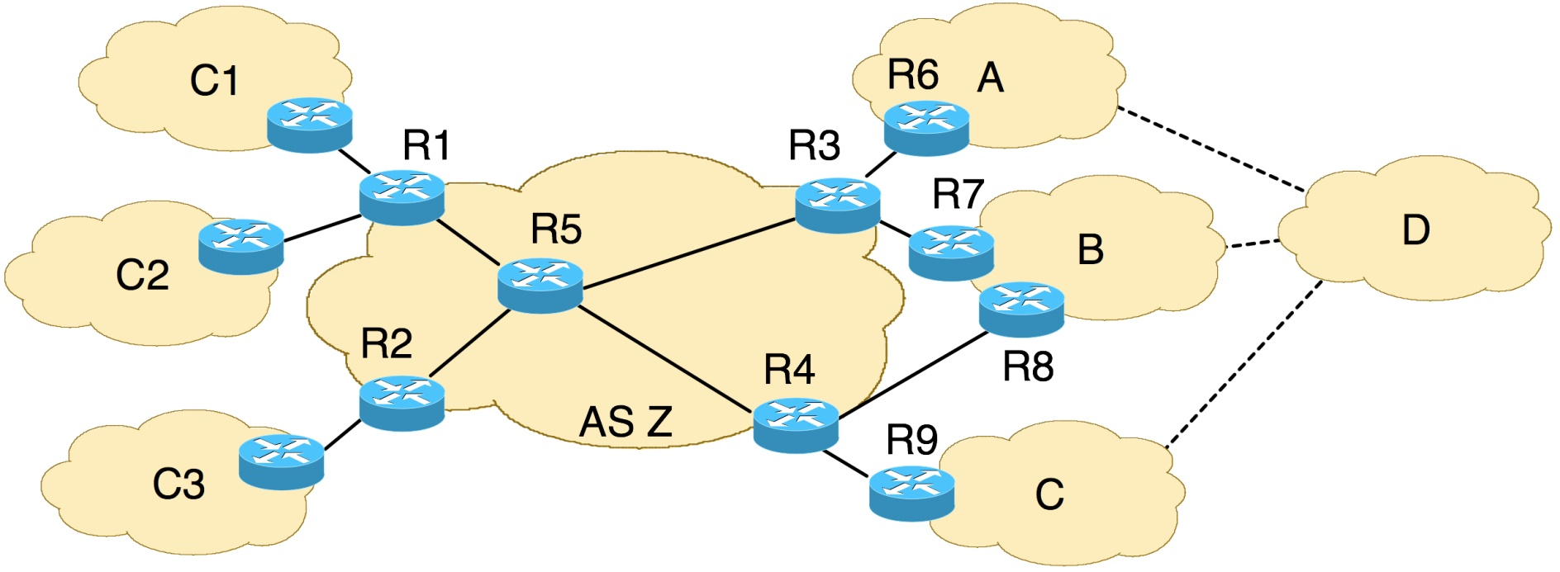
Challenges in ISP Routing Management (1)
Many useful routing policies cannot be realized (e.g., customized route selection)
  Large ISPs usually have rich path diversity
  Different paths have different properties
  Different neighbors may prefer different routes
Bank
VoIP
provider
School

Slide 4
Challenges in ISP Routing Management (2)
Many realizable policies are hard to configure
  From network-level policies to router-level configurations
  Trade-offs of objectives w/ current BGP configuration interface
Is it secure?
How expensive is this route?
Bank
Is it stable?
VoIP
provider
School
Does it have low latency?
Would my network be overloaded if I let C3 use this route?

Slide 5

Challenges in ISP Routing Management (3)
Network maintenance causes disruption
  To routing protocol adjacencies and data traffic
  Affect neighboring routers / networks

Slide 6
List of Challenges
Goals | Status Quo
Customized route selection | Essentially “one-route-fits-all”
Trade-offs among policy objectives | Very difficult (if not impossible) with today’s configuration interface
Non-disruptive network maintenance | Disruptive best practice (through routing protocol reconfiguration)

Slide 7
A Principled Approach
– Three Abstractions for Three Goals
Goal | Abstraction | Results
Customized route selection | Neighbor-specific route selection | NS-BGP [SIGMETRICS’09]
Flexible trade-offs among policy objectives | Policy configuration as a decision problem of reconciling multiple objectives | Morpheus [JSAC’09]
Non-disruptive network maintenance | Separation between the “physical” and “logical” configurations of routers | VROOM [SIGCOMM’08]

Slide 8
Neighbor-Specific BGP (NS-BGP):
More Flexible Routing Policies While Improving Global Stability
Work with Michael Schapira and Jennifer Rexford
[SIGMETRICS’09]

Slide 9
The BGP Route Selection
“One-route-fits-all”
  Every router selects one best route (per destination) for all neighbors
  Hard to meet diverse needs from different customers

Slide 10
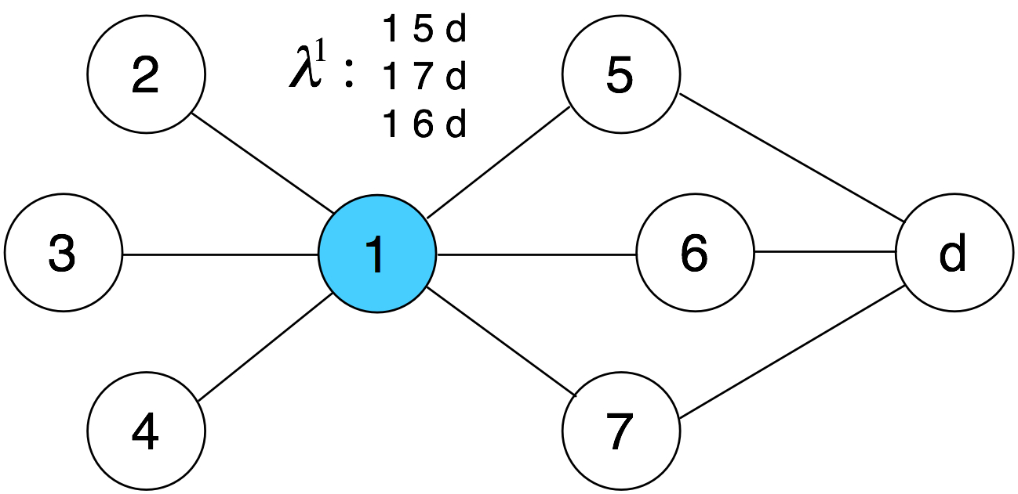
BGP’s Node-based Route Selection
In conventional BGP, a node (ISP or router) has one ranking function (that reflects its routing policy)

Slide 11
Neighbor-Specific BGP (NS-BGP)
Change the way routes are selected
  Under NS-BGP, a node (ISP or router) can select different routes for different neighbors
Inherit everything else from conventional BGP
  Message format, message dissemination, …
Using tunneling to ensure data path work correctly
  Details in the system design discussion

Slide 12
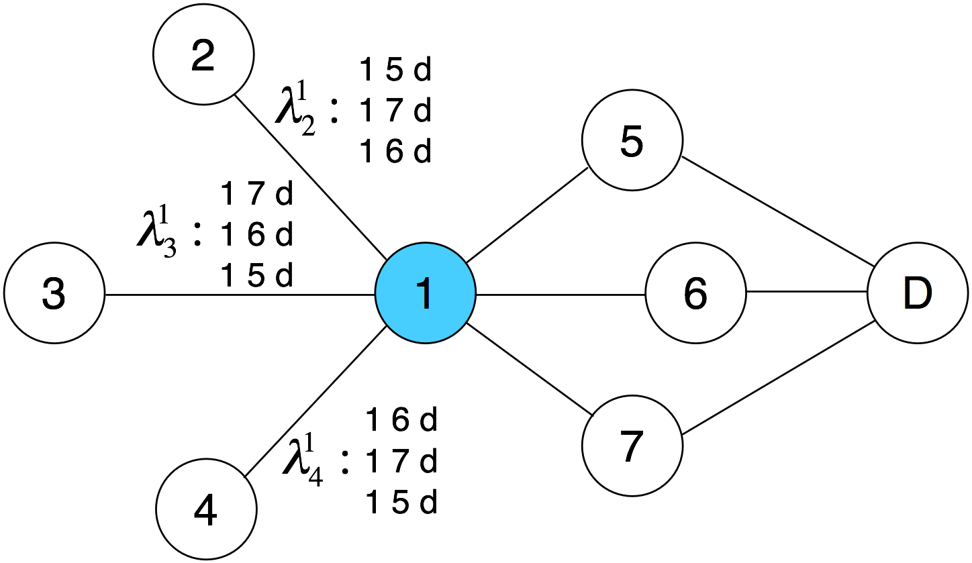
New Abstraction:
Neighbor-based Route Selection
In NS-BGP, a node has one ranking function per neighbor / per edge link
is node i’s ranking function for link (j, i), or equivalently, for neighbor node j.

Slide 13
Would the Additional Flexibility
Cause Routing Oscillation?
ISPs have bilateral business relationships
Customer-Provider
  Customers pay provider for access to the Internet
Peer-Peer
  Peers exchange traffic free of charge

Slide 14
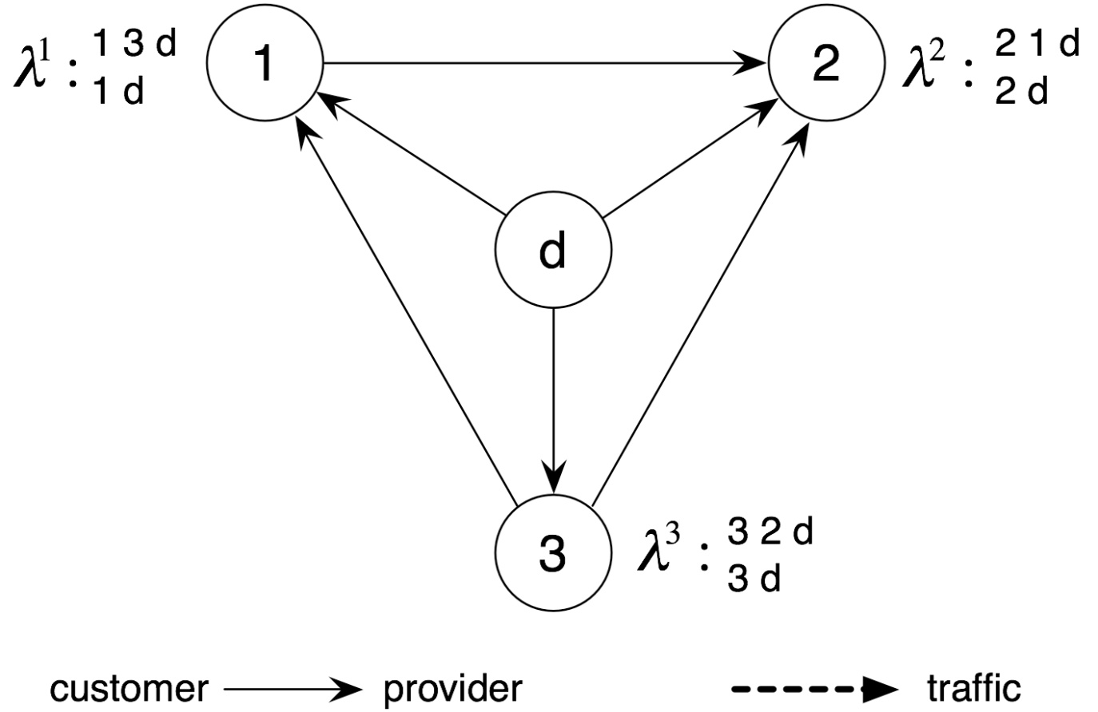
Would the Additional Flexibility
Cause Routing Oscillation?
Conventional BGP can easily oscillate
  Even without neighbor-specific route selection
(1 d) is not available
(1 d) is available
(2 d) is available
(2 d) is not available
(3 d) is not available
(3 d) is available

Slide 15
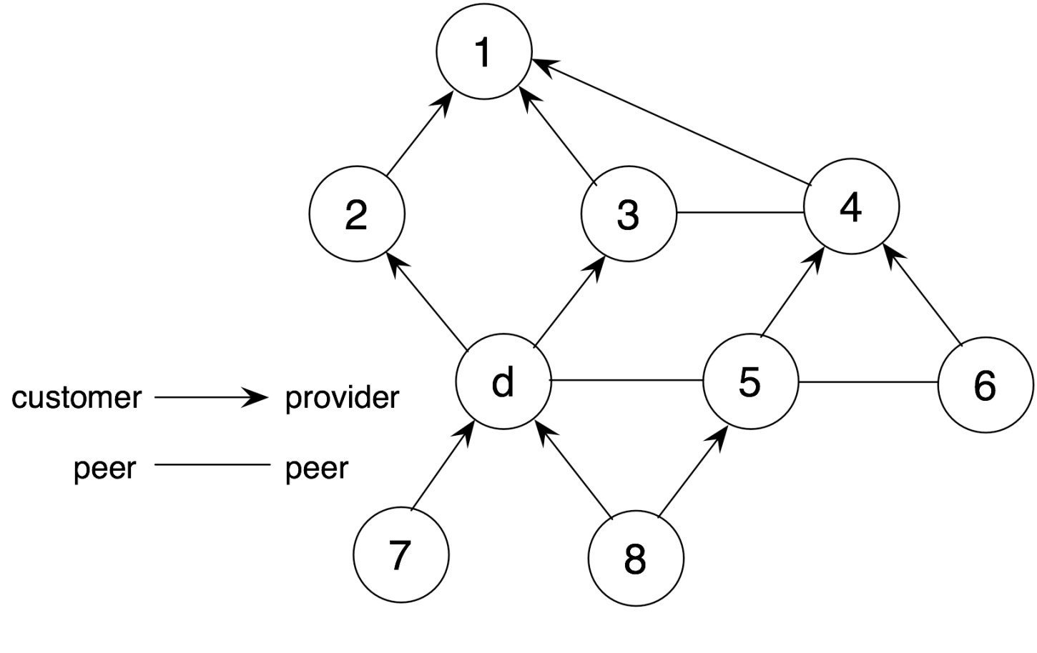
The “Gao-Rexford” Stability Conditions
Preference condition
  Prefer customer routes over peer or provider routes
Export condition
  Export only customer routes to peers or providers
Topology condition
  No cycle of customer-provider relationships
Node 3 prefers “3 d” over “3 1 2 d”
Valid paths: “1 2 d” and “6 4 3 d”
Invalid path: “5 8 d” and “6 5 d”

Slide 16
“Gao-Rexford” Too Restrictive for NS-BGP
ISPs may want to violate the preference condition
  To prefer peer or provider routes for some (high-paying) customers
Some important questions need to be answered
  Would such violation lead to routing oscillation?
  What sufficient conditions (the equivalent of “Gao-Rexford” conditions) are appropriate for NS-BGP?

Slide 17
Stability Conditions for NS-BGP
Surprising results: Ns-BGP improves stability!
  The more flexible NS-BGP requires significantly less restrictive conditions to guarantee routing stability
The “preference condition” is no longer needed
  An ISP can choose any “exportable” route for each neighbor
  As long as the export and topology conditions hold
That is, an ISP can choose
  Any route for a customer
  Any customer-learned route for a peer or provider

Slide 18
Why Stability is Easier to Obtain in NS-BGP?
The same system will be stable in NS-BGP
  Key: the availability of (3 d) to 1 is independent of the presence or absence of (3 2 d)
(1 d) is available
(2 d) is available
(3 d) is available

Slide 19
Practical Implications of NS-BGP
NS-BGP is stable under topology changes
  E.g., link/node failures and new peering links
NS-BGP is stable in partial deployment
  Individually ISPs can safely deploy NS-BGP incrementally
NS-BGP improves stability of “backup” relationships
  Certain routing anomalies are less likely to happen than in conventional BGP

Slide 20
We Can Now Safely Proceed With
System Design & Implementation
What we have so far
  A neighbor-specific route selection model
  A sufficient stability condition that offers great flexibility and incremental deployability
What we need next
  A system that an ISP can actually use to run NS-BGP
  With a simple and intuitive configuration interface

Slide 21
Morpheus: A Routing Control Platform With Intuitive Policy Configuration Interface
Work with Ioannis Avramopoulos and Jennifer Rexford
[IEEE JSAC 2009]

Slide 22
First of All, We Need Route Visibility
Currently, even if an ISP as a whole has multiple paths to a destination, many routers only see one

Slide 23
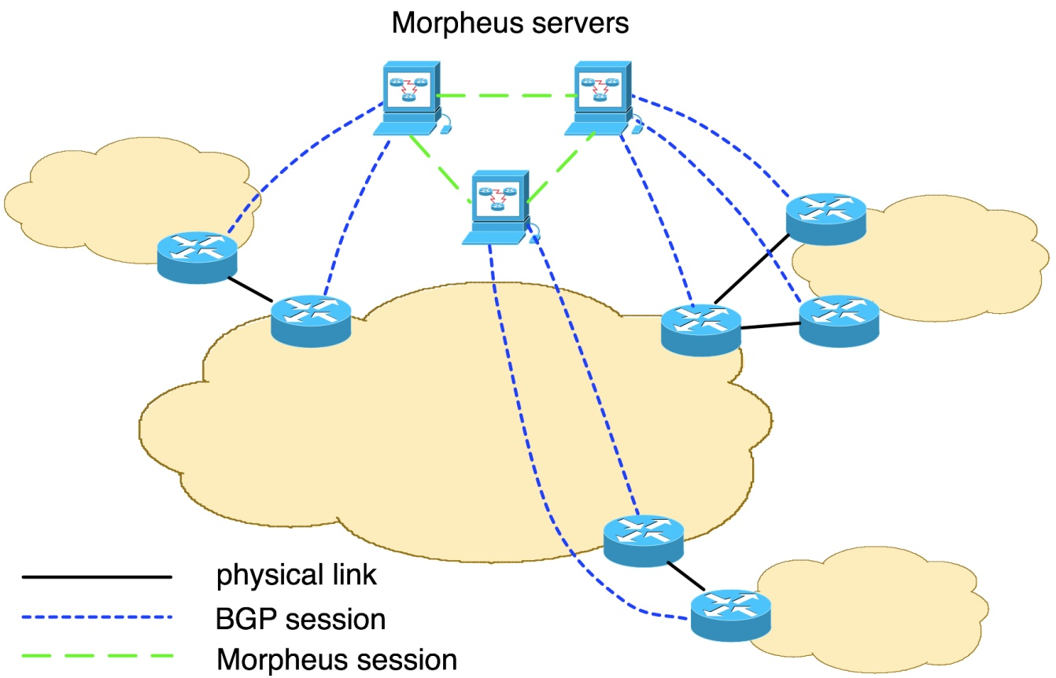
Solution: A Routing Control Platform
A small number of logically-centralized servers
  With complete visibility
  Select BGP routes for routers

Slide 24
Flexible Route Assignment
Support for multiple paths already available
  “Virtual routing and forwarding (VRF)” (Cisco)
  “Virtual router” (Juniper)
R3’s forwarding table (FIB) entries
D: (red path): R6
D: (blue path): R7

Slide 25
Consistent Packet Forwarding
Tunnels from ingress links to egress links
  IP-in-IP or Multiprotocol Label Switching (MPLS)
?

Slide 26
Why Are Policy Trade-offs Hard in BGP?
Local-preference
Every BGP route has a set of attributes
  Some are controlled by neighbor ASes
  Some are controlled locally
  Some are controlled by no one
Fixed step-by-step route-selection algorithm
Policies are realized through adjusting locally controlled attributes
  E.g., local-preference: customer 100, peer 90, provider 80
Three major limitations
AS Path Length
Origin Type
MED
eBGP/iBGP
IGP Metric
Router ID
…

Slide 27



Why Are Policy Trade-offs Hard in BGP?
Limitation 1: Overloading of BGP attributes
Policy objectives are forced to “share” BGP attributes
Difficult to add new policy objectives
Business Relationships
Local-preference
Traffic Engineering

Slide 28
Why Are Policy Trade-offs Hard in BGP?
Limitation 2: Difficulty in incorporating “side information”
Many policy objectives require “side information”
  External information: measurement data, business relationships database, registry of prefix ownership, …
  Internal state: history of (prefix, origin) pairs, statistics of route instability, …
Side information is very hard to incorporate today

Slide 29
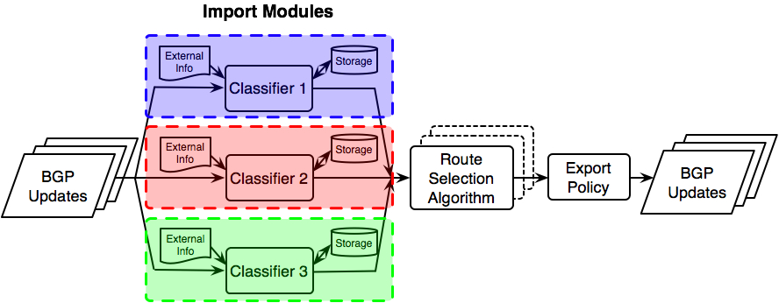
Inside Morpheus Server: Policy
Objectives As Independent Modules
Each module tags routes in separate spaces (solves limitation 1)
Easy to add side information (solves limitation 2)
Different modules can be implemented independently (e.g., by third-parties) – evolvability

Slide 30
Why Are Policy Trade-offs Hard in BGP?
Limitation 3: Strictly rank one attribute over another (not possible to make trade-offs between policy objectives)
E.g., a policy with trade-off between business relationships and stability
Infeasible today
“If all paths are somewhat unstable,
pick the most stable path (of any length);
Otherwise,
pick the shortest path through a customer”.

Slide 31
New Abstraction: Policy Configuration as Reconciling Multiple Objectives
Policy configuration is a decision problem of
… how to reconcile multiple (potentially conflicting) objectives in choosing the best route
What’s the simplest method with such property?

Slide 32
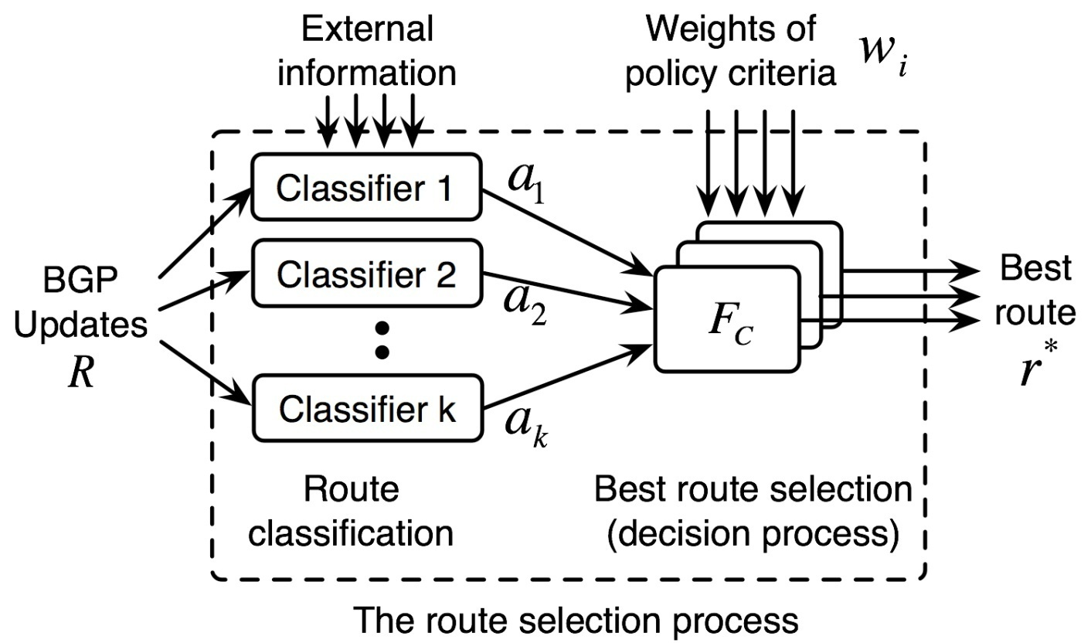
Use Weighted Sum Instead of Strict Ranking
Every route has a final score:
The route with highest is selected as best:

Slide 33
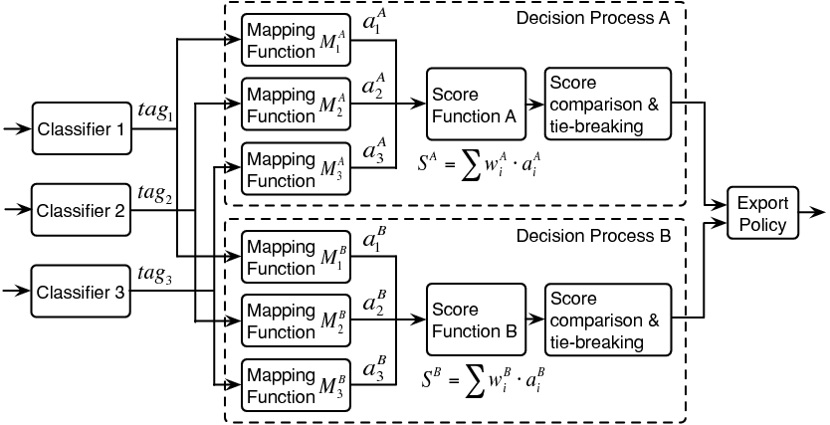
Multiple Decision Processes for NS-BGP
Multiple decision processes running in parallel
Each realizes a different policy with a different set of weights of policy objectives

Slide 34
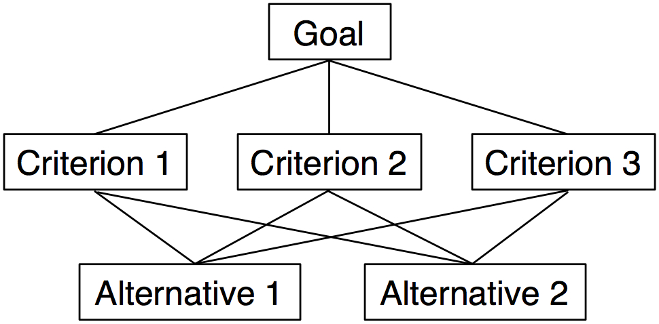
How To Translate A Policy Into Weights?
Picking a best alternative according to a set of criteria is a well-studied topic in decision theory
Analytic Hierarchy Process (AHP) uses a weighted sum method (like we used)

Slide 35
Use Preference Matrix To Calculate Weights
Humans are best at doing pair-wise comparisons
Administrators use a number between 1 to 9 to specify preference in pair-wise comparisons
  1 means equally preferred, 9 means extreme preference
AHP calculates the weights, even if the pair-wise comparisons are inconsistent
 | Latency | Stability | Security | Weight
Latency | 1 | 3 | 9 | 0.69
Stability | 1/3 | 1 | 3 | 0.23
Security | 1/9 | 1/3 | 1 | 0.08

Slide 36
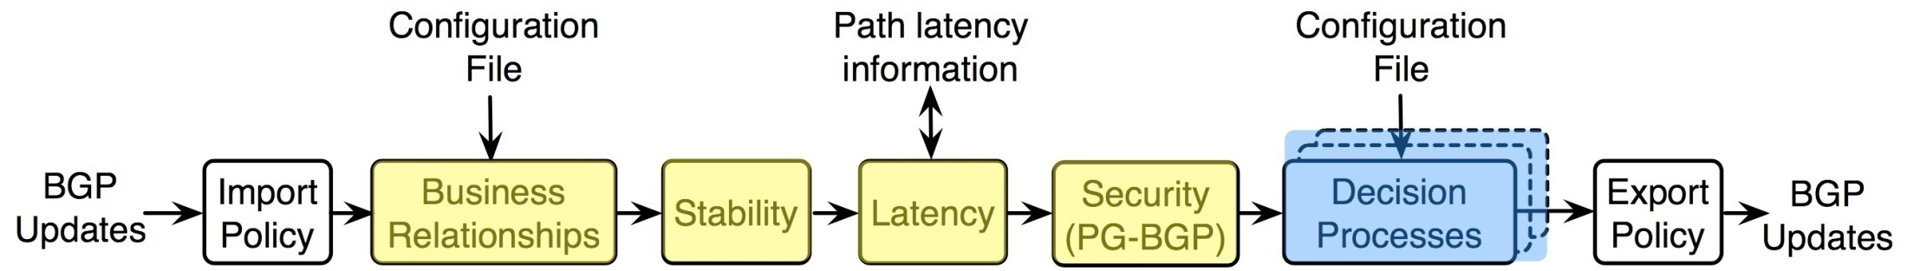
Prototype Implementation
Implemented as an extension to XORP
  Four new classifier modules (as a pipeline)
  New decision processes that run in parallel

Slide 37
Evaluation
Classifiers work very efficiently
Morpheus is faster than the standard BGP decision process (w/ multiple alternative routes for a prefix)
Throughput – our unoptimized prototype can support a large number of decision processes
Classifiers | Biz relationships | Stability | Latency | Security
Avg. time (us) | 5 | 20 | 33 | 103
Decision processes | Morpheus | XORP-BGP
Avg. time (us) | 54 | 279
# of decision process | 1 | 10 | 20 | 40
Throughput (update/sec) | 890 | 841 | 780 | 740

Slide 38
What About Managing An ISP’s
Own Network?
Now we have a system that supports
  Stable transition to neighbor-specific route selection
  Flexible trade-offs among policy objectives
What about managing an ISP’s own network?
  The most basic requirement: minimum disruption
  The most mundane / frequent operation: network maintenance

Slide 39
VROOM: Virtual Router Migration As A Network Adaptation Primitive
Work with Eric Keller, Brian Biskeborn,
Kobus van der Merwe and Jennifer Rexford
[SIGCOMM’08]

Slide 40
Disruptive Planned Maintenance
Planned maintenance is important but disruptive
  More than half of topology changes are planned in advance
  Disrupt routing protocol adjacencies and data traffic
Current best practice: “cost-in/cost-out”
  It’s hacky: protocol re-configuration as a tool (rather than the goal) to reduce disruption of maintenance
  Still disruptive to routing protocol adjacencies and traffic
Why didn’t we have a better solution?

Slide 41
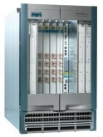
The Two Notions of “Router”
The IP-layer logical functionality, and the physical equipment
Logical
(IP layer)
Physical

Slide 42
The Tight Coupling of Physical & Logical
Root of many network adaptation challenges (and “point solutions”)
Logical
(IP layer)
Physical

Slide 43
New Abstraction: Separation Between the “Physical” and “Logical” Configurations
Whenever physical changes are the goal, e.g.,
  Replace a hardware component
  Change the physical location of a router
A router’s logical configuration should stay intact
  Routing protocol configuration
  Protocol adjacencies (sessions)

Slide 44
VROOM: Breaking the Coupling
Re-mapping the logical node to another physical node
VROOM enables this re-mapping of logical to physical through virtual router migration
Logical
(IP layer)
Physical

Slide 45
Example: Planned Maintenance
NO reconfiguration of VRs, NO disruption
VR-1
A
B

Slide 46

Example: Planned Maintenance
NO reconfiguration of VRs, NO disruption
A
VR-1
B

Slide 47
Example: Planned Maintenance
NO reconfiguration of VRs, NO disruption
A
VR-1
B

Slide 48
Virtual Router Migration: the Challenges
Migrate an entire virtual router instance
  All control plane & data plane processes / states

Slide 49
Virtual Router Migration: the Challenges
Migrate an entire virtual router instance
Minimize disruption
  Data plane: millions of packets/second on a 10Gbps link
  Control plane: less strict (with routing message retransmission)

Slide 50
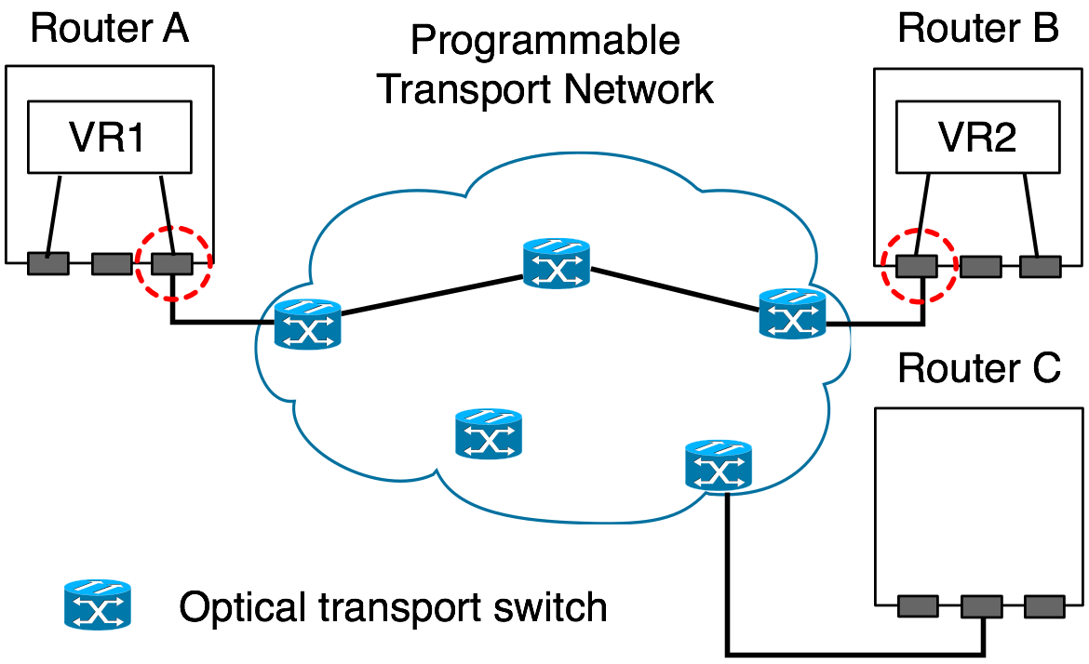
Virtual Router Migration: the Challenges
Migrating an entire virtual router instance
Minimize disruption
Link migration

Slide 51
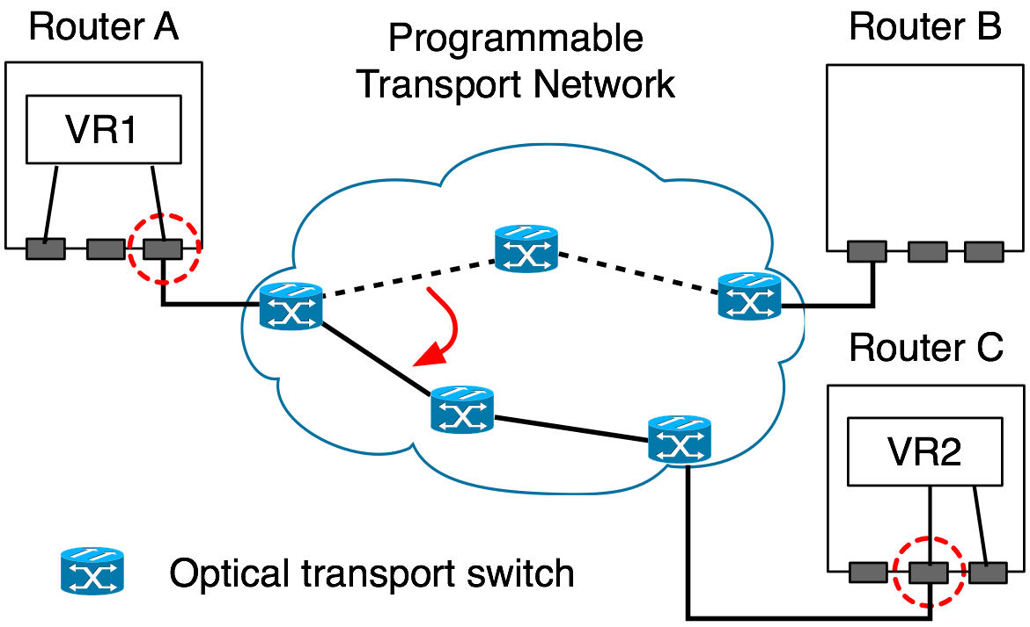
Virtual Router Migration: the Challenges
Migrating an entire virtual router instance
Minimize disruption
Link migration

Slide 52
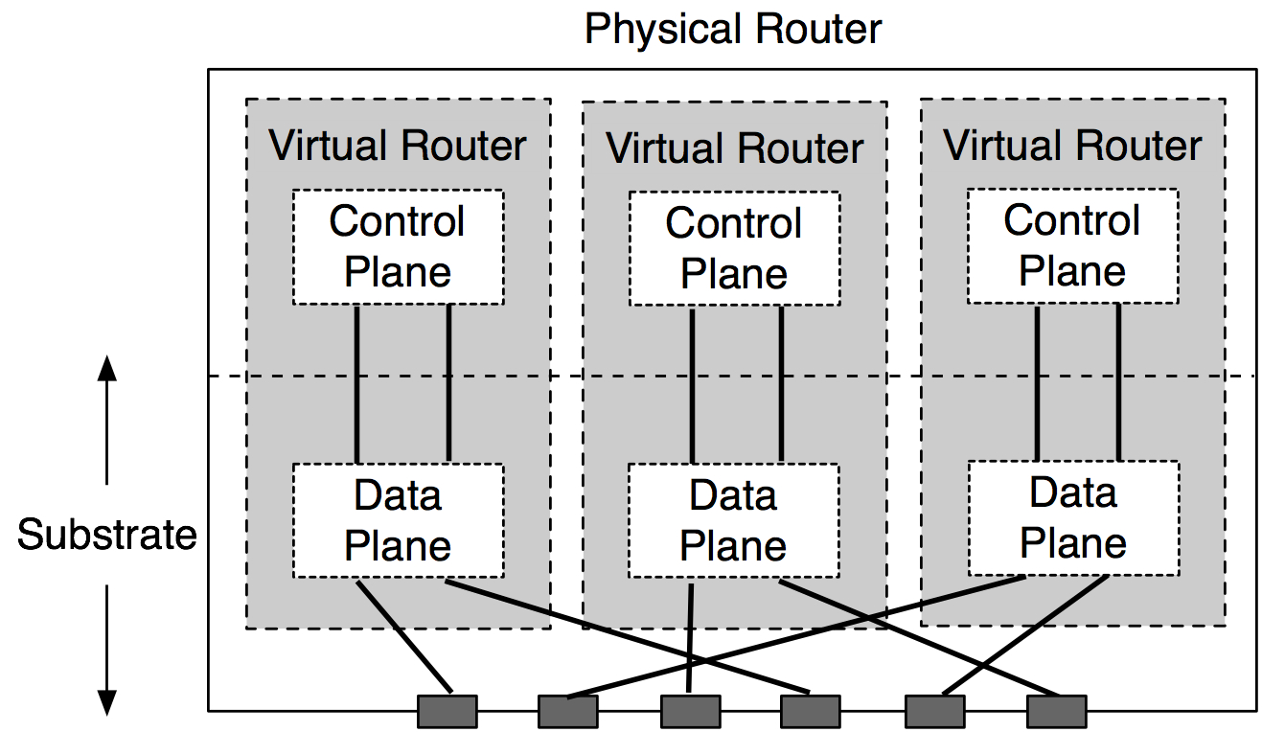
VROOM Architecture
Data-Plane Hypervisor
Dynamic Interface Binding

Slide 53
VROOM’s Migration Process
Key idea: separate the migration of control and data planes
Migrate the control plane
Clone the data plane
Migrate the links

Slide 54
Control-Plane Migration
Leverage virtual server migration techniques
Router image
  Binaries, configuration files, etc.

Slide 55
Control-Plane Migration
Leverage virtual migration techniques
Router image
Memory
  1st stage: iterative pre-copy
  2nd stage: stall-and-copy (when the control plane is “frozen”)

Slide 56
Control-Plane Migration
Leverage virtual server migration techniques
Router image
Memory
CP
Physical router A
DP
Physical router B

Slide 57
Data-Plane Cloning
Clone the data plane by repopulation
  Enable migration across different data planes
  Eliminate synchronization issue of control & data planes
Physical router A
DP-old
CP
Physical router B
DP-new
DP-new

Slide 58
Remote Control Plane
Data-plane cloning takes time
  Installing 250k routes takes over 20 seconds [SIGCOMM CCR’05]
The control & old data planes need to be kept “online”
Solution: redirect routing messages through tunnels
Physical router A
DP-old
CP
Physical router B
DP-new

Slide 59
Remote Control Plane
Data-plane cloning takes time
  Installing 250k routes takes over 20 seconds [SIGCOMM CCR’05]
The control & old data planes need to be kept “online”
Solution: redirect routing messages through tunnels
Physical router A
DP-old
CP
Physical router B
DP-new

Slide 60
Double Data Planes
At the end of data-plane cloning, both data planes are ready to forward traffic
DP-old
CP
DP-new

Slide 61
Asynchronous Link Migration
With the double data planes, links can be migrated independently
A
DP-old
B
CP
DP-new

Slide 62
Prototype Implementation
Control plane: OpenVZ + Quagga
Data plane: two prototypes
  Software-based data plane (SD): Linux kernel
  Hardware-based data plane (HD): NetFPGA
Why two prototypes?
  To validate the data-plane hypervisor design (e.g., migration between SD and HD)

Slide 63
Evaluation
Impact on data traffic
  SD: Slight delay increase due to CPU contention
  HD: no delay increase or packet loss
Impact on routing protocols
  Average control-plane downtime: 3.56 seconds (performance lower bound)
  OSPF and BGP adjacencies stay up

Slide 64
VROOM is a Generic Primitive
Can be used for various frequent network changes/adaptations
  Simplify network management
  Power savings
  …
With no data-plane and control-plane disruption

Slide 65
Migration Scheduling
Physical constraints to take into account
  Latency
    E.g, NYC to Washington D.C.: 2 msec
  Link capacity
    Enough remaining capacity for extra traffic
  Platform compatibility
    Routers from different vendors
  Router capability
    E.g., number of access control lists (ACLs) supported
The constraints simplify the placement problem

Slide 66
Contributions of the Thesis
Proposal | New abstraction | Realization of the abstraction
NS-BGP | Neighbor-specific route selection | The theoretical results (proof of stability conditions, robustness to failures, incremental deployability)
Morpheus | Policy configuration as a decision process of reconciling multiple objectives | System design and prototyping The AHP-based configuration interface
VROOM | Separation of “physical” and “logical” configuration of routers | The idea of virtual router migration The migration mechanisms

Slide 67
Morpheus and VROOM: 1 + 1 > 2
Morpheus and VROOM can be deployed separately
Combining the two together offers additional synergies
  Morpheus makes VROOM simpler & faster (as BGP states no longer need to be migrated)
  VROOM offloads maintenance burden from Morpheus and reduces routing protocol churns
Overall, Morpheus and VROOM separate network management concerns for administrators
  IP layer issues (routing protocols, policies): Morpheus
  Lower-layer issues: VROOM

Slide 68
Final Thought: Revisiting Routers
A router used to be a one-to-one, permanent binding of routing & forwarding, logical & physical
Morpheus breaks the one-to-one binding, and takes its “brain” away
VROOM breaks the permanent binding, takes its “body” away
Programmable transport network is taking (part of ) its forwarding job away
Now, how secure is “the job as a router”? ☺

Slide 69
Backup Slides

Slide 70
How a neighbor gets the routes in NS-BGP
Having the ISP pick the best one and only export that route
  +: Simple, backwards compatible
  -: Reveals its policy
Having the ISP export all available routes, and pick the best one itself
  +: Doesn’t reveal any internal policy
  -: Has to have the capability of exporting multiple routes and tunneling to the egress points

Slide 71
Why wasn’t BGP designed to be neighbor-specific?
Different networks have little need to use different paths to reach the same destination
There was far less path diversity to explore
There was no data plane mechanisms (e.g., tunneling) that support forwarding to multiple next hops for the same destination without causing loops
Selecting and (perhaps more importantly) disseminating multiple routes per destination would require more computational power from the routers than what's available at the time then BGP was first designed

Slide 72
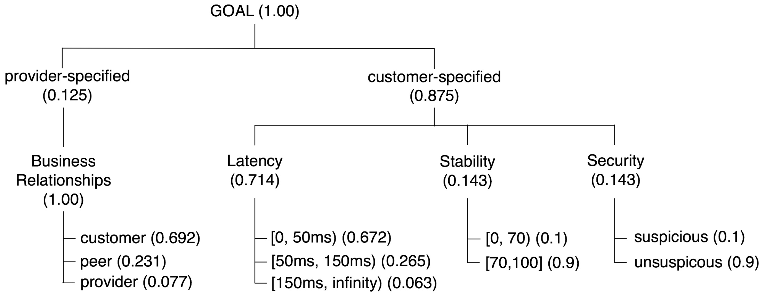
The AHP Hierarchy of An Example Policy

Slide 73
Evaluation Setup
Realistic setting of a large Tier-1 ISP*
  40 POPs, 1 Morpheus server in each POP
  Each Morpheus server: 240 eBGP / 15 iBGP sessions, 39 sessions with other servers
  20 routes per prefix
Implications
  Each Morpheus server takes care of about 15 edge routers
*: [Verkaik et al. USENIX07]

Slide 74
Experiment Setup
Update sources
Morpheus server
Update sinks
Full BGP
Routing Table
BGP sessions
BGP sessions
Full BGP RIB dump on Nov 17, 2006 from Route Views (216k routes)
Morpheus server: 3.2GHz Pentium 4, 3.6GB of memory, 100Mb NIC
Update sources: Zebra 0.95, 3.2GHz Pentium 4, 2GB RAM, 100Mb NIC
Update sinks: Zebra 0.95, 2.8GHz Pentium 4, 1GB RAM, 100Mb NIC
Connected through a 100Mb switch

Slide 75
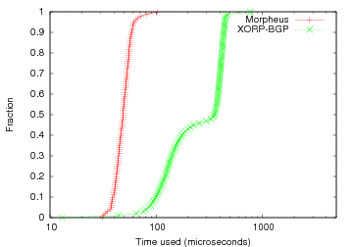
Evaluation - Decision Time
Morpheus is faster than the standard BGP decision process, when there are multiple alternative routes for a prefix
20 routes per prefix
Average decision time:
Morpheus: 54 us
XORP-BGP: 279 us

Slide 76
Decision Time
Morpheus: decision time grows linearly in the number of edge routers (O(N))

Slide 77
Evaluation – Throughput
Setup
  40 POPs, 1 Morpheus server in each POP
  Each Morpheus server: 240 eBGP / 15 iBGP sessions, 39 sessions with other servers
  20 routes per prefix
Our unoptimized prototype can support a large number of decision processes in parallel
# of decision process | 1 | 10 | 20 | 40
Throughput (update/sec) | 890 | 841 | 780 | 740

Slide 78
Sustained Throughput
What throughput is good enough?
  ~ 600 updates/sec is more than enough for a large Tier-1 ISP*
*: [Verkaik et al. USENIX07]

Slide 79
Memory Consumption
5 full BGP route tables
Tradeoff between memory and performance (CPU time)
  Trade 30%-40% more memory for halving the decision time
Memory keeps becoming cheaper!

Slide 80
Interpreting The Evaluation Results
Implementation not optimized
Supports from routers can boost throughput
  BGP monitoring protocol (BMP) for learning routes
    Reduce # of eBGP sessions, better scalability
    Faster edge link failure detection
  BGP “add-path” capability for assigning routes
    Edge routers push routes to neighbor ASes
Morpheus servers are built on commodity hardware
  Moore’s law predicts the performance growth and price drop

Slide 81
Other Systems Issues
Consistency between different servers (replicas)
  Two-phase commit
Single point of failure
  Connect every router to two Morpheus servers (one primary, one backup)
Other scalability and reliability issues
  Addressed and evaluated by previous work on RCP (Routing Control Platform) [FDNA’04, NSDI’05, INM’06, USENIX’07]

Slide 82
Edge Router Migration: OSPF + BGP
Average control-plane downtime: 3.56 seconds
  Performance lower bound
OSPF and BGP adjacencies stay up
Default timer values
  OSPF hello interval: 10 seconds
  BGP keep-alive interval: 60 seconds

Slide 83
Events During Migration
Network failure during migration
  The old VR image is not deleted until the migration is confirmed successful
Routing messages arrive during the migration of the control plane
  BGP: TCP retransmission
  OSPF: LSA retransmission

Slide 84
Impact on Data Traffic
The diamond testbed
n1
VR
n0
n3
n2

Slide 85
Impact on Data Traffic
SD router w/ separate migration bandwidth
  Slight delay increase due to CPU contention
HD router w/ separate migration bandwidth
  No delay increase or packet loss

Slide 86
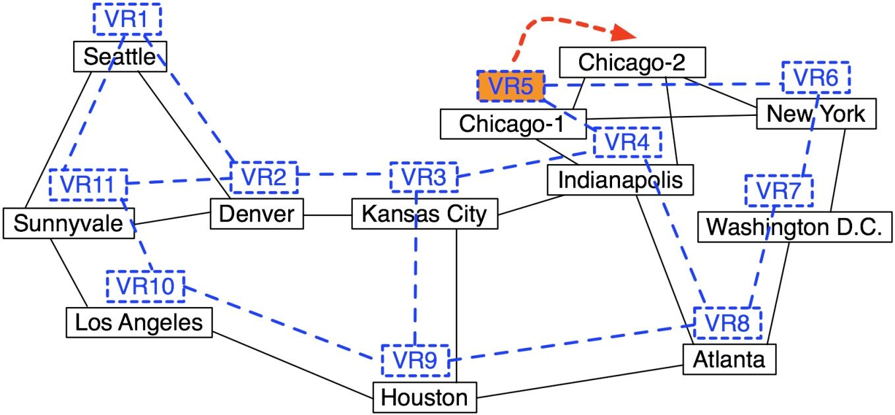
Impact on Routing Protocols
The Abilene-topology testbed

Slide 87
Impact on Routing Protocols
Average control-plane downtime: 3.56 seconds
  Performance lower bound
OSPF and BGP adjacencies stay up
When routing changes happen during migration
  Miss at most one LSA (Link State Announcement)
  Get retransmitted 5 seconds later
  Can use smaller LSA retrans. timer (e.g., 1 sec)

