Slide 1

Designing Compact Data Structures for
Network Measurement and Control
Xiaoqi Chen, FPO
Oct 4th, 2023
Advisor: Prof. Jennifer Rexford,
Reader: Prof. Mark Braverman, Prof. Minlan Yu.
Non-Reader: Prof. David Walker, Prof. Maria Apostolaki

Slide 2
Thesis Outline
Ch2 Background: architectural constraints of high-speed switches
Part 1: Measurement and telemetry
  Ch3 PRECISION: heavy-hitter flow analysis
  Ch4 BeauCoup: run multiple queries simultaneously
Part 2: Real-time, closed-loop control
  Ch5 ConQuest: queue measurement and microburst mitigation
  Ch6 AHAB: scalable fair bandwidth allocation with network slicing
Summary and conclusion

Slide 3




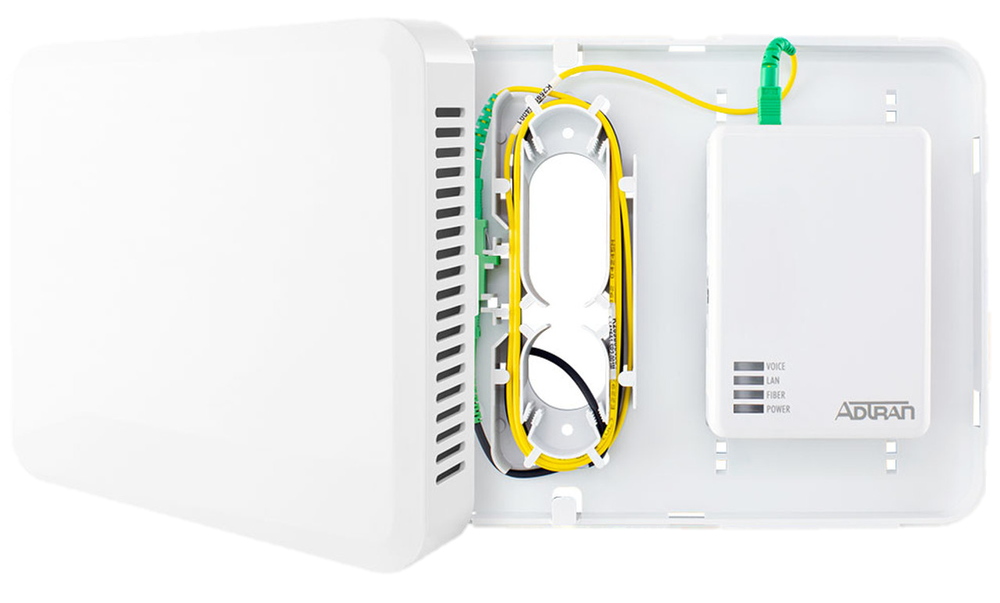
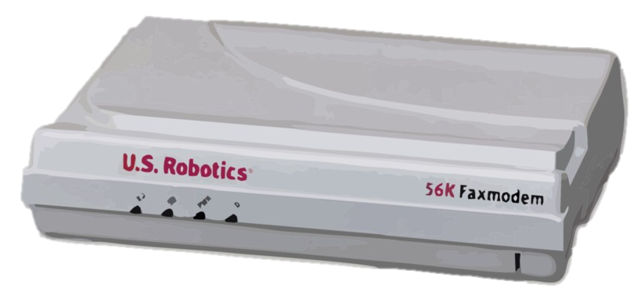


Fast, faster, fast enough?
1990s: 56kbps
2000s: 50Mbps
2010s: 1Gbps
2023: Beyond bandwidth!
Dial-up
DSL / Cable
Fiber-optics
FTTH, 5G, SD-WAN…
My favorite phone
1997, GSM
Not my favorite phone
2023, 5G mmWave

Slide 4

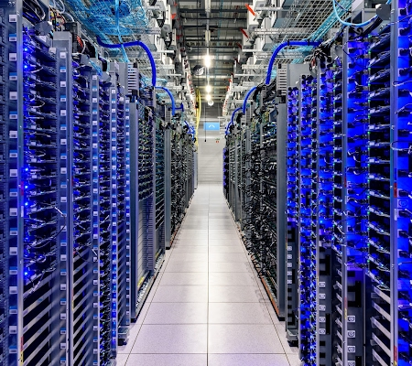


Many applications, diverse needs…
Image credit: Google, Minh Pham
1990s: 56kbps
2000s: 50Mbps
2010s: 1Gbps
2023: Beyond bandwidth!
VR/Metaverse: low latency
Data Center: high reliability
Internet of Things: security

Slide 5




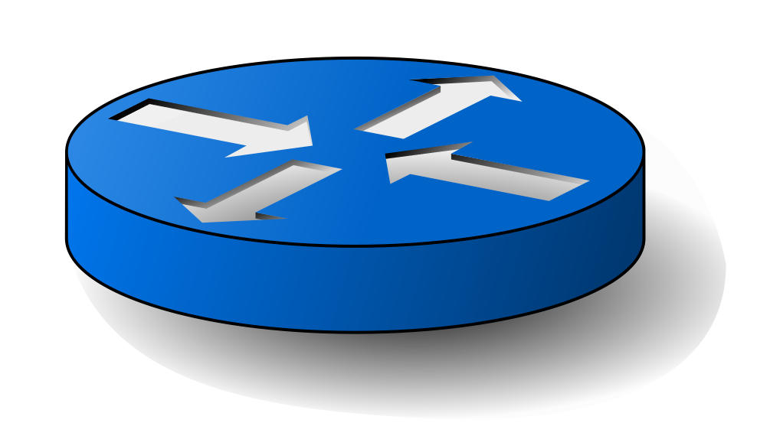



Switches can do more!
Traditionally, the “inside” of network mostly does forwarding
Control Plane
Forwarding rules
Forwarding rules:
DstIP 128.*.*.* -> port 1
DstIP 130.*.*.* -> port 2
…
Fixed-function Data Plane

Slide 6

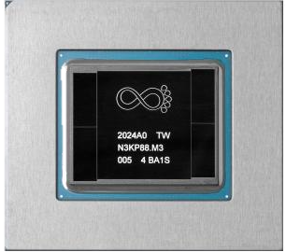








Switches can do more!
Programmable Data Plane: run custom algorithms inside the network
Prime opportunity for measurement and real-time adaptation
Control Plane
Algorithms
Forwarding rules
Measuring statistics,
anomaly detection
Real-time mitigation

Slide 7
Inside a high-speed switch…
Crossbar
Ingress
Egress
Queue
Ingress
Egress
Queue

Slide 8
Inside a high-speed switch…
Algorithm can read and modify packet “headers”
E.g., read “Destination IP” and make a routing decision
Crossbar
Ingress
Egress
Queue
Congested: No
Packet
SrcIP: 13.9.0.5
DstIP: 8.8.8.8
Payload: …
Forwarding:
8.*.*.* -> Port 1
Ingress
Egress
Queue

Slide 9
Inside a high-speed switch…
Can also write to local memory, maintain statistics across packets
Counter: 2
Popular Destination: 8.8.8.8
Memory
Memory
Crossbar
Ingress
Egress
How many packets?
Queue
Packet
Packet
Ingress
Egress
Queue

Slide 10
Main challenge: memory access constraints
Limited memory size (compared to huge amount of traffic)
Can only access a small constant number of memory addresses
per packet…
Limited bandwidth for updating memory
Memory
Crossbar
Ingress
Queue
High bandwidth for reading/writing packets
Ingress
Queue

Slide 11
Memory access bottleneck: “Moore’s law”?
HBM3
HBM
GDDR6
Infiniband NDR
GDDR3
Memory access is becoming expensive!
Network speed grows 45%-50% annually
Memory bandwidth only grows 33%-40% annually
400GbE
Gbit/s
SDRAM
DDR
EDO
Sources:
1. Nielsen Norman Group.
2. Amir Gholami, Riselab.
3. Wikipedia: List of interface bit rates.
Infiniband SDR
100base-X
Year

Slide 12

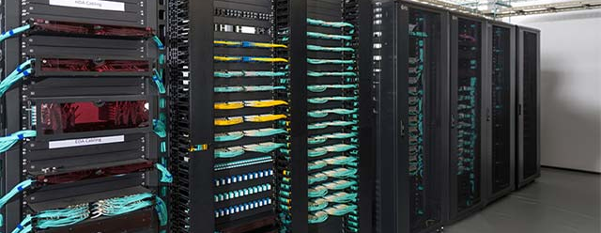

The gap between theory and practice…
Streaming Algorithm
High-speed switches
Small memory, big data
Arbitrary computation
Arbitrary access to local memory
Small memory, huge traffic
Constant-time processing
Limited memory access
(4-16 addresses per packet)
Bridging the gap!

Slide 13



In-network algorithms can build better measurement and closed-loop control
Measuring and telemetry:
Ch3: heavy-hitter flows
Ch4: many simultaneous queries
Real-time, closed-loop control:
Ch5: microburst analysis & mitigation
Ch6: fair bandwidth enforcement w/ slicing

Slide 14






Part 1: network measurement & analytics on high-speed programmable switches
Previously: packet sampling
Network speed⬈, sampling rate⬊
Can’t find needle in haystack
Now: in-network algorithms
Analyze every packet
Only report the findings

Slide 15


Chapter 3: Heavy-hitter flows
Packets can be grouped into flows
(e.g., by source and destination addresses)
A few “Heavy-Hitters”, a.k.a. elephant flows, send most of the packets.
No memory to maintain per-flow counters – only count the elephants!
Flow size
All flows

Slide 16
Space-saving: just evict the global minimum
Existing algorithm: maintain a table of flow IDs and their counters
  If a counter already exists for this flow ID, simply increment the counter
  Otherwise, take over the global minimum counter, replace its flow ID
Challenge: maintaining global minimum requires many memory accesses!
Flow ID | Count
8.8.8.8:53 | 100
4.2.2.2:53 | 50
1.1.1.1:53 | 20
100.1.2.3:80 | 5
Packet
dstIP=4.2.2.2 port=53
51
Packet
dstIP=8.8.4.4 port=53
8.8.4.4:53
6

Slide 17
Adapting to Data Plane:
Approximate Global Minimum
Flow ID: x
h₁(x)=0 h₂(x)=2 h₃(x)=0 h₄(x)=3
Split table into D=4 stages
Find approximate minimum c’_{min},
by randomly querying 4 addresses (based on flow ID)
Inspired by Count-Min Sketch and HashPipe
h₁ |  | h₂ |  | h₃ |  | h₄
Flow ID: y
h₁(y)=3 h₂(y)=2 h₃(y)=3 h₄(y)=1
Sivaraman et al. Heavy-hitter detection entirely in the data plane. SOSR 2017
Graham Cormode and Shan Muthukrishnan. An improved data stream summary: the count-min sketch and its applications. Journal of Algorithms 55.1 (2005): 58-75.

Slide 18
Adapting to Data Plane:
Too Late to Update
We only know the approximate minimum count c’_{min} at the end of pipeline.
Too late to update!
Packet recirculation: hurts throughput
Solution: probabilistic packet recirculation
With small probability, recirculate
(Flow ID, minimum stage #)
h₁ |  | h₂ |  | h₃ |  | h₄
5 |  |  |  | 7
 |  | 3
 |  |  |  |  |  | 4
4
Flow ID=x
Stage#=2, c’_{min}=3

Slide 19
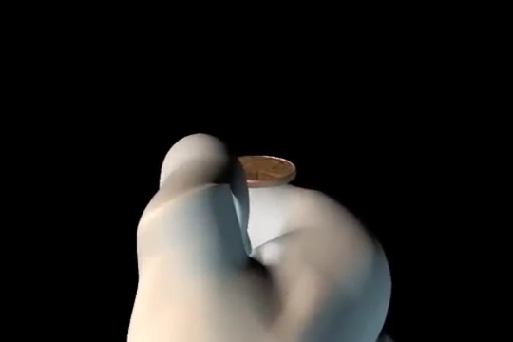
The PRECISION algorithm
h₁ |  |  | h₂ |  |  | h₃
_{ID} | # |  | _{ID} | # |  | _{ID} | #
a | 106 |  | N/A | 100 |  | N/A | 100
b | 103 |  | g | 102 |  | N/A | 100
c | 105 |  | f | 130 |  | k | 160
d | 104 |  | N/A | 100 |  | l | 180
Visit d=3 random entries, one per stage
  If ID matched, +1
  Otherwise, find out c’_{min}
Flip coin, P=1/(c’_{min}+1)
If coin is head:
  copy and recirculate
  update minimum counter
Pkt
ID=z
z
103
S#=2
ID=z
c’_{min}=102
Coin flip: P=1/103

Slide 20
Evaluation: how many stages are enough?

Slide 21
Chapter 3: PRECISION
Summary and Key Insights
Pipeline-friendly data structure: avoid global min!
Evict an approximate minimum of random choices
Use D=3~4 choices (stages) is sufficient
Comparable accuracy to SOTA algorithms
(that are not hardware-optimized)

Slide 22



Chapter 4: Count-distinct queries
DDoS:
Are there many Source IPs sending to one particular Destination IP?
Internet
Key
0 | 1 | 0 | 0 | 0 | 3 | 0 | 1 | 0 | …
5
Select DstIP where distinct(SrcIP)>1000
Strawman solution:
1. Write down a list of SrcIP?
5.x.x.x, 6.x.x.x, 8.x.x.x, …
2. Use HyperLogLog?
Attribute
Threshold

Slide 23
Many network traffic queries
DDoS?
Worm?
Port Scan?
…
Different keys/attrs, need multiple data structures
Internet
0 | 1 | 0 | 0 | 0 | 3 | 0 | 1 | …
5
6 | 6 | 2 | 0 | 1 | 0 | 0 | 9 | …
Query | Key | Attribute | Threshold
DDoS | DstIP | SrcIP | 1000
Worm | SrcIP | DstIP | 300
PortScan | SrcIP,DstIP | DstPort | 100
… | … | … | …
8
1 | 4 | 8 | 4 | 5 | 2 | 9 | 3 | …
4
…

Slide 24

Many network traffic queries
I have 42 queries
Run 42 data structures?
I can’t…
Limited bandwidth for updating memory
Memory access is becoming expensive!
Network speed grows 45%-50% annually
Memory bandwidth only grows 33%-40% annually
Memory

Slide 25
One memory update at a time!
Can we process many queries using
very few (constant) memory accesses?
Game plan:
  Each query uses only o(1) memory update per packet on average
  Combine many different queries,
  on average uses O(1)
  Coordinate, at most O(1) per packet
NitroSketch [SIGCOMM’19]
~✓
❌
❌
Sampling
(inaccurate)
✓
✓
✓
Hardest

Slide 26
The coupon collector problem
4 different coupons, collect all of them
Random draws
How many total draws are required?
?
A
B
C
D
[1] Siobhan's Problem: The Coupon Collector Revisited
Brian Dawkins. The American Statistician, Vol 45(1), p76-82. 1991.

Slide 27
BeauCoup coupon collector
f(SrcIP) -> Coupon
?
Random Mapping
DDoS: Select DstIP where
distinct(SrcIP)>1000
Collect different coupons
SrcIP: 10.0.1.15
DstIP: 162.249.4.107
Key: 162.249.4.107
Coupons:
f(10.0.1.15) -> Coupon ?
f(10.0.1.33) -> Coupon ?
f(10.0.1.15) -> Coupon ?
f(10.0.1.42) -> No Coupon
C
A
B
C
D
B
SrcIP: 10.0.1.33
DstIP: 162.249.4.107
C
SrcIP: 10.0.1.42
DstIP: 162.249.4.107

Slide 28
BeauCoup coupon collector
f(SrcIP) -> Coupon
?
Generalization: (m, p, n)-coupon collector
m*p<1, most packets collect no coupon
m=8 coupons in total
Example:
(m=8, p=1%, n=4)
Given a new SrcIP, each coupon is drawn with probability p=1%
stop at n=4 different coupons

Slide 29
Query Compiler: finding (m,p,n)
Query set
Q = {q₁, q₂, …}
Per-Query Limit γ=1/|Q|
CC Configurations
q_{i}’s Collector Configuration
Total coupons: m
Each probability: p
Coupons to collect: n
Goal:
Stop near Threshold
Update limit m*p≤γ
HW limit, e.g., m≤32
Query
Compiler
q_{i}’s Collector Configuration
Total coupons: m
Each probability: p
Coupons to collect: n
Query q_{i}
Key, Attribute,
Threshold
q_{i}’s Collector Configuration
Total coupons: m_{i}
Each probability: p_{i}
Coupons to collect: n_{i}
Query q_{i}
Key, Attribute,
Threshold
Query q_{i}
Key, Attribute,
Threshold
Threshold=1000
Example: |Q|=100 ->
γ=0.01 access per packet
Key=SrcIP, Attr=DstIP
Threshold=1000
m=20, p=1/2048, n=8
-> E[#Attr]=1012.79

Slide 30
Stacking queries
?
q₁: f(SrcIP) -> Coupon .
m₁=4, p₁=1/8
?
q₂: f(SrcIP) -> Coupon .
m₂=3, p₂=1/16
…
Random
hash function
h₁(SrcIP) -> [0,1)
…
q₁ #1
q₁ #2
q₁ #3
q₁ #4
q₂ #1
q₂ #2
q₂ #3
0
1/4
1/2
3/4
1
4 coupons for q₁
3 coupons for q₂

Slide 31
One hash function for each attribute
?
q₁: f(SrcIP) -> Coupon .
m₁=4, p₁=1/8
?
q₆: g(DstIP) -> Coupon .
m₆=3, p₆=1/8
…
h₁(SrcIP) ->
q₁ #1
q₁ #2
q₁ #3
q₁ #4
0
1/4
1/2
3/4
1
…
h₂(DstIP) ->
q₆ #1
q₆ #2
q₆ #3
0
1/4
1/2
3/4
1

Slide 32
Coupon collector table
Packet
SrcPort: 27000
DstPort: 443
SrcIP: 10.0.1.33
DstIP: 4.3.2.1
Q , Key | Coupons
q₄: 8.8.8.8:53
q₄: 1.1.1.1:53
q₅: 10.0.0.1
q₆: 10.0.1.33
q₆: 10.0.1.15
q₆ #1
q₆ Coupon #1
Key: 10.0.1.33
1
2
3
4
h
3
2
4
1
3
4
1
2
3
Query q₆
Key 10.0.1.33
Packet
SrcPort: 25012
DstPort: 443
SrcIP: 10.0.1.15
DstIP: 162.249.4.107
1
2
1
2
3
q₆ #3
q₆ Coupon #3
Key: 10.0.1.15
1
2
3
h
3
Space efficiency:
Keys from all queries multiplexed into one table
Only keep rows for “active keys” (at least one coupon)
Clear rows after timeout
SrcIP 10.0.1.33 is sending
to >1000 distinct DstIPs.
q₆: SrcIP
q₆: DstIP, 1000

Slide 33


The BeauCoup framework: installing queries
Query set Q = {q₁, q₂, …}
Header field names
Key, Attribute, Threshold
Static
program
Dynamic
rules
Code
Generator
Query Compiler
The installed rules represent query set Q
Update queries on the fly, with no downtime caused by recompiling
code
(m,p,n)
Vendor
Compiler
Rules Generator
Data plane
program
Table rules
Coupon Bitmaps:
0000000000…
Coupon Bitmaps:
0110111101…
Packets
Alerts
Programmable Switch

Slide 34
Evaluation highlights
How efficient is BeauCoup?
We uses 4x~10x fewer memory access than the state-of-the-art to achieve the same accuracy.
What about fairness?
Equalized accuracy for same-threshold queries.

Slide 35
Evaluation metric: Mean Relative Error
Threshold
Lower accuracy (higher error in when to activate)
Wider
x = Actual # of distinct
A “better” coupon collector, with narrower distribution
Error=|x - Threshold|
Normalized Metric:
MRE= Error / Threshold
Narrow
Notes:
MRE of 20%-30% acceptable for network monitoring. Naturally, more queries means higher error, operator’s tradeoff. performance anomaly detection allows some error 20%, but not
But, first, we compare against other algorithm

Slide 36
Evaluation: accuracy / mem access tradeoff
NitroSketch-Univmon¹
BeauCoup
Sampling²
HyperLogLog
4x~10x
Better
¹NitroSketch: Robust and General Sketch-based Monitoring in Software Switches.
Liu et al., SIGCOMM 2019
²On estimating the number of flows. Spang & McKeown, Buffer Sizing Workshop 2019
Better
Stricter
Notes:
comment: say why 20% is good enough. with these algorithm: could identify DDoS / worm spreader / port spreading attack, with some fuzziness.
also mean more queries

Slide 37
Evaluation: Across multiple queries
Run |Q|=26 queries simultaneously
Fairness among queries: same accuracy
Key=SrcIP
Attribute= DstIP
Threshold=1000
Key=SrcIP
Attribute= DstIP+DstPort
Threshold=1000
Key=DstIP+DstPort
Attribute= SrcIP
Threshold=1000
Key=DstIP+DstPort
Attribute= SrcIP+SrcPort
Threshold=1000
Mean Relative Error
Total memory access per packet

Slide 38
Evaluation 2: Across multiple queries
Run |Q|=26 queries simultaneously
Intuition:
high-threshold query is ”easier”,
low-threshold query benefits from more memory access
Threshold=100
Threshold=500
Threshold=5000
Threshold=10000
Mean Relative Error
Total memory access per packet

Slide 39
Chapter 4: BeauCoup
Summary and Key Insights
Count-distinct using o(1) memory access per packet
4x-10x fewer memory accesses than SOTA
Running many queries, always constant memory access

Slide 40
In-network algorithms can build better measurement and closed-loop control
Measuring and telemetry:
Ch3: Heavy hitter flows
Ch4: many simultaneous queries
Real-time, closed-loop control:
Ch5: microburst analysis & mitigation
Ch6: fair bandwidth enforcement w/ slicing

Slide 41

Part 2: real-time, closed-loop reaction
for optimizing network performance
Control Plane
“Reaction” based on control plane has high delay…

Slide 42

Part 2: real-time, closed-loop reaction
for optimizing network performance
In-network computing enables closed-loop reaction in real time

Slide 43

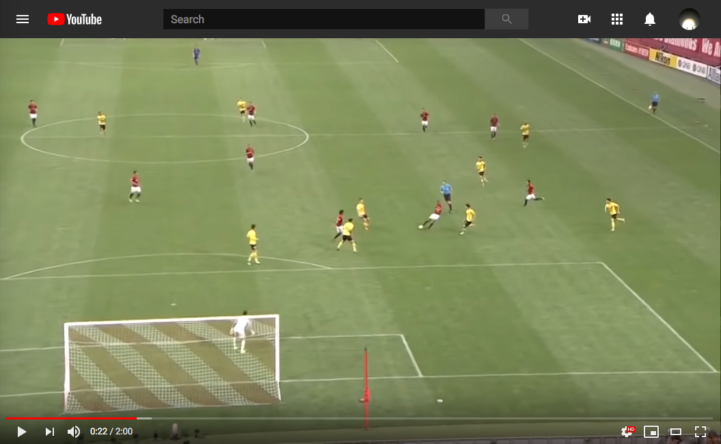


Chapter 5: Queue and microburst analysis
Queue might become full, when many packets burst in
High delay / packet loss
Crossbar
Ingress
Egress
Pkt
Pkt
Routing
Queue
Ingress
Egress
Pkt
Pkt
Routing
Queue

Slide 44
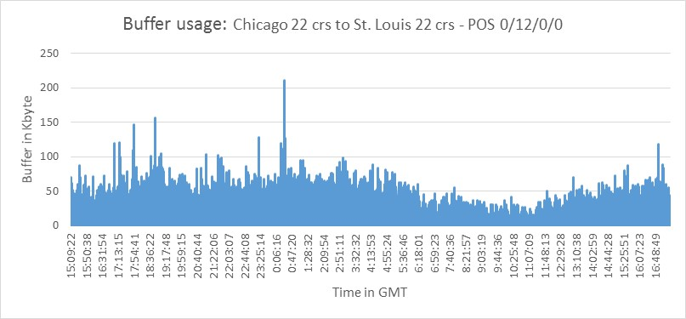
Microbursts: sub-millisecond queue anomaly
Bad for interactive applications (AR/VR/Streaming)
In data centers, caused by incast.
Also in carrier networks?
Hard to measure: only lasts <1-2ms
Harder to react: By the time it’s
detected, harm is already done!
Max queue length stats,
at an AT&T metro backbone switch
5x
Microbursts
3x
Queue Length
1x
16:00:00
0:00:00
8:00:00
16:00:00
Time in day (24h)
In-network algorithm to the rescue:
Fine-grained measurement + real-time reaction

Slide 45
Analyzing queues: Why am I waiting?
Which flow has many packets in the queue?
Flow ID: A
{SrcIP: XXX, DstIP: YYY}
Egress
Queue
E
B
B
B
D
C
B
B
A
Why am I waiting?
It’s because flow B!

Slide 46
A strawman solution
Maintain a “flow size in the queue” table
Increment when packet arrives
Subtracts when packet exits
Egress
Queue
C
C
B
A
Flow | Count
1
A
0
B
1
Memory access
Memory access
2
C
1

Slide 47
Challenge: memory partitioned!
400 Gbps = 1 packet per 1.67 nanoseconds
Concurrent access is hard to implement, must prevent hazard
Memory partitioned before and after queuing
Memory
Shared Memory
Memory
Crossbar
Ingress
Egress
Queue
Ingress
Egress
Queue

Slide 48
Solution: snapshots
Slice traffic into small time periods, save “snapshots”
Example: each snapshot records T=4 packets
Query last ⌊Δ/T⌋=2 snapshots
Why I suffered high delay?
Egress
Queue
B
B
E
C
B
B
C
A
D
B
B
D
A
B
I enqueued at t_{e}=5
I dequeued at t_{d}=14
High delay: Δ=9
Historical Departures
Flow | ~Count
 | 1
 | 5
 | 1
 | 1
?
S1 | S2 | S3 | S4 | …
A
Memory access
B
C
D

Slide 49
Round-robin snapshots
Need to clean memory every <1ms, control plane is too slow
Solution: gradually Clean and Recycle the snapshots!
Read
Read
Write
Clean
Read
Read
Read

Slide 50
The ConQuest data structure
Slice traffic into time windows
For each packet dequeued:
  Write into the latest snapshot
  Read some recent snapshots
  Clean the oldest snapshot

Slide 51

Mitigating microbursts via closed-loop control
Check for every packet:
  Is there a microburst? (Queue size)
  Is this flow the culprit? (Snapshots)
Real-time reaction:
  Tagging, Dropping, Rerouting
  Prevent high delay / packet loss
Egress
B
Queue
B
D
B
B
D
B
A
C
B

Slide 52
Evaluation highlights
How accurate is ConQuest?
Achieved >90% Precision and Recall when identifying bursty flows in the queue.
Can ConQuest improve end-to-end performance?
Reduced average Flow Completion Time by 11%

Slide 53
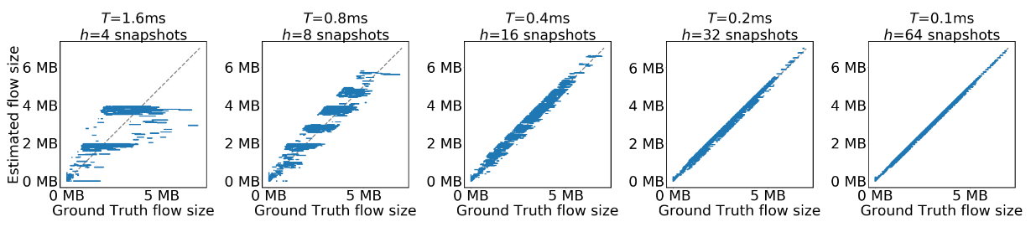
In Queue Flow Size Estimation
More Snapshots
Higher absolute error
Lower absolute error

Slide 54
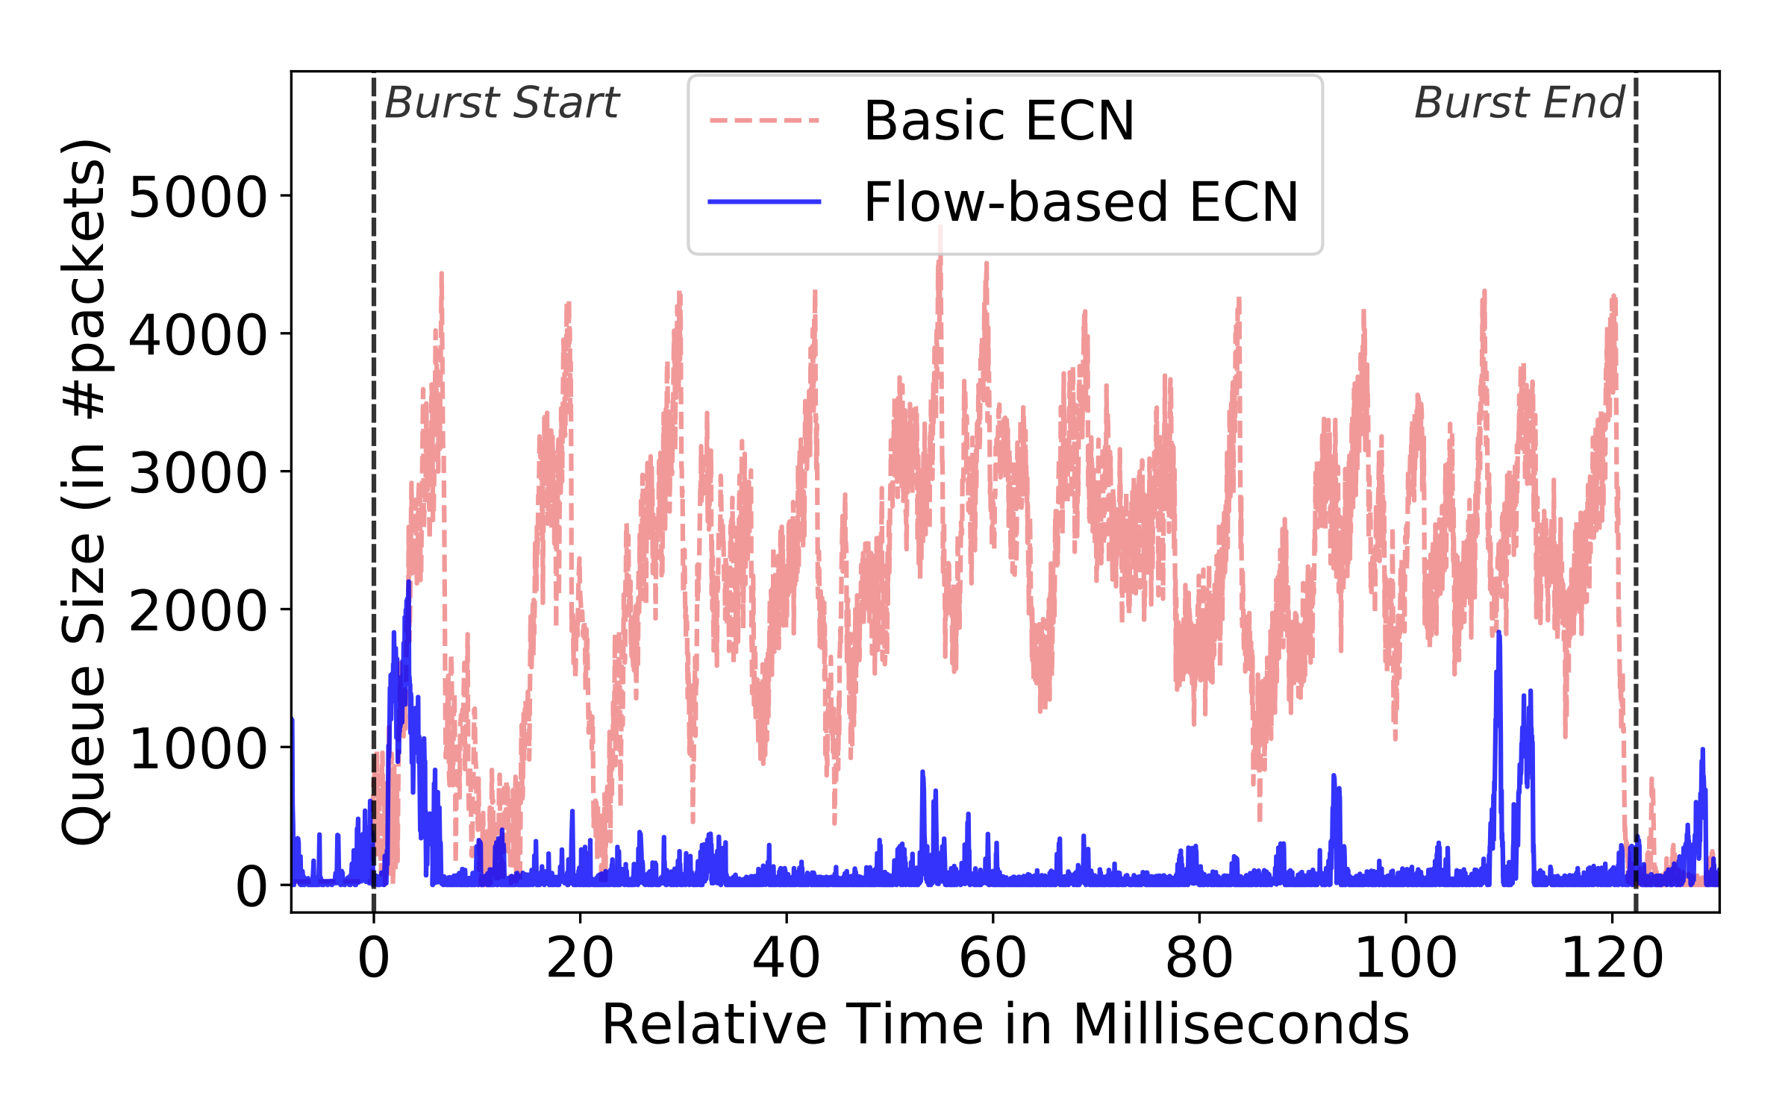
Testbed Evaluation: 10k flows/sec + bursts
Baseline: ECN for all flows when queue is long
ConQuest: ECN only for bursty flows
Flow-based ECN reduces Flow Completion Time
Queue remains short, bursty flow effectively suppressed
11%

Slide 55
Chapter 5: ConQuest
Summary and Key Insights
Fine-grained queue buffer analysis in data plane
Mitigate root causes of microbursts in real time
Deployed in real-world campus & carrier networks
(Princeton P4Campus, AT&T Labs)

Slide 56
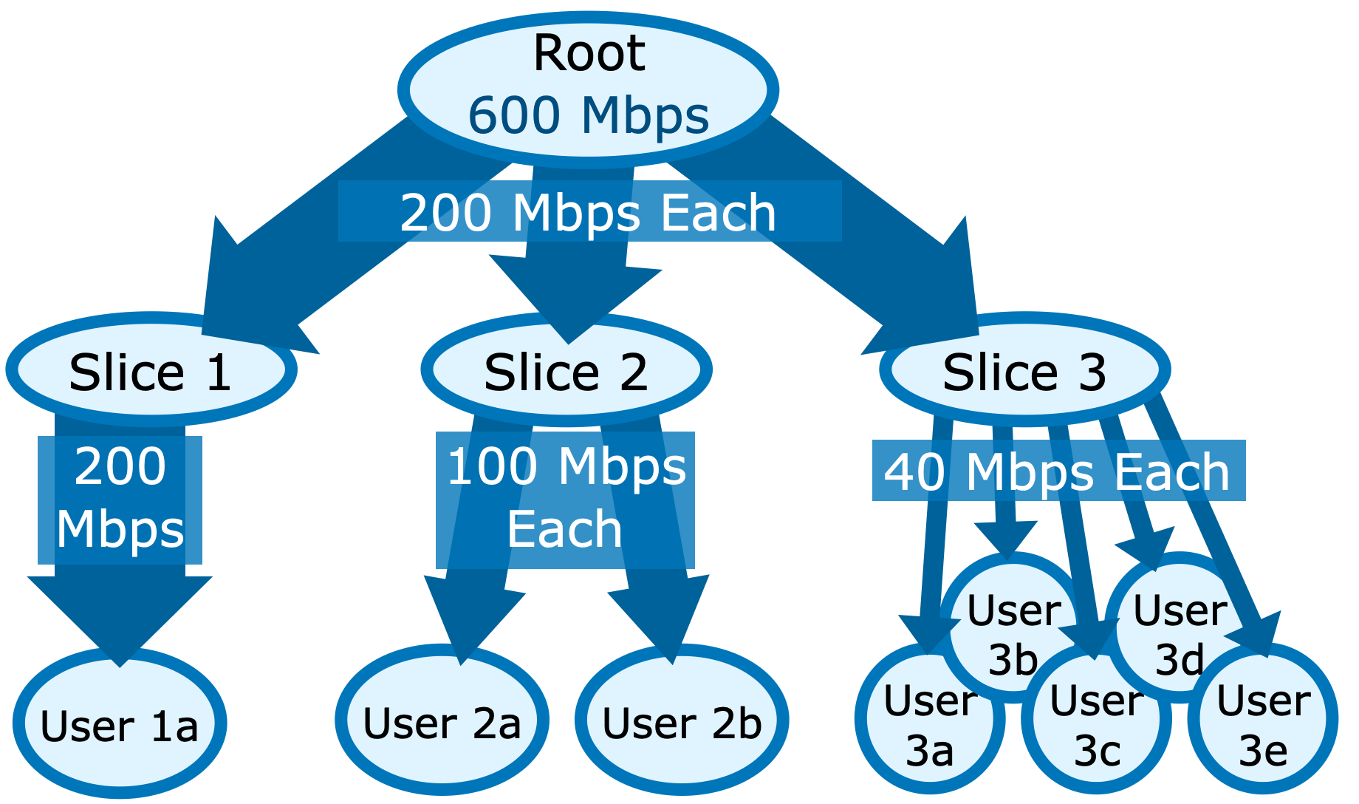
Chapter 6: Scalable bandwidth fairness
Network slicing: resource allocation and performance isolation.
For bandwidth: First share BW between slices, then between users.
* For simplicity, all slices and users have equal weight.
Trivial to add weighted case.

Slide 57
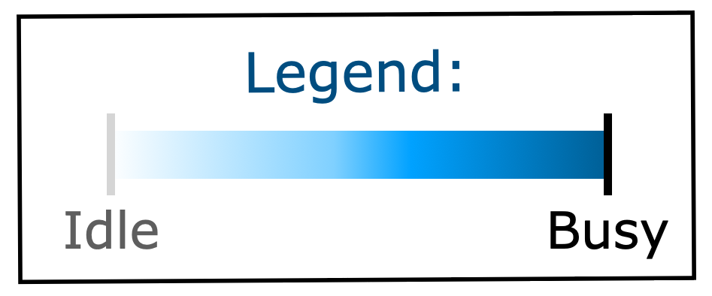
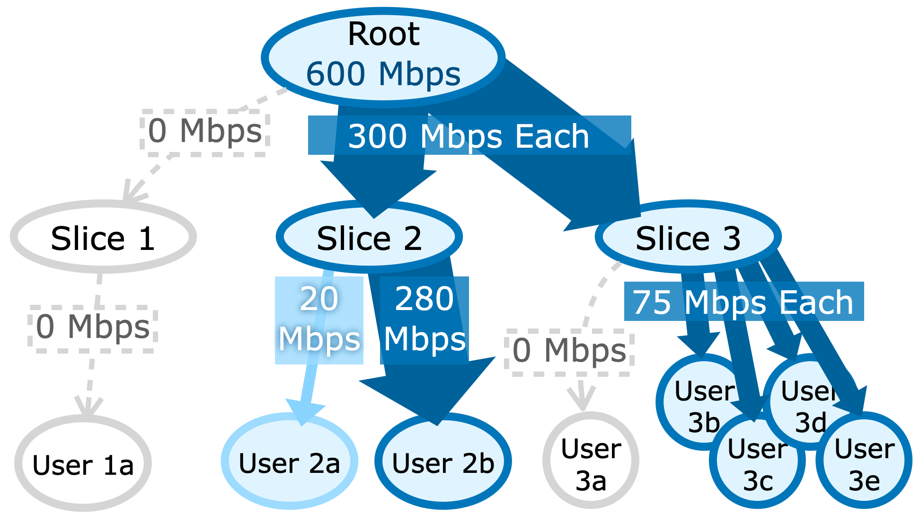
Fair bandwidth allocation is dynamic
If some user or slice is underutilized, fairly re-allocate the surplus
Allocation is constantly changing
User 1a, 3a go offline
User 2a needs only 20

Slide 58
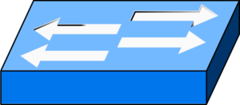
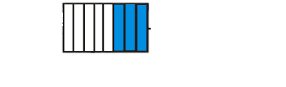

Scalable hierarchical bandwidth fairness
Goal: Support thousands of slices, millions of users
CPU-based Software switch? High latency
Programmable switch? Hardware constraints
  8-32 hardware queues per port
  Limited arithmetic
  Small memory

Slide 59
Scalable hierarchical bandwidth fairness
Challenge 1: can’t easily calculate the per-user fair rate limit
Solution: guess a limit, closed-loop iterative update
Challenge 2: can’t use per-user memory to track sending rate
Solution: CMS-LPF sketch, approximate per-user rate

Slide 60

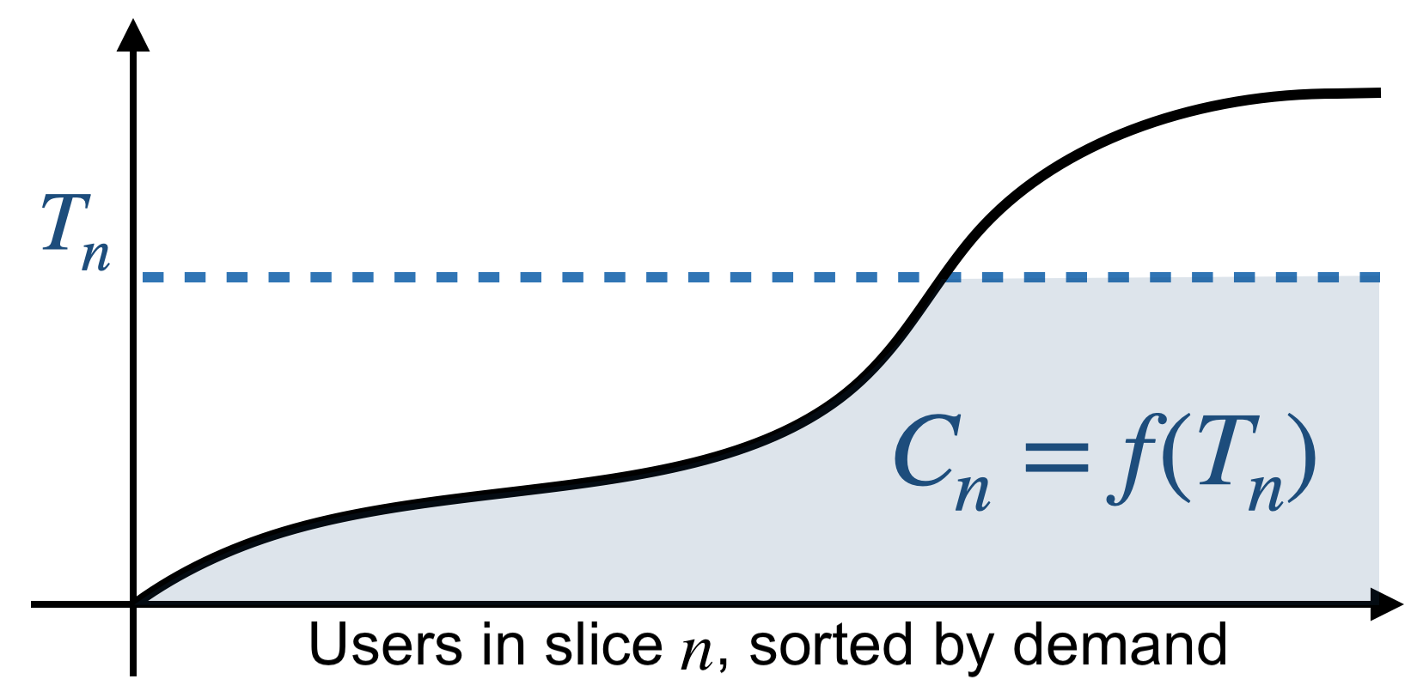
Challenge 1: Finding fair per-user rate limit
Demand: 20Mbps
Demand: 180Mbps
Limited to: 110Mbps
Sort and plot all user’s bandwidth demand
Apply limit T_{n}
Total bandwidth used is shaded area f(T_{n})
T_{n}
110Mbps

Slide 61
Challenge 1: Finding fair per-user rate limit
The ”right” limit means total usage equals capacity:
C_{n} =f(T_{n})
But how do we find T_{n}?
Just guess and refine!
Demand: 20Mbps
Demand: 180Mbps
Limited to: 110Mbps
T_{n}
110Mbps

Slide 62
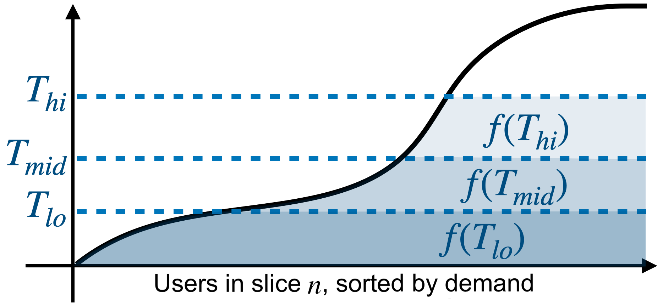
Fair rate limit via closed-loop refinement
Adjust T : pick 3 candidates, track 3 hypothetical demands

Slide 63
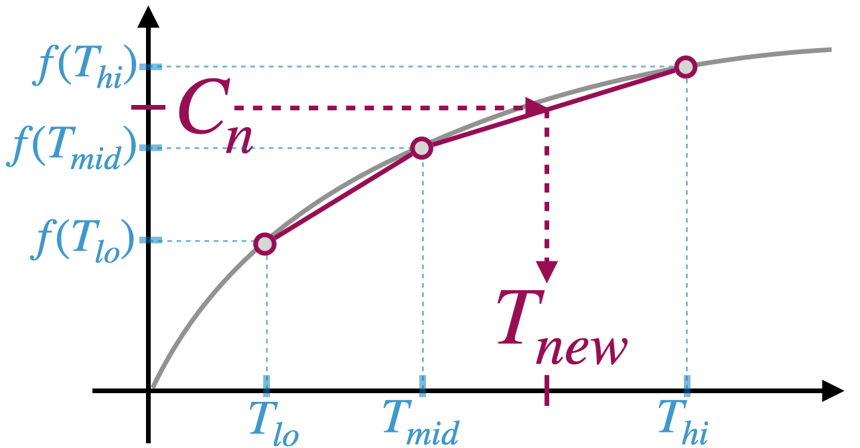
Fair rate limit via closed-loop refinement
Plot f(T ) on Y-axis. X-axis is different T limits
We can then map C_{n} into T_{new} : approx. linear interpolation
Repeat every epoch, until convergence

Slide 64
Challenge 2: Tracking per-user sending rate
Per-user rate limit T can be enforced via probabilistic drop*:
p= (1-T/R)
But this requires knowing the user’s sending rate R
How to get per-user sending rate, without per-user memory?
Idea: we only care about heavy users… Use sketch!
* Disclaimers:
Only when R >T
This is for UDP. For TCP needs something fancier (see paper)

Slide 65

Solving scalability challenge: CMS-LPF sketch
Count-Min Sketch: approximate data structure for heavy-hitter flows
CMS-LPF: approximate
per-user sending rate
h₁(id)
h₂(id)
h₃(id)
0 | +1 | 0 | 0 | 2
14 | 0 | +1 | 5 | 0
7 | 0 | 23 | 0 | +1
Pkt
Flow id
min
Estimate
flow size
h₁(id)
h₂(id)
h₃(id)
Σ
Σ
Σ
Σ
Σ
T, uid,
size
Pkt
Σ
Σ
Σ
Σ
Σ
Low-Pass Filter:
self-decaying counter for
exponential moving average
Σ
Σ
Σ
Σ
Σ
min
Estimate
per-user sending rate
Pkt
Time,
Pkt size
Σ
Average total sending rate

Slide 66
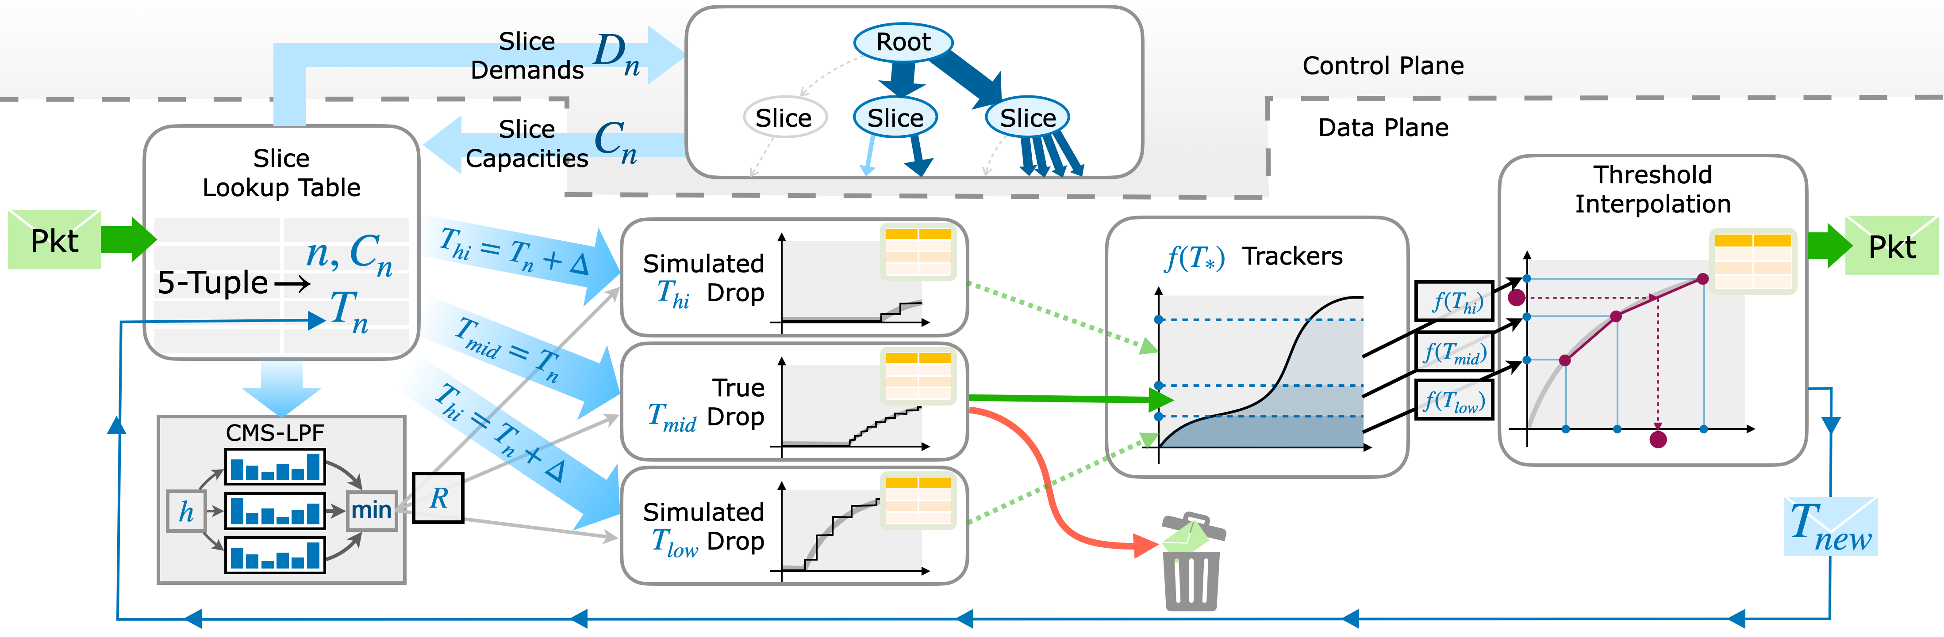
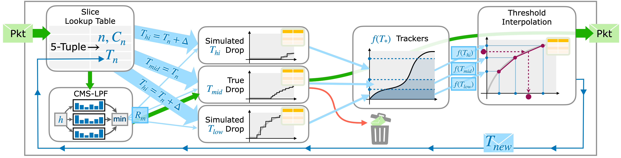
AHAB: Hardware implementation on Tofino
First, look up slice id n and its current per-user rate limit T_{n} ;
Also, use CMS-LPF to get estimated per-user sending rate R .
Approximated probabilistic dropping (using match-action rules).
Linear interpolation for new rate limit T_{new} ; update using messenger packets.

Slide 67
Evaluation overview
1. How fast can AHAB converge to the right limit?
✓ 3.1ms, 13x faster than state-of-the-art
2. How fair (accurate)?
✓ Throughput within 4%-6% of ideal fair rate
3. Can AHAB scale?
✓ Millions of users

Slide 68
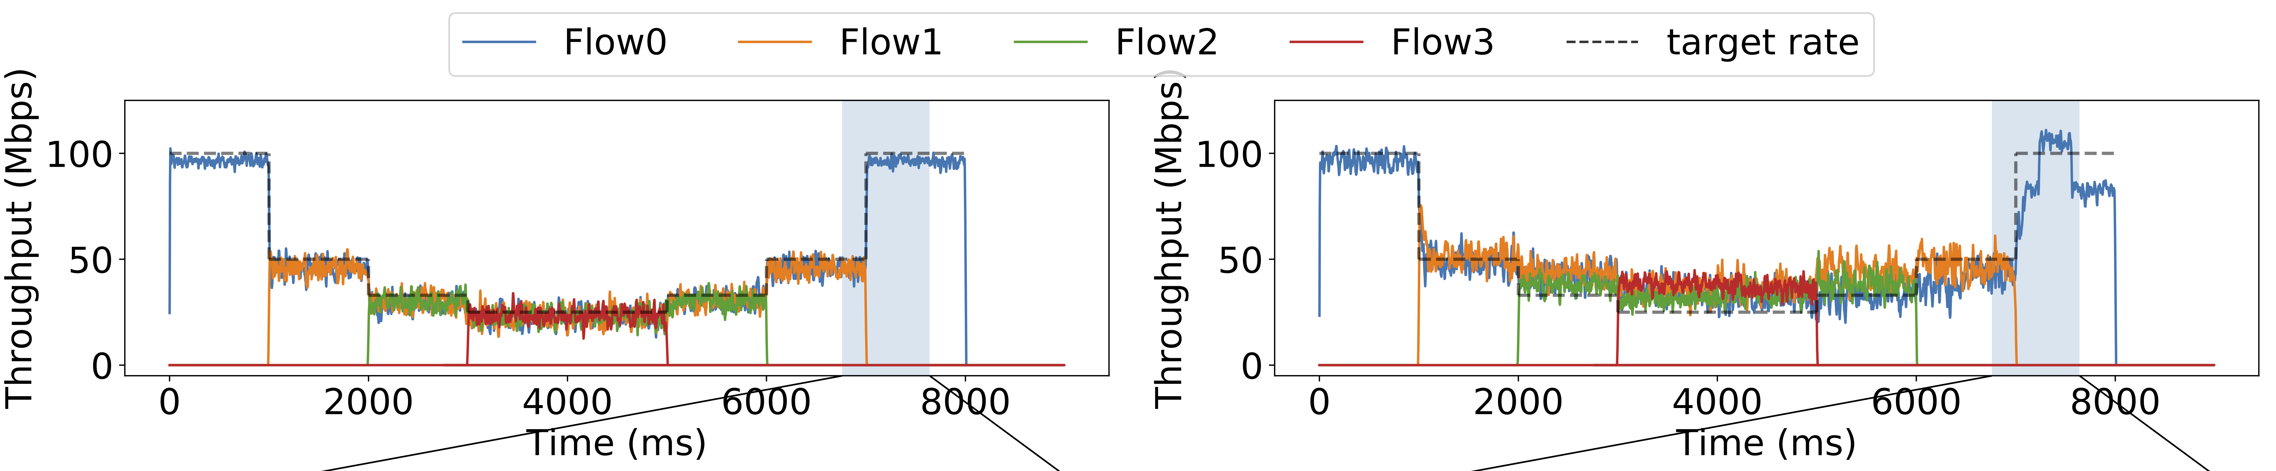
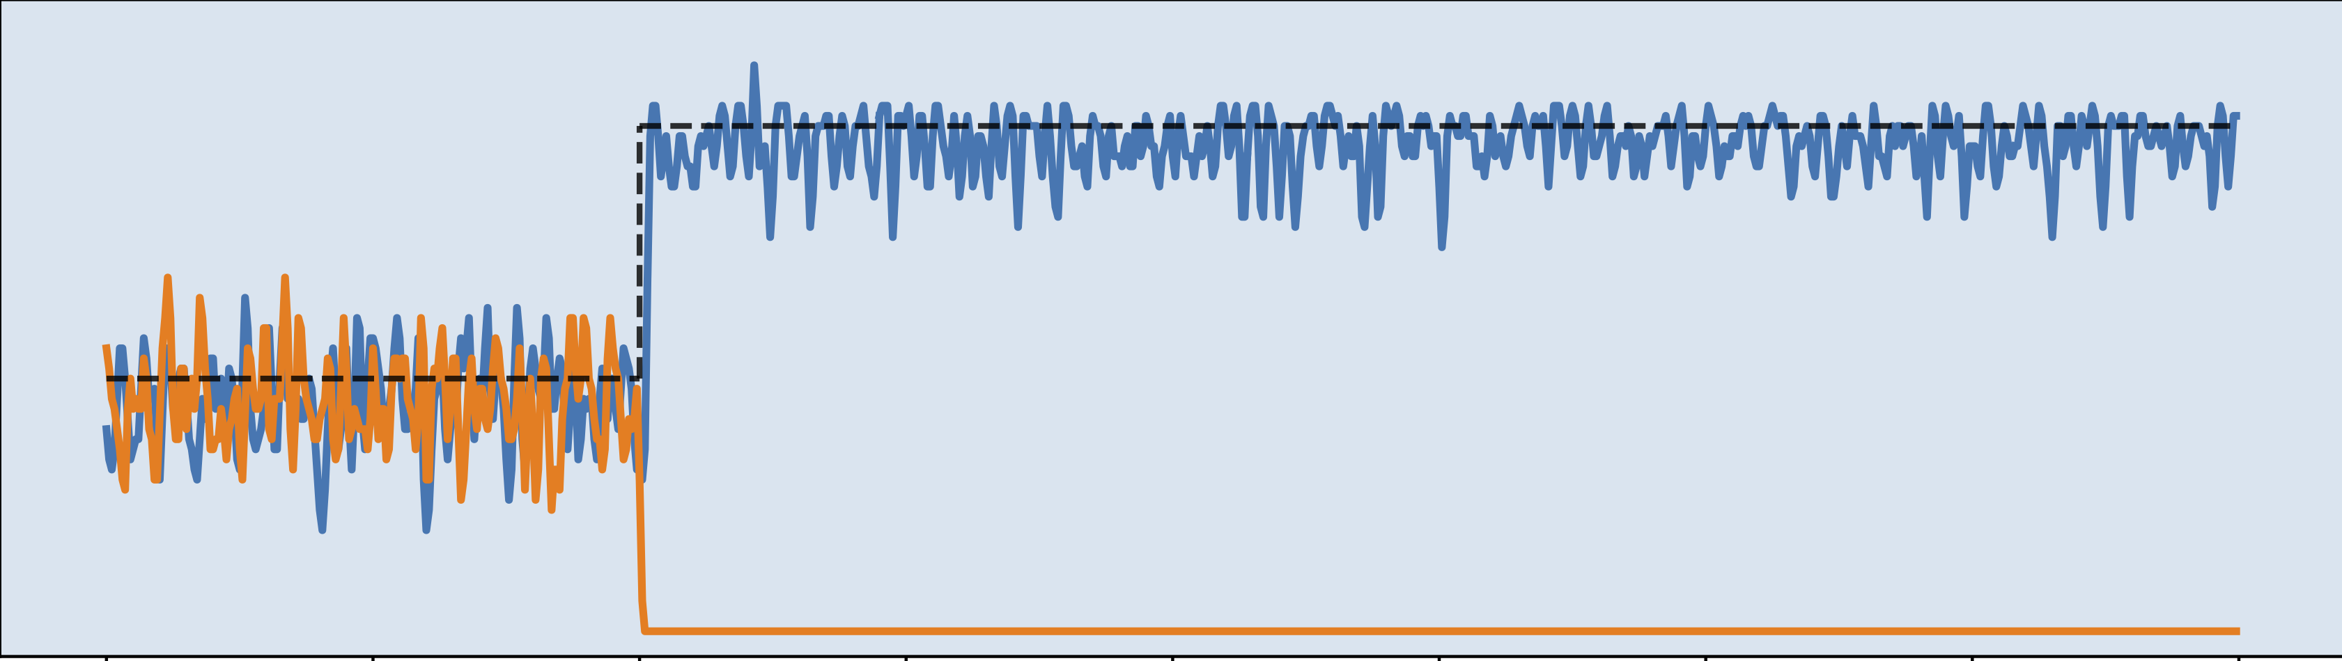
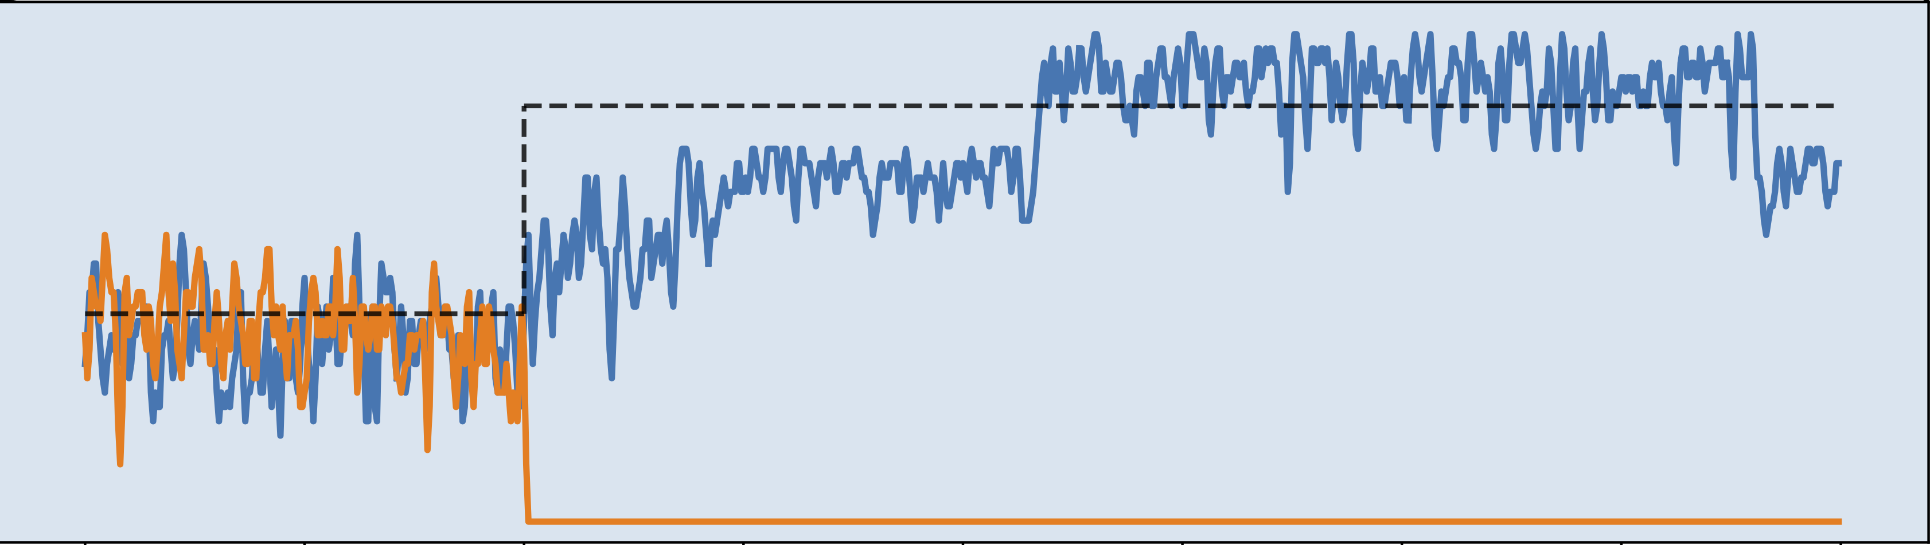
Evaluation: Fast convergence to fairness
Setup: 1 to 4 flows sharing a slice (fixed 100Mbps capacity)
Compare AHAB with prior state-of-the-art, HCSFQ

Slide 69
Evaluation: Fast convergence to fairness
AHAB’s iterative update converges in 3.1ms
Instead, HCSFQ needs 42ms to converge (13x)

Slide 70
Evaluation: Accuracy of approximated fairness
Flows with different demands: 10Mbps, 20Mbps, 30Mbps…160Mbps
Enforced to within 4%-6% of fair bandwidth limit.

Slide 71
Evaluation: Scalability
Simulate CMS-LPF errors for a very large number of users,
using local ISP trace (6M users) and CAIDA (7.3M users)
# of Users | CMS-LPF size needed | SRAM utilization
3 millions | 2048x3 (24KB) | 1.56%
6 millions | 4096x3 (48KB) | 2.60%
24 millions (est.) | 16384x3 (768KB) | 8.85%
Other hardware resource metrics
HW Resource | Instr. Words | Hash Unit | TCAM | Stages
Utilization | 28.6% | 37.5% | 5.2% | 12+9

Slide 72
Chapter 6: AHAB
Summary and Key Insights
Closed-loop iterative refinement for per-user rate limit
    Approximated linear interpolation for updates
    Quick convergence: 3-5ms (3-5 epochs)
Avoid per-user memory when estimating sending rate
    New sketch: CMS-LPF rate estimator
    Scales to 1k slices, 24 millions of users

Slide 73
In-network algorithms can build better measurement and closed-loop control
Measuring and telemetry:
Ch3: Heavy hitter flows
Ch4: many simultaneous queries
Real-time, closed-loop control:
Ch5: microburst analysis & mitigation
Ch6: fair bandwidth enforcement w/ slicing

Slide 74
Conclusion, Q&A
Measurement: tailoring sketches for switches
  Adapt theoretical insights into hardware-friendly design
  Focus on fundamental & long-term constraints, not quirks
Closed-loop control: embrace fuzziness
  Real-timeliness opens new possibility
  All approximated: input, decision-making, and output
Future: more distributed & dynamic network algorithms

