Slide 1
Scalable Management of
Enterprise and Data Center Networks
Minlan Yu
minlanyu@cs.princeton.edu
Princeton University
Notes:
Thanks for the introduction. I’m happy to present the talk to you today.

Slide 2




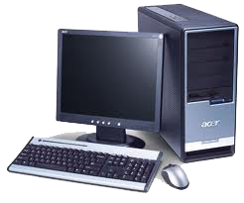
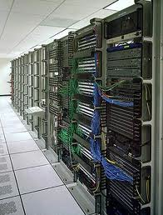




Edge Networks
Enterprise networks
(corporate and campus)
Data centers (cloud)
Internet
Home networks
Notes:
focus
I work on edge networks, edge networks are the networks that are at the edge of the Internet
There have been growing interest at the edge of the Internet such as the networks in companies, campuses, data centers, and home.
%Traditional Internet research focuses on the *inside* of the Internet, or on the protocols running on the end hosts.
There have been growing interest at these edge networks, because the design and management of these networks significantly affect the users experience and service quality.
Today most researches focus on how to make these networks bigger, faster, and more efficient. But one unexplored area that is important for realizing all these goals is management

Slide 3


Redesign Networks for Management
Management is important, yet underexplored
  Taking 80% of IT budget
  Responsible for 62% of outages
Making management easier
  The network should be truly transparent
  Redesign the networks
  to make them easier and cheaper to manage
Notes:
Managing edge networks is important…
Transparent, and second to application
Redesign
rather than "bolting on" management to the existing network, you are changing the network to make it inherently easier to manage
Much research focuses on making faster…
management is 80% of cost and responsible for more than half of outages. So, while much research focuses on making networks faster and more efficient, you're focusing on the underexplored problem of how to make them easier to manage. You could also stress that there are so many of these edge networks, each with a huge army of people to manage them, and often to keep them easy enough to manage there are restrictions on how they grow and what kinds of applications they support. (e.g., in our department, there are a lot of restrictions imposed by our clumsy firewall.) To realize the full power of the Internet in our lives, to make the network truly transparent, we *must* make networks easier and less expensive to manage. The best technologies are the ones that disappear, that become transparent as the air we breathe. Networking today is far from that goal.
networks were not designed for management, and your goal is (rather than "bolting on" management to the existing network, you are changing the network to make it inherently easier to manage

Slide 4

Main Challenges
Flexible Policies (routing, security, measurement)
Large Networks
(hosts, switches, apps)
Simple Switches
(cost, energy)
Notes:
There are three main challenges on managing the edge networks: First, these networks are growing bigger with more and more …
Each of these challenges is already a hard problem itself, addressing all the three challenges together is a even harder problem. In this talk I’ll show you how we achieve the three goals together.
presumably you'll say something about the parenthetical comments for each of the three topics. And prepare the audience that you'll briefly discuss each of these three topics to set the stage for your research.

Slide 5




Large Enterprise Networks
Hosts
(10K - 100K)
Switches
(1K - 5K)
….
Applications
(100 - 1K)
….
Notes:
These hosts are heterogeneous and can move around. For example, in our campus,

Slide 6





Large Data Center Networks
Switches
(1K - 10K)
….
….
….
….
Servers and Virtual Machines
(100K – 1M)
Applications
(100 - 1K)
Notes:
Virtual machine migration

Slide 7




Flexible Policies
Considerations:
- Performance
- Security
- Mobility
- Energy-saving
- Cost reduction
- Debugging
- Maintenance
… …
Customized Routing
… …
Measurement
Diagnosis
Access Control
Alice
Alice
Notes:
Soooooo many considerations
For trading applications that exchange real-time stock information in the cloud, reducing the delay of milliseconds is very important, operators will configure low-latency path to these apps.
Network security is also an important goal. In a medical company network, the operators need to make sure malicious users cannot access the patients’ private data, so they have to install access control rules..
In a cloud, cloud providers may bill the users based on the number of bits they use. So operators need to make sure they accurately count the amount of traffic from different users.
In these large edge networks, operators want to apply flexible policies to make the network more secure, support host mobility… For example, many applications have strict requirements on network performance, operators need to configure different routing paths for different applications. For the applications that transfer real-time market information in data center, operators may want to configure them to use low-latency path. These enterprise and especially data centers are the target of different attacks. To improve security, operators may need to install access control rules to block the traffic from malicious users. Finally measurement and diagnosis is also important to identify the potential problems and ensure the network is robust for the users. For example, operators may want to investigate the amount of web traffic in the network, who is using the most bandwidth.

Slide 8
Switch Constraints
Increasing link speed
(10Gbps and more)
Switch
Small, on-chip memory
(expensive,
power-hungry)
Storing lots of state
Forwarding rules for many hosts/switches
Access control and QoS for many apps/users
Monitoring counters for specific flows
Notes:
1byte per nanosecond
High speed, we cannot just use normal memory, we have to use high speed, onchip memory → expensive, power hungry → small → but lots of state
All these require such a large amount of state that a switch cannot handle

Slide 9
Edge Network Management
Specify policies
Management System
Configure devices
Collect measurements
on hosts
SNAP [NSDI’11]
Scaling diagnosis
on switches
BUFFALO [CONEXT’09]
Scaling packet forwarding
DIFANE [SIGCOMM’10]
Scaling flexible policy
Notes:
Operators first specify…
My research focuses on how to redesign the network to address the three challenges at the same time. I built two systems:
Due to the three challenges, today, network operators devote tremendous time and effort to network management.
Yankee group reports that in enterprises 80% of IT budget is spent on network management.
But they can only support a limited management tasks.
I built two new systems that make the network more scalable and easier to manage.
Focus on DIFANE, and give a brief description of SNAP
How to design network functions that best support different management tasks
How to implement different management tasks in the network

Slide 10
Research Approach
New algorithms & data structure
Systems prototyping
Evaluation & deployment
Effective use of switch memory
Prototype on Click
Evaluation on real topo/trace
BUFFALO
Effective use of switch memory
Prototype on OpenFlow
Evaluation on AT&T data
DIFANE
Efficient data collection/analysis
Prototype on Win/Linux OS
Deployment in Microsoft
SNAP
Notes:
In my other works, I also use optimization theory, random walk, hashing, and graph theory.
These algorithms and data structures are not useful if we cannot demonstrate them with real prototypes.
These prototypes are not sufficient to make real world impact of my research, so I also actively collaborate with industry.

Slide 11

BUFFALO [CONEXT’09]
Scaling Packet Forwarding on Switches
Notes:
Mention nickel of buffalo
Our project title came from this lovely animal in the nickle. Hope our talk will convince you that our solution is as cheap as this nickle.

Slide 12
Packet Forwarding in Edge Networks
Hash table in SRAM to store forwarding table
  Map MAC addresses to next hop
  Hash collisions:
Overprovision to avoid running out of memory
  Perform poorly when out of memory
  Difficult and expensive to upgrade memory
00:11:22:33:44:55
00:11:22:33:44:66
… …
aa:11:22:33:44:77
Notes:
- slide 9: is the extra delay on hash collisions really all that big a deal? isn't it more the overhead on theswitch and the complexity of the hardware? for any one packet, the extra delay doesn't seem that big a deal
On chip SRAM at most 640 KB
Perfect hashing: complicated and may not work
Very bad performance for a user..opposed to graceful degradation
Upgrade memory: network increase rapidly…
I said that you could imagine very large networks particularly in wide-area setting -- e.g., Google or Microsoft has its own backbone and many data centers and could use seaBuff to treat the whole thing as one flat virtual layer-2 switch.

Slide 13
Bloom Filters
Bloom filters in SRAM
  A compact data structure for a set of elements
  Calculate s hash functions to store element x
  Easy to check membership
  Reduce memory at the expense of false positives
x
V₀
V_{m-1}
0
0
0
1
0
0
0
1
0
1
0
1
0
0
0
h₁(x)
h₂(x)
h₃(x)
h_{s}(x)
Notes:
slide 10: when you mention false positives, dwell a little more on why FPs happen, e.g., that these bitsmay have been set to 1 because of other insertions
On Buffalo... I think the key thing is that, no matter how much memory the switches have, you always want to stay within the available memory. The BF solution does that, by design. Other solutions do not. Another key point is that some (cheaper) switches could use Buffalo while others use a larger memory (and perhaps have their memory upgraded over time, as needed). Having cheaper switches that do not require upgrades helps reduce the cost of a large enterprise network. E.g., the many smaller switches at the periphery of the network.

Slide 14
BUFFALO: Bloom Filter Forwarding
One Bloom filter (BF) per next hop
  Store all addresses forwarded to that next hop
Bloom Filters
query
Nexthop 1
Nexthop 2
hit
Packet
destination
……
Nexthop T
Notes:
Stress that whle BF is an old idea, several problems must be solved to make the idea viable in SPAF network
- slide 11: before tranisitioning to the challenges in slide 12, you could say something nice about using BFs,e.g., that you can always stay within the size of the memory, even as the number of destinations grows

Slide 15
Comparing with Hash Table
Save 65% memory with 0.1% false positives
More benefits over hash table
  Performance degrades gracefully as tables grow
  Handle worst-case workloads well
65%
Notes:
Hash: 48+log(T) per entry, this Is not fair…. 6 byte -→ 3 byte 34% of the memory….
out loud, make sure to stress that it's not just the 65% that matters, but the graceful way you can handle a growing table by simply increasing the false-positive rate, whereas the hash-table solution is out of luck.
t (i) you degrade gracefully as tables grow (rather than running out of memory) and (ii) handle worst-case workloads well

Slide 16
False Positive Detection
Multiple matches in the Bloom filters
  One of the matches is correct
  The others are caused by false positives
Bloom Filters
Multiple hits
query
Nexthop 1
Nexthop 2
Packet
destination
……
Nexthop T

Slide 17
Handle False Positives
Design goals
  Should not modify the packet
  Never go to slow memory
  Ensure timely packet delivery
When a packet has multiple matches
  Exclude incoming interface
    Avoid loops in “one false positive” case
  Random selection from matching next hops
    Guarantee reachability with multiple false positives
Notes:
Never forward a packet back out the way it came in
> - make sure to tie back very explicitly to slide 5 and how/why occasional misdirection/redirection happens in exchange for scalability.

Slide 18
One False Positive
Most common case: one false positive
  When there are multiple matching next hops
  Avoid sending to incoming interface
Provably at most a two-hop loop
  Stretch <= Latency(AB) + Latency(BA)
Shortest path
A
dst
False positive
B
Notes:
B does not have fp, and only has one matching next hop A
Assuming fp is small..(binomial in fact)

Slide 19
Stretch Bound
Provable expected stretch bound
  With k false positives, proved to be at most
  Proved by random walk theories
However, stretch bound is actually not bad
  False positives are independent
  Probability of k false positives drops exponentially
Tighter bounds in special topologies
  For tree, expected stretch is (k > 1)
Notes:
Different switches use different hash functions
Underlying graph is a tree, tree is common in data center…
What is k…. The number of fp for a single dst across the network

Slide 20
BUFFALO Switch Architecture

Slide 21
Prototype Evaluation
Environment
  Prototype implemented in kernel-level Click
  3.0 GHz 64-bit Intel Xeon
  2 MB L2 data cache, used as SRAM size M
Forwarding table
  10 next hops, 200K entries
Peak forwarding rate
  365 Kpps, 1.9 μs per packet
  10% faster than hash-based EtherSwitch

Slide 22
BUFFALO Conclusion
Indirection for scalability
  Send false-positive packets to random port
  Gracefully increase stretch with the growth of forwarding table
Bloom filter forwarding architecture
  Small, bounded memory requirement
  One Bloom filter per next hop
  Optimization of Bloom filter sizes
  Dynamic updates using counting Bloom filters
Notes:
in the real talk, you may want to pause between main sections of the talk, e.g., each of the three parts of the BF talk, to see if there are questions. pauses are useful to let the audience take a break, and also make sure everyone understands. you'll also want to make eye contact with people in the audience so you can judge if they understand, are paying attention, etc. (also, making eye contact helps keep the audience engaged.) right now, you are looking mostly away from the audience (e.g., at the projection of your slides on the screen), and sometimes looking forward but not focusing on anyone in particular.
Key design decisions
One Bloom filter per next hop
Optimizing of Bloom filter sizes
Preventing forwarding loops
Dynamic updates using counting Bloom filters

Slide 23
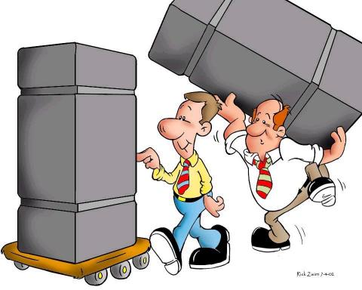
DIFANE [SIGCOMM’10]
Scaling Flexible Policies on Switches
Do It
Fast ANd
Easy
Notes:
Joint work with …

Slide 24

Traditional Network
Management plane:
offline, sometimes manual
Control plane:
Hard to manage
Data plane:
Limited policies
New trends: Flow-based switches & logically centralized control
Notes:
Traditional networks: the data and control plane are both on the switches.
The data plane is the hardware part of the switch, which actually forward the packets, and the control plane are the so-called brain of the switch, the protocols that make all of the decisions about where traffic should go. Different vendors may provide different sets of policy support in the data plane, and it is limited. The software code in the control plane is also bundled with the switch, so it is hard for operators to manage. So most of the management tasks in these networks are done in an offline fashion and sometimes just manually configuring each switches.
Brains are on the switches themselves→ scalable, data plane
Control plane: not standard, private code

Slide 25

Data plane: Flow-based Switches
Perform simple actions based on rules
  Rules: Match on bits in the packet header
  Actions: Drop, forward, count
  Store rules in high speed memory (TCAM)
Flow space
TCAM (Ternary Content
Addressable Memory)
src. (X)
forward via link 1
dst.
(Y)
1. X:* Y:1 → drop
2. X:5 Y:3 → drop
3. X:1 Y:* → count
4. X:* Y:* → forward
Count packets
drop
Notes:
commercial switches supporting OpenFlow are available (e.g., from HP, NEC, and Quanta) and that several operational networks are already deploying OpenFlow.
TCAM: 64Mbit (8MB) 3-4ns lookup time, 100$, 20W, 1M (32 bit prefix 32bit associated value) (1U == 200-400 Watt)
SRAM: 512KB 1$/MB 1-3 W
Priority
> - define TCAM, so audience understands what they are and why they are so
> useful for matching on packets. stress more that, because they match the
> packet against all rules in parallel, TCAMs are expensive and power-hungry,
> so you are often limited in the # of rules the switch can support. some of
> the details of TCAMs -- how they work, how expensive they are -- matter
> later in the talk, so good to explain a bit more when you first introduce them

Slide 26


Control Plane: Logically Centralized
RCP [NSDI’05], 4D [CCR’05],
Ethane [SIGCOMM’07],
NOX [CCR’08], Onix [OSDI’10],
Software defined networking
DIFANE:
A scalable way to apply fine-grained policies
Notes:
(the limited TCAM space and the limited resources on the controller). the two strawman solutions -- pre-installed rules and Ethane -- each address one scaling problem at the expense of the other.

Slide 27

Pre-install Rules in Switches
Pre-install
rules
Controller
Packets hit
the rules
Forward
Problems: Limited TCAM space in switches
  No host mobility support
  Switches do not have enough memory
Notes:
Specify high-level policies in a management system
Enforce low-level rules in the switches
Host mobility is not stressed before…

Slide 28
Install Rules on Demand (Ethane)
Buffer and send
packet header
to the controller
Controller
Install
rules
First packet
misses the rules
Forward
Problems: Limited resource in the controller
  Delay of going through the controller
  Switch complexity
  Misbehaving hosts
Notes:
10 ms→ leaving the fast data plane
Ethane does reactive solution not NOX
Sending the whole packet consume too much traffic in the controller
Mention switch bottleneck

Slide 29
Design Goals of DIFANE
Scale with network growth
  Limited TCAM at switches
  Limited resources at the controller
Improve per-packet performance
  Always keep packets in the data plane
Minimal modifications in switches
  No changes to data plane hardware
Combine proactive and reactive approaches for better scalability
Notes:
New algorithm and data structure that have these properties

Slide 30
DIFANE: Doing it Fast and Easy
(two stages)
Notes:
DIstributed Flow Architecture
for Networked Enterprises

Slide 31
Stage 1
The controller proactively generates the rules and distributes them to authority switches.

Slide 32

Partition and Distribute the Flow Rules
Flow space
accept
Controller
Distribute partition information
AuthoritySwitch B
Authority Switch A
Authority Switch C
reject
Authority
Switch B
Egress Switch
Authority
Switch A
Ingress Switch
Authority
Switch C

Slide 33
Stage 2
The authority switches keep packets always in the data plane and reactively cache rules.

Slide 34
Packet Redirection and Rule Caching
Authority Switch
Feedback:
Cache rules
Ingress Switch
Forward
Egress Switch
Redirect
First packet
Following packets
Hit cached rules and forward
A slightly longer path in the data plane is faster than going through the control plane

Slide 35
Locate Authority Switches
Partition information in ingress switches
  Using a small set of coarse-grained wildcard rules
  … to locate the authority switch for each packet
A distributed directory service of rules
  Hashing does not work for wildcards
AuthoritySwitch B
X:0-1 Y:0-3 ➔ A
X:2-5 Y: 0-1➔ B
X:2-5 Y:2-3 ➔ C
Authority Switch A
Authority Switch C
Notes:
Traditionally, ppl use hashing to map keys to values. Here, the keys are packets and the values are the rules.
Hashing does not work for mapping packets to the areas
but not DHT

Slide 36
Packet Redirection and Rule Caching
Authority Switch
Feedback:
Cache rules
Ingress Switch
Auth. Rules
Forward
Egress Switch
First
packet
Redirect
Cache Rules
Partition Rules
Following packets
Hit cached rules and forward

Slide 37
Three Sets of Rules in TCAM
Type | Priority | Field 1 | Field 2 | Action | Timeout
Cache Rules | 1 | 00** | 111* | Forward to Switch B | 10 sec
 | 2 | 1110 | 11** | Drop | 10 sec
 | … | … | … | … | …
Authority Rules | 14 | 00** | 001* | Forward Trigger cache manager | Infinity
 | 15 | 0001 | 0*** | Drop, Trigger cache manager
 | … | … | … | … | …
Partition Rules | 109 | 0*** | 000* | Redirect to auth. switch
 | 110 |  |  | …
 | … | … | … | … | …
In ingress switches
reactively installed by authority switches
In authority switches
proactively installed by controller
In every switch
proactively installed by controller
Notes:
Everything is using just limited number of TCAM entries
Important…..

Slide 38
DIFANE Switch Prototype
_{Built with OpenFlow switch}
Cache rules
Recv Cache
Updates
Send Cache
Updates
Only in Auth. Switches
Control Plane
Cache
Manager
Notification
Just software modification for authority switches
Cache Rules
Data
Plane
Authority Rules
Partition Rules
Notes:
Standard OF API

Slide 39
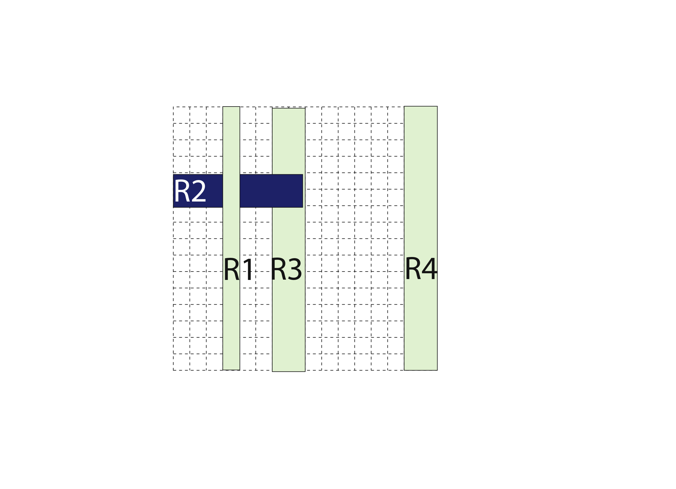
Caching Wildcard Rules
Overlapping wildcard rules
  Cannot simply cache matching rules
src.
dst.
Priority:
R1>R2>R3>R4

Slide 40
Caching Wildcard Rules
Multiple authority switches
  Contain independent sets of rules
  Avoid cache conflicts in ingress switch
Authority switch 1
Authority switch 2

Slide 41
Partition Wildcard Rules
Partition rules
  Minimize the TCAM entries in switches
  Decision-tree based rule partition algorithm
Cut B is better than Cut A
Cut B
Cut A
Notes:
NP-hard problem for K >= 2

Slide 42
Testbed for Throughput Comparison
Testbed with around 40 computers
Ethane
DIFANE
Controller
Controller
Authority Switch
….
….
Traffic generator
Traffic generator
Ingress switch
Ingress switch
Notes:
Prototype with OpenFlow switches, evaluate on a test bed of over 40 machines
One authority switch, first-packet flows.

Slide 43
Peak Throughput
One authority switch; First Packet of each flow
1 ingress switch
2
3
4
DIFANE
Ethane
DIFANE
(800K)
Ingress switch
Bottleneck
(20K)
DIFANE is self-scaling:
Higher throughput with more authority switches.
Controller
Bottleneck (50K)
Notes:
Stress log scale
DIFANE is self-scaling
35pkts per flow on average

Slide 44
Scaling with Many Rules
Analyze rules from campus and AT&T networks
  Collect configuration data on switches
  Retrieve network-wide rules
  E.g., 5M rules, 3K switches in an IPTV network
Distribute rules among authority switches
  Only need 0.3% - 3% authority switches
  Depending on network size, TCAM size, #rules
Notes:
100K entries, 1.6 MB TCAM per authority switch with 100 authority switches.

Slide 45
Summary: DIFANE in the Sweet Spot
Distributed
Logically-centralized
Traditional network
(Hard to manage)
OpenFlow/Ethane
(Not scalable)
DIFANE: Scalable management
Controller is still in charge
Switches host a distributed directory of the rules
Notes:
A new data structure that harnesses the capacity of the TCAMs across all the switches to give the illusion of a much larger TCAM.

Slide 46

SNAP [NSDI’11]
Scaling Performance Diagnosis for Data Centers
Scalable Net-App Profiler
Notes:
Talk about how SNAP helps developers and auto-adaptation

Slide 47


Applications inside Data Centers
….
….
….
….
Front end Server
Aggregator
Workers
Notes:
A single application(propagated and aggregated), the same server is shared by many more apps, some are delay sensitive while others have high throughput. All these applications inside data centers are already complicated when things are right, but what if something goes wrong?

Slide 48
Challenges of Datacenter Diagnosis
Large complex applications
  Hundreds of application components
  Tens of thousands of servers
New performance problems
  Update code to add features or ﬁx bugs
  Change components while app is still in operation
Old performance problems (Human factors)
  Developers may not understand network well
  Nagle’s algorithm, delayed ACK, etc.
Notes:
We have many low-level protocols such as….that is a mystery to developers without a networking background, but these protocols may have significant performance impact. It could be a disaster for a database expert to work with a TCP stack
- slide 34: audience probably won't know what "Nagle's algorithm" and "delayed ACK" are. you can finesse this out loud, and say that networking protocols have many low-level mechanisms (and view these as examples you don't expect the audience to know).
in practice, I think Microsoft doesn't
really "hot swap" in the new code, but rather brings up new images for a
service and gradually phase out the old ones your point is more that change
in constant.
Just stress the point about constant influx of new developers out loud.
silly window syndrome

Slide 49
Diagnosis in Today’s Data Center
Packet trace:
Filter out trace for long delay req.
App logs:
#Reqs/sec
Response time
1% req. >200ms delay
Host
App
Too expensive
Application-specific
OS
Packet sniffer
SNAP:
Diagnose net-app interactions
Switch logs:
#bytes/pkts per minute
Generic, fine-grained, and lightweight
Too coarse-grained
Notes:
Google and microsoft
100K$ a few monitoring machines monitor two racks of servers

Slide 50
SNAP: A Scalable Net-App Profiler that runs everywhere, all the time

Slide 51
SNAP Architecture
Online, lightweight processing & diagnosis
Offline, cross-conn diagnosis
Management System
Topology, routing
Conn → proc/app
At each host for every connection
Cross-connection correlation
Collect data
Performance Classifier
Offending app,
host, link, or switch
Adaptively polling per-socket statistics in OS
Snapshots (#bytes in send buffer)
Cumulative counters (#FastRetrans)
Classifying based on the stages of data transfer
Sender app→send buffer→network→receiver
Notes:
Overview to give sense of what SNAP is
Tuning polling rate to reduce overhead
Input
Topology, routing information
Mapping from connections to processes/apps
Sharing the same switch/link, app code

Slide 52
SNAP in the Real World
Deployed in a production data center
  8K machines, 700 applications
  Ran SNAP for a week, collected terabytes of data
Diagnosis results
  Identified 15 major performance problems
  21% applications have network performance problems
Notes:
Terabytes , less than 1 GB per machine per day
Read every 500 ms
700 always running, persistent connection
> - summarize that you found 15 serious performance bugs and worked with
developers to fix their code.

Slide 53
Characterizing Perf. Limitations
#Apps that are limited for > 50% of the time
Send Buffer
  Send buffer not large enough
1 App
  Fast retransmission
  Timeout
Network
6 Apps
Receiver
8 Apps
  Not reading fast enough (CPU, disk, etc.)
  Not ACKing fast enough (Delayed ACK)
144 Apps
Notes:
6 apps self inflicted packet loss" "incast
Life of transfer: be sure to talk about ack
One connection is always limited by one component, it’s good for the network, if it’s limited by apps
Nagle and delayed ack… : small data which trigger Nagle’s algo.

Slide 54
Delayed ACK Problem
Delayed ACK affected many delay sensitive apps
  even #pkts per record → 1,000 records/sec
  odd #pkts per record → 5 records/sec
  Delayed ACK was used to reduce bandwidth usage and server interrupts
A
B
Data
ACK every
other packet
ACK
Proposed solutions:
Delayed ACK should be disabled in data centers
….
Data
200 ms
ACK
Notes:
point out 1000s txn/s versus 5, based on parity of number of packets in request. Delayed ack disable cost (at least mention)
configuration-file distribution service
1M connections…
- clarify up front that Delayed ACK is a mechanism in TCP, not something added
by the developers or operators in the data center.

Slide 55
Diagnosing Delayed ACK with SNAP
Monitor at the right place
  Scalable, lightweight data collection at all hosts
Algorithms to identify performance problems
  Identify delayed ACK with OS information
Correlate problems across connections
  Identify the apps with significant delayed ACK issues
Fix the problem with operators and developers
  Disable delayed ACK in data centers

Slide 56
Edge Network Management
Specify policies
Management System
Configure devices
Collect measurements
on hosts
SNAP [NSDI’11]
Scaling diagnosis
on switches
BUFFALO [CONEXT’09]
Scaling packet forwarding
DIFANE [SIGCOMM’10]
Scaling flexible policy
Notes:
Operators first specify…
My research focuses on how to redesign the network to address the three challenges at the same time. I built two systems:
Due to the three challenges, today, network operators devote tremendous time and effort to network management.
Yankee group reports that in enterprises 80% of IT budget is spent on network management.
But they can only support a limited management tasks.
I built two new systems that make the network more scalable and easier to manage.
Focus on DIFANE, and give a brief description of SNAP
How to design network functions that best support different management tasks
How to implement different management tasks in the network

Slide 57
Thanks!

