Slide 1

Reliable Internet Routing
Martin Suchara
Thesis advisor
Prof. Jennifer Rexford

Slide 2
The Importance of Service Availability
Network service availability more important than before
New critical network applications
  VoIP, teleconferencing, online banking
Applications moving to the cloud
  Latency and disruptions affect performance of enterprise applications
Routing is critical for availability
  Provides connectivity/reachability

Slide 3

Is Best Effort Availability Enough?
Traditional approach: build reliable system out of unreliable components
Networks with rich connectivity
Routing protocols that find an alternate path if the primary one fails
Transmission protocols retransmit data lost during transient disruptions
link cut

Slide 4
Better than Best-Effort Availability
Improper load balancing → service disruptions
  Choose alternate paths after a link failure that allow good load balancing
Some configurations prevent convergence
  Router configurations that allow routing protocols to (quickly) agree on a path
False announcement → choice of wrong path
  Prevent adversarial attacks on the routing system

Slide 5
The Three Problems
Routers in a single autonomous system search for optimal paths (after a failure)
  Cooperative model
Rational autonomous systems with conflicting business policies that do not allow them to agree on a route selection
  Rational model
Attacks by other autonomous systems
  Adversarial model

Slide 6
In This Work
Failure Resilient Routing | BGP Safety Analysis | Secure Routing with Small Groups
Ensure good load balancing after a failure | Detect conflicting routing policies | Prevent malicious route hijacks
Cooperative | Rational | Adversarial
Intradomain (MPLS) | Interdomain (BGP) | Interdomain (BGP)
Architecture design, simulation and optimization | Analysis of a distributed system | Protocol design and measurement-driven simulation
Best paper award in SIGMETRICS 2011 | In INFOCOM 2011 | Technical report and CoNext workshop

Slide 7

Part I
Failure Resilient Routing
Simple Failure Recovery with Load Balancing
Martin Suchara
in collaboration with:
D. Xu, R. Doverspike,
D. Johnson and J. Rexford

Slide 8
Failure Recovery and Traffic Engineering in IP Networks
Uninterrupted data delivery when equipment fails
Re-balance the network load after failure
Existing solutions either treat failure recovery and traffic engineering separately or require congestion feedback
This work: integrated failure recovery and traffic engineering with pre-calculated load balancing
Notes:
1. Why failure recovery essential:
For backbone network operators: accidental cuts
Datacenters: with increasing sizes of datacenters the probability of a failed hardware component increases
Local enterprise networks: the same reasons, link and router failures
2. Load rebalancing: focus of research in this area. Network vulnerable to congestion when a link fails.

Slide 9
Architectural Goals
Simplify the network
  Allow use of minimalist cheap routers
  Simplify network management
Balance the load
  Before, during, and after each failure
Detect and respond to failures
Notes:
The three architectural goals.

Slide 10
The Architecture – Components
Management system
  Knows topology, approximate traffic demands, potential failures
  Sets up multiple paths and calculates load splitting ratios
Minimal functionality in routers
  Path-level failure notification
  Static configuration
  No coordination with other routers
Notes:
Goal of this slide: emphasize points of the work that are interesting and novel.
1. Router functionality:
- Path level notification: topology discovery no longer necessary, can use protocols such as BFD (Bidirectional Forwarding Detection)
- Static configuration: definition; no need to reconfigure for each failure
- No coordination: saves time
2. Management system
- Has all the information to set up paths that are diverse enough to work for all failures, and that allow load balancing.

Slide 11

The Architecture
• topology design
• list of shared risks
• traffic demands
• fixed paths
• splitting ratios
t
0.25
0.25
s
0.5
Notes:
The workings of our architecture is shown in this picture. The server represents the management system. … Let’s consider what happens when a link fails.

Slide 12
The Architecture
• fixed paths
• splitting ratios
t
0.5
0.5
s
0
link cut
path probing

Slide 13
The Architecture: Summary
Offline optimizations
Load balancing on end-to-end paths
Path-level failure detection
How to calculate the paths and
splitting ratios?
Notes:
Goal: justify why this is good, simple, effective…
Offline optimizations: speed; access to network information allows to find the optimal set of paths and splitting ratios
Effectivity of end-to-end load balancing: compared to local reroute
Path-level failure detection: avoids topology discovery

Slide 14
Goal I: Find Paths Resilient to Failures
A working path needed for each allowed failure state (shared risk link group)
e₁
R1
e₃
R2
e₂
e₄
e₅
Example of failure states:
S = {e₁}, { e₂}, { e₃}, { e₄}, { e₅}, {e₁, e₂}, {e₁, e₅}
Notes:
1. Introduce failure states.
2. Explain why some links fail together: links in one cable bundle may be cut together, a router breaks down, etc.
3. For each failure state, at least one path works.

Slide 15
Goal II: Minimize Link Loads
links indexed by e
failure states indexed by s
aggregate congestion cost weighted for all failures:
cost
Φ(u_{e}^{s})
u_{e}^{s} =1
minimize ∑_{s} w^{s}∑_{e} Φ(u_{e}^{s})
while routing all traffic
link utilization u_{e}^{s}
failure state weight
Cost function is a penalty for approaching capacity
Notes:
1. Piecewise linear function that penalizes link load. Small penalty for increasing load, very steep penalty close to the link capacity. Chose this function so that our optimization problem formulation does not have to include explicit capacity constraints.
2. Optimization problem objective:
inner sum
failure state weight as a probability of failure
outer sum

Slide 16
Possible Solutions
Suboptimal solution
Good performance and practical?
congestion
Solution not scalable
capabilities of routers
Too simple solutions do not do well
Diminishing returns when adding functionality
Notes:
Clarify that a “solution” means two things: (i) functionality of the routers and (ii) resulting optimization performed by the management system.
Allow any functionality -> low congestion.
Take away too much functionality -> too much congestion.
In this work we are looking for the sweet spot. How much functionality can we take away and still do well?

Slide 17
Computing the Optimal Paths
Solve a classical multicommodity flow for each combination of edge failures:
min load balancing objective
s.t. flow conservation
demand satisfaction
edge flow non-negativity
Decompose flow into paths and splitting ratios
Paths used by our heuristics (coming next)
Solution also a performance upper bound
Notes:
Explain the three constraints.
Decompose solution into paths and splitting ratios. These diverse paths are used by our subsequent solutions.

Slide 18
1. State-Dependent Splitting:
Per Observable Failure
Custom splitting ratios for each observed combination of failed paths
NP-hard unless paths are fixed
configuration:
Failure | Splitting Ratios
- | 0.4, 0.4, 0.2
p2 | 0.6, 0, 0.4
… | …
at most 2^{#paths} entries
p₁
0.4
0.6
0.4
p₂
p₃
0.2
0.4
Notes:
In contrast to the previous approach, here the router does not know which edge failed. In this example, it cannot distinguish which of the two links failed, it only knows p_2 doesn’t work.
Show how to look up the configuration, and say how large the configuration is.
NP hardness result.

Slide 19
2. State-Independent Splitting:
Across All Failure Scenarios
Fixed splitting ratios for all observable failures
Non-convex optimization even with fixed paths
Heuristic to compute splitting ratios
  Average of the optimal ratios
configuration:
p1, p2, p3:
0.4, 0.4, 0.2
p₁
0.4
0.667
0.4
p₂
p₃
0.2
0.333
Notes:
A simpler yet solution. The configuration determines fixed splitting ratios. Traffic is renormalized on the working paths.
Show the example.
Non-convex optimization, must use heuristics.

Slide 20
Our Solutions
State-dependent splitting
State-independent splitting
How do they compare to the optimal solution?
Simulations with shared risks for AT&T topology
  954 failures, up to 20 links simultaneously

Slide 21
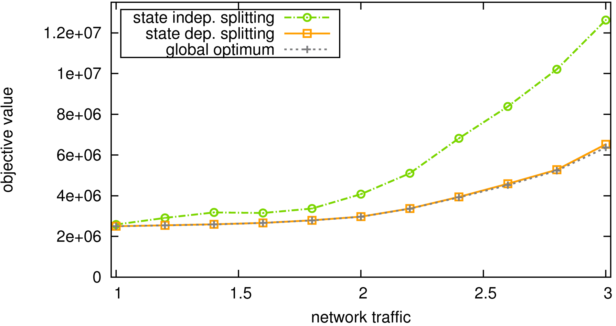
Congestion Cost – AT&T’s IP
Backbone with SRLG Failures
How do we compare to OSPF? Use optimized OSPF link weights [Fortz, Thorup ’02].
State-independent splitting not optimal but simple
objective value
State-dependent splitting indistinguishable from optimum
increasing load
network traffic
Additional router capabilities improve performance up to a point
Notes:
State-dependent splitting does as well as the optimal solution. This demonstrates that additional router capabilities only improve performance up to a point.
State-independent splitting does worse, but it uses simpler routers. If too much functionality is removed, the performance suffers.
OSPF:
- used for load balancing in the AT&T network today
- recent work on optimizing OSPF weights, how do we compare?

Slide 22
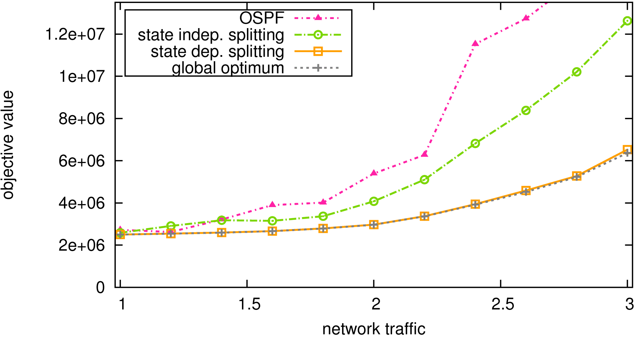
Congestion Cost – AT&T’s IP
Backbone with SRLG Failures
OSPF with optimized link weights can be suboptimal
objective value
increasing load
network traffic
OSPF uses equal splitting on shortest paths. This restriction makes the performance worse.
Notes:
The performance of OSPF with optimized link weights can be worse, especially for higher traffic loads.
This is despite the fact that we obtained custom OSPF weights for each of the load levels.
This does not mean that the link weight setting algorithm is suboptimal. Rather, our more detailed investigation revealed the restrictions imposed by OSPF, which splits the load equally on paths with equal weights, make the protocol less flexible, and hence it is impossible for OSPF to achieve the same performance as our solution.

Slide 23
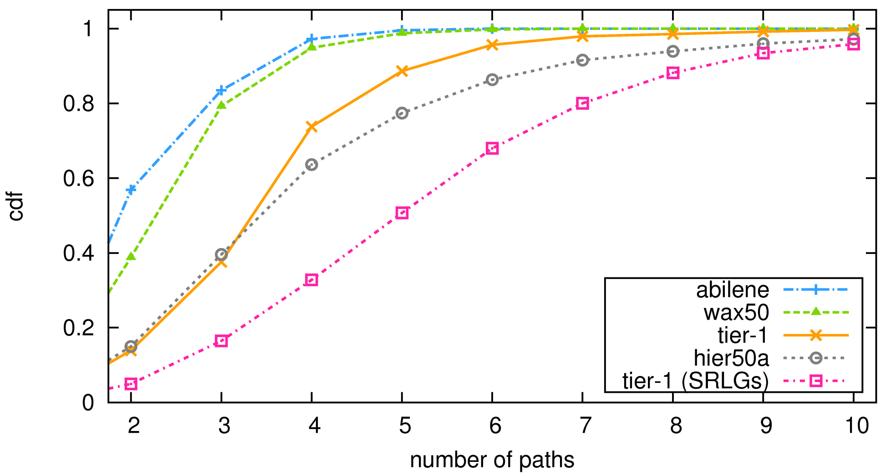
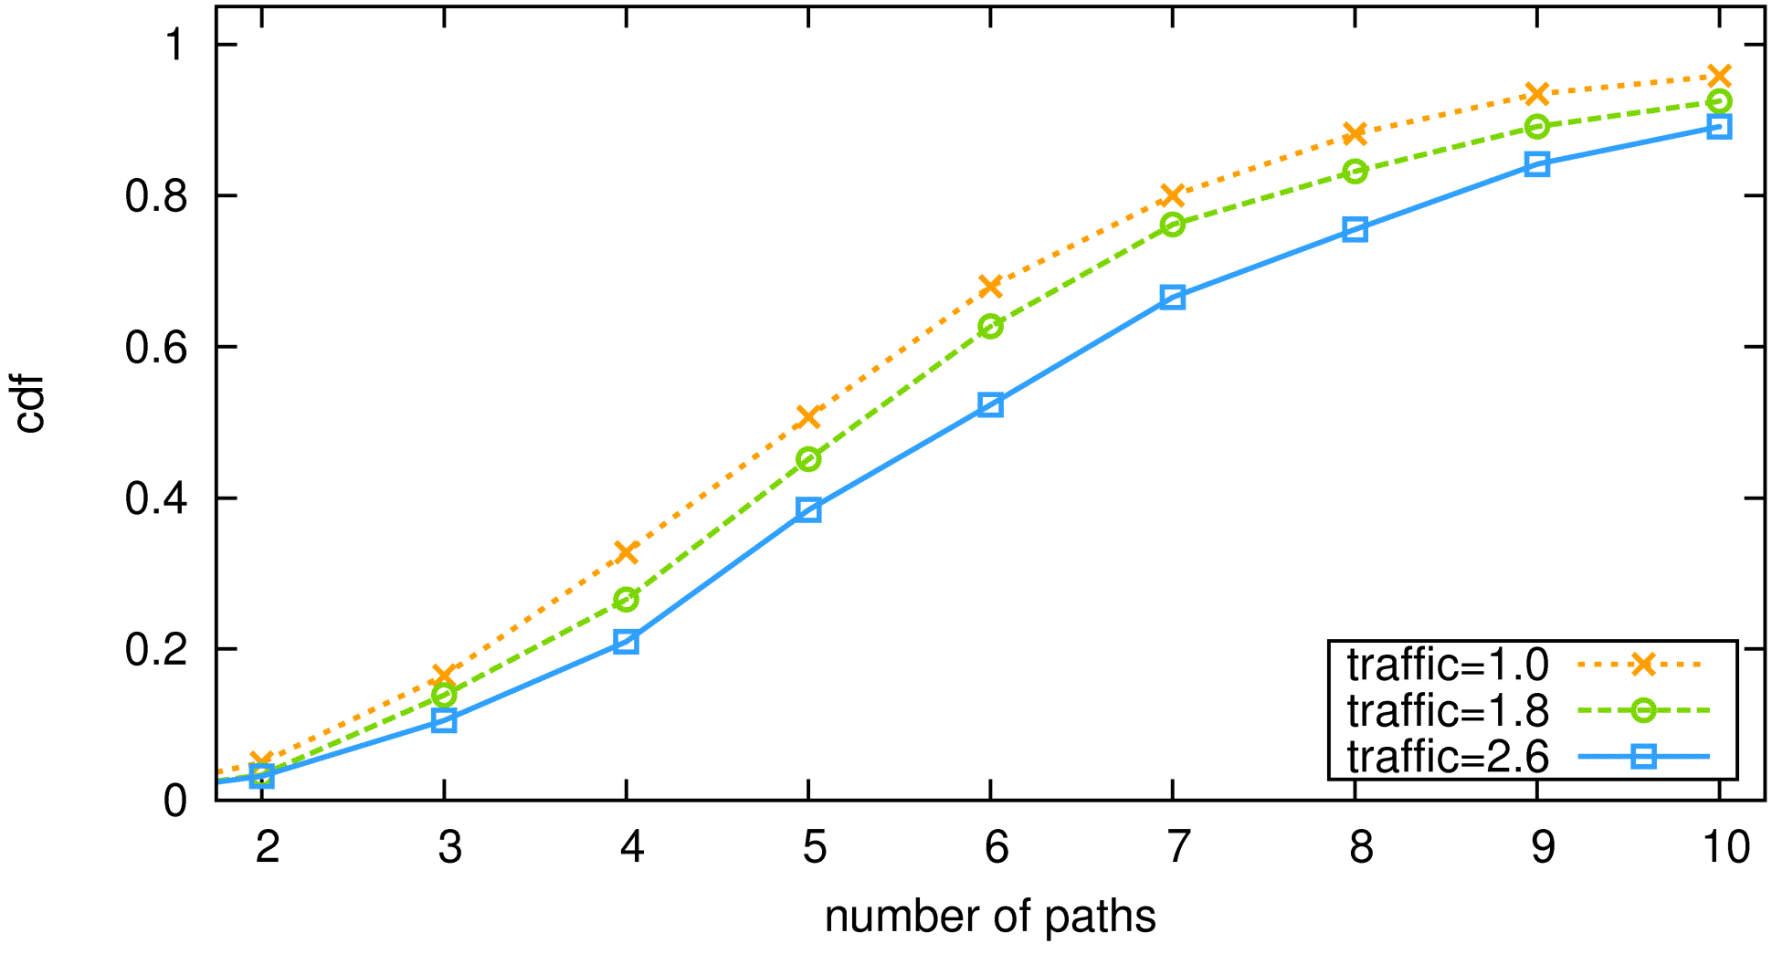
Number of Paths – Various Topologies
cdf
number of paths
number of paths
More paths for larger and more diverse topologies
Notes:
This is an analogy of the previous graph. Here we are looking at the number of paths for various topologies. We see that the number of paths is greater in larger more diverse topologies.

Slide 24
Summary
Simple mechanism combining path protection and traffic engineering
Favorable properties of state-dependent splitting algorithm:
(i) Near optimal load balancing
(ii) Simplifies network management and design
(iii) Small number of paths
(iv) Delay comparable to current OSPF
Path-level failure information is just as good as complete failure information
Notes:
We present a simple mechanism that combines path protection and traffic engineering.
We show a number of favorable properties of our solutions.
We make the exciting observation that if the ingress routers obtain path-level failure information, they can still balance the load just as well as if they had the full topology information.
Our solution is attractive because it simplifies network management and design.

Slide 25
Part II
BGP Safety Analysis
The Conditions of BGP Convergence
Martin Suchara
in collaboration with:
Alex Fabrikant and
Jennifer Rexford

Slide 26
The Internet is a Network of Networks
Previous part focuses on a single autonomous system (AS)
~35,000 independently administered ASes cooperate to find routes
Some route policies do not allow convergence
  Past work: “reasonable” policies that are sufficient for convergence
  This work: necessary and sufficient conditions of convergence

Slide 27
The Border Gateway Protocol (BGP)
BGP calculates paths to each address prefix
5
2
“I can reach d via AS 1”
3
Data traffic
“I can reach d via AS 1”
4
“I can reach d”
1
Prefix d
Each Autonomous System (AS) implements its own custom policies
  Can prefer an arbitrary path
  Can export the path to a subset of neighbors

Slide 28

Business Driven Policies of ASes
Customer-Provider Relationship
  Provider exports its customer’s routes to everybody
  Customer exports provider’s routes only to downstream customers
Peer-Peer Relationship
  Export only customer routers to a peer
  Export peer routes only to customers

Slide 29

BGP Safety Challenges
35,000 ASes and 300,000 address blocks
Routing convergence usually takes minutes
  But the system does not always converge…
Prefer 120 to 10
Prefer 210 to 20
1
2
Use 20
Use 120
Use 210
Use 10
0
d

Slide 30
Results on BGP Safety
Absence of a “dispute wheel” sufficient for safety (Griffin, Shepherd, Wilfong, 2002)
Necessary or sufficient conditions of safety (Gao and Rexford, 2001), (Gao, Griffin and Rexford, 2001), (Griffin, Jaggard and Ramachandran, 2003), (Feamster, Johari and Balakrishnan, 2005), (Sobrinho, 2005), (Fabrikant and Papadimitriou, 2008), (Cittadini, Battista, Rimondini and Vissicchio, 2009), …
Verifying safety is computationally hard (Fabrikant and Papadimitriou, 2008), (Cittadini, Chiesa, Battista and Vissicchio, 2011)

Slide 31
Models of BGP
Existing models (variants of SPVP)
  Widely used to analyze BGP properties
  Simple but do not capture spurious behavior of BGP
This work
  A new model of BGP with spurious updates
  Spurious updates have major consequences
  More detailed model makes proofs easier!

Slide 32
SPVP– Traditional Model of BGP (Griffin and Wilfong, 2000)
The higher the more preferred
Permitted paths
120
10
ε
210
20
ε
Selected path: 210
Always includes the empty path
1
2
The topology
0
The destination
Activation models the processing of BGP update messages sent by neighbors
System is safe if all “fair” activation sequences lead to a stable path assignment

Slide 33
What are Spurious Updates?
A phenomenon: router announces a route other than the highest ranked one
1230
10
Spurious BGP update 230:
210
20
230
230
Selected path: 20
1
2
3
30
0
Behavior not allowed in SPVP
Notes:
Mention that this is a real phenomenon. Verified by talking to a major router vendor, and observed by Jennifer at AT&T.

Slide 34
What Causes Spurious Updates?
Limited visibility to improve scalability
  Internal structure of ASes
  Cluster-based router architectures
Timers and delays to prevent instabilities and reduce overhead
  Route flap damping
  Minimal Route Advertisement Interval timer
  Grouping updates to priority classes
  Finite size message queues in routers

Slide 35
DPVP– A More General Model of BGP
DPVP = Dynamic Path Vector Protocol
  Transient period τ after each route change
  Spurious updates with a less preferred recently available route
Only allows the “right” kind of spurious updates
  Every spurious update has a cause in BGP
  General enough and future-proof
Notes:
Transient time period starts after a node receives an update that will change its path assignment.
MAKE PRECISE

Slide 36
DPVP– A More General Model of BGP
The permitted paths and their ranking
Spurious update
Selected path: 210
120
10
ε
210
20
ε
Remember all recently available paths (e.g. 20, 210)
20
1
2
StableTime = τ after last path change
0
Spurious updates are allowed only if current time < StableTime
Spurious updates may include paths that were recently available or the empty path

Slide 37
Consequences of Spurious Updates
Spurious behavior is temporary, can it have long-term consequences?
Yes, it may trigger oscillations in otherwise safe configurations!
Which results do not hold in the new model?

Slide 38
Analogs of Previous Results in DPVP
Most previous results in SPVP also hold for DPVP
  Absence of a “dispute wheel” sufficient for safety in SPVP (Griffin, Shepherd, Wilfong, 2002)
  Still sufficient in DPVP
Some results cannot be extended
  Slightly different conditions of convergence
  Exponentially slower convergence possible
Notes:
Mention that we are not disproving theorems. We just observe the conclusions do not hold!

Slide 39
DPVP Makes Analysis Easier
No need to prove that:
  Announced route is the highest ranked one
  Announced route is the last one learned from the downstream neighbor
We changed the problem
  PSPACE complete vs. NP complete

Slide 40
Necessary and Sufficient Conditions
How can we prove a system may oscillate?
  Classify each node as “stable” or “coy”
  At least one “coy” node exists
  Prove that “stable” nodes must be stable
  Prove that “coy” nodes may oscillate
Easy in a model with spurious announcements

Slide 41
Necessary and Sufficient Conditions
Definition: CoyOTE is a triple (C, S, Π) satisfying several conditions
1230
10
210
20
230
Coy nodes may make spurious announcements
1
2
30
Stable nodes have a permanent path
3
One path assigned to each node proves if the node is coy or stable
0
Theorem: DPVP oscillates if and only if it has a CoyOTE

Slide 42
Verifying the Convergence
Conditions = Finding a CoyOTE
In general an NP-hard problem
Can be checked in polynomial time for most “reasonable” network configurations!
e.g.
(i) filter paths violating business relationships
(ii) prefer paths not containing certain AS numbers
(iii) prefer paths from certain groups of neighbors
(iv) prefer shorter paths over longer ones
(v) prefer paths from a lowest AS number neighbor
Notes:
Regular expression = compact representation of the problem inputs.

Slide 43
DeCoy – Safety Verification Algorithm
Goal: verify safety in polynomial time
Key observation: greedy algorithm works!
  Let the origin be in the stable set S
  Keep expanding the stable set S until stuck
  If all nodes become stable system is safe
  Otherwise system can oscillate

Slide 44
Summary
DPVP: best of both worlds
  More accurate model of BGP
  Model simplifies theoretical analysis
Key results
(i) Spurious announcements are real
(ii) Safe instances in SPVP may oscillate in DPVP
(iii) No dispute wheel → safety
(iv) Necessary and sufficient conditions of convergence, can be found in polynomial time

Slide 45
Part III
How Small Groups can Secure Routing
Martin Suchara
in collaboration with:
Ioannis Avramopoulos
and Jennifer Rexford

Slide 46
Vulnerabilities – Example 1
Invalid origin attack
  Nodes 1, 3 and 4 route to the adversary
  The true destination is blackholed
1
2
3
4
5
6
7
Genuine origin
Attacker
12.34.*
12.34.*
Notes:
Attack can happen because customer exports prefix which is not verified by the provider (although strict verification could solve this problem)
Motivate the significance of the problem and explain why on average 50% of the internet will pick the route to the adversary

Slide 47
Vulnerabilities – Example 2
Adversary spoofs a shorter path
  Node 4 routes through 1 instead of 2
  The traffic may be blackholed or intercepted
No attack
1
2
3
4
5
6
7
Thinks route thru 2 shorter
Genuine origin
12.34.*
Notes:
Attack can happen because routers of an ISP can be compromised
Motivate the significance of the problem, explain this is a very powerful attack because ISP has good connectivity and can “export route to many neighbors at once”

Slide 48
Vulnerabilities – Example 2
Adversary spoofs a shorter path
  Node 4 routes through 1 instead of 2
  The traffic may be blackholed or intercepted
Announce 17
1
2
3
4
5
6
7
Thinks route thru 1 shorter
Genuine origin
12.34.*
Notes:
Attack can happen because routers of an ISP can be compromised
Motivate the significance of the problem, explain this is a very powerful attack because ISP has good connectivity and can “export route to many neighbors at once”

Slide 49
State of the Art – S-BGP and soBGP
Mechanism: identify which routes are invalid and filter them
S-BGP
  Certificates to verify origin AS
  Cryptographic attestations added to routing announcements at each hop
soBGP
  Build a (partial) AS level topology database
Notes:
Let’s start by describing what current solutions can do
Solutions need some public key infrastructure
mention S-BGP and soBGP are similar, but soBGP is amenable to *partial deployment*

Slide 50
How Our Solution Helps
Benefits of previous solutions only for large deployments (10,000 ASes)
  No incentive for early adopters
Our goal: Provide incentives to early adopters!
The challenge: few participants relying on many non-participants
  Our Solution: raise the bar for the adversary significantly
  10-20 cooperating nodes
Notes:
Solutions need very large participation base to achieve benefits
Even when fully deployed there are a number of residual vulnerabilities
S-BGP has been around for over 10 years, and has not been deployed
State of art not deployed, our key contribution: *deployability*

Slide 51
Lessons Learned from Experimentation
Observation | Justification
Participation of large ISPs is important | They learn many routes some of which are valid
Perfect detection of bad routes is desirable | Better (but not ideal) performance
The non-participants are worse off than the participants | The participants reject implicated routes while non-participants accept all
Need to increase path diversity | Perfect detection not enough
Notes:
- Large ISPs have access to more / diverse paths (unlike the average AS which is a singlehomed stub)
- Even though the participants indirectly help the non-participants, the non-participants are still worse off than the participants

Slide 52
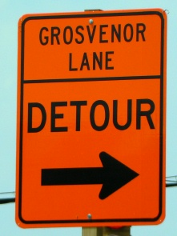
Our Approach – Key Ideas
Circumvent the adversary with secure overlay routing
Hijack the hijacker: all participants announce the protected prefix
Hire a few large ISPs to help
Detect invalid routes accurately with data plane detectors
Notes:
- Even if a participant does not learn any good routes, it should be able to circumvent the adversary. In our system, it can do it through secure overlay routing - SBone

Slide 53

Our Approach – Key Ideas
Circumvent the adversary with secure overlay routing
Hijack the hijacker: all participants announce the protected prefix
Hire a few large ISPs to help
Detect invalid routes accurately with data plane detectors
Notes:
We would like to force the non-participants to pick a valid route. This can be done by using the weapon of the adversary – by lying to the non-participants.
This is called Shout. It works together with Sbone.

Slide 54

Our Approach – Key Ideas
Circumvent the adversary with secure overlay routing
Hijack the hijacker: all participants announce the protected prefix
Hire a few large ISPs to help
Detect invalid routes accurately with data plane detectors
Notes:
- Observed before using large ISPs helps

Slide 55
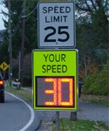
Our Approach – Key Ideas
Circumvent the adversary with secure overlay routing
Hijack the hijacker: all participants announce the protected prefix
Hire a few large ISPs to help
Detect invalid routes accurately with data plane detectors
Notes:
- Repeat can be done with data-plane probing

Slide 56
Secure Overlay Routing (SBone)
Protects intra-group traffic
Overlay of participants’ networks
Use peer route
Bad paths detected by probing
Use provider route
Use longer route
1
1
2
2
Participant
Nonparticipant
5
5
4
3
Detected as bad
12.34.*
; 12.34.1.1
6
7
7
12.34.*
; 12.34.1.1
Notes:
Animation:
1. When Sbone is not used, nodes 1, 2, 5 and 6 believe the adversary
2. Let’s illustrate what happens when the orange nodes deploy SBone
3. Node #7 announces its tunnel endpoint; of course the clever adversary tries to attack the tunnel as well as the original prefix
4. Let’s consider the available underlay routes to the tunnel endpoint. We see that all participants are able to pick a valid underlay route to the tunnel endpoint in node #7.
5. Finally, we see that all participants can use the overlay links (dotted) to successfully tunnel to node #7.
- Note: SBone differs from traditional overlay because it connects networks rather than individual end-hosts

Slide 57
Secure Overlay Routing (SBone)
Traffic may go through an intermediate node
Uses path through intermediate node 3
Forwards traffic for 1
?
1
2
?
?
12.8.1.1
5
?
4
3
12.34.*
; 12.34.1.1
; 12.8.1.1
6
7
57
12.34.*
; 12.34.1.1
Notes:
Of course, the participants may not always be able to pick a direct underlying path to the tunnel endpoint. I will show you that the SBone may help even in this case.
1. First, notice that the set of participants changed. Node #2 is a non-participant and will always route through the adversary to the tunnel endpoint. Node 1 and 5 cannot reach the tunnel endpoint in node #7 directly because all the underlying paths are bad.
2. Fortunately, node #1 can use an indirect path and tunnel the traffic to node #1 which subsequently forwards the traffic to node #7.

Slide 58

SBone – 30 Random + Help of Some
Large ISPs
Percentage of Secure Participants
5 large ISPs
3 large ISPs
1 large ISP
0 large ISPs
Group Size (ASes)
58
Notes:
Describe axes again, explain will focus on participants now, therefore the y-axis is % of participants; will look at non-participants later
Must mention that the x-axis does not include the large ISPs

Slide 59
SBone – Multiple Adversaries
Solution: enlist more large ISPs!
Percentage of Secure Participants
With 5 adversaries, the performance degrades
5 large ISPs
3 large ISPs
1 large ISP
0 large ISPs
Group Size (ASes)
59
Notes:
- Performance degrades but just as before larger group of large ISPs / more participants helps

Slide 60
SBone – Properties
Observation | Justification
SBone offers good availability even for very small groups | It better exposes path diversity
Non-participants are not secure yet | They lack the ability to tunnel around problems
60
Notes:
- So the remaining problem is how to secure the non-participants

Slide 61
Hijacking the Hijacker – Shout
Secure traffic from non-participants
All participants announce the protected prefix
Prefers short customer’s path leading to adversary
Use shortest path 1412.34.*
Once the traffic enters the overlay, it is securely forwarded to the true prefix owner
1
2
12.34.*
3
4
5
12.34.*
6
7
Node 4 shouts
61
12.34.*
12.34.*

Slide 62
Shout + SBone – 1 Adversary
With as few as 10 participants + 3 large ISPs, 95% of all ASes can reach the victim!
Percentage of Secure ASes
5 large ISPs
3 large ISPs
1 large ISP
0 large ISPs
Group Size (ASes)
62
Notes:
- Now considering all participants on the y-axis

Slide 63
Shout + SBone – 5 Adversaries
Percentage of Secure ASes
More adversaries  larger groups required!
5 large ISPs
3 large ISPs
1 large ISP
0 large ISPs
Group Size (ASes)
63

Slide 64
Shout – Properties
Observation | Justification
Can secure communication from non-participants | It suffices if non-participant reaches any participant
Routing table sizes do not increase | Increases < 5%
Shout does not inflate path lengths significantly | Path lengths increase by <15% with 3 large ISPs
64

Slide 65
Summary
SBone and Shout are novel mechanisms that allow small groups to secure BGP
The proposed solution
(i) Secures address space of a small group of participants
(ii) Allows both participants and non-participants pick valid routes
(iii) Provides incentives to the adopters
65

Slide 66
Conclusion

Slide 67
Better than Best-Effort Availability
Our three solutions:
(i) Allow routers in a single AS to cooperatively find failure resilient paths and balance the load
(ii) Major step towards allowing rational ASes to verify their configurations do not prevent route convergence
(iii) Small number of participating ASes can protect themselves against malicious BGP attacks
Improved reliability of the Internet

Slide 68
Thank You!

