Slide 1

Wide-Area Traffic Management for
Cloud Services
Final Public Oral
Joe Wenjie Jiang
Advisors: Profs. Jennifer Rexford & Mung Chiang
Feb 09, 2012

Slide 2
The Importance of Traffic Management
Internet increasingly a platform for cloud services
  Web search, video streaming, social networks, online games
Cloud services need effective traffic management
  Wide-area, geographically-replicated
Performance is the life blood
  Latency, throughput
Service providers care about operational costs
  Traffic billing, electricity, management
Design new traffic management solutions, and make this process more systematic, automated, and effective

Slide 3
Who is Managing the Traffic
Content Providers (CPs) deploy content using CDNs
Internet
Content Distribution Network
(CDN)
Client

Slide 4
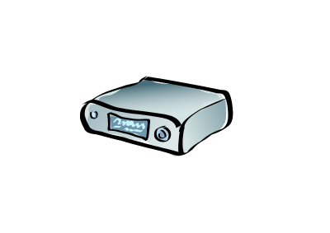
Who is Managing the Traffic
Content Providers (CPs) use decentralized CDNs, e.g., nano data centers
Internet
Nano Data Centers
(NaDa)
Client

Slide 5

Who is Managing the Traffic
ISPs provide connectivity and route packets
Client

Slide 6
Traffic Management: Server Selection
CDN
Who:
CDN, Nano Data Centers
What:
Map one or multiple data centers (servers) to a client
Why:
Proximity, load balancing, cost
…
…
Server
Mapping Node
Mapping Node
Client
Client
Client
Client

Slide 7
Traffic Management: Network Routing
CDN
Who:
Network operator (ISP)
What:
One or multiple paths connecting client/server, traffic split ratio
Why:
Improve throughput, avoid congestion, enforce policy constraints
…
…
Server
Client
Client
Client
Client

Slide 8
Traffic Management: Content Placement
CDN
Who:
CP
What:
Which content to place on which server
Why:
Throughput & cost, a large catalog of content, popularity changes
…
…
Server
Client
Client
Client
Client

Slide 9
Opportunity for Coordinating Traffic Management
Cooperation b/w different institutions
Cloud Service Providers (CSPs) blur these boundaries
  ISP+CDN: AT&T
  CDN+CP: YouTube
Server
Selection
Content
Placement
Network
Routing

Slide 10
The Need for Sharing Information
Mis-aligned objectives lead to conflicting decisions
Decisions sub-optimal due to lack of visibility
Example:
Latency-oriented
Server
Selection
Does not see all wide-area paths
Throughput-, congestion-, cost-oriented
Content
Placement
Network
Routing

Slide 11
The Need for Joint Control
Decisions are coupled, depend on each other
Separate optimizations not globally (Pareto) optimal
Example:
Server
Selection
Local caching + SS is non-optimal
TE+ SS is non-optimal
Content
Placement
Network
Routing

Slide 12
The Need for Distributed Implementation
Coordinate, but keep functional separation
Scalability: a large number of network elements, e.g., mapping nodes, clients
Example:
Server
Selection
10^2 mapping nodes
10^2 servers
10^3 edge links
10^6 clients (IP-prefix)
Content
Placement
Network
Routing

Slide 13
Our Contributions
How to Share Information?
Do not want to expose internal structure
How much info is needed? Bound on efficiency loss?
How to Jointly Control?
Decisions heterogeneous: resolution & time-scales
High computational complexity
How to Enable Decentralized Implementation?
Notoriously prone to oscillations
Inaccuracy: does not optimize designated objectives

Slide 14
Part 1: Sharing Information
How to Share Information?
Do not want to expose internal structure
How much info is sufficient? Bound on efficiency loss?
Cooperative Server Selection & Traffic Engineering in an ISP Network [Sigmetrics’09]
Three models with an increasing amount of cooperation
Improve visibility b/w routing and server-selection
Optimality conditions, performance bound, Nash bargaining solution

Slide 15
Part 2: Joint Control
How to Jointly Control?
Decisions heterogeneous: resolutions & time-scales
High computational complexity
Federating Content Distribution in Decentralized CDNs [In submission]
Administratively separate groups of “last-mile” servers
Joint request routing and content placement
Easy to implement in practice, provably optimal

Slide 16
Part 3: Decentralized Design
How to Enable Decentralized Implementation?
Notoriously prone to oscillations
Inaccuracy: does not optimize designated objectives
DONAR: Decentralized Server Selection for Cloud Services [Sigcomm’10]
Outsourcing server-selection with a distributed mapping service
Customized policies that balance perf., load, and costs
Scalable, responsive, accurate, serving real CDN traffic

Slide 17
Our Design Approaches
Top-Down
divide-and-conquer
admin. separation
scalability
Optimization
design language
expressiveness
comp. efficiency
Practical Design
perf. evaluation
trace-based sim.
implementation

Slide 18
A Revisit of Architectural Choices
Layering
data plane: Ethernet, IP, TCP/UDP
control plane: selecting routes, replicas, etc
State
centralized
distributed
Interfacing
ad hoc, limited visibility
systematic, more expressive
Functionality
modularized, coordinated
coupled, clean-state

Slide 19
Part I
Cooperative Server Selection and
Traffic Engineering in an ISP Network
Joint work w/ Rui Zhang-Shen, Jennifer Rexford and Mung Chiang [Sigmetrics’09]
TE
SS

Slide 20
Internet Service Providers (ISPs)
ISPs provide connectivity and transit services:
How to route packets

Slide 21
Content Providers (CPs)
CPs generate and distribute content:
Where to find source
20%
50%
30%

Slide 22
Traffic Engineering Calculates Route
Traffic Engineering
minimize Σ link cost
subject to flow conservation
variable flow on each link
0.5
i
0.2
0.4
0.3
0.1
0.7
0.2
j
Link Cost
0.1
Treats traffic matrix as a constant
j
i
vol_{ij}
1
0
Link Utilization

Slide 23
Server Selection Decides Traffic
Server Selection
minimize average latency
subject to demand satisfaction
server load split/cap
variable mapping for each client
70%
30%
100%
Link Delay
User performance depends on ISP routing
proximity
path congestion
0
1
Link Utilization

Slide 24
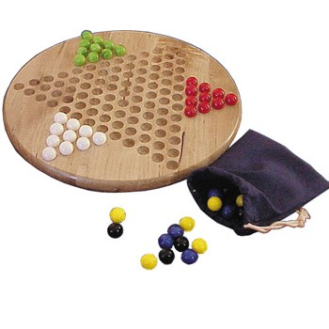
TE-SS Interaction: Mirror Image
Path
ISP
Traffic Engineering
CDN
Server Selection
Traffic
Why is today’s Internet stable?
Is such an equilibrium efficient?
How to improve by cooperation?

Slide 25
No Cooperation: Today’s TE and CDN
Limited
visibility
  CP limited network visibility
  End-to-end measurement, or geo-database
  Sub-optimal user performance
ping
geo-database
TE
SS
complete
traffic matrix
other traffic

Slide 26

No Cooperation: Stability
Limited
visibility
  Theorem
  There exists a Nash equilibrium of today’s practice.
  Confirms no oscillation
  Lack of visibility does not affect stability
ping
geo-database
TE
SS
complete
traffic matrix
other traffic

Slide 27

No Cooperation: Sub-optimal
Limited
visibility
  Theorem
  The CDN performance gap can
  be unbounded with limited visibility.
  The equilibrium is not Pareto-optimal
  Opportunity for improving both CDN and TE
SS
(perf. cost)
No coop
Pareto
TE (congestion)

Slide 28
Improved Visibility
Limited
visibility
Improved visibility
  From asymmetric to symmetric information share
  ISP shares complete topology and routing decisions
  Given a fixed routing decision, CDN is able to achieve the optimal user performance
topology,
routing
TE
SS
complete
traffic matrix
other traffic

Slide 29
Improved Visibility: Stability
Limited
visibility
Improved visibility
  Theorem
There exists a Nash equilibrium with improved visibility.
  Sharing information does not cause oscillation
topology,
routing
TE
SS
complete
traffic matrix
other traffic

Slide 30
Improved Visibility: Optimality Results
Limited
visibility
Improved visibility
  Theorem
The equilibrium is unique, globally optimal, and can be realized by separate optimizations, given that
  TE and SS have identical costs
  No other traffic
topology,
routing
TE
SS
complete
traffic matrix

Slide 31
Improved Visibility: Optimality Results
Limited
visibility
Improved visibility
  Implications
  Given sufficient information and same objectives, TE and SS are synergistic
  A good motivation for ISP-CDN, e.g., AT&T
topology,
routing
TE
SS
complete
traffic matrix

Slide 32
Improved Visibility: Non-optimality Results
Limited
visibility
Improved visibility
  The equilibrium is not Pareto-optimal in general
  CDN improvement may be at the cost of TE degradation
SS
(perf. cost)
No coop
Info share
Pareto
TE (congestion)

Slide 33
Improved Visibility: Paradox of Extra Info
Limited
visibility
Improved visibility
Theorem [Paradox of Extra Information]
  When CP is given more visibility, the CDN performance at the equilibrium can even degrade, and such degradation can be unbounded.
  Braess’s Paradox
  The existence of multiple equilibria
SS
(perf. cost)
No coop
Info share
Pareto
TE (congestion)

Slide 34
The Need for A Joint Design
Limited
visibility
Improved visibility
Sharing objectives
Design Requirements
  Performance efficiency
  W/o exposing internal structure
  Functionality separation
  Fairness

Slide 35
Nash Bargaining Solution (NBS)
NBS
max (TE₀-TE)(SS₀-SS)
s.t. demand satisfaction
var rate(c,s,p): traffic for
client c from server s on
path p
Starting point in the contract: e.g., today’s performance
SS
(perf. cost)
(TE₀, SS₀)
The design requirement is assured by four axioms of NBS
(TE, SS)
TE (congestion)

Slide 36
Implementing NBS with Functional Separation
TE_{new}
NBS
Link usage
f^{cp}, f^^{bg}
Consistency prices u_{l}, v_{l}
SS_{new}
  Theorem The distributed algorithm converges to the optimum of NBS.

Slide 37
Evaluation: Where are the Sweet Spots
  Evaluation on tier-1 ISP backbones
  Realistic cost functions, traffic model and link distributions
  Better improvement when CDN traffic is little or much
  Confirms the existence of the paradox of extra info

Slide 38
Part I Conclusion
Traffic management decisions do not coordinate well due to limited visibility into each other
Three abstractions with an increasing amount of information share
  End-to-end measurement at the edge
  Expose more information, e.g., topology and routes, at the core
  Communicating objectives while keeping functional separation and internal info.
Theoretical proofs and experimental validation

Slide 39

Part II
Federating Content Distribution in
Decentralized CDNs
Joint work w/ Stratis Ioannidis, Laurent Massoulie and Fabio Picconi
[In preparation]

Slide 40
CDN Trends
Total Internet traffic >10¹⁹ Bytes per month in 2011; video traffic alone predicted to grow 3x by 2015¹.
ISPs build their own CDNs, and start to form federated CDNs
  IETF CDNi working group
  OCX (Operator Carrier Exchange)
Extending to decentralized CDNs: last-mile servers
  Nano Data Center (NaDa) consortium, set-top boxes
  Managed peer-to-peer, e.g., Pando
¹Cisco visual networking index: Forecast and methodology, 2010-2015

Slide 41
Advantages of Last-Mile CDNs
Closer to end users and deep caching
  Reduce latency, cross-network traffic
Own the network backbone over which content is transmitted
  Better paths, more coordination
More POPs (point of presence) across the Internet
Built-in bandwidth cost advantage

Slide 42


Federated Content Distribution
ISP 2
ISP 1
ISP 3

Slide 43
New Challenges
Smaller server usually implies limited storage and bandwidth capacity
  To handle a very large catalog of content, e.g., video
  From latency-oriented to throughput-oriented services
Inter-connecting multiple CDNs
  Directing requests from one CDN to another not straightforward
  Replicating content between different CDNs/servers can be a pain

Slide 44
System Design Objectives
Goal: optimize performance and cost
  Maximize the total throughput given the server resources
  Minimize cross-traffic costs
    Latency
    Transit/billing cost
Joint control of request routing and content placement across all CDNs
  Inter-ISP: which ISP to direct to, including local
  Intra-ISP: which particular server to choose
  Content placement: which set of content to place on each server

Slide 45
Why is the Joint Design Difficult?
Size: 10s ISPs, 10^3 servers/ISP, >10^6 content
  Complexity: content placement is NP-hard
  Optimality: separate optimization is sub-optimal
  Dynamics: changing content popularity
  Time-scales: content placement much slower

Slide 46
A Divide-and-Conquer Approach
Accurate placement
Inexpensive replication
Optimized objective
Efficient computation
Content Replication
Server-level content placement
Cost-efficient content shuffling
Algorithmic design
Global Optimization
Inter-ISP request routing
ISP-level content placement
Distributed optimization
Server Selection
Intra-ISP request routing
Graph theory, dynamic fluid theory
Simple implementation
Optimal dropping prob.
Scalable, adaptive, simple, and provably-optimal federated content distribution

Slide 47
System Model: Costs
Backup server s
ISP d’
cost(d,s)
ISP d
cost(d,d)
cost(d,d’)
ISP d”
Unit download cost: latency & traffic billing

Slide 48
System Model: Decision Variables
  p^{d}_{c}: fraction of servers in ISP d that cache content c
Backup server s
ISP d’
ISP d
  R^{dd’}_{c}: request rate of content c from d served by d’
ISP d’’

Slide 49
Global Optimization for Minimizing Costs
Weighted download cost
Cache size
Demand
Total capacity
Content capacity
Necessary (coarse-grain) conditions
  R^{dd’}_{c}: request rate of content c from d served by d’
  p^{d}_{c}: fraction of boxes in d that cache c
  c: content
  d: ISP
  B: # of boxes
  U: # of upload slots
  M: memory size
  λ_{c}: request rate of content c

Slide 50
A Distributed Solution to the Global Problem
The global optimization is a linear programming
  Computationally-efficient solution, but …
CDNs are administratively separate
  Hard to deploy a global coordinator
  Do not want to expose internal information
We develop a distributed algorithm
  Each ISP solves a local version of cost-minimization problem
  Only requires exchange of summary statistics, on aggregated server/user
  Provably converges to the global optimum

Slide 51
Intra-ISP Server Selection
Goal: need to ensure that every arrived request is served given calculated rates R^{dd’}_{c} and fractions p^{d}_{c}
Simple strategy is sub-optimal:
  Randomly assign a server that holds the requested content
  May get stuck b/c servers with the desired content may not have free upload slots
Repacking is optimal but expensive
  Migrate existing downloads
  Expensive operation, service interruption
  Solving a maximum matching problem (finding an augmenting path) for every request

Slide 52
Intra-ISP Server Selection
Goal: need to ensure that every arrived request is served given calculated rates R^{dd’}_{c} and fractions p^{d}_{c}
We propose Uniform Slot:
  Randomly choose a server that has the content, w/ probability proportional to its free uploads slots
  No migration cost
  Easy to implement in practice
  Optimality?

Slide 53
Matching Theory
Hall’s Condition:
requests
|N(V)| ≥ |V|
servers

Slide 54
Optimality of Uniform-Slot Policy
Theorem
Hall’s condition is both necessary and sufficient condition such that the uniform-slot policy achieves zero request drops with a high probability (as the number of servers increases).
How to ensure that Hall’s condition holds, by placing content on each server?
  Given the calculated replication ratio p^{d}_{c}
  A large number of constraints
  Need to consider the content shuffling cost, as popularity changes

Slide 55
Content Replication Strategy
Designated Slot Placement
  Calculates the exact content combination on each server
  An algorithm to incrementally construct the content placement
  Minimizes the content shuffling cost, e.g., # of moves needed between two replication profiles.
Theorem
Given p^{d}_{c} calculated by global problem, Hall’s condition always holds under the designated slot placement strategy.

Slide 56
Accuracy of Uniform-Slot Policy
  Event-driven simulator that implements distributed optimization, Uniform Slot request-routing, Designated Slot Placement
  Dropping probability decreases quickly as B grows
  A demonstration that the joint solution is self-scalable

Slide 57
Real-life BitTorrent Trace-based Evaluation
  30-day trace of Vuze (largest BT client) global network
  8M unique IPs
  Users grouped by country, top 30 countries
  Content demand measured during a 24-hour interval

Slide 58
Effectiveness of Joint Design
Cost metric
Local | 0
Home | 0
Remote | Unif [0, 1]
Server | 3
  LRU: Least Recently Used
  LFU: Least Frequently Used
  Closest: first available ISP with min cost

Slide 59
Part II Conclusion
Separate traffic management decisions do not enable a global optimality
Joint control of request routing and content placement in federated CDNs
  A divide-and-conquer approach for computational tractability
  Scalable, simple solutions with optimality guarantees
Theoretical proofs and trace-based evaluation

Slide 60
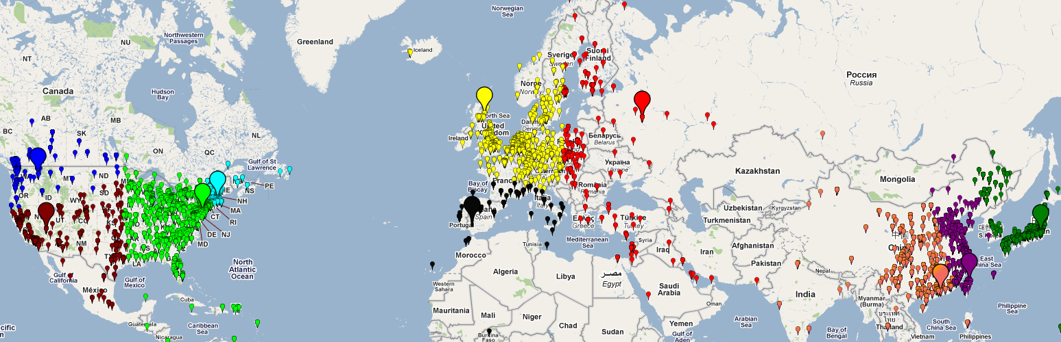
Part III
DONAR: Decentralized Server Selection
for Cloud Services
Joint work Patrick Wendell, Mike Freedman and Jennifer Rexford
[Sigcomm’10]

Slide 61
Server Selection for Geo-Replicated Services
Service Replicas
Mapping
Nodes
DNS/
HTTP Proxy
DNS/
HTTP Proxy
DNS/
HTTP Proxy
Client
Requests

Slide 62
Expressing Server-Selection Policies
Today’s approaches
  Location-aware: selecting the closest node
  Load-aware: round-robin
  Heuristic-based: closest-node from the pool of servers that have current load below a threshold
We want more complex policy expression!
  For complex load-balancing
  For optimizing operational costs, such as traffic billing.

Slide 63
Policy Constraints Expression
Service Replicas
Bandwidth cap 10,000 request/min
Desire 10% traffic ratio allow ±3% deviation
Outsource to
DONAR
Mapping
Nodes
DONAR
DONAR
DONAR
Client
Requests

Slide 64
Optimizing Performance w/ Policy Constraints
Weighted network cost
Demand satisfaction
Bandwidth cap
Server load split within tolerance
Server selection

Slide 65
Need for A Decentralized Solution
By the numbers
  DONAR nodes: N (10²); servers: S (10²); clients: C (10⁶)
A central coordinator
  Measure client traffic: O(C)
  Solve the global problem
  Return mapping decisions: O(C*S)
Each DONAR node does not need to share its own client space
  Make decision for local clients
  Yet be aware of global impact and server constraints

Slide 66
Global Optimization w/ Mapping Nodes
Weighted network cost
Demand satisfaction
Decomposable!
Bandwidth cap
Server load split within tolerance
Server selection via mapping node

Slide 67
Distributed Algorithm: Local SS Problem
Local Info
Prices from all servers
Aggregate info from other nodes
Local Perf.
Global Load
Traffic load from other nodes

Slide 68
DONAR Algorithm
Service Replicas
Mapping
Nodes
DONAR
DONAR
DONAR
Solve LOCAL
problem
Share summary messages O(S)

Slide 69
DONAR Algorithm
Service Replicas
Mapping
Nodes
DONAR
DONAR
DONAR
An order of 10⁴ message reduction!
Solve LOCAL
problem
Share summary messages O(S)

Slide 70
DONAR Algorithm
Service Replicas
Mapping
Nodes
DONAR
DONAR
DONAR
Theorem
The distributed algorithm converges to the optimum of the GLOBAL problem

Slide 71
Evaluation with Real CDN Traffic Trace
  2-hour trace of request data from CoralCDN
  DONAR algorithm adapts to split weight changes quickly
  Very responsive to traffic load changes

Slide 72
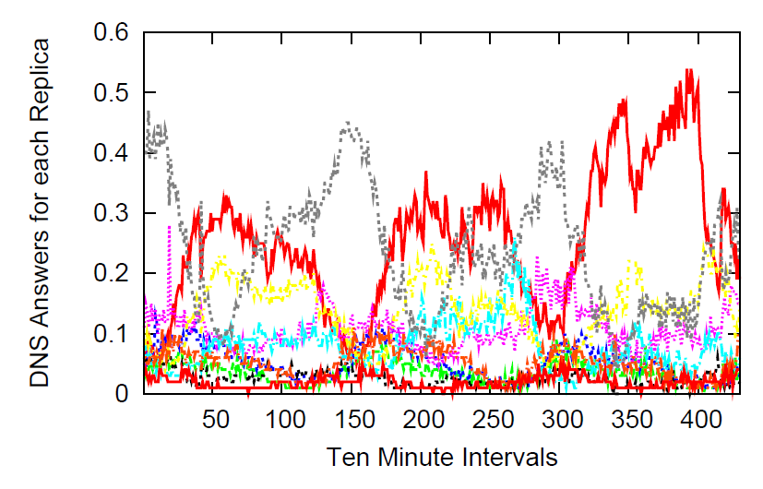
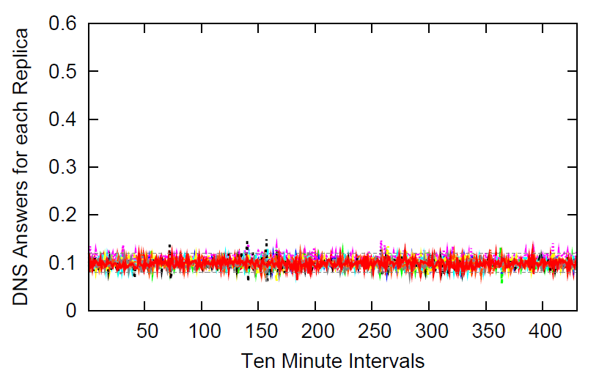
Prototype Implementation & Deployment
DONAR publicly deployed since 11/2009 (Patrick Wendell & Andrew Schran)
Production use for:
  MeasurementLab
  CoralCDN
Service receives around 1 million DNS requests per day.
  Closest-Node Policy
  Equal-Split Policy

Slide 73
Part III Conclusion
Distributed implementation of traffic management solutions for large-scale geo-distributed services.
A distributed system outsourcing server-selection for cloud services
  Customized policies that balance performance, load, and costs
  Distributed algorithm that is scalable, responsive, and accurate
Theory-inspired design demonstrated by real-life deployment

Slide 74
Networking as a Discipline
“The ability to master complexity is valuable…
But not the same as the ability to extract simplicity,
which lays the intellectual foundations…
Abstractions are keys to extract simplicity.”
S. Shenker, “The future of networking, and the past of protocols.”

Slide 75
Synergistic Solutions Simplify CSP Traffic Mgmt.
 | Traffic Management | Scope | Abstraction
Sharing Information | Coordinate routing and server-selection | Inside an ISP-CDN network | Communication b/w layers
Joint Control | Jointly control content placement and request routing | Across federated CDNs | Modularization
Decentralized Implementation | Outsource server-selection to DONAR with customized policies | CDN-specific | Distributed states

Slide 76
Future Research Directions
Optimizing CSP operational costs
  More complicated traffic billing models, such as 95-percentile
  Location-dependent, time-varying costs, such as power draw
Other traffic management within a CSP backbone
  Operator also controls the server, e.g., sending rate
  Applications have different priorities
Long term server placement
  Need to upgrade their infrastructure
  More servers vs. more paths? Location?

Slide 77
The End
Thank You

