Slide 1

Serval: Software Defined
Service-Centric Networking
serval-arch.org
Jen Rexford
Erik Nordstrom, David Shue, Prem Gopalan,
Rob Kiefer, Mat Arye, Steven Ko, Mike Freedman
Princeton University

Slide 2
Internet of the 1970s
Network designed for accessing a specific host.
ftp, telnet
SDS Sigma
SDS 940
PDP-11
h1
h3
IMP 0
IMP 1
h2
h4
UCLA
Stanford

Slide 3
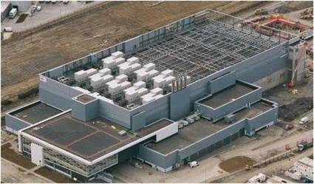
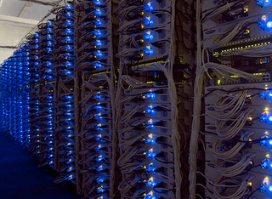







Service-Centric Networking
1970s
1980s
1990s
2000s
Users agnostic of actual service instance and its location
Notes:
Next: These services have vastly different/complex requirements in comparison to the simple resource sharing offered by host-host model.

Slide 4
Challenges: Multiplicity and Dynamism
Service with dynamic pool of replicas
  Challenge: keep service resolution up-to-date
Failure
Internet
Load
Balancer
Replicated
Web Service
Notes:
Wide-area: DNS, local: load balancers
Update DNS and load balancers on service instance failure/recovery
DNS caching, all traffic through load balancer

Slide 5
Challenges: Multiplicity and Dynamism
IaaS with dynamic traffic demand
  Challenge: migrate VMs to balance network load
VM
Migration
Internet
VM
Migration
Notes:
Purpose of service resolution threefold: 1) redirect clients to nearby replica, 2) one that is live, and 3) not overloaded. This gives users a good service experience and evenly spreads the load across all replicas, allowing the service to scale.
With multiplicity in replicas, challenges are: keep state of live replicas up-to-date, find good one.
DNS load balancers: caching is pervasive throughout the network, leading to slow failover and clumsy load balancing. TTLs are often ignored to give faster response times.

Slide 6
Challenges: Multiplicity and Dynamism
Mobile end-hosts with multiple interfaces
  Challenge: seamless service access across virtual migrations and physical mobility
Enterprise
Network
Transit
Provider
Multi-
Homing
4G
Cellular
Provider
Physical
Mobility
Notes:
Cannot spread a single connection over multiple interfaces, or keep a connection alive across changes in location

Slide 7
Supporting Modern Services
Defining “the right” abstractions
  Service naming
  Service-level events
  Common APIs
Separating control and data
  Programmability through a well-defined data plane
  Policy/control through a flexible control plane
Notes:
Building foundations, allowing innovation

Slide 8
Service-Centric Abstractions
Service = group of processes with same functionality
  Have: IP address + port number
  Problems: Slow DNS failover due to caching, inefficient and costly stateful load balancers with fate sharing
  Want: Service names with a group abstraction that hide composition and location
Flow = dynamic service communication context
  Have: Five-tuple, bound to interface and location
  Problems: Connections break when addresses change
  Want: Flow names decoupled from location and underlying communication interface

Slide 9
A Clean Role Separation in the Stack
Naming the right things at the right level
  What you access (serviceID), over which flows (flowIDs), and at which service instance (IP address)
TCP/IP
Serval
bind (IP + port)
bind (serviceID)
Application
demux (IP + port)
Transport
demux ( )
Service
Access
forward (IP)
serviceID
flowID
Network
forward (IP)
Notes:
Mention rationale for position of SAL in the stack
Connection handling in the SAL allows reuse of functionality across multiple transport protocols.

Slide 10
Service Names (ServiceID)
Different granularities of services
  Entire distributed Web service
  Replicated partition in back-end storage
  Set of peers distributing a common file
ServiceIDs allocated in blocks
  Ensures global uniqueness
  Enables prefix-based aggregation
ServiceID carried in network packets
  Service-level routing
  Late-binding to a service instance

Slide 11
Active Sockets
Applications should operate on service names
bind(fd, serviceID)
listen(fd)
connect(fd, serviceID)
Network stack must resolve service to instance for client
Network stack must advertise service for server

Slide 12
Separating Control and Data
(un)register X
Application
Service Controller
Socket
Control-Plane Protocol
Service controller
DNS or other database
OpenFlow controller
bind(X) close()
Service
Control API
Data Delivery
Kernel
Network
Stack
ServiceID | Action | Sock/Addr
X
Service Table
Dest Address | Next Hop
IP Forwarding Table
Notes:
Talk about updating state in tables.

Slide 13
Data Plane: The Service Table
ServiceID | Action | Rule State
Prefix A | FORWARD | Send to addr A1
Prefix B | FORWARD | Send to [A2, A3, A4]
Prefix C | DEMUX | Send to listening sock s
Prefix D | DELAY | Queue and notify service controller
Prefix E | DROP
* | FORWARD | Send to A5

Slide 14
The Service Table (SIB)
ServiceID | Action | Rule State
Prefix A | FORWARD | Send to addr A1
Prefix B | FORWARD | Send to [A2, A3, A4]
Prefix C | DEMUX | Send to listening sock s
Prefix D | DELAY | Queue and notify service controller
Prefix E | DROP
* | FORWARD | Send to A5

Slide 15
The Service Table (SIB)
ServiceID | Action | Rule State
Prefix A | FORWARD | Send to addr A1
Prefix B | FORWARD | Send to [A2, A3, A4]
Prefix C | DEMUX | Send to listening sock s
Prefix D | DELAY | Queue and notify service controller
Prefix E | DROP
* | FORWARD | Send to A5

Slide 16
The Service Table (SIB)
ServiceID | Action | Rule State
Prefix A | FORWARD | Send to addr A1
Prefix B | FORWARD | Send to [A2, A3, A4]
Prefix C | DEMUX | Send to listening sock s
Prefix D | DELAY | Queue and notify service controller
Prefix E | DROP
* | FORWARD | Send to A5

Slide 17
The Service Table (SIB)
ServiceID | Action | Rule State
Prefix A | FORWARD | Send to addr A1
Prefix B | FORWARD | Send to [A2, A3, A4]
Prefix C | DEMUX | Send to listening sock s
Prefix D | DELAY | Queue and notify service controller
Prefix E | DROP
* | FORWARD | Send to A5

Slide 18
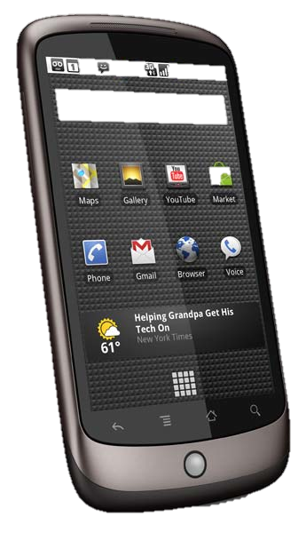
Ad hoc Service Discovery
flowID
addr
srvID
4
X
SRC
b
3
2
connect(X)
SYN-ACK
DST
a
1
SYN-ACK
flowID
b
addr
srvID
SYN
SRC
3
a
1
DST
*
X
SYN
SYN
1
4
a
SYN-ACK
flowID
addr
srvID
X
ServiceID | Action | Rule State
* | FORWARD | 192.168.1.255
SRC
c
4
DST
a
1
c
SYN-ACK

Slide 19
Service-Level Forwarding
Kernel
Network
Stack
FlowID | Socket
ServiceID | Action | Sock/Addr
Service-level
Forwarding
Flow Table
Service Table
Dest Address | Next Hop
IP Forwarding Table
Notes:
Talk about updating state in tables.

Slide 20
Load Balancing Example
SYN
a
1
flowID
2
e
X
addr
srvID
3
X
SYN
SRC
a
1
SYN
a
1
DST
b
X
X | d,e
* | a
e
X
1
App
Transport
d
X | b
b
Service Access
X
IP
s_{X}
a
c
X | s_{X}
* | b
SRC
e
2
4
SYN-ACK
DST
a
1
e

Slide 21
Connections with Multiple Flows
Application
Socket s
Transport
FlowID | Socket
flowID f_{C1}
Service
Access
Flow Table
flowID f_{C2}
IP
interfaces
a1
a2
Network
Flow demux’d by unique local flowID, not “5 tuple”

Slide 22
Migration and Multipath
f_{C1}
f_{S1}
a1
a3
s_{C}
s_{S}
f_{C2}
f_{S2}
a2
a4
Host C
Host S

Slide 23
Migration and Multipath
f_{C1}
f_{S1}
a1
a3
s_{C}
s_{S}
f_{C2}
f_{S2}
a2
a4
Host C
Host S
Socket Descriptor | Remote ServiceID | Cntrl Seq # | Local flowIDs | Remote interfaces
S_{C} | X | seq_{C} | f_{C1}, f_{C2} | a3, a4
Socket State
Local flowID | Local Interface | Remote Interface
f_{C1} | a1 | a3
f_{C2} | a2 | a4

Slide 24
Migration and Multipath
f_{C1}
f_{S1}
a1
a3
s_{C}
s_{S}
f_{C2}
f_{S2}
a2
a4
Host C
Host S
Socket Descriptor | Remote ServiceID | Cntrl Seq # | Local flowIDs | Remote interfaces
S_{C} | X | seq_{C} | f_{C1}, f_{C2} | a3, a4
Socket State
Local flowID | Local Interface | Remote Interface
f_{C1} | a1 | a3
f_{C2} | a2 | a4
a4

Slide 25
Prototype
End-host network stack
  Linux kernel module
  BSD sockets with AF_SERVAL protocol family
  AF_INET sockets can be accessed simultaneously
Legacy middleboxes / NATs handled via encap.
Translator for incremental deployment
  Unmodified apps and end-hosts
  Serval apps with unmodified services

Slide 26
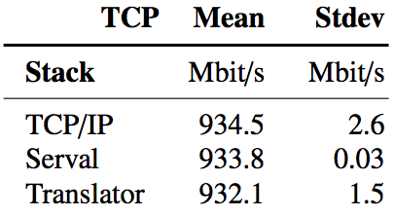
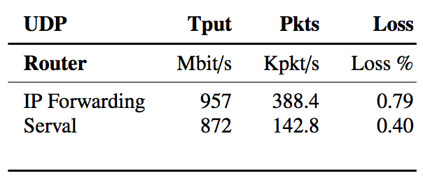
Competitive Performance

Slide 27
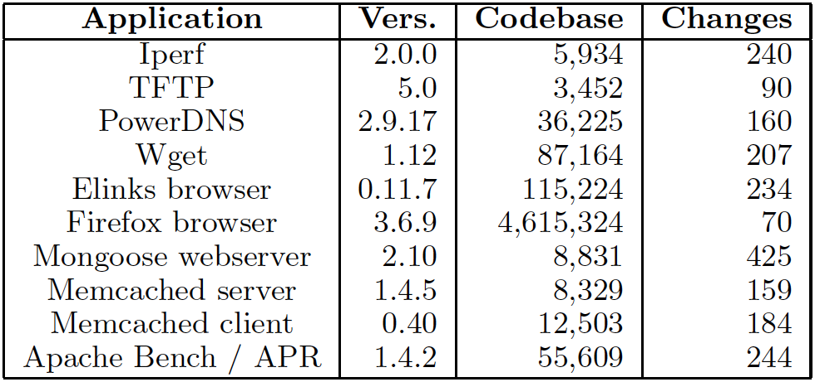
Applications are Easy to Port

Slide 28
Example Applications
Server replicas
  Multiple Mongoose servers
  Balancing load over live server instances
Key-value store partition
  Multiple Memcached servers
  Routing requests to partitions based on the key
Migrating flows
  Load balancing across network interface cards
  Migrating virtual machines across layer-3 networks

Slide 29

Making Service Management Easier
Controller
X
X
X

Slide 30
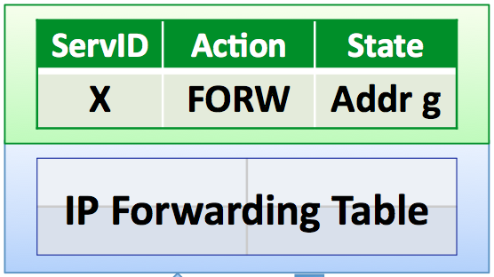
Managing Switches and Services
Switch and service state similar
  FIB: <layer 2-3 mask | ACTION | STATE>
  SIB: <service prefix | ACTION | STATE>
Software Defined Networking
  OpenFlow focuses on layer-2/3
  Serval extends to hosts, services
Read events and write rules
  With FIB: packets, topology changes, flow counters
  With SIB: host/interface changes, service instance changes, connection/host/service statistics
Controller
Switches

Slide 31
Ongoing Research
SDN to the edges
  Joint end-host and switch control
Software-defined service resolution
  Leveraging legacy systems like DNS and routing
  Ad hoc, local service discovery
Software-defined path selection
  Multipath and interface migration in datacenter
  Interface selection and migration on mobile devices

Slide 32
serval-arch.org
Papers, demos, source code (GPL) online

