Slide 1

Serval: An End-Host Stack for Service-Centric Networking
serval-arch.org
Jen Rexford
Erik Nordstrom, Mike Freedman, David Shue,
Prem Gopalan, Rob Kiefer, Mat Arye, Steven Ko
Princeton University

Slide 2
The Internet of the 1970s
Killer Apps:
telnet, ftp
IMP 2
SRI
IMP 4
Utah
IMP 3
UCSB
IMP 1
UCLA
Network designed for accessing hosts
Notes:
Static routes, location doesn’t change
Simple services

Slide 3





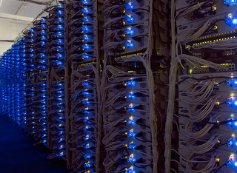


The Internet of the 2000s
Datacenter
Datacenter
Users agnostic of actual service location and instance
Notes:
Segue: so, to provide this type of service access, we today have to rely on the age old host-centric abstractions dating back to the ARPANET. So, part of this talk is about providing new abstractions for service-centric communication, and then also about how to build a software architecture around these. But to define these abstractions, we first have to understand what service access involve.

Slide 4
What does Service Access Involve?
Locate a nearby service datacenter
  Map service name to location
Connect to service
  Establish data flow to instance
  Load balance between pool of replicas
Maintain connectivity to service
  Migrate between interfaces and networks
Notes:
Segue: So, because we rely on suboptimal abstractions for providing and accessing services, this forces us to overload these abstractions in order to provide new functionality

Slide 5
Today’s (Overloaded) Abstractions
Service is IP + port
  Exposes location
  Specifies app. protocol
  One service per IP
Flow is “five tuple”
  Binds flow to interface and location
  Cannot migrate between interfaces or networks
TCP/IP
connect(IP + port)
Application
demux (IP + port)
Transport
Network

Slide 6
Service Access Today
Datacenter
Enterprise
Network
Transit
Provider
4G
Cellular
Provider
Datacenter
Notes:
So, when providing service access today, this overloading confines us to suboptimal abstractions when providing and accessing services, which leads to a number of problems

Slide 7
Finding a Service Location
Enterprise
Network
Transit
Provider
DNS
4G
Cellular
Provider
Load-Balanced
Web Service
DNS binds service to location at client (early binding)
  Caching and ignoring “time to live” exacerbates problem
  Slow failover when instance or load balancer fail

Slide 8
Connecting to Service
Enterprise
Network
Transit
Provider
4G
Cellular
Provider
Load-Balanced
Web Service
Datacenter LB maps single IP to multiple servers
  Must do this for every packet on path -> fate sharing
  Increases complexity and cost

Slide 9
Maintaining Connectivity to Service
Enterprise
Network
VM
Migration
Transit
Provider
4G
Cellular
Provider
Datacenter
Migrate virtual machines (VMs) to balance load
  Requires flat addressing or tunneling within datacenter

Slide 10
Maintaining Connectivity to Service
Datacenter
Enterprise
Network
Transit
Provider
Multi-
Homing
4G
Cellular
Provider
Datacenter
Physical
Mobility
Flows break when switching networks or interfaces
  Requires virtual LANs (VLANs), home agents, triangle routing

Slide 11
Contributions
Naming abstractions
  Services, flows
  Clean role separation in the network stack
Service-centric network stack (Serval)
  Service-level control/data plane split
  Service-level events
Notes:
Works with unmodified apps and services
Give future reference of service/flows

Slide 12
Naming Abstractions

Slide 13
Today’s (Overloaded) Abstractions
TCP/IP
bind (IP + port)
Application
demux (IP + port)
Transport
forward (IP)
Network
Notes:
Looking back at today’s overloaded abstractions, how does Serval actually improves the situation

Slide 14
Serval Abstractions
Serval cleans the slate
  (But not completely)
Network layer unmodified!
Service Access Layer (SAL)
  Connects to services
  Maintains connectivity
Serval
Application
Transport
Service
Access
forward (IP)
Network
Notes:
We are cleaning the slate (referring to blanked out layers) --- but not completely
IP remains unmodified – it turns out that when we no longer overload abstractions, the network layer is just fine as is. In fact, it returns to the simplicity of the initial network design

Slide 15
Serval Abstractions
Service = ServiceID
  Group of processes with identical functionality
Flow = FlowID
  Invariant demux key
  Host-local, ephemeral
Location = IP address
  Location, interface
  Can change dynamically
Serval
connect(serviceID)
Application
Transport
demux ( )
Service
Access
serviceID
flowID
forward (IP)
Network
Notes:
Mention how to acquire a service name
Transport protocol is only doing data delivery

Slide 16
A Clean Role Separation in the Stack
What you access (serviceID), over which flows (flowIDs), and at which service instance (IP address)
TCP/IP
Serval
Application
bind (IP + port)
bind (serviceID)
Transport
demux (IP + port)
Service
Access
demux ( )
serviceID
flowID
Network
forward (IP)
forward (IP)

Slide 17
Service Names (ServiceIDs)
Provider prefix
Provider specific
Self-Certifying
ServiceIDs allocated in blocks
  Prefix ensures global uniqueness
  Prefix-based aggregation and longest prefix match
A ServiceID late binds to a service instance
  ServiceID in first packet of connection
  Service-level routing and forwarding
Notes:
Mention self-certifying (and memcached)

Slide 18
A Service-Aware Network Stack
bind(sock, serviceID)
listen(sock)
connect(sock, serviceID)
Network stack must resolve service to instance for client
Network stack must advertise service for server

Slide 19
Software Architecture

Slide 20
Serval End-host Architecture
Application
Service Controller
Service
Control API
FlowID | Socket
ServiceID | Action | Sock/Addr
Flow Table
Service Table
Dest Address | Next Hop
IP Forwarding Table
Notes:
Add elements successively

Slide 21
Data Plane: The Service Table
ServiceID | Action | Rule State
Prefix A | FORWARD | Send to addr A1
Prefix B | FORWARD | Send to [A2, A3, A4]
Prefix C | DEMUX | Send to listening sock s
Prefix D | DELAY | Queue and notify service controller
Prefix E | DROP
* | FORWARD | Send to A5

Slide 22
Data Plane: The Service Table
ServiceID | Action | Rule State
Prefix A | FORWARD | Send to addr A1
Prefix B | FORWARD | Send to [A2, A3, A4]
Prefix C | DEMUX | Send to listening sock s
Prefix D | DELAY | Queue and notify service controller
Prefix E | DROP
* | FORWARD | Send to A5

Slide 23
Data Plane: The Service Table
ServiceID | Action | Rule State
Prefix A | FORWARD | Send to addr A1
Prefix B | FORWARD | Send to [A2, A3, A4]
Prefix C | DEMUX | Send to listening sock s
Prefix D | DELAY | Queue and notify service controller
Prefix E | DROP
* | FORWARD | Send to A5

Slide 24
Data Plane: The Service Table
ServiceID | Action | Rule State
Prefix A | FORWARD | Send to addr A1
Prefix B | FORWARD | Send to [A2, A3, A4]
Prefix C | DEMUX | Send to listening sock s
Prefix D | DELAY | Queue and notify service controller
Prefix E | DROP
* | FORWARD | Send to A5

Slide 25
Data Plane: The Service Table
ServiceID | Action | Rule State
Prefix A | FORWARD | Send to addr A1
Prefix B | FORWARD | Send to [A2, A3, A4]
Prefix C | DEMUX | Send to listening sock s
Prefix D | DELAY | Queue and notify service controller
Prefix E | DROP
* | FORWARD | Send to A5
Notes:
Segue: now that we have a service-level data plane, how can use that to provide service access?

Slide 26
Service Access with Serval
X
Service
Router
d
Internet
c
X
a
Datacenter
e
Notes:
Here we have an example of a client and a datacenter with two service instances, and an intermediate host that we call a service router. The service router manages the pool of replicas and provides load balancing. New replicas can register with the SR to increase the capacity of the service

Slide 27
Adding a Service Instance
Application
Service Controller
Register
Service X
bind(X)
S
FlowID | Socket
ServiceID | Action | Sock/Addr
X
DMX
s
Add DEMUX rule

Slide 28
Removing a Service Instance
Application
Service Controller
Unregister
Service X
close()
S
FlowID | Socket
ServiceID | Action | Sock/Addr
X
DMX
s
Remove DEMUX rule

Slide 29

Control Plane: The Service Controller
Service Controller
Service X
@ address a
Service Controller
DNS

Slide 30
Control Plane: The Service Controller
Service Controller
Service X
@ address d
FlowID | Socket
ServiceID | Action | Sock/Addr
X
FWD
d
Add FORWARD rule

Slide 31
Service Access with Serval
X
bind(X)
Service
Router
X | d,e
X@d
X | c
d
Internet
X@c
c
X@e
X
bind(X)
a
Datacenter
e
Notes:
Generate control/service events, propagate service events
How the control plane updates state
Forward according to service state (resolution)
Because the stack is service aware, take system developer’s notion of service name and operate on in network

Slide 32
Connecting to Service X
Application
Service Controller
socket()
S
FlowID | Socket
ServiceID | Action | Sock/Addr
2
s
X
FWD
c
Allocates local flowID
a

Slide 33
Connecting to Service X
Application
connect(X)
S
FlowID | Socket
ServiceID | Action | Sock/Addr
2
s
X
FWD
c
a
To c
a
c
2
-
X
SYN

Slide 34
Load Balancing in Service Router
FlowID | Socket
ServiceID | Action | Sock/Addr
X
FWD
d,e
From a
To e
c
f
a
c
X
SYN
a
e
X
SYN

Slide 35
Service Instance Providing Service X
Application
S
FlowID | Socket
ServiceID | Action | Sock/Addr
X
DMX
s
From a
e
a
e
2
-
X
SYN

Slide 36
Service Instance Providing Service X
Application
accept()
S_{c}
S
FlowID | Socket
ServiceID | Action | Sock/Addr
3
s_{c}
X
DMX
s
To a
e
e
a
3
2
SYN-ACK

Slide 37
Service Access with Serval
X
a
e
X
SYN
a
c
X
SYN
Service
Router
X | d,e
d
Internet
c
X
a
e
a
SYN-ACK
Datacenter
e
e
a
data
Notes:
Compare to today’s on-path LBs
simplify

Slide 38

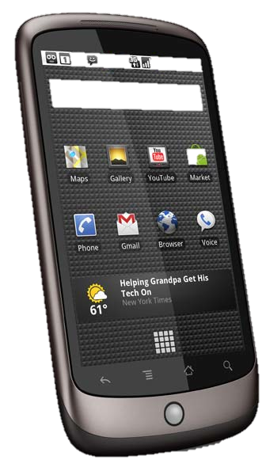
Ad hoc Service Discovery
Accessing service X
connect(X)
X
b
a
SYN-ACK
b
a
*
X
SYN
a
c
a
SYN-ACK
X
ServiceID | Action | Rule State
default | FORWARD | “broadcast”
c
Notes:
Segue: Something about connecting to services outside datacenters and no service router

Slide 39
Wide-Area Successive Refinement
Service
Router
X
g
f
Internet
X
Service
Router
b
d
X
c
X@e
a
X | d,e
* | b
e
Ad hoc discovery
Intra-domain hierarchy
Centralized controller
Notes:
Compare to today’s on-path LBs
simplify

Slide 40
Wide-Area Successive Refinement
Service
Router
X
g
f
X/24@f
Internet
X/24 | c
X
Service
Router
b
d
X/24@c
X
c
X@e
a
X | d,e
* | b
e
Ad hoc discovery
Inter-domain routing
Intra-domain hierarchy
Centralized controller
Notes:
Compare to today’s on-path LBs
simplify

Slide 41
Wide-Area Successive Refinement
DNS
X/24
Service
Router
X
DNS
g
f
Internet
X
* | DLY
X
Service
Router
b
d
X
c
X@e
a
X | d,e
* | b
e
Ad hoc discovery
Inter-domain routing
Legacy DNS lookups
Intra-domain hierarchy
Centralized controller
Notes:
Compare to today’s on-path LBs
simplify

Slide 42
Wide-Area Successive Refinement
DNS
Service
Router
X
DNS
g
f
Internet
* | DLY
X
Service
Router
b
d
X
c
a
X | d,e
* | b
e
Ad hoc discovery
Inter-domain routing
Legacy DNS lookups
Intra-domain hierarchy
Centralized controller
Notes:
Compare to today’s on-path LBs
simplify

Slide 43
Wide-Area Successive Refinement
DNS
Service
Router
X
DNS
g
f
Internet
X/24 | c
X
Service
Router
b
d
X
c
a
X | d,e
* | b
e
Ad hoc discovery
Inter-domain routing
Legacy DNS lookups
Intra-domain hierarchy
Centralized controller
Notes:
Compare to today’s on-path LBs
simplify

Slide 44
What does Service Access Involve?
Locating a nearby service datacenter
  Map service name to location
Connecting to service
  Establish data flow to instance
  Load balance between pool of replicas
Maintaining connectivity to service
  Migrate between interfaces and networks
Notes:
Segue: It turns out, that with our new abstractions and clean role separation in the stack, supporting migration is straightforward

Slide 45
Migration of Flows
f_{C1}
f_{S1}
a1
a3
s_{C}
s_{S}
a2
a4
Host C
Host S
Migrate flow
a1 -> a2
RSYN
RSYN-ACK
ACK
Notes:
Segue: this functionality arises naturally from our abstr.
Shouldn’t bind flows to a particular network path

Slide 46
Multipath with Multiple Subflows
f_{C1}
f_{S1}
a1
a3
s_{C}
s_{S}
f_{C2}
f_{S2}
a2
a4
Host C
Host S
Add flow
SYN
SYN-ACK
ACK
Notes:
Emphasize that this works with any transport protocol, not only MPTCP

Slide 47
Prototype
End-host network stack (28,000 LOC)
  Linux kernel module
  BSD sockets with AF_SERVAL protocol family
  AF_INET sockets can be accessed simultaneously
Legacy middleboxes / NATs handled via encap.
Translator for incremental deployment
  Unmodified apps and end-hosts
  Serval apps with unmodified services
Notes:
Add LOC

Slide 48
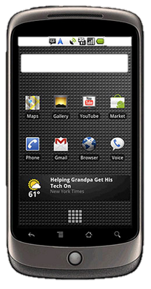
Incremental Deployment
App
Translator
TCP/IP
Serval

Slide 49
Incremental Deployment
Translator
App
Translator
Serval
TCP/IP
TCP/IP

Slide 50
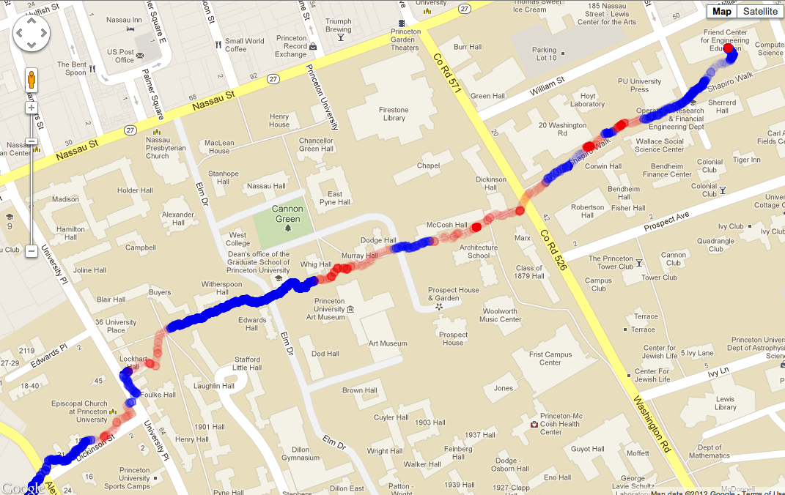
Use of Migration on Clients
WiFi
Cellular
Saves > 900 MB cellular data per month
Single Serval TCP connection that never breaks
Notes:
Migration can also benefit clients. Here a student used Serval and our translator to stream Google music to his mobile device while walking from home to the CS department at Princeton. The streaming application uses a single Serval TCP connection that never breaks. In the process the mobile device’s service controller uses a policy engine to transparently migrate the flow from cellular to wifi and back as connectivity allows. The blue dots indicate cellular connectivity while the red ones are wifi. The gradient indicates the signal quality used by the policy engine to decide when to migrate. We did some back-of-the-envelope calculations on the cellular data savings.

Slide 51
Uses of Migration on Servers
Load balancing across NICs
Flow 1
moved to eth1
Both flows use eth0
Notes:
Here we have two clients connecting to the same interface on the server, sharing the capacity of that link. After a few seconds, the server migrates one of the client flows to a secondary interface, allowing the clients to achieve the full throughput capacity of each of the links. You can use this functionality to, for example, move elephant flows to a separate network in the datacenter.
(This doesn’t work without Serval)

Slide 52
Uses of Migration on Servers
Migrating VMs across subnets
VM migrates flow to new address
VM changes subnet, acquiring new address
Notes:
Another benefit of migration on servers is for migrating VMs across layer 3 domains. Here we are showing a VM that maintains a data flow while migrating from one subnet to another, and acquiring a new address in the process. During the address re-assignment we see a short interruption in the data flow, but after a second or so it recovers. This VM-migration functionality allows datacenters to use scalable IP topologies while still supporting VM migration. (This doesn’t work without Serval)

Slide 53
Competitive Performance
TCP Throughput
 | Mean (Mbit/s)
TCP/IP | 934.5
Serval | 933.8
Translator | 932.1
Service Table Throughput
 | Mbit/s | Kpkt/s
IP forwarding | 987 | 388.4
Serval | 872 | 142.8
Notes:
Service table LPM only on the first packet

Slide 54
Applications are Easy to Port
Application | Codebase | Changes
Iperf | 5,934 | 240
TFTP | 3,452 | 90
wget | 87,164 | 207
Elinks browser | 115,224 | 234
Firefox browser | 4,615,324 | 70
Mongoose webserver | 8,831 | 425
Memcached server | 8,329 | 159
Memcached client | 12,503 | 184

Slide 55
Load Balancing Among Replicas
Web
Servers
SR
2 join
2 leave
1 joins

Slide 56
Partitioning among Memcached
Memcached
Servers
1,2,3,4
SR
9
6,7
,5,
5,6,7,8
10
9,10,11,12
5
13,14,15,16
11,12
8
, ,10

Slide 57
Making Service Management Easier
Controller
X
X
X

Slide 58
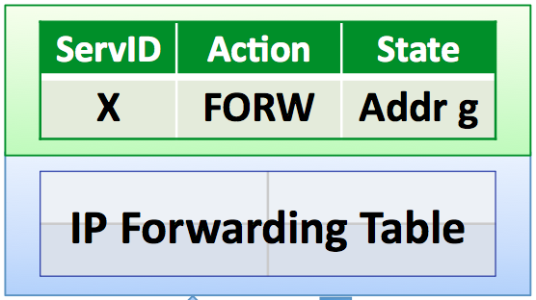
Managing Switches and Services
Switch and service state similar
  FIB: <layer 2-3 mask | ACTION | STATE>
  SIB: <service prefix | ACTION | STATE>
Software Defined Networking
  OpenFlow focuses on layer-2/3
  Serval extends to hosts, services
Read events and write rules
  With FIB: packets, topology changes, flow counters
  With SIB: host/interface changes, service instance changes, connection/host/service statistics
Controller
Switches

Slide 59
Summary of Contributions
New naming abstractions: easier to build services
  Discovering and accessing services
  Maintaining robust connectivity
Service-level control/data plane split
  Flexible service resolution and discovery
  Joint service and network management

Slide 60


serval-arch.org
@servalnetwork
Papers, demos, source code (GPL) online

Slide 61
Related Work
Locator/identifier separation
  HIP, i3, HAIR, DOA, LISP, LNA
Data-oriented networking
  DONA, CCNx
Support for mobility and migration
  TCP Migrate, Mobile IP, ROAM
Multipath and multi-homing
  MPTCP, SCTP, Shim6

Slide 62
Example Applications
Server replicas
  Multiple Mongoose servers
  Balancing load over live server instances
Key-value store partition
  Multiple Memcached servers
  Routing requests to partitions based on the key
Migrating flows
  Load balancing across network interface cards
  Migrating virtual machines across layer-3 networks

Slide 63
Accessing Services by serviceID’s
websrv
memcached
websrv
websrv
memcached
websrv
memcached
websrv
websrv
memcached
websrv
websrv
memcached

Slide 64
Service-Level Anycast
flowID
addr
srvID
SYN
SYN
SRC
a
1
a
1
a
1
X
DST
b
X
e
X
g
X
App
1
2
3
4
Transport
* | e
X | f,g
* | b
X
Service Access
* | b
s_{X}
f
SYN
c
IP
b
X | s_{X}
* | e
a
e
d
g
First (SYN) packet routed on serviceID

Slide 65
Service-Level Anycast
flowID
addr
srvID
SYN
SYN
SRC
a
1
a
1
a
1
X
DST
b
X
e
X
g
X
App
1
2
3
4
Transport
* | e
X | f,g
* | b
X
Service Access
* | b
s_{X}
f
SYN
c
IP
b
X | s_{X}
* | e
a
e
SRC
g
2
SYN-ACK
d
g
5
DST
a
1
Response contains IP address of resolved destination
All subsequent packets directly between endpoints

Slide 66
Connections with Multiple Flows
Application
Socket s
Transport
FlowID | Socket
flowID f_{C1}
Service
Access
Flow Table
flowID f_{C2}
IP
interfaces
a1
a2
Network
Flow demux’d by unique local flowID, not “5 tuple”

Slide 67
Name-based routing
Late binding
Locator/ID separation
Mobility
Address/routing scalability
CCN
i3/ROAM
TRIAD
IPNL
Service access
Name/addr./port separation
Programmability
DONA
HAIR
Serval
DOA
LNA
LISP
HIP
TCP-Migrate
Multi-path
Multi-homing
MPTCP

Slide 68
Challenges: Load Balancing Today
DNS
a
X: a or b
Service X?
X @ b
b
cache b
Load
Balancer
Problem: Caching early-binding load balancing
Problem: LB cannot distinguish one service from another
Problem: LB must be on data path ➔fate sharing
Notes:
OSP – typical service is replicated, has load-balancing functionality and partitioned backend storage. Replica failures raise need for timely and prompt registration and updates to resolution systems.

