Slide 1
iSDX: An Industrial-Scale Software-Defined IXP
Arpit Gupta, Princeton University
http://sdx.cs.princeton.edu
Robert MacDavid, Rüdiger Birkner, Marco Canini,
Nick Feamster, Jennifer Rexford, Laurent Vanbever

Slide 2
Disclaimer
Creative Commons Attribution 4.0 International Public License
By exercising the Licensed Rights (defined below), You accept and agree to be bound by the terms and conditions of this Creative Commons Attribution 4.0 International Public License ("Public License"). To the extent this Public License may be interpreted as a contract, you are granted the Licensed Rights in consideration of your acceptance of these terms and conditions, and the Licensor grants You such rights in consideration of benefits the Licensor receives from making the Licensed Material available under these terms and conditions. For full details, explanations, and examples of the use of this License, please visit:
http://creativecommons.org/licenses/by/4.0/legalcode. Nothing in this Public License constitutes or may be interpreted as a limitation upon, or waiver of, any privileges and immunities that apply to the Licensor or You, including from the legal processes of any jurisdiction or authority.

Slide 3
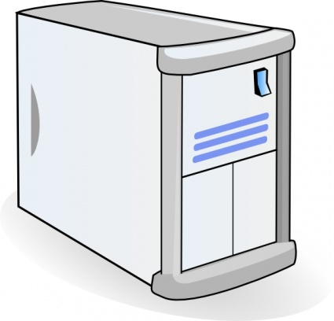
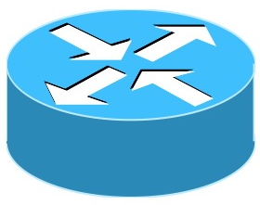

Internet Exchange Points (IXPs)
Route Server
BGP Session
IXP
Switching Fabric
AS A Router
AS B Router
AS C Router
3
Notes:
Before we talk about software defined IXPs, let’s briefly talk about traditional IXPs. At any IXP, participants connect their border router to the IXP’s switching fabrics to exchange traffic. They establish BGP session with route server to exchange routes with other IXP participants.

Slide 4
Software Defined IXPs (SDXs)
SDX Controller
SDX
BGP Session
SDN Switch
AS A Router
AS B Router
AS C Router
Notes:
With respect to this traditional model of IXPs, what we proposed few years back was to replace the traditional L2 switching fabric with an SDN switch and route server with SDX controller. This SDX controller now subsumes the behavior of route server, that is it not only receives BGP update messages from the IXP participants, but it also receives SDN policies from them, combines these policies together and pushes them down to the data plane.

Slide 5
SDX Opens Up New Possibilities
More flexible business relationships
  Make peering decisions based on time of day, volume of traffic & nature of application
More direct & flexible traffic control
  Define fine-grained traffic engineering policies
Better security
  Prefer “more secure” routes
  Automatically black hole attack traffic
Notes:
…
When we first proposed Software defined IXPs, it resonated well with many IXP operators

Slide 6
Deployment Ready SDX is Hard!
Deployment Experience:
  Inter-Agency Exchange
  Large IXP in Europe
  Smaller IXPs in Asia
Challenges:
  Scalability
  …
We will focus on the Scalability Challenge today
Notes:
But building an SDX that is deployable in production networks is hard.
We participated in setting up SDXs with various IXP operators,
From our experiences we observed that there exist various fundamental challenges that need to solved before we can make SDX production ready.
The most critical challenge is the scalability of the SDX platforms and that is the focus of my talk today

Slide 7
Scalability Challenge
Devices | Operations | Data Plane Performance
 |  | State (# entries) | Update Rate (flow-mods/s)
 | Match-Action on Multiple Headers | 100K | 2,500
Notes:
Even though SDN switches can support flexible match-action operations, they have limited data plane state and can only support about 2500 flow-mods/second.
Making SDN policies congruent with BGP requires both large forwarding tables and very high data plane update rate.

Slide 8
Scalability Challenge
Devices | Operations | Data Plane Performance
 |  | State (# entries) | Update Rate (flow-mods/s)
 | Match-Action on Multiple Headers | 100K | 2,500
 | Matches on IP Prefixes only | ~1M | N/A
Problem: Optimize the usage of available devices
Notes:
To address the scalability problem we can leverage participants’ border routers at the IXP. Though these routers have a larger TCAM space which we can leverage but they can only support limited operations in the data plane. The problem of scaling SDX boils down to a classic problem, where we need to optimize the usage of multiple components with disparate capabilities and limitations to scale the performance of the system.

Slide 9
Simple Example
SDX Controller
AS A
IXP Fabric
AS C
announces
10/8, 40/8
  dPort = 443 → fwd(C)
  dPort = 22 → fwd(C)
AS D
announces
10/8, 40/8, 80/8
AS B
  dPort = 80 → fwd(E)
AS E
announces
80/8
Notes:
In this talk we will refer to the simple example shown here to better understand the nature of the scalability challenges and how we addressed them. We have 5 IXP participants,
Transition
A-E. A & B express outbound SDN policies forwarding traffic to C, D, and E.
A & B will send their outbound SDN policies to SDX controller, which will compile them and send them to the data plane. Let’s see how many forwarding table entries are required for these SDN policies.

Slide 10
Forwarding Table Entries at SDX
SDN Policies | # Forwarding Table Entries
dPort = 443 → fwd(C) | 1
dPort = 22 → fwd(C) | 1
dPort = 80 → fwd(E) | 1
AS A
AS B
Number of forwarding table entries for
A & B’s Outbound SDN Policies
Notes:
These SDN policies are simple in nature and each require one flow table entry.

Slide 11
Goal Tracker
 | Simple Example
Baseline | 3
Large IXP Dataset:
  BGP RIBs & Updates from large IXP
  511 IXP participants
  96 million peering routes for 300K IP prefixes
  25K BGP updates for 2-hour duration
Notes:
In this talk we will use a goal tracker to
To get a better sense of the scalability challenges, I will compare the results for forwarding table entries with the actual experiment we ran usinf the BGP RIB data from a large IXP with more than 500 participants.

Slide 12
Goal Tracker
 | Simple Example | Large IXP
Baseline | 3 | 62K (0)
Large IXP Dataset:
  BGP RIBs & Updates from large IXP
  511 IXP participants
  96 million peering routes for 300K IP prefixes
  25K BGP updates for 2-hour duration

Slide 13
Goal Tracker
 | Simple Example | Large IXP
Baseline | 3 | 62K (0)
Satisfies design goals, but …

Slide 14
Goal Tracker
 | Simple Example | Large IXP
Baseline | 3 | 62K (0)
… not congruent with BGP!

Slide 15
Challenge: Congruence with BGP
SDX Controller
dIP = 80.0.0.1, dPort = 443
p
AS A
IXP Fabric
AS C
announces
10/8, 40/8
  dPort = 443 → fwd(C)
Ensure p is not forwarded to C

Slide 16
Solution: SDN Policy Augmentation
SDX Controller
dIP = 80.0.0.1, dPort = 443
p
AS A
IXP Fabric
AS C
announces
10/8, 40/8
  dIP ∈ {10/8, 40/8} ⋀
  dPort = 443 → fwd(C)
Match on prefixes advertised by C
Notes:
You cannot match on group of prefixes, not yet, so each match on prefix corresponds to a new forwarding table entry

Slide 17
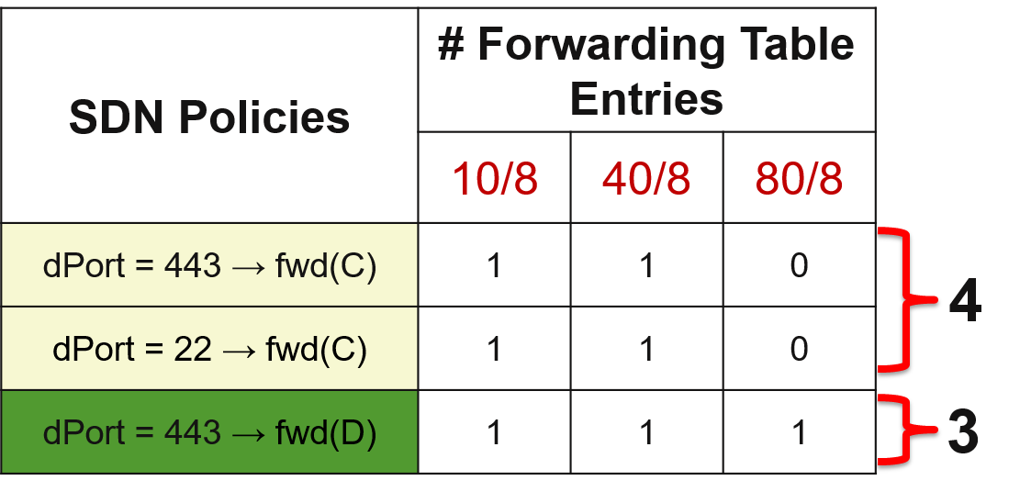
Data Plane State Explosion!
SDN Policy Augmentation increases
forwarding table entries

Slide 18
Goal Tracker
 | Simple Example | Large IXP
Baseline | 3 | 62K (0)
Policy Augmentation | 7 | 68M (16K)
Not possible to support these many
forwarding table entries and update rate!

Slide 19
Forwarding Equivalence Classes
SDN Policies | # Forwarding Table Entries
 | 10/8 | 40/8 | 80/8
dPort = 443 → fwd(C) | 1 | 1 | 0
dPort = 22 → fwd(C) | 1 | 1 | 0
dPort = 443 → fwd(D) | 1 | 1 | 1
10/8, 40/8 exhibit similar forwarding behavior
Revision # v.7
Sponsored by Open Networking Foundation

Slide 20
Leveraging Forwarding Equivalence
forward to
BGP Next Hop
10/8
40/8
80/8
AS C
announces
10/8, 40/8
AS S
IXP Fabric
AS D
announces
10/8, 40/8, 80/8
  dPort = 443 → fwd(C)
Single BGP Next Hop for 10/8, 40/8

Slide 21
Leveraging Forwarding Equivalence
forward to
BGP Next Hop
match on
BGP Next Hop
10/8
40/8
fwd(C)
80/8
AS C
announces
10/8, 40/8
AS S
IXP Fabric
AS D
announces
10/8, 40/8, 80/8
  dPort = 443 → fwd(C)
Flow Rules at SDX match on BGP Next Hops

Slide 22
Goal Tracker
 | Simple Example | Large IXP
Baseline | 3 | 62K (0)
Policy Augmentation | 7 | 68M (16K)
*FEC Computation | 4 | 21M (35K)
[*Gupta et al., SIGCOMM’14]
Still not possible to support these many
forwarding table entries and update rate!
Notes:
This is how far we managed to reach in the previous iteration of SDX. As you can see it is good, but not good enough. There is no way we can afford these many flow table entries
And update rate at larger IXPs.

Slide 23
More Efficient FEC Computation
SDN Policies | # Forwarding Table Entries
 | {10/8, 40/8} | 80/8
dPort = 443 → fwd(C) | 1 | 0
dPort = 22 → fwd(C) | 1 | 0
dPort = 443 → fwd(D) | 1 | 1
Independent FEC Computation
can be more efficient
Notes:
We started with exploring schemes that can make FEC computation more efficient.

Slide 24
Partitioning FEC Computation
Large number of SDX participants
  Many different policies on groups of prefixes
  Leads to a large number of small FECs of prefixes
Compute FECs independently
  Separate computation per participant
  Leads to small number of large FECs, and less frequent recomputation
  Enables “scale out” of the FEC computation

Slide 25
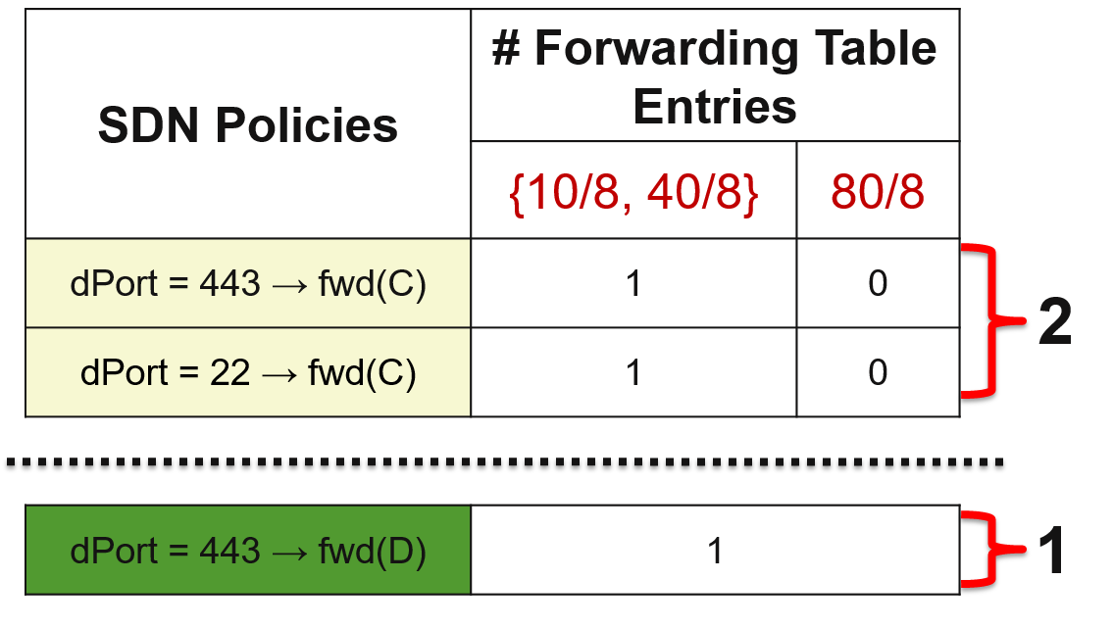
FEC Computation Partitioning in Action
A & B independently compute FECs

Slide 26
Goal Tracker
 | Simple Example | Large IXP
Baseline | 3 | 62K (0)
Policy Augmentation | 7 | 68M (16K)
FEC Computation | 4 | 21M (35K)
Independent FEC Computation | 3 | 763K (15K)
Still not possible to support these many
forwarding table entries and update rate!

Slide 27
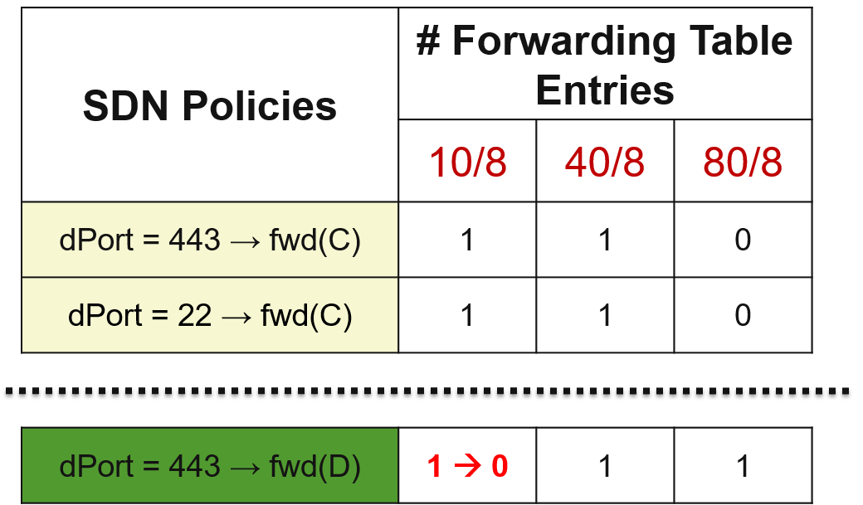
Undesired BGP & SDN Coupling
Incoming BGP Update:
{AS D withdraws route for prefix 10/8}

Slide 28
Decoupling BGP from SDN
Leverage advances in commodity hw switches
  Support for Bitmask Matching (OF 1.3)
Extend BGP “next hop” encoding
  So far: encode FECs (single field)
  New idea: encode reachability bitmask (multi field)
Changing only the BGP announcements
  No need to update the SDX data plane!
Notes:
Make IXP data plane immune to BGP dynamics

Slide 29
Reachability Bitmask in Action
forward to
BGP Next Hop
Dedicate one bit per participant
10/8
40/8
Reachable via AS C
80/8
AS C
announces
10/8, 40/8
AS S
IXP Fabric
AS D
announces
10/8, 40/8, 80/8
  dPort = 443 → fwd(C)
Reachable via AS D

Slide 30
Reachability Bitmask in Action
forward to
BGP Next Hop
match on
Reachability Bitmask
10/8
40/8
fwd(C)
Reachable via AS C
80/8
AS C
announces
10/8, 40/8
AS S
IXP Fabric
AS D
announces
10/8, 40/8, 80/8
  dPort = 443 → fwd(C)
Immune to BGP Dynamics
Reachable via AS D
‹#›
Notes:
I know what you are thinking…;)
Partitioning of the control plane is still critical, as each participant, only consider the participant for which they have SDN policy for the reachability bitmask
The paper talks about how we can encode the reachability information for 100s of participants in limited bitspace. The paper talks about how addressed this problem in greater details.

Slide 31
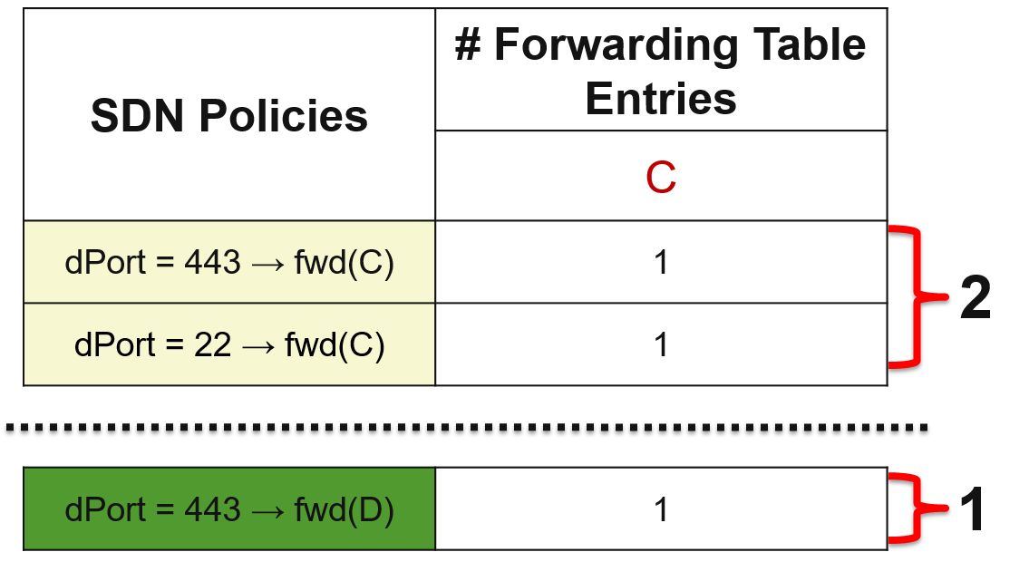
Reachability Bitmask in Action
Reduces Data Plane State

Slide 32
Goal Tracker
 | Simple Example | Large IXP
Baseline | 3 | 62K (0)
Policy Augmentation | 7 | 68M (16K)
FEC Computation | 4 | 21M (35K)
Independent FEC Computation | 3 | 763K (15K)
Reachability Encoding | 3 | 65K (0)
Revision # v.7
Sponsored by Open Networking Foundation

Slide 33
iSDX Evaluation Summary
Data Plane State:
  Requires 65K < 100K forwarding table entries
Data Plane Update Rate:
  Requires 0 < 2500 updates/second
Other Goals:
  Processes BGP update bursts in real time (50 ms)
  Requires only 360 BGP Next Hops compared to 25K from previous solutions

Slide 34
You Can Run iSDX Today!
http://sdx.cs.princeton.edu
Running code
  Vagrant & Docker based setup
  Instructions to run with Hardware Switches
Ongoing efforts
  Hosted by Open Networking Foundation
  Community Link: https://community.opensourcesdn.org/wg/iSDX/dashboard
  Mailing List (general info, anyone in the world can register): isdx@community.OpenSourceSDN.org
  More info and project landing page: https://www.OpenSourceSDN.org
Deployment
    Inter-agency exchange
    IXPs in Europe & Asia

