Slide 1
Putting the “Inter” in “Internet”
Jennifer Rexford
Princeton University

Slide 2
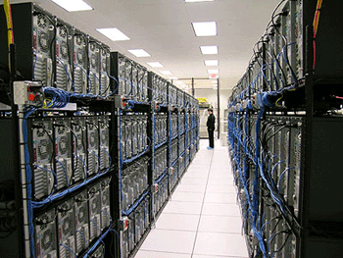
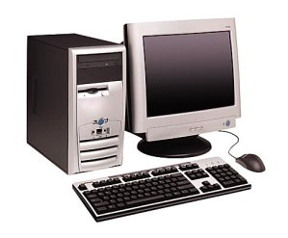





The Internet
Global system of interconnected computers using a standard (TCP/IP) protocol suite…
Internet
Notes:
Global system of interconnected computers

Slide 3















The Internet
Offering an extensive set of services
Notes:
Global system of interconnected computers

Slide 4
The Internet
A network of networks
4
3
5
2
7
6
1
~ 50,000 Autonomous Systems (ASes)

Slide 5
The Internet
Interdomain routing on IP address blocks
4
3
5
2
7
6
1
Web server
Border Gateway Protocol (BGP)
12.34.56.0/24
Notes:
Routing on IP address blocks

Slide 6
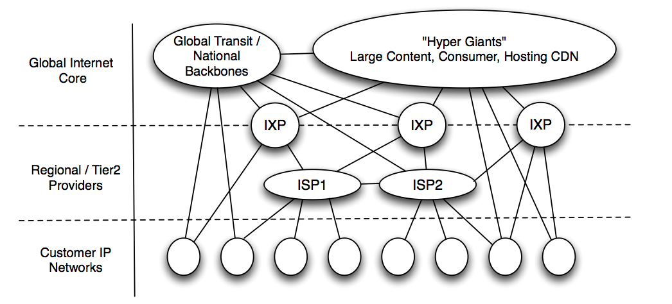
The Interdomain Ecosystem is Evolving ...
Rise of (very) large cloud/content providers
Notes:
In recent years, to accommodate the growing demand for video content, these giant content providers like Google, Akamai, Netflix and others are peering at as many locations as possible.
This has resulted in a flatter and densely interconnceted Internet.
This new Internet requires richer peering arrangements and more direct & flexible traffic control.

Slide 7
The Interdomain Ecosystem is Evolving ...
Growing number and role of
Internet eXchange Points (IXPs)
Notes:
Around 350-400 IXPs (like AMS-IX), half in U.S. and Europe
Direct delivery of content, particularly video
Keeping local traffic local, particularly in developing regions

Slide 8
… But the Internet Routing System is Not
Routing only on destination IP address blocks
  (No customization of routes by application or sender)
Can only influence immediate neighbors
  (No ability to affect path selection remotely)
Indirect control over packet forwarding
(Indirect mechanisms to influence path selection)
Enables only basic packet forwarding
(Difficult to introduce new in-network services)

Slide 9
Enter Software-Defined Networking (SDN)
Match packets on multiple header fields
(not just destination IP address)
Control entire networks with a single program
(not just immediate neighbors)
Direct control over packet handling
(not indirect control via routing protocol arcana)
Perform many different actions on packets
(beyond basic packet forwarding)

Slide 10
Software-Defined Networking

Slide 11



Software Defined Networks
control plane: distributed algorithms
data plane: packet processing

Slide 12
Software Defined Networks
decouple control and data planes

Slide 13
Software Defined Networks
decouple control and data planes
by providing open standard API

Slide 14

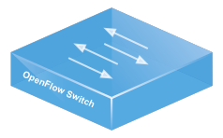
Simple, Open Data-Plane API
Prioritized list of rules
  Pattern: match packet header bits
  Actions: drop, forward, modify, send to controller
  Priority: disambiguate overlapping patterns
  Counters: #bytes and #packets
srcip = 1.2.*.*, dstip = 3.4.5.* → drop
srcip = *.*.*.*, dstip = 3.4.*.* → forward(2)
3. srcip = 10.1.2.3, dstip = *.*.*.* → send to controller

Slide 15
(Logically) Centralized Controller
Controller Platform

Slide 16
Protocols ➔ Applications
Controller Application
Controller Platform

Slide 17
Seamless Mobility
See host sending traffic at new location
Modify rules to reroute the traffic

Slide 18
Server Load Balancing
Pre-install load-balancing policy
Split traffic based on source IP
10.0.0.1
src=0*,
dst=1.2.3.4
10.0.0.2
src=1*,
dst=1.2.3.4

Slide 19
Example SDN Applications
Seamless mobility and migration
Server load balancing
Dynamic access control
Using multiple wireless access points
Energy-efficient networking
Blocking denial-of-service attacks
Adaptive traffic monitoring
Network virtualization
Steering traffic through middleboxes
<Your app here!>

Slide 20


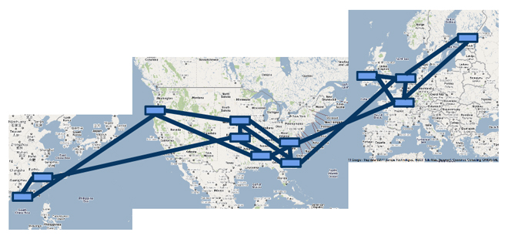

A Major Trend in Networking
Entire backbone
runs on SDN
Bought for $1.2 x 10⁹
(mostly cash)

Slide 21
SDN and the “Inter”net
SDN today
  Used inside a single Autonomous System
  Data center, enterprise, backbone, …
Our goal:
  Reinvent interdomain traffic delivery

Slide 22
SDX: Software-Defined eXchange
Arpit Gupta, Laurent Vanbever, Muhammad Shahbaz, Sean Donovan, Brandon Schlinker, Nick Feamster, Jennifer Rexford, Scott Shenker, Russ Clark, Ethan Katz-Bassett
Georgia Tech, Princeton University, UC Berkeley, USC

Slide 23
Deploy SDN at Internet Exchanges
Leverage: SDN deployment even at single IXP can yield benefits for tens to hundreds of ISPs
Innovation hotbed: Incentives to innovate as IXPs on front line of peering disputes
Growing in numbers: ~100 new IXPs established in past three years
Notes:
Content delivery
Keep local traffic local (cost, performance, privacy/wiretapping)

Slide 24
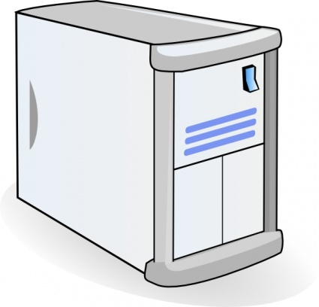
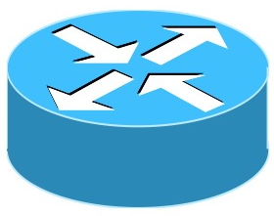

Conventional IXPs
Route Server
BGP Session
IXP
Switching Fabric
AS A Router
AS B Router
AS C Router
Notes:
So let’s first take a look as what a typical Exchange Point looks like.
Exchange points have multiple participants. Their edge routers are connected to each other using using IXP’s switching fabric.
These edge routers use the IXP’s route server to exchange BGP routes with each other.

Slide 25
SDX = SDN + IXP
SDX Controller
SDX
BGP Session
SDN Switch
AS A Router
AS B Router
AS C Router
Notes:
Compared to these IXPs, we replace the switching fabric with SDN switches and the route server with SDX controller.
This SDX controller,
subsumes router server’s behavior of exchanging BGP routes
It also takes participant’s SDN specific policies as input, combines them together and pushes down the set of OF rules.

Slide 26
SDX Opens Up New Possibilities
More flexible business relationships
  Make peering decisions based on time of day, volume of traffic, and nature of application
More direct and flexible traffic control
  Fine-grained traffic engineering
  Steering traffic through “middleboxes”
Better security
  Automatically drop attack traffic
  Prevent “free riding”
Notes:
SDX opens up new possibilities
With SDX it is possible to have more flexible bus relationships, Network operators can now make peerinf decisions based on time of day, volume of traffic and nature of application.
SDX enables more direct and flexible traffic control, network operators can define fine grained inbound/outbound TE policies.
SDX also enables better security. It is now possible to prefer more secure routes and automatically blackhole attack traffic. Note that this blocking can now be done at a much finer level of granularity minimizing the collateral damage.
To get a better sense of what new things are possible with SDX, let’s consider a simple use case.

Slide 27
Inbound Traffic Engineering
SDX Controller
SDX
AS A
Router
C1
C2
10.0.0.0/8
AS B Router
AS C Routers
Notes:
Now let’s consider another scenario where AS C’s policy is to receive HTTP traffic on C2.

Slide 28
Inbound Traffic Engineering
Incoming Data
C1
C2
AS A Router
AS B Router
10.0.0.0/8
AS C Routers
Incoming Traffic | Out Port | Using BGP | Using SDX
dstport = 80 | C1
Notes:
Now let’s consider another scenario where AS C’s policy is to receive HTTP traffic on C2.
Now such a fine grained policy is not possible with BGP

Slide 29
Inbound Traffic Engineering
Incoming Data
C1
C2
AS A Router
AS B Router
10.0.0.0/8
Fine grained policies not possible with BGP
AS C Routers
Incoming Traffic | Out Port | Using BGP | Using SDX
dstport = 80 | C1 | ?

Slide 30
Inbound Traffic Engineering
Incoming Data
C1
C2
AS A Router
AS B Router
10.0.0.0/8
Enables fine-grained traffic engineering policies
AS C Routers
Incoming Traffic | Out Port | Using BGP | Using SDX
dstport = 80 | C1 | ? | match(dstport =80)→ fwd(C1)
Notes:
So SDX enables more direct & fine grained traffic control which is not possible in current networks.
There are bunch of other applications that are also possible with SDX and you find more details about them in the paper.

Slide 31
Prevent DDoS Attacks
AS 3
SDX 1
SDX 2
AS 2
AS 1

Slide 32
Prevent DDoS Attacks
Attacker
AS1 under attack originating from AS3
AS 3
SDX 1
SDX 2
AS 2
AS 1
Victim

Slide 33
Use Case:
Prevent DDoS Attacks
Attacker
AS1 can remotely block attack traffic at SDX(es)
AS 3
SDX 1
SDX 2
AS 2
AS 1
Victim

Slide 34
SDX-based DDoS protection vs.
Traditional Defenses/Blackholing
Remote influence
  Physical connectivity to SDX not required
More specific
  Drop rules based on multiple header fields, source address, destination address, port number …
Coordinated
  Drop rules can be coordinated across multiple IXPs
Notes:
There are bunch of other applications that are also possible with SDX and you find more details about them in the paper.

Slide 35
Building SDX is Challenging
Programming abstractions
  How networks define SDX policies and how are they combined together?
Interoperation with BGP
  How to provide flexibility w/o breaking global routing?
Scalability
  How to handle policies for hundreds of peers, half million address blocks, and matches on multiple header fields?
Notes:
So far it looks like SDX is the solution which can enable more flexible peering arrangements, & more direct & flexible traffic control, but building a real deployable SDX is not easy.
The first challenge is to define the right programming abstractions, i.e how can participants express policies independently. Another challenge is that all the SDX participants share the same switching fabric, so their policies need to be combined together and translated into set of flow rules. So we also need to define the right abstractions for combining participant’s policies together.
Another challenge is the fact that we have SDN specific policies at the IXP and every one else is using BGP. So we have to make sure that participants’ policies safely interact with BGP, w/o creating any forwarding loops or blackholes.
And finally we are talking about thousands of prefixes, hundreds of peers and matches on multiple header fields, we need to take scalability into considerations

Slide 36
Building SDX is Challenging
Programming abstractions
  How networks define SDX policies and how are they combined together?
Interoperation with BGP
  How to provide flexibility w/o breaking global routing?
Scalability
  How to handle policies for hundreds of peers, half million prefixes and matches on multiple header fields?

Slide 37
Directly Program the SDX Switch
Switching Fabric
A1
B1
match(dstport=80)→drop
match(dstport=80)→fwd(C1)
C1
C2
AS A & C directly program the SDX Switch
Notes:
All the participants share the same switching fabric. One option is that they can all directly express policies for this switch.

Slide 38
Conflicting Policies
Switching Fabric
drop? C1?
A1
B1
match(dstport=80)→drop
match(dstport=80)→fwd(C1)
C1
C2
How to restrict participant’s policy
to traffic it sends or receives?

Slide 39
Virtual Switch Abstraction
Switching Fabric
Virtual Switch
Virtual Switch
A1
AS A
AS B
B1
match(dstport=80)→drop
Virtual Switch
AS C
match(dstport=80)→fwd(C1)
C1
C2
Each AS writes policies for its own virtual switch
Notes:
For that we came up with Virtual Switch Abstraction. Here each AS is provided with their own virtual SDX switch for which they express their policies.
These policies are applied only if traffic enters or leaves their network.

Slide 40
Combining Participant’s Policies
Switching Fabric
Virtual Switch
Virtual Switch
A1
AS A
AS B
B1
p
match(dstport=80)→fwd(C)
Virtual Switch
AS C
Pol_{A}
match(dstport=80)→fwd(C1)
C1
C2
Pol_{C}
Policy(p) = Pol_{A} → Pol_{C}
Notes:
….
This approach naturally resolves policy conflicts, as it follows packets to determine the order in which policies should be applied.

Slide 41
Building SDX is Challenging
Programming abstractions
  How networks define SDX policies and how are they combined together?
Interoperation with BGP
  How to provide flexibility w/o breaking global routing?
Scalability
  How to handle policies for hundreds of peers, half million prefixes and matches on multiple header fields?
Notes:
SDX enables flexible interdomain routing policies, but we need to make sure that this flexibility is not breaking the global routing system as everyone else is still using BGP.
The challenge is how we provide these flexibilities w/o creating any forwarding loops or blackholes.

Slide 42
Requirement: Forwarding Only Along BGP Advertised Routes
20/8
A
SDX
B
10/8
C
match(dstport=80) → fwd(C)
Notes:
BGP announcements are sort of permissions to send. How to make sure SDX policies are not breaking this permission model in global routing.
To prevent forwarding loops, we want to make sure that forwarding is only along BGP Advertised routes.
In this example AS A has two peers, B & C. It has policy of forwarding port 80 traffic to C.

Slide 43
Ensure ‘p’ is not forwarded to C
dstip = 20.0.0.1
dstport = 80
20/8
p
A
SDX
B
10/8
C
match(dstport=80) → fwd(C)

Slide 44
Solution: Policy Augmentation
20/8
A
SDX
B
10/8
C
(match(dstport=80) && match(dstip = 10/8))→ fwd(C)
Notes:
The solution to this problem is to augment A’s policies by matching on prefixes advertised by C before forwarding.
This is one of the many solutions we developed to ensure safer interoperation with BGP. You can find more details in the paper.

Slide 45
Building SDX is Challenging
Programming abstractions
  How networks define SDX policies and how are they combined together?
Interoperation with BGP
  How to provide flexibility w/o breaking global routing?
Scalability
  How to handle policies for hundreds of peers, half million prefixes and matches on multiple header fields?
Notes:
But this should be good enough to give you an intuition that after policy augmentations, we can have matches for half a million IP prefixes, we are combining policies of hundreds of SDX participants matching on multiple header fields.

Slide 46
Scalability Challenges
Reducing data-plane state:
  Support for all forwarding rules
  in (limited) SDN switch memory (millions of flow rules possible)
Reducing control-plane computation:
  Faster policy compilation (policy compilation takes hours for initial compilation)
Notes:
Scalability challenges are two dimensional, we need to reduce the data plane state as we have limited switch memory, and we also need to reduce the time it takes to translate participant’s policies into set of of rules.

Slide 47
Scalability Challenges
Reducing Data-Plane State: Support for all forwarding rules in (limited) switch memory millions of flow rules possible
Reducing Control-Plane Computation: Faster policy compilation
policy compilation could take hours
Notes:
But given the scale of operations at Exchange Points, we are talking about flow rules of the order of few millions and policy compilation of the order of few hours.

Slide 48
Reducing Data-Plane State:
Observations
Internet routing policies defined for groups of prefixes.
Edge routers can handle matches on hundreds of thousands of IP prefixes.
Notes:
Let’s see how we resolved these scalability challenges.
We made two important observations, (1) most of the Internet routing policies are defined for group of prefixes, (2) participant’s edge routers are tailored to handle matched on hundreds of thousands of prefixes.
These observations gave us an intuition, that we should not write flow rules for individual IP prefixes and somehow use participant’s edge routers to tag prefix groups.

Slide 49
Reducing Data-Plane State:
Solution
Group prefixes with similar forwarding behavior
10/8
40/8
20/8
SDX Controller
Notes:
So we developed an algorithm to determine set of prefixes which have same forwarding behavior at SDX.

Slide 50
Reducing Data-Plane State:
Solution
Advertise one BGP next hop for each such
prefix group
forward to
BGP Next Hop
10/8
40/8
20/8
Edge router
Notes:
For each such prefix group we assign same BGP virtual next hop. . Participant’s edge routers match on IP prefixes and forward the traffic to assigned next hop

Slide 51
Reducing Data-Plane State:
Solution
Flow rules at SDX match on BGP next hops
forward to
BGP Next Hop
match on
BGP Next Hop
10/8
fwd(1)
40/8
fwd(2)
20/8
Edge router
SDX FIB
Notes:
As a result of that SDX needs to write rules matching for BGP next hops avoiding matches for individual prefixes.

Slide 52
Reducing Data-Plane State:
Solution
For hundreds of participants’ policies, few millions ➔ < 35K
flow rules
Notes:
As a result of that SDX needs to write rules matching for BGP next hops avoiding matches for individual prefixes.

Slide 53
Reducing Control-Plane Compilation: Initial Compilation Time
(Pol_{A} + Pol_{B} + Pol_{C}) >> (Pol_{A} + Pol_{B} + Pol_{C})
Skip unnecessary steps
  Most policies involve a small subset of participants
Simplify computation
  Policies are disjoint (e.g., different virtual switch/port)
Memoize intermediate results
  Avoid repeating a computation multiple times
  Hundreds of participants requires < 15 minutes

Slide 54
Reducing Control-Plane Compilation: Recompilation Time
Almost all traffic goes to stable IP prefixes
  Only 10-15% of prefixes saw any updates in a week
Most BGP updates affect just a few groups
  Recompute rules only for affected groups of prefixes
BGP updates are bursty
  Fast, but suboptimal, recompilation in real time
  Optimized, but slow, recompilation in the background
  Most recompilation after a BGP update < 100 ms

Slide 55
Application-Specific Peering
Transit Portal brings real traffic to SDX

Slide 56
Application-Specific Peering
Policy = match(dstport = 80) >> fwd(B)

Slide 57
Application-Specific Peering

Slide 58
SDX Platform
Running code with full BGP-integration
  Github: https://github.com/sdn-ixp/sdx/
SDX testbeds:
  Transit Portal for “in the wild” experiments
  Mininet for controller experiments
Ongoing deployment activities
  Internet2, GENI, ESnet, SOX, NSA-LTS
  Regional IXPs in US, Europe, and Africa
Notes:
So far we have developed a prototype of SDX. We have two different types of SDX testbeds. One uses Transit portal to bring live traffic to the SDX switch and the other uses virtual containers in Mininet to emulate edge routers. We also have a demo after this session which shows how we develop two applications using SDX and how they interoperate with each other.
You can find more details about this testbed from our github repo. We also have instructions for users to get started with SDX and try out their own new applications.

Slide 59
Niagara: SDN-Based
Server Load Balancing
Joint work with Nanxi Kang (Princeton) and Monia Ghobadi, Alex Shraer, and John Reumann (Google), with support from Josh Bailey (Google) and Jamie Curtis (REANNZ) on operational deployment at the REANNZ SDX

Slide 60
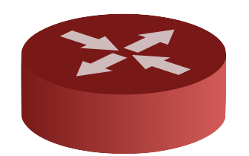

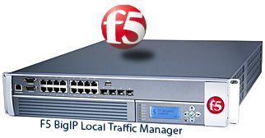



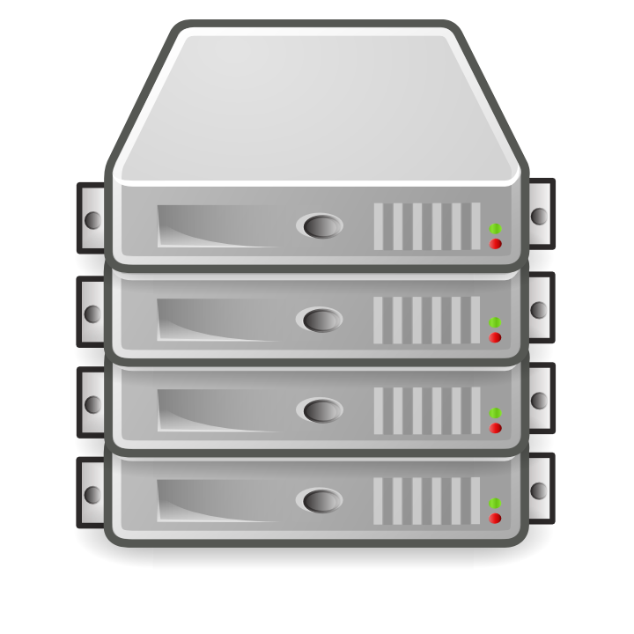



Server Load Balancing Today
OVS
….
….
Dedicated appliances
  Costly
  Hard to scale
  Single point of failure
Software load balancer
  Lower performance
  Higher power usage

Slide 61
Load Balancer With SDN Switches
Commodity SDN hardware switches
  Cheap
  High bandwidth
  Low power
Split traffic based on header fields
clients
srcip | dstip | action
0* | 1.2.3.4 | Fwd to server 1
1* | 1.2.3.4 | Fwd to server 2

Slide 62
Scalability Challenges
Many services (dstip)
  Cloud could host ~10,000 services
Many backend servers
  Could have a dozen (clusters of) servers
But, small switch rule-table size
  E.g., 4000 entries

Slide 63
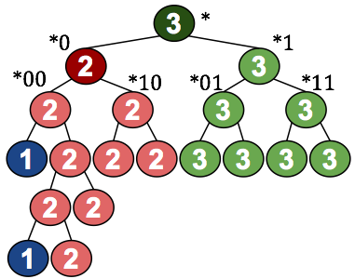
Optimizing Rule-Table Size
Approximate weights for a single service
  Match on the last bits of the source IP address
  Expansion of powers of two
Three servers with weights {1/6, 1/3, 1/2}
Weight | Estimation | Rules
1/6 | 1/8 + 1/32 | *000, *00100
1/3 | 1/2 – 1/8 – 1/32 | *0
1/2 | 1/2 | *
Notes:
1/6 (16.667%): 15.625%
1/3 (33.333%): 34.375%
1/2 (50.000%): 50.000%

Slide 64
Optimizing Rule-Table Size
Dividing rule table across services
  Truncate the approximation for each service
  Giving more rules to more popular services
  Optimal, greedy optimization algorithm
Service A
Service B
Service C

Slide 65
Optimizing Rule-Table Size
Sharing rules across multiple services
  Group all services with similar weights
  E.g., {1/2,1/2} vs. {1/8, 7/8}
Use two stages of rules
dstip | tag
1.2.3.1 | 1
1.2.3.2 | 1
1.2.3.3 | 2
1.2.3.4 | 1
1.2.3.5 | 2
1.2.3.6 | 1
1.2.3.7 | 2
…
tag | srcip | action
1 | 0* | Fwd to cluster 1
1 | * | Fwd to cluster 2
2 | 000* | Fwd to cluster 1
2 | * | Fwd to cluster 2

Slide 66
Evaluation and Deployment
Simulation experiments
  10,000 services
  16 clusters of servers
  Can get by with 4000 rules
Operational demonstration
  Deployed at the REANNZ SDX
  Load balancing for Web and DNS services
  Extending to an ongoing deployment
Illustrates the value of an SDX

Slide 67
Conclusion
The Internet is changing
  Rise of large content/cloud providers
  Increasing role of Internet eXchange Points
Software-Defined Networking can help
  New capabilities for wide-area traffic delivery
  New abstractions and scalability techniques
Next steps
  Wider operational deployment
  Additional SDX applications
  Distributed exchange points

