Slide 1

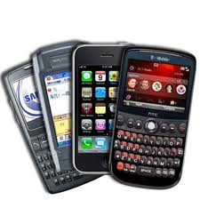


Understanding the “Net Neutrality” Debate
Jennifer Rexford’91
Princeton University

Slide 2
Network Neutrality
Treat all data on the Internet equally
  Not block, discriminate, or charge differently
  … by user, content, site, platform, app, etc.
Proponents
  Openness is a hallmark of the Internet
  Net-neutrality preserves competition
  Service providers have a near monopoly
Opponents
  Good to have variety of service plans/prices
  Broadband space is already competitive
  Restricting providers restricts competition

Slide 3

FCC and Open Internet
Openness: “the absence of any gatekeeper blocking lawful
uses of the network or picking winners and losers online”
Open Internet Order (2010)
  Transparency
  No blocking
  No unreasonable discrimination
Verizon vs. FCC (2014)
  FCC has no authority to enforce these rules
  … since providers are not “common carriers”
Notes:
January 14, 2014:

Slide 4
Open Internet Advisory Committee
Open Internet Advisory Committee (2012)
  Track effects of the Open Internet Order
  Provide recommendations to the FCC
Mobile broadband working group
  Mobile broadband is crucial to the Internet
  Yet, the technology is immature
Special treatment in Open Internet Order
  Transparency
  No blocking of competing applications
  No discrimination except for management practice

Slide 5
Promoting a Virtuous Cycle
Networks
Mobile
devices
Users
Applications
Notes:
The mobile broadband ecosystem is built on a seemingly “virtuous cycle,” where networks that are fast, reliable, and widely available encourage the creation of mobile devices that connect to these networks, which spurs innovation in compelling applications, which in turn motivate more users to adopt the technology, spurring further investment in the underlying networks.

Slide 6
Complex Inter-relationships
Mobile service providers
Apps
Apps
OS
Device
Network equipment vendors
Notes:
Important roles played by many parties, including the network (i.e., mobile network operators and network equipment vendors), the devices (i.e., device manufacturers and operating­system developers), and the applications (i.e., application developers) in delivering mobile broadband services to users.

Slide 7
Small Number of Big Players
 | U.S. Ecosystem (1Q 2013)
Smartphone vendor shipments | Apple (38%), Samsung (29%), LG (10%)
Smartphone OS market share | Google Android (56%), Apple iOS (38%)
Mobile provider market share | Verizon (34%), AT&T (30%), Sprint (16%), T-Mobile (12%)
Radio access equipment vendors | Ericsson (50%), Alcatel-Lucent (36%), Nokia-Siemens (10%)
Application developers | Many, diverse, most make < $500/month, but a small fraction are very successful

Slide 8
Small Number of Big Players
 | U.S. Ecosystem (1Q 2013)
Smartphone vendor shipments | Apple (38%), Samsung (29%), LG (10%)
Smartphone OS market share | Google Android (56%), Apple iOS (38%)
Mobile provider market share | Verizon (34%), AT&T (30%), Sprint (16%), T-Mobile (12%)
Radio access equipment vendors | Ericsson (50%), Alcatel-Lucent (36%), Nokia-Siemens (10%)
Application developers | Many, diverse, most make < $500/month, but a small fraction are very successful

Slide 9
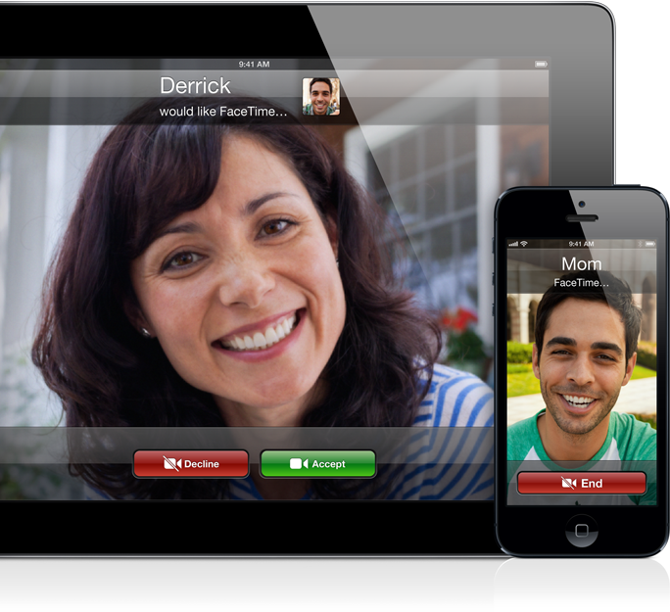
Apple FaceTime
High-quality video chat service
Originally available only over WiFi

Slide 10
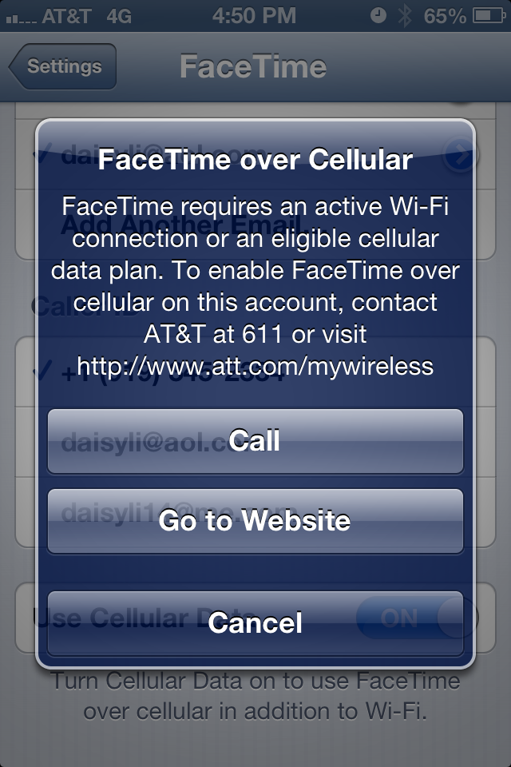
AT&T and FaceTime: A Timeline
Jun’12: Apple announces
FaceTime over cellular
  Carrier restrictions may apply
Aug’12: AT&T limits use
of FaceTime over cellular
  Limited to customers with
  the Mobile Share plan
  Sprint and Verizon announce
  support on all data plans

Slide 11
AT&T and FaceTime: A Timeline
Aug’12: Some advocates & press denounce
  AT&T violated Open Internet Order
  FaceTime competes with telephony service
  Shouldn’t discriminate by data plan
Aug’12: AT&T responds in a blog
  AT&T’s policy is transparent
  AT&T has no video chat app
  FCC doesn’t regulate preloaded apps

Slide 12
AT&T and FaceTime: A Timeline
Sep’12: Public interest groups respond
  Intent to file an FCC complaint
Oct’12: AT&T customer files FCC complaint
  Blocking on his “unlimited” data plan
Nov’12: AT&T relaxes FaceTime limitations
  Supporting FaceTime on some plans over LTE
In ‘13: AT&T rolls out FaceTime over cellular
  On all data plans (including unlimited plans)

Slide 13
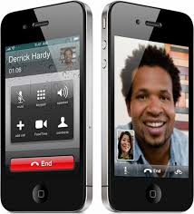
AT&T/FaceTime Issues
Pre-loaded application
  Available to all users
  of popular phone
  Accessed via device’s
  core calling features

Slide 14
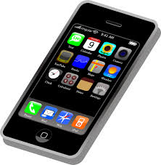
AT&T/FaceTime Issues
High bandwidth usage
  Heavy load in both directions
  Asymmetric network capacity
  Limited adaptation in the face of congestion

Slide 15

AT&T/FaceTime Issues
Staged deployment
  Rapid adoption could lead to unpredictable load
  Initially limit the number of users accessing an app

Slide 16
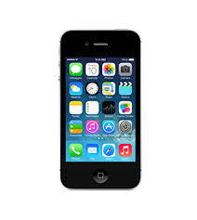
AT&T/FaceTime Issues
Enforcement point
  Usage limited on the device, not in the network

Slide 17
Opinion #1: App Developers
Bad to single out one (popular) app
  May led to blocking other lawful apps
  Requires upgrade to expensive plans
  Discourages investment in mobile apps
App-agnostic management is better
  Rate limit customers during peak hours
  Vary pricing based on the congestion
  … regardless of the application

Slide 18
Opinion #2: Service Providers
AT&T at a higher risk for focused overload
  Many customers have iPhones
  … and unlimited data plans
Good to introduce FaceTime gradually
  Constrain the number of users
  Create incentives to limit use
  Reduce negative impact on others
Dynamic rate limiting was less attractive
  Complex, not supported by equipment
  May degrade performance for all

Slide 19
The Tip of the Iceberg
Carrier service agreements
  Billing models (e.g., unlimited, capped, etc.)
  Device locking and restrictions on tethering
  Zero-rating (“toll free”) trend outside the U.S.
Apps and operating systems
  App stores (screening policies, revenue sharing)
  Network-unfriendly apps (chatty, unfair, inefficient)
  Android handset agreements (anti-fragmentation)

Slide 20
Conclusions
Network neutrality is a complex issue
  What is “openness”?
  What best enables “competition”?
  What is the best way to foster openness?
Issue goes far beyond service providers
  Applications, operating systems, devices
  Beyond the purview of the FCC
Going forward, need ways to encourage
  Transparency, education, and competition

Slide 21
References
FCC Open Internet Advisory Committee
  http://www.fcc.gov/encyclopedia/open-internet-advisory-committee
OIAC annual report (Aug’13)
  http://transition.fcc.gov/cgb/oiac/oiac-2013-annual-report.pdf
AT&T/FaceTime Case Study (Jan’13)
  http://transition.fcc.gov/cgb/events/ATT-FaceTimeReport.pdf
Openness in Mobile Broadband Ecosystem (Aug’13)
  http://transition.fcc.gov/cgb/oiac/Mobile-Broadband-Ecosystem.pdf

