Slide 1

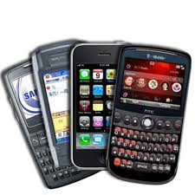
Mobile Broadband
Working Group
Jennifer Rexford
Princeton University

Slide 2
Two Studies: Depth and Breadth
 | AT&T/FaceTime Case Study | Mobile Broadband Ecosystem
Scope | Mobile network operators (carriers) | Mobile broadband ecosystem
Openness | Transparency, blocking, traffic discrimination | Incentivizing innovation in mobile broadband
Time frame | Short term, single timely event | Long-term trends and principles

Slide 3
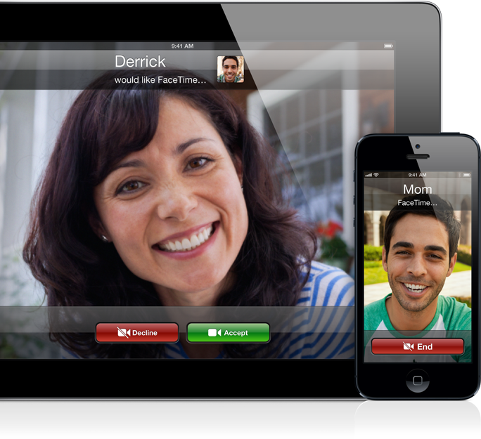
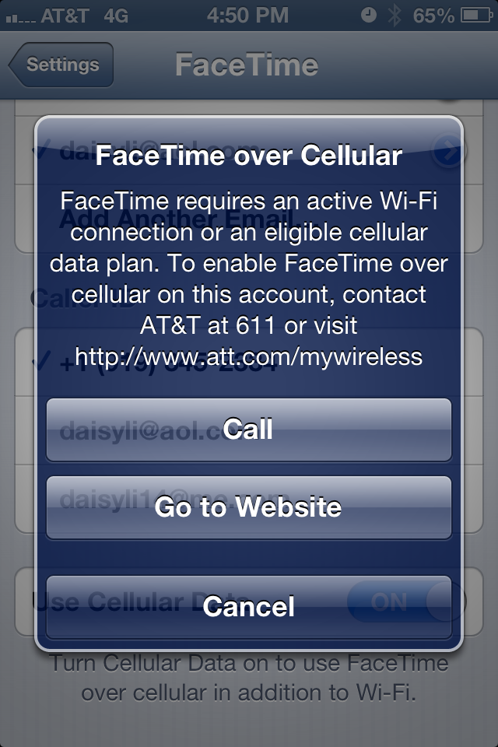
AT&T/FaceTime
Apple FaceTime
  High-quality video chat
  Originally only on WiFi
  Cellular starting Jun’12
AT&T restrictions
  Initially limited to MobileShare plan
  Claims that AT&T violated the OIO
  AT&T disagreed with these claims
  AT&T gradually relaxed restrictions

Slide 4
AT&T/FaceTime Issues
Pre-loaded application
  Available to all users of popular phone
  Accessed via device’s core calling features
High bandwidth requirements
  Symmetric usage, with asymmetric capacity
  Limited adaptation in the face of congestion
Staged deployment
  Rapid adoption could lead to unpredictable load
  Initially limit the number of users accessing an app
Enforcement point
  Usage limited on the device, not in the network

Slide 5
AT&T/FaceTime Perspectives
Application developers
  Blocking lawful applications chills innovation
  Better to manage congestion directly
  E.g., rate limits or usage-based pricing
Carriers
  AT&T has many “unlimited plan” customers
  Staged deployment to prevent an overload
  Apple allowed carriers to manage the app
Equipment vendors
  Pre-installed app that aggressively uses bandwidth
  Alternative traffic-management approaches could have reduced overall quality of the customer experience

Slide 6
Mobile Broadband Ecosystem
Seemingly virtuous cycle
  Networks, mobile devices, apps, and users
Complex inter-relationships
  Apps, operating systems, and devices
  Carriers and network equipment vendors
Small number of dominant players
  Smartphones: Apple, Samsung, LG
  Operating systems: Google Android, Apple IOS
  Carriers: Verizon, AT&T, Sprint, T-Mobile
  Radio net: Ericsson, Alcatel-Lucent, Nokia-Siemens

Slide 7
Four Case Studies
App stores
  Screening, revenue sharing, app promotion,
  Longer-term trend of HTML5
Carrier service agreements
  Device locking, tethering and app restrictions
  Trend toward two-sided pricing (EU, Asia)
Network-unfriendly apps
  Chatty, unfair, or inefficient apps
  Educating app developers and users
WiFi offloading
  Low-cost alternative for wireless broadband
  Variable performance, security, and mobility
  Enables greater competition and user choice

Slide 8
Conclusions
Consider interactions between all players
  Even those not subject to the OIO
Track the trends affecting competition
  HTML5, WiFi offloading, two-sided pricing, …
Foster healthy mobile broadband ecosystem
  Transparency
  Education
  Competition

