Slide 1

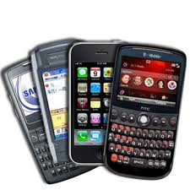


Understanding the “Net Neutrality” Debate
Jennifer Rexford
Princeton University

Slide 2
Network Neutrality
Treat all data on the Internet equally
  Not block, discriminate, or charge differently
  … by user, content, site, platform, app, etc.
Proponents
  Openness is a hallmark of the Internet
  Net-neutrality preserves competition
  Service providers have a near monopoly
Opponents
  Good to have variety of service plans/prices
  Broadband space is sufficiently competitive
  Broadband industry is young and evolving

Slide 3

FCC and Open Internet
Openness: “the absence of any gatekeeper blocking lawful
uses of the network or picking winners and losers online”
Open Internet Order (2010)
  Transparency
  No blocking
  No unreasonable discrimination
Verizon vs. FCC (2014)
  FCC has no authority to enforce these rules
  … since providers are not “common carriers”
Notes:
January 14, 2014:

Slide 4
Open Internet Advisory Committee
Open Internet Advisory Committee (2012)
  Track effects of the Open Internet Order
  Provide recommendations to the FCC
Mobile broadband working group
  Mobile broadband is crucial to the Internet
  Yet, the technology is immature
Special treatment in Open Internet Order
  Transparency
  No blocking of competing applications
  No discrimination except for management practice

Slide 5
Promoting a Virtuous Cycle
Networks
Mobile
devices
Users
Applications
Notes:
The mobile broadband ecosystem is built on a seemingly “virtuous cycle,” where networks that are fast, reliable, and widely available encourage the creation of mobile devices that connect to these networks, which spurs innovation in compelling applications, which in turn motivate more users to adopt the technology, spurring further investment in the underlying networks.

Slide 6
Complex Inter-relationships
Mobile service providers
Apps
Apps
OS
Device
Network equipment vendors
Notes:
Important roles played by many parties, including the network (i.e., mobile network operators and network equipment vendors), the devices (i.e., device manufacturers and operating­system developers), and the applications (i.e., application developers) in delivering mobile broadband services to users.

Slide 7
Small Number of Big Players
 | U.S. Ecosystem (1Q 2013)
Smartphone vendor shipments | Apple (38%), Samsung (29%), LG (10%)
Smartphone OS market share | Google Android (56%), Apple iOS (38%)
Mobile provider market share | Verizon (34%), AT&T (30%), Sprint (16%), T-Mobile (12%)
Radio access equipment vendors | Ericsson (50%), Alcatel-Lucent (36%), Nokia-Siemens (10%)
Application developers | Many, diverse, most make < $500/month, but a small fraction are very successful

Slide 8
Small Number of Big Players
 | U.S. Ecosystem (1Q 2013)
Smartphone vendor shipments | Apple (38%), Samsung (29%), LG (10%)
Smartphone OS market share | Google Android (56%), Apple iOS (38%)
Mobile provider market share | Verizon (34%), AT&T (30%), Sprint (16%), T-Mobile (12%)
Radio access equipment vendors | Ericsson (50%), Alcatel-Lucent (36%), Nokia-Siemens (10%)
Application developers | Many, diverse, most make < $500/month, but a small fraction are very successful

Slide 9
AT&T/FaceTime Case Study

Slide 10
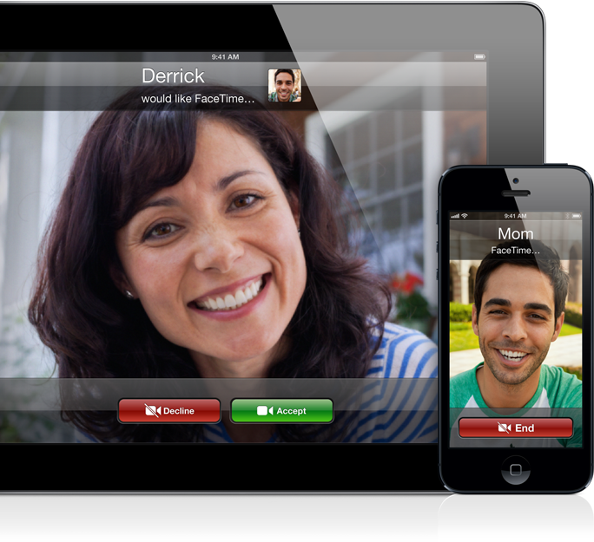
Apple FaceTime
High-quality video chat service
Originally available only over WiFi

Slide 11
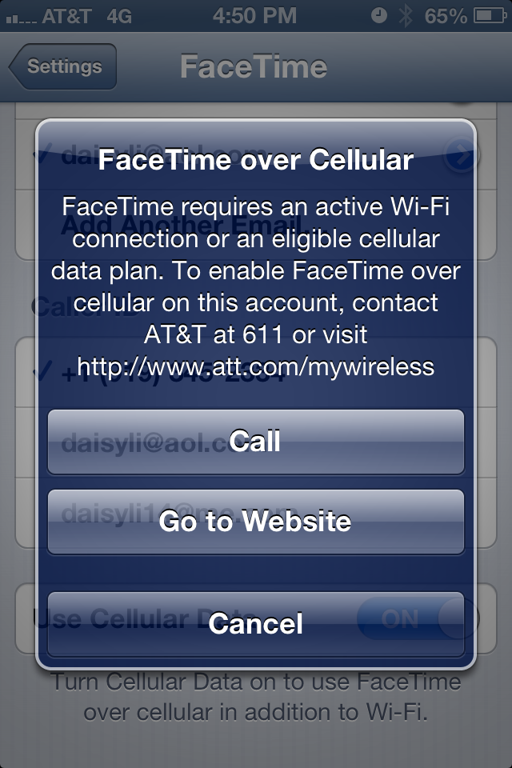
AT&T and FaceTime: A Timeline
Jun’12: Apple announces
FaceTime over cellular
  Carrier restrictions may apply
Aug’12: AT&T limits use
of FaceTime over cellular
  Limited to customers with
  the Mobile Share plan
  Sprint and Verizon announce
  support on all data plans

Slide 12
AT&T and FaceTime: A Timeline
Aug’12: Some advocates & press denounce
  AT&T violated Open Internet Order
  FaceTime competes with telephony service
  Shouldn’t discriminate by data plan
Aug’12: AT&T responds in a blog
  AT&T’s policy is transparent
  AT&T has no video chat app
  FCC doesn’t regulate preloaded apps

Slide 13
AT&T and FaceTime: A Timeline
Sep’12: Public interest groups respond
  Intent to file an FCC complaint
Oct’12: AT&T customer files FCC complaint
  Blocking on his “unlimited” data plan
Nov’12: AT&T relaxes FaceTime limitations
  Supporting FaceTime on some plans over LTE
In ‘13: AT&T rolls out FaceTime over cellular
  On all data plans (including unlimited plans)

Slide 14
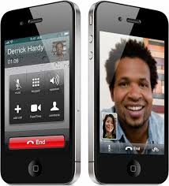
AT&T/FaceTime Issues
Pre-loaded application
  Available to all users
  of popular phone
  Accessed via device’s
  core calling features

Slide 15
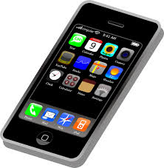
AT&T/FaceTime Issues
High bandwidth usage
  Heavy load in both directions
  Asymmetric network capacity
  Limited adaptation in the face of congestion

Slide 16

AT&T/FaceTime Issues
Staged deployment
  Rapid adoption could lead to unpredictable load
  Initially limit the number of users accessing an app

Slide 17
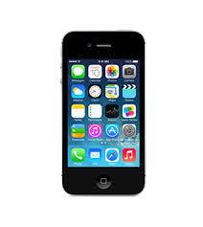
AT&T/FaceTime Issues
Enforcement point
  Usage limited on the device, not in the network

Slide 18
Opinion #1: App Developers
Bad to single out one (popular) app
  May lead to blocking other lawful apps
  Requires upgrade to expensive plans
  Discourages investment in mobile apps
App-agnostic management is better
  Rate limit customers during peak hours
  Vary pricing based on the congestion
  … regardless of the application

Slide 19
Opinion #2: Service Providers
AT&T at a higher risk for focused overload
  Many customers have iPhones
  … and unlimited data plans
Good to introduce FaceTime gradually
  Constrain the number of users
  Create incentives to limit use
  Reduce negative impact on others
Dynamic rate limiting was less attractive
  Complex, not supported by equipment
  May degrade performance for all

Slide 20
Openness in the Mobile Broadband Ecosystem

Slide 21
Small Number of Big Players
 | U.S. Ecosystem (1Q 2013)
Smartphone vendor shipments | Apple (38%), Samsung (29%), LG (10%)
Smartphone OS market share | Google Android (56%), Apple iOS (38%)
Mobile provider market share | Verizon (34%), AT&T (30%), Sprint (16%), T-Mobile (12%)
Radio access equipment vendors | Ericsson (50%), Alcatel-Lucent (36%), Nokia-Siemens (10%)
Application developers | Many, diverse, most make < $500/month

Slide 22
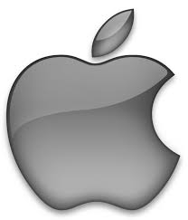

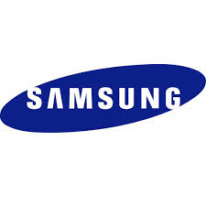

Some “Vertical” Players
Apple
  Devices (iPhone/iPad) and OS (iOS)
Google
  OS (Android), Apps, and (recently) devices
Samsung
  Top handset manufacturer
  Sells LTE equipment, handset components
Huawei
  Mobile devices and network equipment

Slide 23
International Marketplace
Leadership in cellular deployment
  Europe for 2G (GSM)
  Asia for 3G (WCDMA)
  U.S. for 4G (LTE)
Many leading companies based in U.S.
  Some (e.g., Huawei) bigger outside U.S.
Manufacturing mostly outside U.S.
  Handsets and components
International agreement on standards
Business trends often start outside U.S.
  Lower role of device subsidies, two-sided pricing

Slide 24
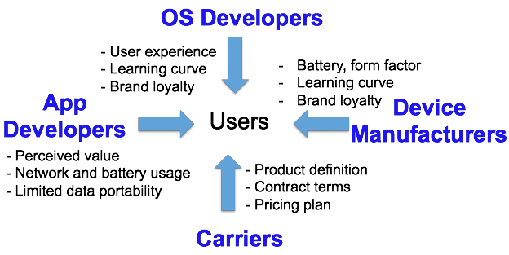
Users

Slide 25
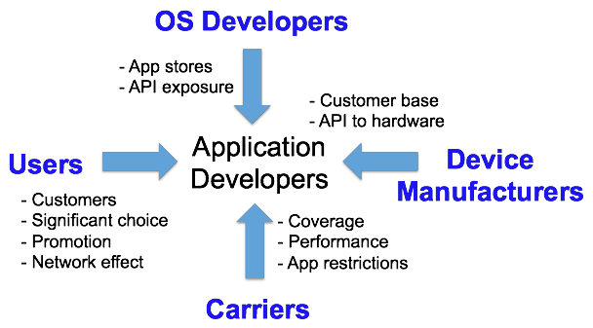
Application Developers

Slide 26
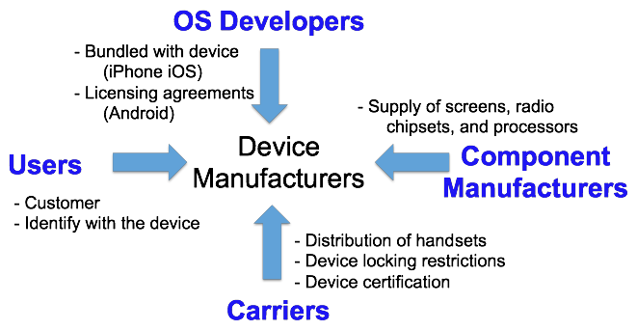
Device Manufacturers

Slide 27
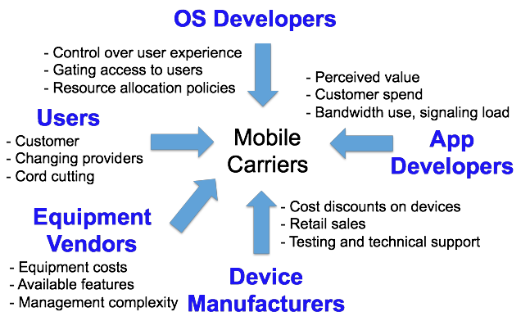
Mobile Carriers

Slide 28
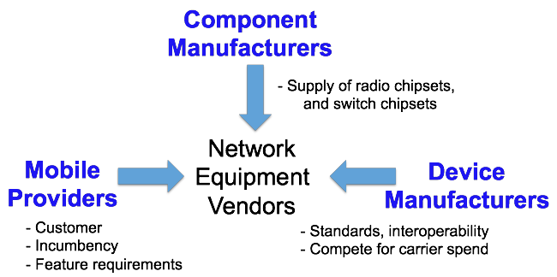
Network Equipment Vendors

Slide 29
Case Studies
App stores
Carrier service agreements
Network-unfriendly applications
SDK and handset agreements
WiFi offloading

Slide 30
Apps & OS: App Stores
Mobile app distribution
  Balancing trust, functionality, convenience
  App review by platform provider
  Semi-sandboxed execution environment
Policies affecting openness
  Installation mechanisms (app store required)
  Screening policies (performance, security, …)
  Revenue-sharing agreements (e.g., 20-30%)
  App store navigation (promotion, categories)
Longer term: HTML5

Slide 31
User & Carrier: Service Agreements
Service agreements and pricing plans
  Customers: clarity and flexibility
  Carriers: recoup costs and limit risk
  Unlimited, usage cap, usage-based pricing
Policies affecting openness
  Billing models (from unlimited to usage-based)
  Device locking (and role of device subsidies)
  Restrictions on tethering
  Application restrictions (e.g., FaceTime)
  Zero-rating (“toll free”) trend outside U.S.

Slide 32
App & Carrier: Net-Unfriendly Apps
Misbehaving apps overload the network
  Chatty: wasting signaling resources
  Unfair: consuming excessive bandwidth
  Inefficient: poor caching wastes bandwidth
Challenging to address
  Large number of developers
  Naiveté about app impact on the network
Aligned incentives
  Educate developers (e.g., AT&T ARO tool)
  Benefit users (e.g., less bandwidth and battery)

Slide 33
OS & Device: SDK/Handset Agreements
Android
  OS is free and open (unlike Apple iOS)
  But the OS isn’t the whole story
Agreements with handset manufacturers
  Early access to new versions of Android
  Engineering and technical support
  Access to Google Play (app store and search)
Anti-fragmentation policy
  Reduces app portability problems
  Limits OS experimentation (e.g., search, navigation)

Slide 34
Long-Term Trend: WiFi Offloading
WiFi offloading
  Unlicensed spectrum
  Low-cost (free or cheap to users)
  Carries 30-70% of mobile data traffic
Multiple flavors
  Home or office, offered by a business (e.g., Starbucks), commercial service (e.g., Boingo)
Influencing the market structure
  More options for consumers
  Cellular for coverage, and WiFi for capacity
  Seamless authentication and mobility support

Slide 35
Conclusions
Network neutrality is a complex issue
  What is “openness”?
  What best enables “competition”?
  What is the best way to foster openness?
Issue goes far beyond service providers
  Applications, operating systems, devices
  Beyond the purview of the FCC
Going forward, need ways to encourage
  Transparency, education, and competition

Slide 36
References
FCC Open Internet Advisory Committee
  http://www.fcc.gov/encyclopedia/open-internet-advisory-committee
OIAC annual report (Aug’13)
  http://transition.fcc.gov/cgb/oiac/oiac-2013-annual-report.pdf
AT&T/FaceTime Case Study (Jan’13)
  http://transition.fcc.gov/cgb/events/ATT-FaceTimeReport.pdf
Openness in Mobile Broadband Ecosystem (Aug’13)
  http://transition.fcc.gov/cgb/oiac/Mobile-Broadband-Ecosystem.pdf

