Slide 1

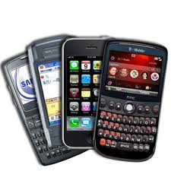
Openness in the Mobile Broadband Ecosystem
Jennifer Rexford
Princeton University
http://transition.fcc.gov/cgb/oiac/Mobile-Broadband-Ecosystem.pdf

Slide 2

FCC and Open Internet
Openness: “the absence of any gatekeeper blocking lawful
uses of the network or picking winners and losers online”
Open Internet Order (2010)
  Transparency
  No blocking
  No unreasonable discrimination
Open Internet Advisory Committee (2012)
  Track effects of the Open Internet Order
  Provide recommendations to the FCC

Slide 3
Mobile Broadband Working Group
Mobile broadband
  Crucial part of Internet access
  Yet, still at an early stage
Special treatment in Open Internet Order
  Network practice transparency
  Certain “no blocking” requirements
  Wider latitude for differentiated service
Two main activities
  AT&T limiting the FaceTime application
  Openness in the mobile broadband ecosystem

Slide 4
Promoting a Virtuous Cycle
Networks
Mobile
devices
Users
Applications
Notes:
The mobile broadband ecosystem is built on a seemingly “virtuous cycle,” where networks that are fast, reliable, and widely available encourage the creation of mobile devices that connect to these networks, which spurs innovation in compelling applications, which in turn motivate more users to adopt the technology, spurring further investment in the underlying networks.

Slide 5
Complex Inter-relationships
Mobile carriers
Apps
Apps
OS
Device
Network equipment vendors
Notes:
Important roles played by many parties, including the network (i.e., mobile network operators and network equipment vendors), the devices (i.e., device manufacturers and operating­system developers), and the applications (i.e., application developers) in delivering mobile broadband services to users.

Slide 6
Small Number of Big Players
 | U.S. Ecosystem (1Q 2013)
Smartphone vendor shipments | Apple (38%), Samsung (29%), LG (10%)
Smartphone OS market share | Google Android (56%), Apple iOS (38%)
Mobile provider market share | Verizon (34%), AT&T (30%), Sprint (16%), T-Mobile (12%)
Radio access equipment vendors | Ericsson (50%), Alcatel-Lucent (36%), Nokia-Siemens (10%)
Application developers | Many, diverse, most make < $500/month

Slide 7
Some “Vertical” Players
Apple
  Devices (iPhone/iPad) and OS (iOS)
Google
  OS (Android), Apps, and (recently) devices
Samsung
  Top handset manufacturer
  Sells LTE equipment, handset components
Huawei
  Mobile devices and network equipment

Slide 8
International Marketplace
Leadership in cellular deployment
  Europe for 2G (GSM)
  Asia for 3G (WCDMA)
  U.S. again for 4G (LTE)
Many leading companies are U.S. based
  Some (e.g., Huawei) bigger outside U.S.
Manufacturing mostly outside U.S.
  Handsets and components
International agreement on standards
Business trends often start outside U.S.
  Lower role of device subsidies, two-sided pricing

Slide 9
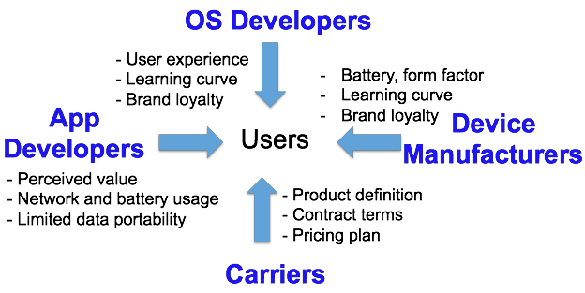
Users

Slide 10
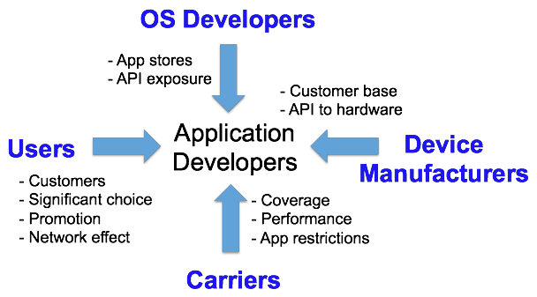
Application Developers

Slide 11
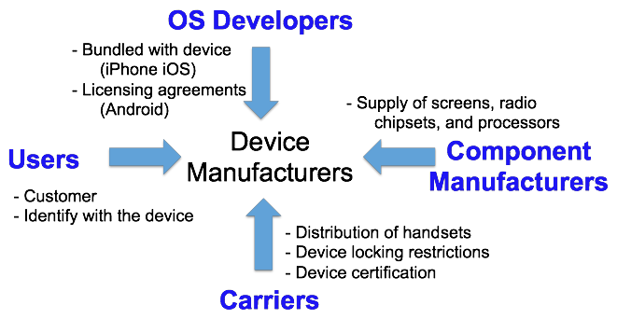
Device Manufacturers

Slide 12
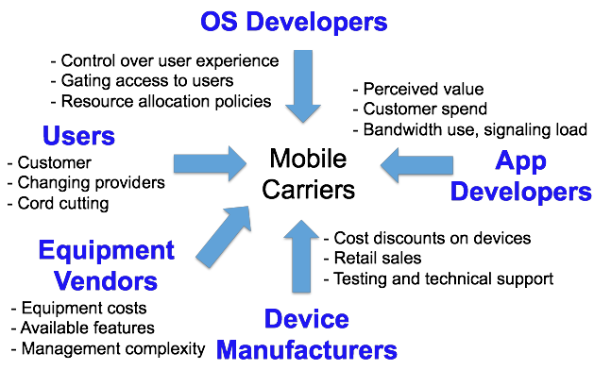
Mobile Carriers

Slide 13
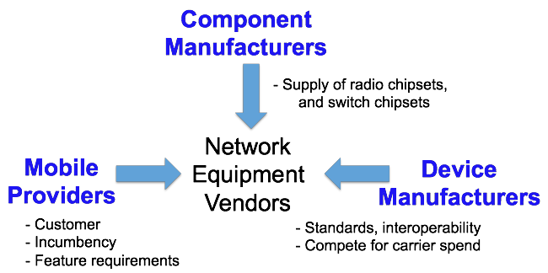
Network Equipment Vendors

Slide 14
Case Studies
App stores
Carrier service agreements
Network-unfriendly applications
SDK and handset agreements
WiFi offloading

Slide 15
Apps & OS: App Stores
Mobile app distribution
  Balancing trust, functionality, convenience
  App review by platform provider
  Semi-sandboxed execution environment
Policies affecting openness
  Installation mechanisms (app store required)
  Screening policies (performance, security, …)
  Revenue-sharing agreements (e.g., 20-30%)
  App store navigation (promotion, categories)
Longer term: HTML5

Slide 16
User & Carrier: Service Agreements
Service agreements and pricing plans
  Customers: clarity and flexibility
  Carriers: recoup costs and limit risk
  Unlimited, usage cap, usage-based pricing
Policies affecting openness
  Billing models (from unlimited to usage-based)
  Device locking (and role of device subsidies)
  Restrictions on tethering
  Application restrictions (e.g., FaceTime)
  Zero-rating (“toll free”) trend outside U.S.

Slide 17
App & Carrier: Net-Unfriendly Apps
Misbehaving apps overload the network
  Chatty: wasting signaling resources
  Unfair: consuming excessive bandwidth
  Inefficient: poor caching wastes bandwidth
Challenging to address
  Large number of developers
  Naiveté about app impact on the network
Aligned incentives
  Educate developers (e.g., AT&T ARO tool)
  Benefit users (e.g., less bandwidth and battery)

Slide 18
OS & Device: SDK/Handset Agreements
Android
  OS is free and open (unlike Apple iOS)
  But the OS isn’t the whole story
Agreements with handset manufacturers
  Early access to new versions of Android
  Engineering and technical support
  Access to Google Play (app store and search)
Anti-fragmentation policy
  Reduces app portability problems
  Limits OS experimentation (e.g., search, navigation)

Slide 19
Long-Term Trend: WiFi Offloading
WiFi offloading
  Unlicensed spectrum
  Low-cost (free or cheap to users)
  Carries 30-70% of mobile data traffic
Multiple flavors
  Home or office, offered by a business (e.g., Starbucks), commercial service (e.g., Boingo)
Influencing the market structure
  More options for consumers
  Cellular for coverage, and WiFi for capacity
  Seamless authentication and mobility support

Slide 20
Conclusions
Consider interactions between all players
  Even those not subject to the OIO
Track the trends affecting competition
  HTML5, WiFi offloading, two-sided pricing, emergence of “vertical” players, …
Foster a healthy ecosystem
  Transparency
  Education
  Competition

