Slide 1
Central Control over Distributed Routing
fibbing.net
Stefano Vissicchio
UCLouvain
SIGCOMM
18th August 2015
Joint work with
O. Tilmans (UCLouvain), L. Vanbever (ETH Zurich) and J. Rexford (Princeton)

Slide 2
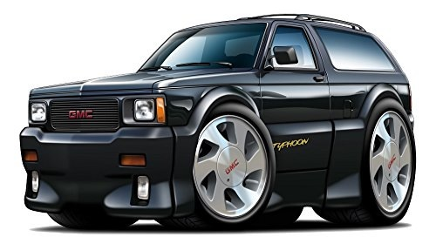
SDN is based on antithetical architecture
with respect to traditional networking
Traditional
(e.g., IGP, distributed MPLS)
SDN
(e.g., OpenFlow, Segment Routing)
Notes:
The recent and growing interest to Software Defined Networking makes it clear that operators want networks to be centrally controlled.
This constitutes a huge difference with the traditional networking model, which is based on tweaking the behavior of distributed protocols.
SDN is indeed taking the completely opposite approach, promoting a fully-centralized architecture.
[talk about the controller]

Slide 3
Centralization improves network management,
but sacrifices robustness of distributed protocols
Traditional
SDN
IGP, tunnelling (RSVP-TE)
Manageability
low
high
Flexibility
low
highest
Scalability
by design
ad hoc
Robustness
high
low
Notes:
Centralization as proposed by SDN comes with multiple advantages.
Prominently, it leads to improved manageability, through a high-level interface for operators to configure their networks, and higher flexibility, in terms of packet processing.
On the flip side, SDN also comes with downsides and challenges.
Mainly, centralization sacrifices the robustness and scalability of the current distributed protocols.

Slide 4
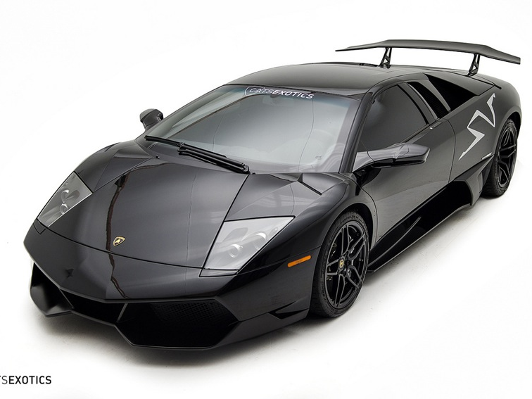
We propose Fibbing, a hybrid SDN architecture
Fibbing
central control over link-state IGPs
Notes:
We propose an architecture which is partially centralized and partially distributed.
The architecture is based on Fibbing, that consists in applying central control over a distributed protocol.
We applied this techniques to control intra-domain routing.

Slide 5
Fibbing combines advantages
of SDN and traditional networking
Traditional
Fibbing
SDN
IGP, tunnelling (RSVP-TE)
Manageability
low
high
high
Flexibility
low
high
highest
Scalability
by design
by design
ad hoc
Robustness
high
high
low
Notes:
By centralizing the decisions and coordinating a distributed protocol, we show that Fibbing combines the advantages of traditional and SDN approaches.
In particular…

Slide 6
Fibbing combines advantages
of SDN and traditional networking
Fibbing
same as SDN
Manageability
high
per-destination
full control
Flexibility
high
some function
are distributed
Scalability
by design
Robustness
high
thanks to partial distribution
Notes:
More precisely, …

Slide 7
Central Control over Distributed Routing
fibbing.net
1
Manageability
2
Flexibility
3
Scalability
4
Robustness
Notes:
In the rest of the talk, I will explain how Fibbing achieves high manageability, flexibility, scalability and robustness, addressing each of those features one by one.

Slide 8
Central Control over Distributed Routing
fibbing.net
1
Manageability
2
Flexibility
3
Scalability
4
Robustness
Notes:
Let me start with manageability, for which I will actually overview the Fibbing architecture.

Slide 9
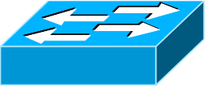
SDN achieves high manageability
by centralizing both computation and installation
requirements
computes paths
e.g., OpenFlow
controller or RCP
derives FIB entries
install FIB entries
Notes:
From an architectural viewpoint, Fibbing is very close to SDN.
You have probably seen this slides multiple times already.
This is a classic SDN architecture, with data-plane devices programmed by a network controller.
Manageability here comes from the fact that the controller exposes a high-level interface to operators.
The controller is then responsible for both computing packet processing based on operators’ requirements and installing the corresponding rules on devices (typically one by one).

Slide 10
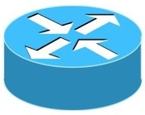
Fibbing is as manageable as SDN,
but centralizes only high-level decisions
requirements
Fibbing
controller
computes paths
Notes:
Fibbing relies on a similar approach, still keeping network-wide control centralized. So, the operator can still talk to a centralized controller, hence achieving the same manageability as SDN. What actually changes is the implementation of operators’ requirements. Indeed, the Fibbing controller centralizing only computation of packet processing (e.g., forwarding paths).

Slide 11
Fibbing keeps installation distributed,
relying on distributed protocols
computes FIB entries
distributed
control-plane
install FIB entries
data-plane
Notes:
However, the actual computation of FIB entries and their installation on data-plane devices is done by a distributed control-plane run on the network.

Slide 12
Distributed installation is controlled
by injecting carefully-computed information
control-plane
messages
Notes:
For the distributed control-plane to install FIB entries realizing the paths computed by the controller, the controller injects properly-computed messages in the distributed control-plane.
In our work, we then focus on determining which messages to inject to control the distributed control-plane.

Slide 13
We study which messages to inject
for controlling intra-domain routing protocols
link-state IGP
input
function
output
weighted
topology
shortest-path
computation
forwarding
paths
Notes:
In particular, we focused on link-state IGPs, that is the shortest-path based routing protocols used for intra-domain routing.
Our work is based on the observation that IGPs can be actually seen (e.g., by the controller) as a function, which computes forwarding paths from information about the network topology, represented as a weighted graph.
The applied function is basically Dijkstra.

Slide 14
The output of the controlled protocol
is specified by operators’ requirements
provided by operators
or controller optimizers
(e.g., DEFO)
link-state IGP
input
function
output
weighted
topology
shortest-path
computation
forwarding
paths
Notes:
In particular, we focused on link-state IGPs, that is the shortest-path based routing protocols used for intra-domain routing.
Our work is based on the observation that IGPs can be actually seen (e.g., by the controller) as a function, which computes forwarding paths from information about the network topology, represented as a weighted graph.
The applied function is basically Dijkstra.

Slide 15
To control IGP output, the Fibbing controller
inverts the shortest-path function
Inverse
weighted
topology
shortest-path
computation
forwarding
paths
Notes:
In particular, we focused on link-state IGPs, that is the shortest-path based routing protocols used for intra-domain routing.
Our work is based on the observation that IGPs can be actually seen (e.g., by the controller) as a function, which computes forwarding paths from information about the network topology, represented as a weighted graph.
The applied function is basically Dijkstra.

Slide 16
Central Control over Distributed Routing
fibbing.net
1
Manageability
2
Flexibility
3
Scalability
4
Robustness

Slide 17
Consider this simple network
(implemented with Cisco routers)
A
B
X
D1
C
D2
source
destination
Notes:
to understand Fibbing flexibility, let me first introduce how Fibbing works.
Consider the example in the figure. [describe example]

Slide 18
An IGP control-plane computes
shortest paths on a shared weighted topology
control-plane
A
1
B
10
1
C
X
D1
3
D2
shortest paths

Slide 19
IGP shortest paths are translated into
forwarding paths on the data-plane
control-plane
data-plane
A
B
A
1
B
10
1
X
C
X
D1
D1
3
D2
C
D2
traffic flow
Notes:
Let’s consider the example network in the figure.
[Describe the figure]

Slide 20
In Fibbing, operators can ask
the controller to modify forwarding paths
requirement
(C,A,B,X,D2)
A
1
B
10
1
C
X
D1
3
D2

Slide 21
The Fibbing controller injects information on
fake nodes and links to the IGP control-plane
requirement
(C,A,B,X,D2)
A
1
B
node V1,
link (V1,C),
map (V1,C) to (C,A)
10
1
C
X
D1
3
D2

Slide 22
Informations are flooded
to all IGP routers in the network
requirement
(C,A,B,X,D2)
A
1
B
node V1,
link (V1,C),
map (V1,C) to (C,A)
10
1
C
X
D1
3
D2

Slide 23
Fibbing messages augment
the topology seen by all IGP routers
requirement
(C,A,B,X,D2)
D2
A
1
B
node V1,
link (V1,C),
map (V1,C) to (C,A)
V1
10
1
1
C
X
D1
3
D2

Slide 24
Augmented topologies translate
into new control-plane paths
requirement
(C,A,B,X,D2)
D2
A
1
B
node V1,
link (V1,C),
map (V1,C) to (C,A)
V1
10
1
1
C
X
D1
3
D2

Slide 25
Augmented topologies translate
into new data-plane paths
requirement
(C,A,B,X,D2)
A
B
D2
A
1
B
node V1,
link (V1,C),
map (V1,C) to (C,A)
V1
10
1
X
1
C
X
D1
D1
3
D2
C
D2
Notes:
- add requirement
- move at the beginning of flexibility section

Slide 26
Fibbing can program
arbitrary per-destination paths
Theorem
Any set of forwarding DAGs can be enforced by Fibbing

Slide 27
Fibbing can program
arbitrary per-destination paths
Theorem
Any set of forwarding DAGs can be enforced by Fibbing
paths to the same destination do not create loops

Slide 28
By achieving full per-destination control,
Fibbing is highly flexible
Theorem
Any set of forwarding DAGs can be enforced by Fibbing
fine-grained traffic steering (middleboxing)
per-destination load balancing (traffic engineering)
backup paths provisioning (failure recovery)

Slide 29
Central Control over Distributed Routing
fibbing.net
1
Manageability
2
Flexibility
3
Scalability
4
Robustness

Slide 30
We implemented a Fibbing controller
Compilation
Augmentation
Optimization
Injection/
Monitoring
+
path
reqs.
network
topology
per-destination
forwarding DAGs
augmented
topology
reduced topology
running
network

Slide 31
We also propose algorithms
to compute augmented topologies of limited size
Compilation
Augmentation
Optimization
Injection/
Monitoring
+
path
reqs.
network
topology
per-destination
forwarding DAGs
augmented
topology
reduced topology
running
network
compilation
heuristics
per-destination
augmentation
cross-destination
optimization

Slide 32
For our Fibbing controller, we propose
algorithms to be run in sequence
Compilation
Augmentation
Optimization
Injection/
Monitoring
+
path
reqs.
network
topology
per-destination
forwarding DAGs
augmented
topology
reduced topology
running
network
compilation
heuristics
per-destination
augmentation
simple
merger
cross-destination
optimization

Slide 33
Consider the following example,
with a drastic forwarding path change
A
1
B
A
1
B
1
100
1
100
C
D
E
F
C
D
E
F
1
1
10
1
1
10
original shortest-path
“down and to the right”
desired shortest-path
“up and to the right”

Slide 34
Simple adds one fake node for every
router that has to change next-hop
1
1
1
A
B
1
1
100
1
C
D
E
F
1
1
10
1
1

Slide 35
Merger iteratively merges fake nodes
(starting from Simple’s output)
1
A
1
B
1
1
100
1
C
D
E
F
1
1
10
1
1

Slide 36
Merger iteratively merges fake nodes
(starting from Simple’s output)
1
A
1
B
1
1
100
1
C
D
E
F
1
1
10
1

Slide 37
This way, Merger programs multiple
next-hop changes with a single fake node
A
1
B
1
1
100
C
D
E
F
1
1
10
Notes:
note that this is more powerful than configuring nodes one-by-one

Slide 38
This way, Merger programs multiple
next-hop changes with a single fake node
A
1
B
1
1
100
C
D
E
F
1
1
10
Previous SDN solutions (e.g., RCP) cannot do the same
Notes:
note that this is more powerful than configuring nodes one-by-one

Slide 39
Simple and Merger achieve different trade-offs
in terms of time and optimization efficiency
We ran experiments on Rocketfuel topologies,
with at least 25% of nodes changing next-hops
Simple runs in milliseconds
Merger takes 0.1 seconds
Merger reduces fake nodes by up to 50%
and up to 90% with cross-destination optimization

Slide 40
We implemented the machinery to
listen to OSPF and augment the topology
Compilation
Augmentation
Optimization
Injection/
Monitoring
+
path
reqs.
network
topology
per-destination
forwarding DAGs
augmented
topology
reduced topology
running
network
OSPF interaction
module

Slide 41
Experiments on real routers show that
Fibbing has very limited impact on routers
# fake
nodes
router
memory (MB)
1 000
0.7
5 000
6.8
10 000
14.5
50 000
76.0
100 000
153
DRAM is cheap
>> # real routers

Slide 42
Experiments on real routers show that
Fibbing has very limited impact on routers
# fake
nodes
router
memory (MB)
1 000
0.7
5 000
6.8
10 000
14.5
50 000
76.0
100 000
153
DRAM is cheap
CPU utilization always under 4%

Slide 43
Experiments on real routers show that
Fibbing does not impact IGP convergence
Upon link failure, we registered no difference in the (sub-second) IGP convergence with
no fake nodes
up to 100,000 fake nodes and destinations

Slide 44
Experiments on real routers show that
Fibbing achieves fast forwarding changes
# fake
nodes
installation
time (seconds)
1 000
0.9
5 000
4.5
10 000
8.9
50 000
44.7
100 000
89.50
894.50 μs/entry

Slide 45
Central Control over Distributed Routing
fibbing.net
1
Manageability
2
Flexibility
3
Scalability
4
Robustness

Slide 46
Fibbing improves robustness
by relying on the underlying IGP
no controller action needed in some cases
IGPs re-converge quickly [Filsfils07]
IGP provides fast failure detection and control-plane sync
thanks to its shared topology
Fibbing supports fail-open and fail-close semantics
see paper

Slide 47
We ran a failure recovery case study,
with distributed Fibbing controller
( fail-close(D1) );
( fail-open(D2) );
D2
A
B
V1
C
X
D1
D2
Notes:
update performance graph

Slide 48
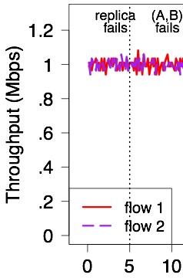
Fibbing survives replica failures
with no impact on forwarding
( fail-close(D1) );
( fail-open(D2) );
D2
A
B
V1
C
X
D1
D2
Notes:
update performance graph

Slide 49
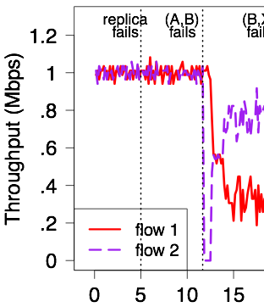
Fibbing reacts to network failures
quickly re-optimizing forwarding
( fail-close(D1) );
( fail-open(D2) );
A
B
C
X
D1
D2
Notes:
update performance graph

Slide 50
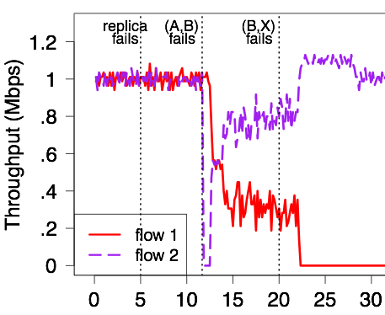
Fibbing reacts to partitions,
respecting fail-close and fail-open semantics
( fail-close(D1) );
( fail-open(D2) );
A
B
C
X
D1
D2
Notes:
update performance graph

Slide 51
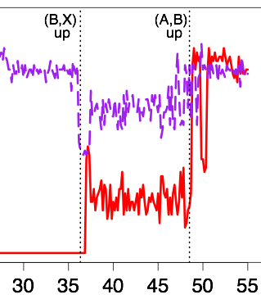
Fibbing recovers correctly
(as soon as failures are fixed)
( fail-close(D1) );
( fail-open(D2) );
D2
A
B
V1
C
X
D1
D2
Notes:
update performance graph

Slide 52
Fibbing shows the benefits of
central control over distributed protocols
Realizes SDN management model
network-wide automated control
Simplify controllers and improves robustness
heavy work is still done by routers
Works today, on existing networks
avoids SDN deployment hurdles

Slide 53
Central Control over Distributed Routing
fibbing.net
Tell me lies, tell me sweet little lies
— Fleetwood Mac
Stefano Vissicchio
stefano.vissicchio@uclouvain.be

