Slide 1
Lessons Learned from the 9/11 Attacks
Jennifer Rexford
Princeton University
Thanks to Craig Partridge for slides from an earlier briefing…

Slide 2
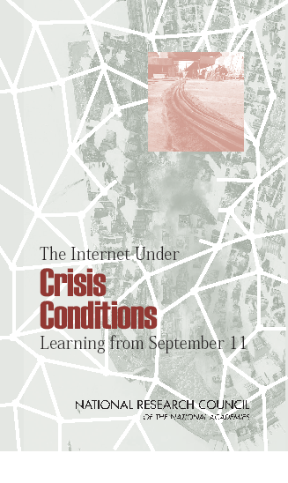
The Internet Under Crisis Conditions:
Learning from September 11
Computer Science and Telecommunications Board
The National Academies
Public release: Nov 2002
Study committee: Craig Partridge (Chair), Paul Barford, David D. Clark, Sean Donelan, Vern Paxson, Jennifer Rexford, and Mary Vernon
CSTB staff: Jon Eisenberg, Marjory Blumenthal, David Padgham, and D.C. Drake

Slide 3
A 9/11 Timeline

Slide 4
Early Morning
Up until 8:46 fairly routine
Some network upgrades during the night
Traffic beginning to increase with the work day
8:46 AA 11 crashes into WTC1
9:02 UA 175 crashes into WTC2
Internet news servers rapidly inundated
9:37 AA 77 crashes into the Pentagon
9:39 NYC without broadcast TV and radio

Slide 5
Mid-Morning
10:05 World Trade Center 2 collapses
Internet infrastructure in WTC2 destroyed
10:28 World Trade Center 1 collapses
At least one trans-atlantic link fails
Internet traffic loads and connectivity drop
11:00 NYC cell phone call demand peaks
11:00 Internet connectivity close to normal
11:39 www.cnn.com now handling demand

Slide 6
Afternoon
1:16 Part of the national 1-800 telephone network fails
4:35 First major electrical outage in NYC
Substation in WTC 7
Internet connectivity dips 2%
5:20 WTC 7 collapses
Extensive damage to Verizon facility
Internet connectivity dips 1%

Slide 7
Evening
Three remaining data-comm centers in lower Manhattan struggle to keep operations running
Dust causes air conditioning problems
Operator error turns off generator at one facility
Access limited
Restoration of service in NYC underway
Feeding network operators difficult
Operational issues continue several days

Slide 8
Report Findings

Slide 9
Findings
The Internet was mostly fine
Little effect on Internet services as a whole
Network displayed considerable flexibility
Limited measurements hamper analysis
Limited data, and limited archiving of data
Lack of a good “typical day” for baseline
Major effect on some Internet services
2500% growth in demand for CNN site
1300% growth in cell phone demand (11am)

Slide 10
Findings
Use of Internet services was not typical
Television and phone were primary services
Internet servers as a backup for TV (news Web sites) and phone (instant messaging, VoIP)
Understanding and enhancing the news
Inadequate redundancy in some parts
ISPs concentrating facilities in one location
Certain physical attacks could be worse
Electronic attacks a more serious concern

Slide 11
Findings
Subtle operational issues merit attention
Network operators’ reliance on 1-800 numbers
Internet and PSTN sharing fibers and conduits
Planning for staff needing to eat and sleep
Multi-day power outages, fuel deliveries, etc.
Better leveraging of Internet in the future
Disaster plans should plan for Internet use
Give some connectivity to all (IM, text msg)

Slide 12
Anecdotes

Slide 13
Anecdotes
CNN Web site
The “one-packet homepage”
Repurposing Turner server machines
Re-Akamaizing the CNN Web site
Hidden dependencies
South Africa top-level domain name server
Authentication server for Florida ISP
Intra-hospital network relying on the Internet
Better Internet stability in some places
Network operators went home…

Slide 14
Conclusions
The Internet on 9/11
The Internet was relatively reliable
Though some services were badly affected
And application usage dramatically shifted
Lessons learned
Better, more systematic measurement
Uncovering hidden dependencies
Addressing operational concerns

