Slide 1
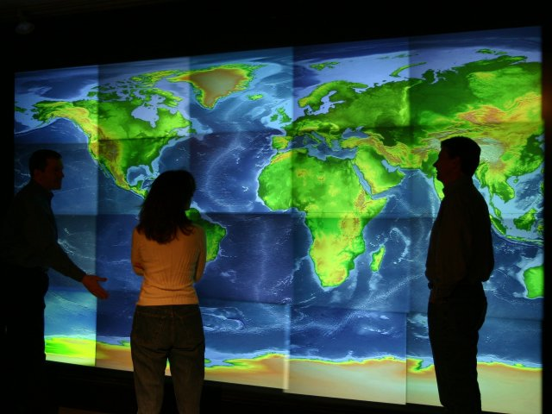
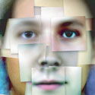
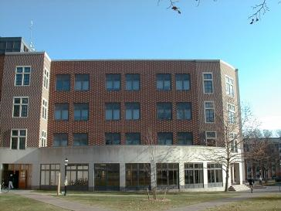
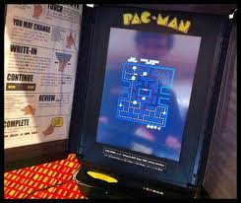
Computer Science at Princeton
Jennifer Rexford ’91
Chair of Computer Science

Slide 2
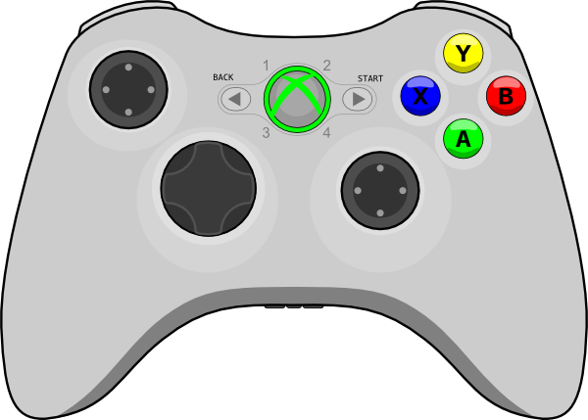


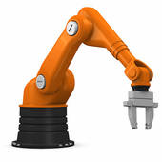








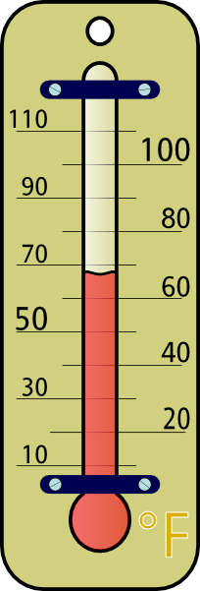





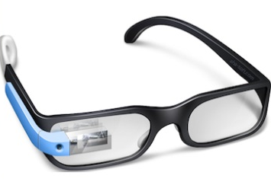
Computer Science is Central
data
people
education
control
analyze
art
deliver
store
energy
policy
compute
visualize
CS
privacy
medicine
Notes:
Computer science is about information (data).
Analyzing it, and using it to control the physical world.
And the design of systems for computing, storing, delivering, visualizing, etc.
And making those systems scalable, reliable, efficient, high performing, etc.
The information comes from an increasingly diverse range of sources,
from computers to science experiments to far flung sensors.
And the outputs affect essentially every aspect of society and our economy.

Slide 3
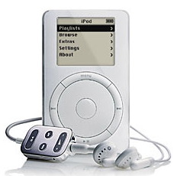
Computers are in Everything...
Camera: computer with a lens
Cell phone: computer with a radio
iPod: computer with an earphone
Car: computers with engine and wheels

Slide 4
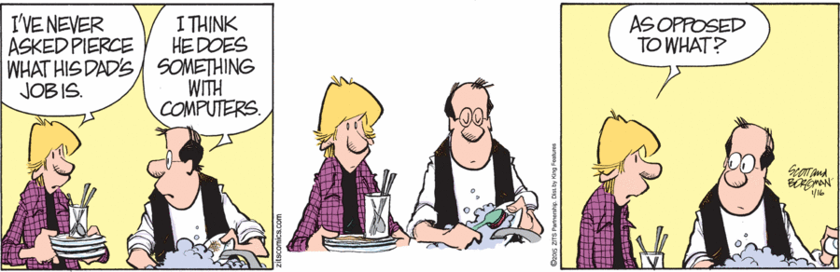
Computer Science is Universal
Computers
  The medium for interacting with everything
  General tools for solving a diverse set of problems
  Making every other human endeavor smarter

Slide 5
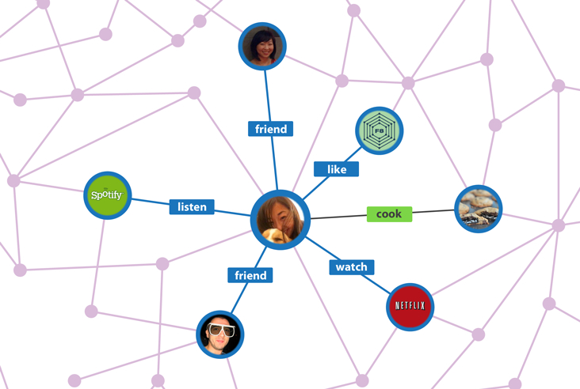


Computer Science is Universal
Computational thinking
  Read, writing, arithmetic, and… computing
  Algorithms are creative output in other fields
  Key to accelerating scientific discovery
Sociology
Finance
Biology
From taxonomy to
analyzing the genome
From focus groups to mining social graphs
From technical analysis to algorithmic trading

Slide 6
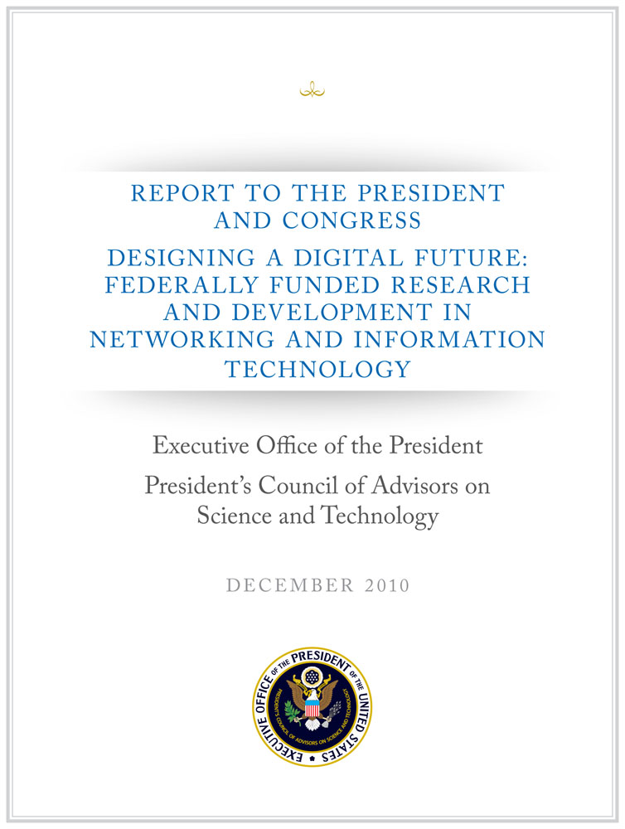
A National Imperative
“Recent technological and societal trends place the further advancement and application of networking and information technology squarely at the center of our Nation’s ability to achieve essentially all of our priorities and to address essentially all of our challenges.”
Source: “Designing a Digital Future” PCAST Report – a periodic congressionally-mandated review of the Federal Networking and Information Technology Research and Development (NITRD) Program.
Notes:
The latest report by The President’s Council of Advisors on Science and Technology (PCAST) on the NITRD program, in fact, offers a compelling a case for Networking and Information Technology as a NATIONAL IMPERATIVE.
This report, which was released released in December of 2010 brings to focus the benefits that have been achieved through the Nation’s 20-year coordinated investments in Networking and Information Technology Research and Development.
Read the QUOTE!
-------
The President’s Council of Advisors on Science and Technology (PCAST) conducts periodic congressionally-mandated review of the Federal Networking and Information Technology Research and Development (NITRD) Program.
Previous PCAST and PITAC reports have positioned NIT principally as central to discovery in science and engineering. This report places NIT as additionally central to fields such as health, energy, transportation, and education. It also focuses heavily on the exceptional role of NIT as an engine of economic growth.

Slide 7
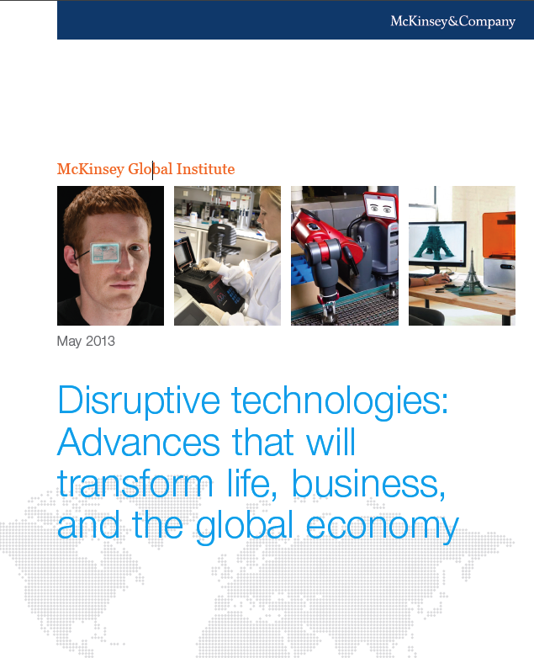
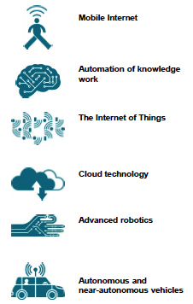
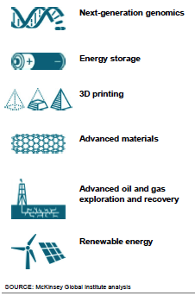
Transforming Life and Economy
Top twelve economically
disruptive technologies (by 2025)
McKinsey Global Institute report
Notes:
McKinsey Global Institute report identified the top 12 technologies with potential for economic disruptio
The top six are computing technologies.
Mobile internet
Automation of knowledge work
The internet of things
Cloud technology
Advanced robotics
Autonomous and near-autonomous vehicles
And the others (next-generation genomics, energy storage, 3-D printing, advanced materials …) rely upon or will be significantly enabled by the use of computing and information technologies.

Slide 8
STEM Job Growth
Math
Social sciences
Physical sciences
Life sciences
Engineers
Computer occupations
Data from the spreadsheet linked at http://www.bls.gov/emp/ep_table_102.htm

Slide 9
Computer Science at Princeton

Slide 10
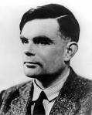
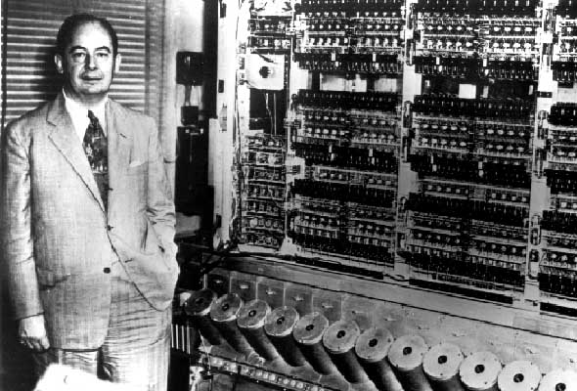
At the Forefront from the Beginning
Alan Turing, *38
  Father of computer science
  Major contributions to theory of
  computation
  Cracked German “Enigma”
  codes in WWII
John von Neumann
  Idea of storing program
  and data in same memory
  Generating random
  numbers
  Scientific computation

Slide 11




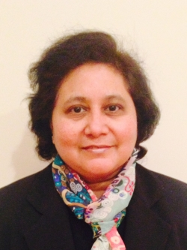






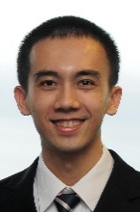

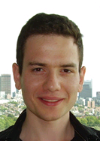







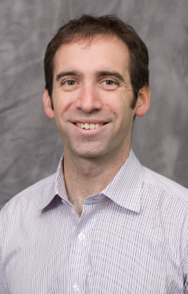
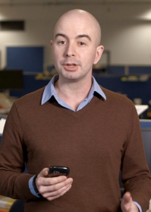




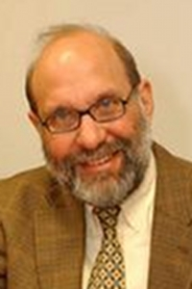
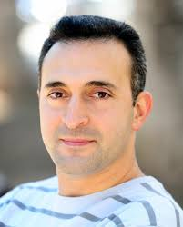
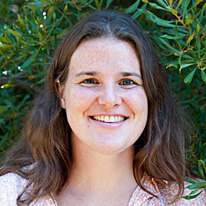


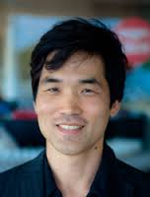
Research Areas
Programming Languages
Computer Architecture
Graphics and Vision
Appel
Walker
Kernighan
Gupta
August
Clark
Martonosi
Rusinkiewicz
Funkhouser
Finkelstein
Xiao
Theory
Systems and Networks
Arora
Braverman
Chazelle
Dvir
Sedgewick
Tarjan
Freedman
Li
Rexford
Feamster
Jamieson
Tech. Policy, Markets, Security
Machine Learning, Computational Science
Felten
LaPaugh
J. Singh
Narayanan
Dobkin
Hazan
Englehardt
M. Singh
Troyanskaya
Seung

Slide 12
Outward-Facing Department
Math
IAS
Complexity
theory
CITP, WWS,
Econ, Politics,
Sociology
ELE
Networks, Comp arch
MAE
Robotics
IT policy
CS
Andlinger
Sustainable IT
Graphics & artifacts
Art,
Archeology
Machine learning
Computational science
ORFE
OIT
Center for
Statistics & ML
Genomics
Neuroscience
Linguistics
Notes:
This is strategic for us:
Princeton has high, uniform quality across campus
Princeton has a small, intimate campus where people can find each other
Princeton is thoughtful in evaluating faculty

Slide 13
Princeton CS and Data Science
Foundations
(algorithms, machine learning)
Science Applications
(genomics, neuroscience)
Platforms
(sensing, compute, storage, network, security/privacy)

Slide 14
Current Students
CS is now the most popular major
Class of 2017 (BSEs and ABs)
  130 juniors (101 BSE and 29 AB)
  46 women (35% of the class)
Class of 2018 (BSEs)
  116 sophomore BSE students in CS
  AB students declare in April ’16
CS 126 is Princeton’s most popular course
  Nearly 70% of all students take at least one CS course

Slide 15
Curriculum
Introductory courses
  COS 126: General CS (taken by all BSEs)
  COS 217: Systems Programming
  COS 226: Algorithms & Data Structures
Eight departmentals, at least two each in
  Systems
  Applications
  Theory
Independent work

Slide 16
Departmentals: Two of Each
Systems
  operating systems, compilers, networks, databases, architecture, programming techniques, ...
Applications
  AI, graphics, vision, security, electronic auctions, HCI/sound, computational biology, information technology & policy...
Theory
  discrete math, theory of algorithms, cryptography, programming languages, computational geometry, ...
Courses in other departments
  ELE, ORF, MAT, MOL, MUS, PHI, PHY, PSY, ...

Slide 17
Fall’15 IW Seminars
Analyzing relationship networks: Social networks and beyond
Online learning and MOOCs
Entrepreneurial lessons for computer scientists
Apps for the environment
A brave new data world
Understanding the world with sensors

Slide 18
Spring’16 IW Seminars
Deep learning
Understanding the world with sensors
Entrepreneurial lessons for computer scientists
Improving CS education with visualization
Using public data to learn, explain, and educate
Apps of random kindness
Online crowdsourcing

Slide 19
Other Options
Certificate in Applications of Computing
  Two of the three: 217, 226, 323
  Two upper-level courses, computing in independent work
  See Professor JP Singh
AB instead of BSE
  Same departmental requirements
  Different university requirements
    Two JP's and a senior thesis vs. one semester of IW
    Foreign language vs. chemistry
    31 courses vs. 36

Slide 20
Undergraduate Projects

Slide 21
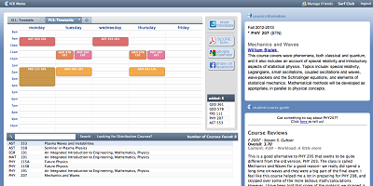
Integrated Course Engine (ICE)
COS 333 project by a group of sophomores in 2008

Slide 22
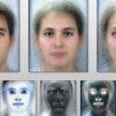
Out of Many Faces Becomes One
Art of Science Competition
Out of Many Faces
Becomes One

Slide 23
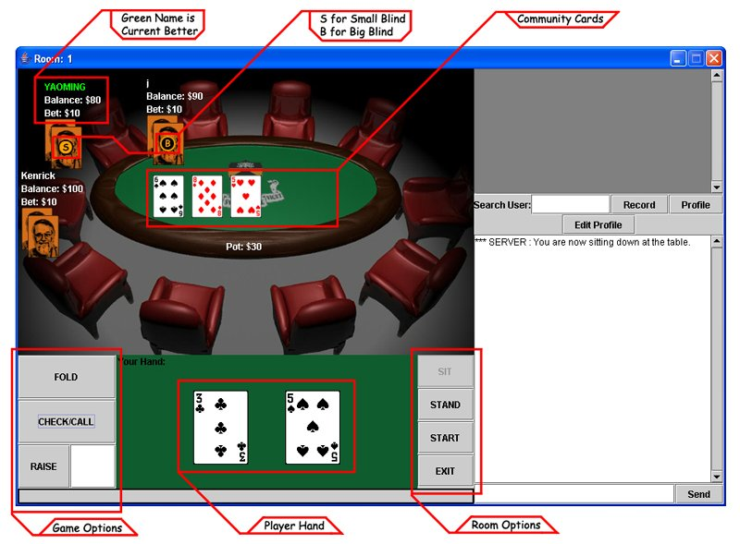
Online Poker

Slide 24

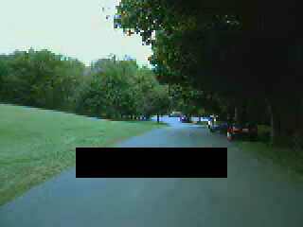



Unmanned Vehicles
Road Detection

Slide 25
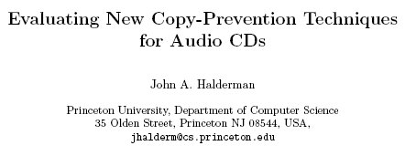
Circumventing Copy Prevention
ACM Workshop on Digital Rights Management, April 2002

Slide 26
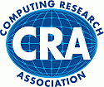
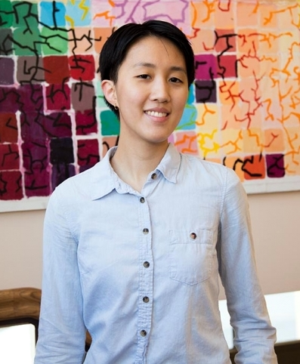
CRA Outstanding Undergrad Award
Two awards per year
  For top undergraduate research
  in North America
Katherine Ye’16
  Formal methods for
  detecting software bugs
  Applied to real-world software

Slide 27
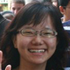

CRA Outstanding Undergrad Award
Princeton won two in 2011
Valentina Shin
  Reassembling frescoes
  By modeling how they break
  PhD student at MIT
Patrick Wendell
  Load balancing for replicated
  Web services
  Operational system used by
  the FCC and by CoralCDN
  Co-founder of DataBricks

Slide 28
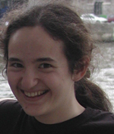
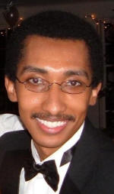
CRA Outstanding Undergrad Award
CRA award in 2008
  Rachel Sealfon
  Research in bio-informatics
  Research scientist at the
  Simons Foundation
CRA award in 2007
  Lester Mackey
  Research in programming
  languages and architecture
  Now a professor at Stanford

Slide 29
Faculty Research Projects

Slide 30
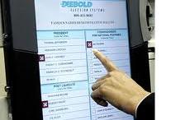
Electronic Voting
Can you steal votes?
Can you evade detection?
Can you break in despite tamper seals?
Security flaws in Diebold Election Systems and Sequoia Advantage voting machines
Installing Pac-Man on Sequoia

Slide 31
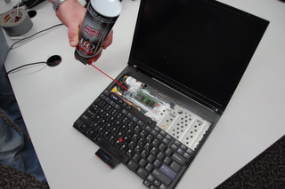
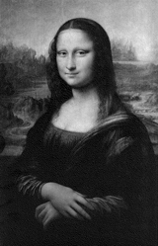
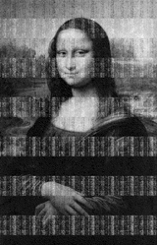
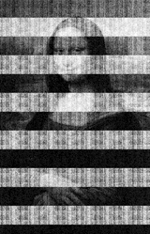

Cold Boot Attacks
Stealing data from
encrypted disks
  Keys stay in memory
  longer than you think
  Especially if you “freeze”
  the memory chips first
5 sec
30 sec
60 sec
5 min

Slide 32
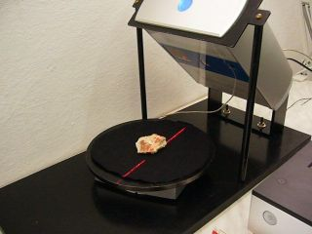
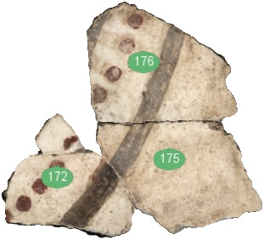
Thera Frescoes
CS and archeology
  Akrotiri on island of Thera
  Wall paintings from the 17th
  century B.C.
  Preserved in volcanic ash
  But, in many little pieces…
Putting the pieces together
  Scanning technology
  Algorithms for matching
    Shape, texture, color, …
  Much faster than manual
  matching, and less boring!

Slide 33
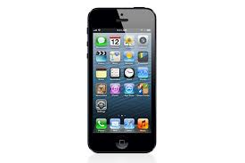
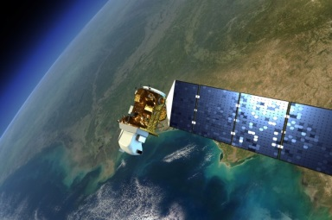
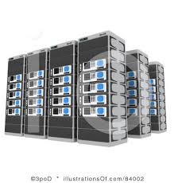
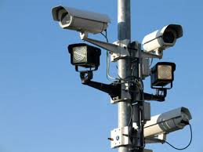
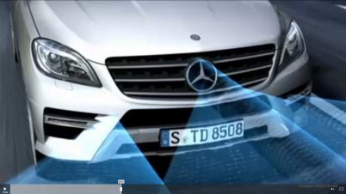
Computer Vision
  Build a model of our world from available visual data
Model of Our World
32

Slide 34
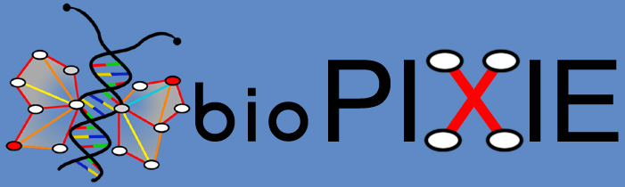

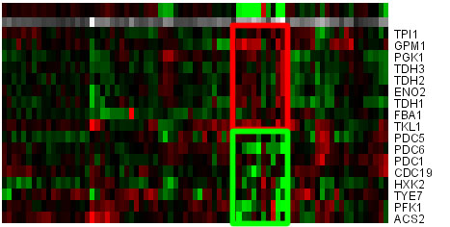
Bio-Informatics
Analyzing and visualizing interactions between genes and proteins
Detecting differences in genes
Chromosomal Aberration Region Miner

Slide 35

PlanetLab
Open platform for developing, deploying, and accessing planetary-scale services
Consists of ~1353 machines in 717locations
An “overlay” on today’s Internet to test new services
Running many novel services for real end users

Slide 36

Software Defined Networking
App1
App2
App3
Controller
control
measure

Slide 37
Questions?
For more info, check out the CS web site
  Web site: http://www.cs.princeton.edu
  Especially the “Guide for the Humble Undergraduate”
Pick up copies of
  The Guide
  Certificate program
  Independent work suggestions

Slide 38
Other Computer Science Resources
Association for Computing Machinery (ACM)
  http://www.acm.org
IEEE Computer Society
  http://www.computer.org
Computing Research Association (CRA)
  http://www.cra.org

Slide 39
Conclusions
Computer science as a discipline
  CS is about information
  CS is everywhere
Computer science at Princeton
  BSE degree, AB degree, and certificate program
  Core CS courses and interdisciplinary connections with psychology, biology, music, art, public policy, etc.
  Courses in a wide range of areas from operating systems to computer music, from computational biology to computer architecture, etc.

Slide 40
Picking Your Major
So many engineering majors, so little time
  How to choose the one that is right for you?
See what excites you in this course
  Exposure to all of the engineering disciplines
  Understanding of the synergy between them
Do choices close a door, or open a window?
  Many opportunities for courses in other departments
  Boundaries between disciplines is a bit fuzzy
  What you do later may differ from what you do now
  All of the departments give you a strong foundation

