Slide 1
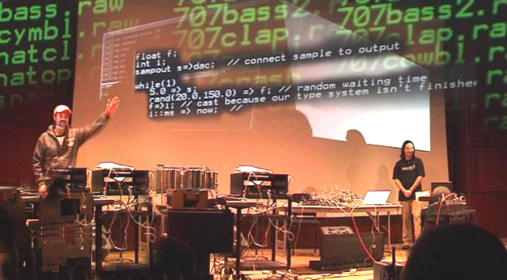
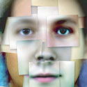
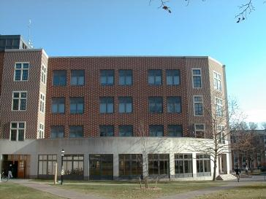
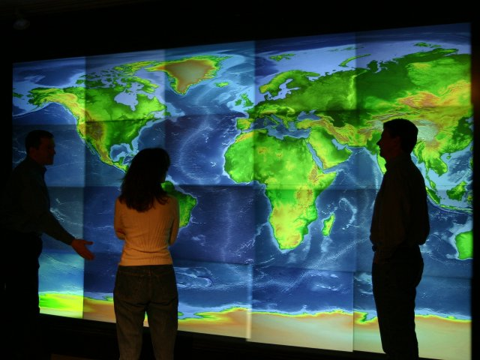
Computer Science http://www.cs.princeton.edu
Jennifer Rexford‘91

Slide 2
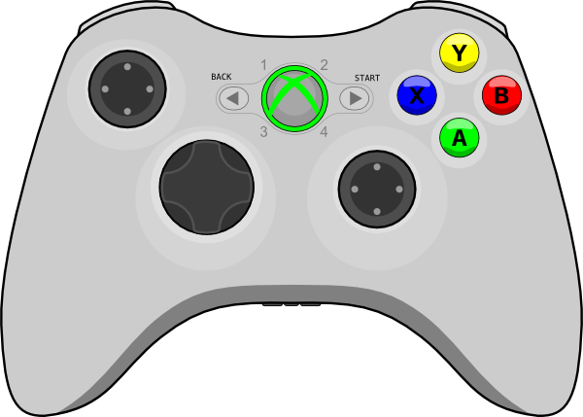

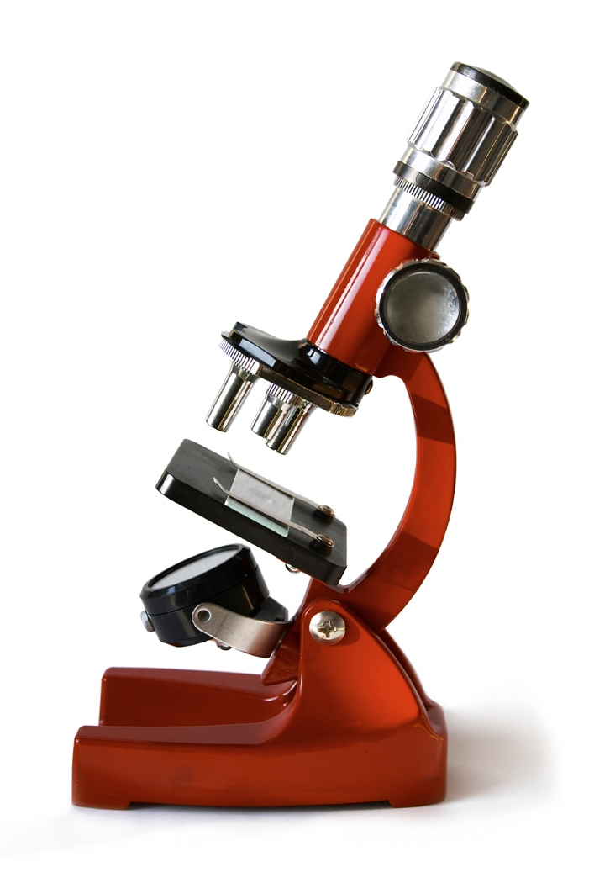
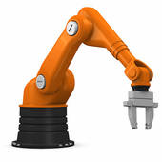








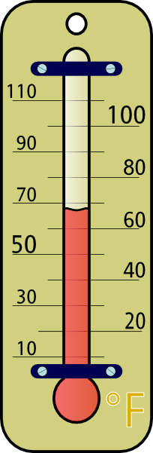





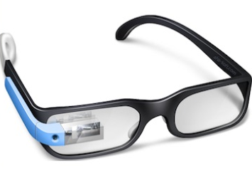
Computer Science
data
people
education
control
analyze
art
deliver
store
energy
policy
compute
visualize
Core CS
privacy
medicine

Slide 3
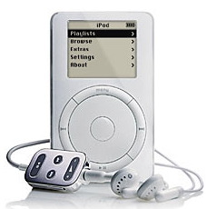
Computers are in Everything...
“A camera is a computer with a lens”
“A cell phone is a computer with a radio”
“An iPod is a computer with an earphone”
“A car is a computer with an engine and wheels”

Slide 4

Networks of Computers are Everywhere
Communication: e-mail, chat, ...
Searching: Google, Yahoo
Shopping: eBay, Amazon, ...
Mapping: online driving directions, Google Earth
Playing: online poker, video games, ...
Sharing: peer to peer file sharing

Slide 5
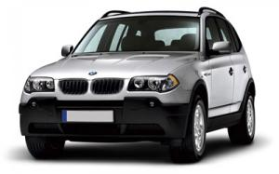
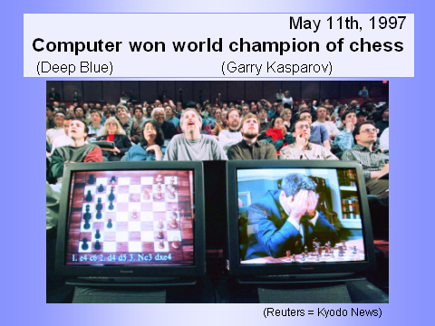
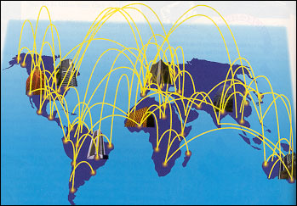
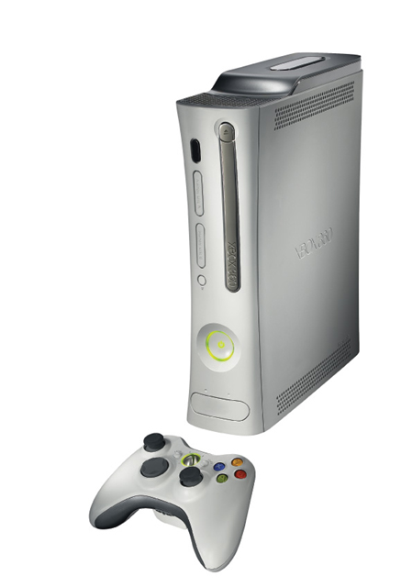
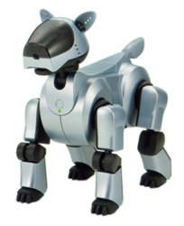

Computational Universe

Slide 6
Computer Science is Universal
Computers
  The medium for interacting with everything
  General tools for solving a diverse set of problems
  Making every other human endeavor smarter
Computational thinking
  Automate the things we need to do
  Model the way the world works
  Read, writing, arithmetic, and… computing

Slide 7
Important Distinctions
Computer Science
vs. Computer Programming
(Java, C++, etc.)
Notion of computation
vs. Concrete Implementations of Computation (Silicon chips, robots, Xbox, etc.)

Slide 8
Web crawler
  Start with a base list of popular Web sites
  Download the Web pages and extract hyperlinks
  Download these Web pages, too
  And repeat, and repeat, and repeat…
Web indexing
  Identify keywords in pages
  Identify popular pages that many point to
Web searching
  Respond in less than a second to user queries

Slide 9
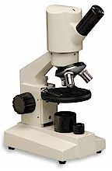
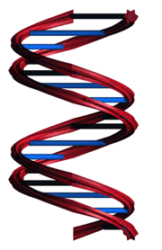
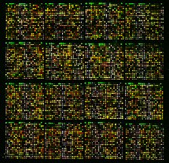
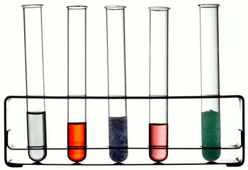
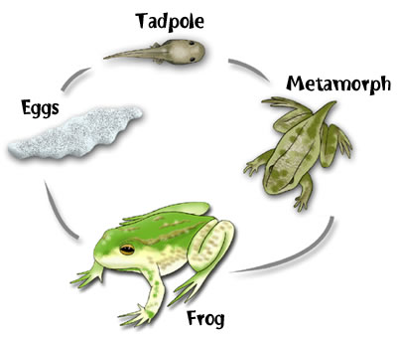
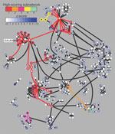
Example: Computational Biology
Old Biology
New Biology
Microarrays
Pathways
Notes:
Maybe say how computers allow us to exploit microarrays to by allowing us to work over massive data sets, and they can help identify pathways of interacting genes or proteins

Slide 10
CS Studies How Computers Work and How to Make Them Work Better
Architecture
  Designing machines
Programming languages and compilers
  Telling them what to do
Operating systems and networks
  Controlling them and communicating between them
Graphics, vision, music, human-computer interaction, information retrieval, genomics, ...:
  Using them
Artificial intelligence and machine learning
  Making them smarter
Algorithms, complexity
  What are the limits and why

Slide 11
Computer Science at Princeton

Slide 12
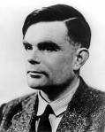
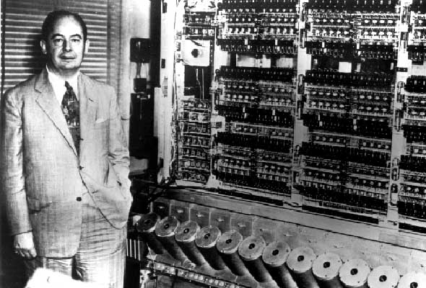
At the Forefront from the Beginning
Alan Turing, *38
  Father of computer science
  Major contributions to theory of
  computation
  Cracked German “Enigma”
  codes in WWII
John von Neumann
  Idea of storing program
  and data in same memory
  Generating random
  numbers
  Scientific computation

Slide 13
The CS Department at Princeton
Around 100 majors (BSE and AB)
  Plus a large number of Certificate students
Who go to
  Grad school
  Software companies both large and small
  Wall St, consulting
30 faculty
  Theory
  Artificial intelligence and machine learning
  Networking and distributed systems
  Programming languages
  Graphics and vision
  Computational biology
  Privacy, security, and information technology policy

Slide 14
Curriculum
Introductory courses
  COS 126: General CS (taken by all BSEs)
  COS 217: Systems Programming
  COS 226: Algorithms & Data Structures
Eight departmentals, at least two each in
  Systems
  Applications
  Theory
Independent work

Slide 15
Departmentals: Two of Each
Systems
  operating systems, compilers, networks, databases, architecture, programming techniques, ...
Applications
  AI, graphics, vision, security, electronic auctions, HCI/sound, computational biology, information technology & policy...
Theory
  discrete math, theory of algorithms, cryptography, programming languages, computational geometry, ...
Courses in other departments
  ELE, ORF, MAT, MOL, MUS, PHI, PHY, PSY, ...

Slide 16
Other Options
Certificate in Applications of Computing
  Two of the three: 217, 226, 323
  Two upper-level courses, computing in independent work
  See Professor Rusinkiewicz
AB instead of BSE
  Same departmental requirements
  Different university requirements
    Two JP's and a senior thesis vs. one semester of IW
    Foreign language vs. chemistry
    31 courses vs. 36

Slide 17
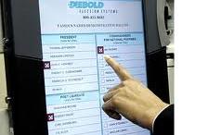
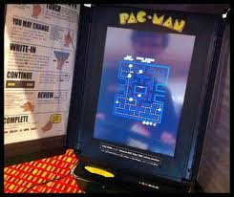
Faculty Projects: Electronic Voting
Can you steal votes?
Can you evade detection?
Can you break in despite tamper seals?
Security flaws in Diebold Election Systems and Sequoia Advantage voting machines
Installing Pac-Man on Sequoia

Slide 18
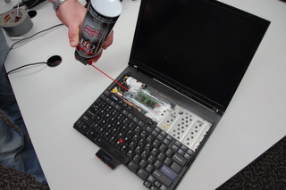
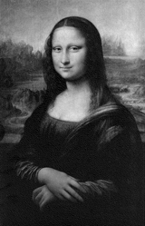
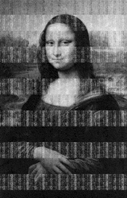
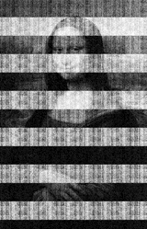

Faculty Projects: Cold Boot Attacks
Stealing data from
encrypted disks
  Keys stay in memory
  longer than you think
  Especially if you “freeze”
  the memory chips first
5 sec
30 sec
60 sec
5 min

Slide 19
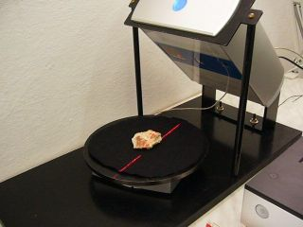
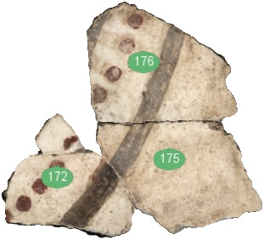
Faculty Projects: Thera Frescoes
CS and archeology
  Akrotiri on island of Thera
  Wall paintings from the 17th
  century B.C.
  Preserved in volcanic ash
  But, in many little pieces…
Putting the pieces together
  Scanning technology
  Algorithms for matching
    Shape, texture, color, …
  Much faster than manual
  matching, and less boring!

Slide 20
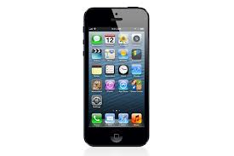
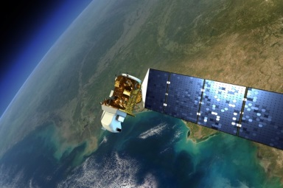
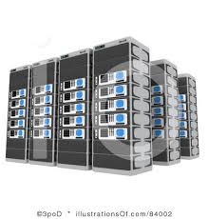
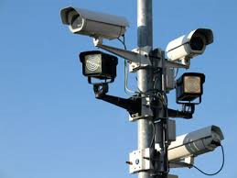
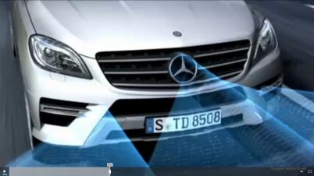
Computer Vision
  Build a model of our world from available visual data
Model of Our World
20

Slide 21
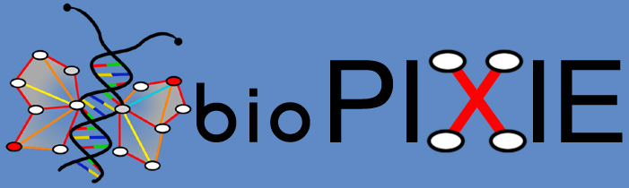

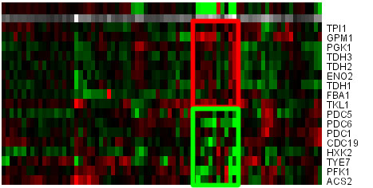
Faculty Projects: Bio-Informatics
Analyzing and visualizing interactions between genes and proteins
Detecting differences in genes
Chromosomal Aberration Region Miner

Slide 22
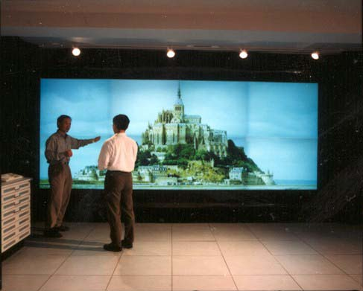
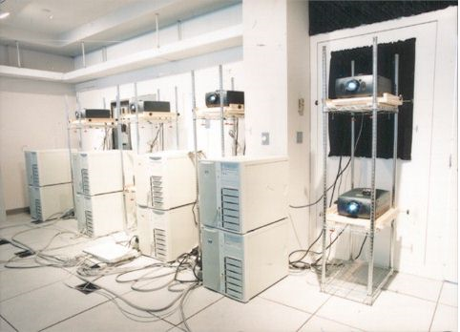
Faculty Projects: Display Wall

Slide 23
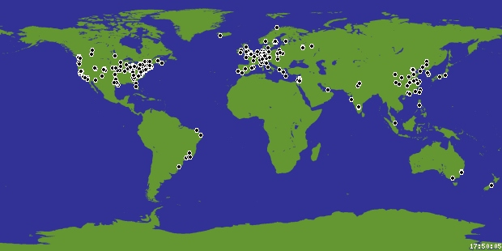
Faculty Projects: PlanetLab
Open platform for developing, deploying, and accessing planetary-scale services
Consists of ~1174 machines in 565 locations
An “overlay” on today’s Internet to test new services
Running many novel services for real end users

Slide 24
Faculty Projects: Serval
Internet of the 1970s
  Network designed to access a specific host
Internet of today
  Mobile hosts
  Geo-replicated
  services
Serval
  Service names
  Multiple flows
  Seamless moves
Enterprise
Network
Transit
Provider
Multi-
Homing
4G
Cellular
Provider
Physical
Mobility

Slide 25
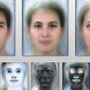
Undergrad Projects
Art of Science Competition
Out of Many Faces
Becomes One

Slide 26
Princeton CAT

Slide 27
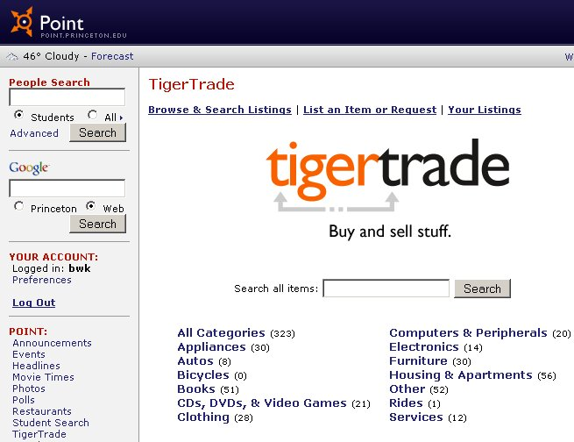
Undergrad Projects
http://point.princeton.edu

Slide 28
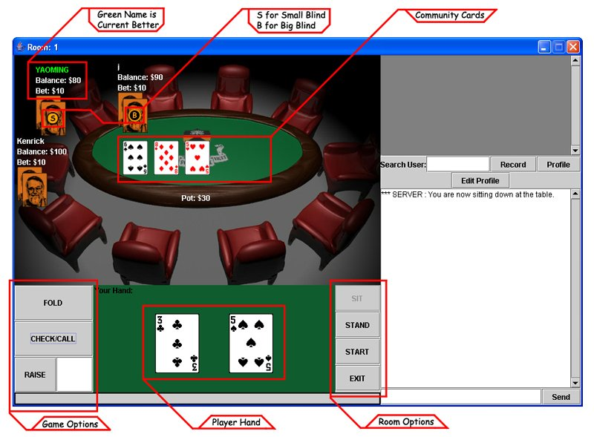
Undergrad Projects

Slide 29

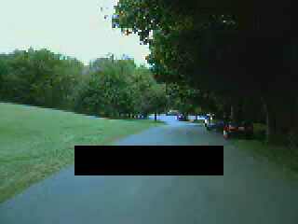



Undergrad Projects
Road Detection

Slide 30
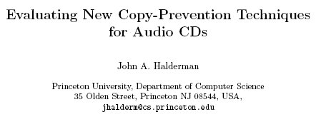
Undergrad Projects
ACM Workshop on Digital Rights Management, April 2002

Slide 31

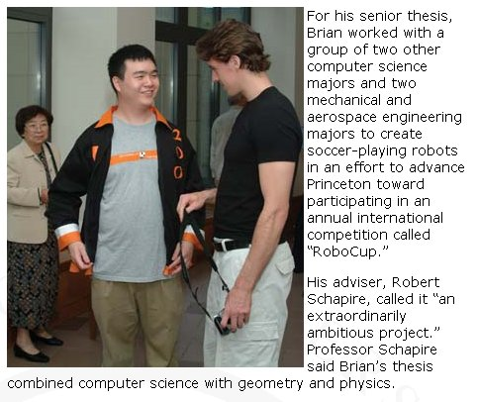
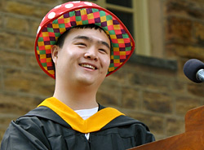
Brian Tsang '04, salutatorian

Slide 32

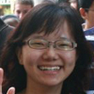

CRA Outstanding Undergrad Award
Two awards per year
  For top undergraduate nationwide
  Princeton won both in 2011
Valentina Shin
  Reassembling frescoes
  By modeling how they break
Patrick Wendell
  Load balancing for replicated
  Web services
  Operational system used by the
  FCC and by CoralCDN

Slide 33
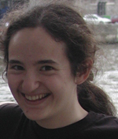

CRA Outstanding Undergrad Award
CRA award in 2008
  Rachel Sealfon
  Research in bio-informatics
CRA award in 2007
  Lester Mackey
  Research in programming
  languages and architecture
  Now a professor at Stanford

Slide 34
Questions?
For more info, check out the CS web site
  Web site: http://www.cs.princeton.edu
  Especially the “Guide for the Humble Undergraduate”
Pick up copies of
  The Guide
  Certificate program
  Independent work suggestions

Slide 35
Other Computer Science Resources
Association for Computing Machinery (ACM)
  http://www.acm.org
IEEE Computer Society
  http://www.computer.org
Computing Research Association (CRA)
  http://www.cra.org

Slide 36
Conclusions
Computer science as a discipline
  CS is about information
  CS is everywhere
Computer science at Princeton
  BSE degree, AB degree, and certificate program
  Core CS courses and interdisciplinary connections with psychology, biology, music, art, public policy, etc.
  Courses in a wide range of areas from operating systems to computer music, from computational biology to computer architecture, etc.

Slide 37
Picking Your Major
So many engineering majors, so little time
  How to choose the one that is right for you?
See what excites you in this course
  Exposure to all of the engineering disciplines
  Understanding of the synergy between them
  E.g., digital camera draws on physics, EE, and CS
Do choices close a door, or open a window?
  Many opportunities for courses in other departments
  Boundaries between disciplines is a bit fuzzy
  What you do later may differ from what you do now
  All of the departments give you a strong foundation

