Slide 1
BGP Safety with Spurious Updates
Martin Suchara
in collaboration with:
Alex Fabrikant and
Jennifer Rexford

Slide 2
The Border Gateway Protocol (BGP)
BGP calculates paths to each address prefix
5
2
“I can reach d via AS 1”
3
Data traffic
“I can reach d via AS 1”
4
“I can reach d”
1
Prefix d
Each Autonomous System (AS) implements its own custom policies
Can prefer an arbitrary path
Can export the path to a subset of neighbors

Slide 3
BGP Safety Challenges
35,000 ASes and 300,000 address blocks
Routing convergence usually takes minutes
But the system does not always converge…
Prefer 120 to 10
Prefer 210 to 20
1
2
Use 20
Use 120
Use 210
Use 10
0
d

Slide 4
Results on BGP Safety
Absence of a “dispute wheel” sufficient for safety (Griffin, Shepherd, Wilfong, 2002)
Necessary or sufficient conditions of safety (Gao and Rexford, 2001), (Gao, Griffin and Rexford, 2001), (Griffin, Jaggard and Ramachandran, 2003), (Feamster, Johari and Balakrishnan, 2005), (Sobrinho, 2005), (Fabrikant and Papadimitriou, 2008), (Cittadini, Battista, Rimondini and Vissicchio, 2009), …
Verifying safety is computationally hard (Fabrikant and Papadimitriou, 2008), (Cittadini, Chiesa, Battista and Vissicchio, 2011)

Slide 5
Key Results
Existing models of BGP do not capture important transient phenomena
A new model of BGP
Accurately capture the consequences of transient phenomena on convergence
Retain simplicity of previous models
More accurate model makes proofs easier!

Slide 6
Overview
Classical model of BGP: the SPVP
Spurious BGP updates: what are they?
The surprise: networks believed to be safe oscillate!
Convergence conditions: polynomial time verifiable
Conclusion

Slide 7
Simple Path Vector Protocol (SPVP) Traditional BGP Model (Griffin and Wilfong, 2000)
The higher the more preferred
Permitted paths
120
10
ε
210
20
ε
1
2
Network topology
0
The destination

Slide 8
Simple Path Vector Protocol (SPVP) Traditional BGP Model (Griffin and Wilfong, 2000)
120
10
ε
210
20
ε
Selected paths
1
2
0

Slide 9
Simple Path Vector Protocol (SPVP) Traditional BGP Model (Griffin and Wilfong, 2000)
120
10
ε
210
20
ε
1
2
Activation
0
Activation models the processing of BGP update messages sent by neighbors
Notes:
Activation: node picks its most preferred path consistent with its neighbors’ choices.

Slide 10
Simple Path Vector Protocol (SPVP) Traditional BGP Model (Griffin and Wilfong, 2000)
120
10
ε
Switch to best available
210
20
ε
1
2
Activation
0
Activation models the processing of BGP update messages sent by neighbors
Notes:
Activation: node picks its most preferred path consistent with its neighbors’ choices.

Slide 11
Simple Path Vector Protocol (SPVP) Traditional BGP Model (Griffin and Wilfong, 2000)
120
10
ε
Switch to best available
210
20
ε
1
2
Activation
0
System is safe if all “fair” activation sequences lead to a stable path assignment
Notes:
Activation: node picks its most preferred path consistent with its neighbors’ choices.

Slide 12
Overview
Classical model of BGP: the SPVP
Spurious BGP updates: what are they?
The surprise: networks believed to be safe oscillate!
Convergence conditions: polynomial time verifiable
Conclusion

Slide 13
What are Spurious Updates?
A phenomenon: router announces a route other than the highest ranked one
1230
10
Spurious BGP update 230:
210
20
230
230
Selected path: 20
1
2
3
30
0
Behavior not allowed in SPVP
Notes:
Mention that this is a real phenomenon. Verified by talking to a major router vendor, and observed by Jennifer at AT&T.

Slide 14
What Causes Spurious Updates?
Limited visibility to improve scalability
Internal structure of ASes
Cluster-based router architectures
Timers and delays to prevent instabilities and reduce overhead
Route flap damping
Minimal Route Advertisement Interval timer
Grouping updates to priority classes
Finite size message queues in routers

Slide 15
DPVP– A More General Model of BGP
DPVP = Dynamic Path Vector Protocol
Transient period τ after each route change
Spurious updates with a less preferred recently available route
Only allows the “right” kind of spurious updates
Every spurious update has a cause in BGP
General enough and future-proof
Notes:
Transient time period starts after a node receives an update that will change its path assignment.
MAKE PRECISE

Slide 16
DPVP– A More General Model of BGP
The permitted paths and their ranking
Spurious update
Selected path: 210
120
10
ε
210
20
ε
Remember all recently available paths (e.g. 20, 210)
20
1
2
StableTime = τ after last path change
0
Spurious updates are allowed only if current time < StableTime
Spurious updates may include paths that were recently available or the empty path

Slide 17
Overview
Classical model of BGP: the SPVP
Spurious BGP updates: what are they?
The surprise: networks believed to be safe oscillate!
Convergence conditions: polynomial time verifiable
Conclusion

Slide 18
Consequences of Spurious Updates
Spurious behavior is temporary, can it have long-term consequences?
Yes, it may trigger oscillations in otherwise safe configurations!

Slide 19
The Surprise: Spurious Announcements Trigger Permanent Oscillations!
Safe instance in all classical models of routing:
130
10
1
2
210
20
Stable outcome
0
3210
320
30
3
Stable because node 3 cannot use route 30

Slide 20
The Surprise: Spurious Announcements Trigger Permanent Oscillations!
Oscillates if node 3 announces route 30
130
10
1
2
210
20
0
Spurious update
30
3210
320
30
3
Can be caused by route flap damping

Slide 21
Some Results No Longer Hold
Absence of a “dispute reel” necessary and sufficient for safety under filtering in SPVP (Cittadini et al., 2009)
Our result: permanent oscillations in DPVP even without a reel
Linear time convergence of BGP (Sami et al., 2009)
Our result: exponential slowdown

Slide 22
Overview
Classical model of BGP: the SPVP
Spurious BGP updates: what are they?
The surprise: networks believed to be safe oscillate!
Convergence conditions: polynomial time verifiable
Conclusion

Slide 23
Convergence Conditions
Absence of a “dispute wheel” sufficient for safety in SPVP (Griffin, Shepherd, Wilfong, 2002)
One of the most cited results
Absence of a “dispute wheel” is still sufficient for safety in DPVP
Most of the previous results of the past decade still hold under DPVP!

Slide 24
DPVP Makes Analysis Easier
No need to prove that:
Announced route is the highest ranked one
Announced route is the last one learned from the downstream neighbor
We changed the problem
PSPACE complete vs. NP complete

Slide 25
Necessary and Sufficient Conditions
How can we prove a system may oscillate?
Classify each node as “stable” or “coy”
At least one “coy” node exists
Prove that “stable” nodes must be stable
Prove that “coy” nodes may oscillate
Easy in a model with spurious announcements

Slide 26
Necessary and Sufficient Conditions
Definition: CoyOTE is a triple (C, S, Π) satisfying several conditions
1230
10
210
20
230
Coy nodes may make spurious announcements
1
2
30
Stable nodes have a permanent path
3
One path assigned to each node proves if the node is coy or stable
0
Theorem: DPVP oscillates if and only if it has a CoyOTE

Slide 27
Verifying the Convergence Conditions = Finding a CoyOTE
In general an NP-hard problem
Can be checked in polynomial time for most “reasonable” network configurations!
e.g.
(i) filter paths violating business relationships
(ii) prefer paths not containing certain AS numbers
(iii) prefer paths from certain groups of neighbors
(iv) prefer shorter paths over longer ones
(v) prefer paths from a lowest AS number neighbor
Notes:
Regular expression = compact representation of the problem inputs.

Slide 28
DeCoy – Safety Verification Algorithm
Goal: verify safety in polynomial time
Key observation: greedy algorithm works!
Let the origin be in the stable set S
Keep expanding the stable set S until stuck
If all nodes become stable system is safe
Otherwise system can oscillate

Slide 29
Overview
Classical model of BGP: the SPVP
Spurious BGP updates: what are they?
The surprise: networks believed to be safe oscillate!
Convergence conditions: polynomial time verifiable
Conclusion

Slide 30
Conclusion
DPVP: best of both worlds
More accurate model of BGP
Model simplifies theoretical analysis
Key results
(i) Spurious announcements are real
(ii) Safe instances in SPVP may oscillate in DPVP
(iii) No dispute wheel → safety
(iv) Necessary and sufficient conditions of convergence, can be found in polynomial time

Slide 31
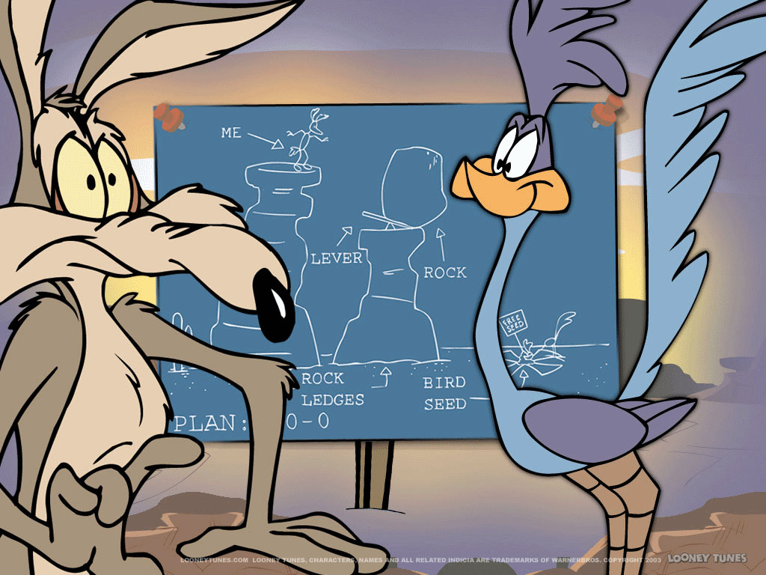
Thank You!

