Slide 1
DONAR: Decentralized Server Selection for Cloud Services
Jennifer Rexford, Princeton University
Joint work with Joe Wenjie Jiang,
Michael J. Freedman, and Patrick Wendell

Slide 2
Outline
Server selection background
Constraint-based policy interface
Scalable optimization algorithm
Production deployment
Notes:
DONAR provides outsourced server selection:
We introduce a set of new, better primitives for policy expression.
We’ve developed a scalable internal algorithm to realize this interface.
We designed and deployed a fault-tolerant system to do this

Slide 3
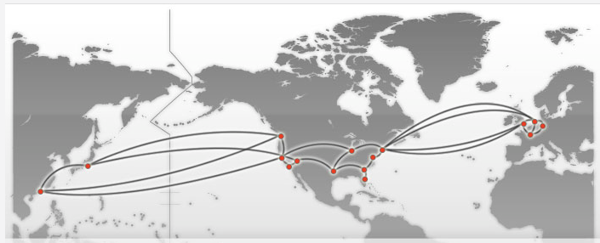
User-Facing Services are Geo-Replicated
Notes:
Today’s services distributed
This is a CDN deployment, even very small services running on eg. AWS can replicate across the globe

Slide 4
Reasoning About Server Selection
Client Requests
Mapping
Nodes
Service
Replicas
Notes:
What is server selection?
Intermediary layer which makes decisions mapping clients to servers.
Various wide-erea protocols, DNS, HTTP Redirection or Proxying,
All share need to decide how to assign incoming client amongst wide area replicas

Slide 5

Example: Distributed DNS
Clients | Mapping Nodes | Service Replicas
DNS Resolvers
Auth. Nameservers
Servers
Client 1
DNS 1
Client 2
DNS 2
Client C
DNS 10

Slide 6
Example: HTTP Redir/Proxying
Clients | Mapping Nodes | Service Replicas
HTTP Clients
HTTP Proxies
Datacenters
Client 1
Proxy 1
Client 2
Proxy 2
Client C
Proxy 500

Slide 7
Reasoning About Server Selection
Client Requests
Mapping
Nodes
Service
Replicas
Notes:
What is server selection?
Intermediary layer which makes decisions mapping clients to servers.
Various wide-erea protocols, DNS, HTTP Redirection or Proxying,
All share need to decide how to assign incoming client amongst wide area replicas

Slide 8
Reasoning About Server Selection
Client Requests
Mapping
Nodes
Service
Replicas
Outsource to DONAR
Notes:
- Often, this is outsourced to a third party
- Srvices would rather not deploy their own infrastructure

Slide 9
Outline
Server selection background
Constraint-based policy interface
Scalable optimization algorithm
Production deployment
Notes:
DONAR provides outsourced server selection:
We introduce a set of new, better primitives for policy expression.
We’ve developed a scalable internal algorithm to realize this interface.
We designed and deployed a fault-tolerant system to do this

Slide 10
Naïve Policy Choices: “Round Robin”
Client Requests
Mapping
Nodes
Service
Replicas
Notes:
Typically we see very basic policies like this.
Largely because really easy implement on a distributed set of nodes.
Services are ultimately solving a complex resource allocation problem, trying to trade off various components.
We’d like to offer them much better tools to do this job, even if it means our service becomes more complex.

Slide 11
Naïve Policy Choices: “Closest Node”
Client Requests
Mapping
Nodes
Service
Replicas
Goal: support complex policies across many nodes.
Notes:
Typically we see very basic policies like this.
Largely because really easy implement on a distributed set of nodes.
Services are ultimately solving a complex resource allocation problem, trying to trade off various components.
We’d like to offer them much better tools to do this job, even if it means our service becomes more complex.

Slide 12
Policies as Constraints
DONAR Nodes
Replicas
bandwidth_cap = 10,000 req/m
split_ratio = 10%
allowed_dev = ± 5%
Notes:
VERSION B– Coral Setup B is better right?

Slide 13
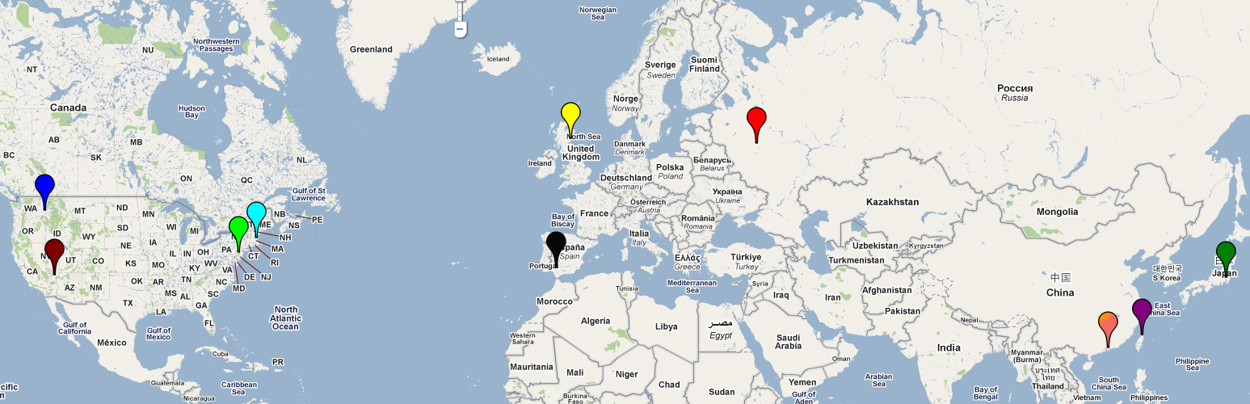
Eg. 10-Server Deployment
How to describe policy
with constraints?
Notes:
Easiest to show this with example (both API usage and optimization).

Slide 14
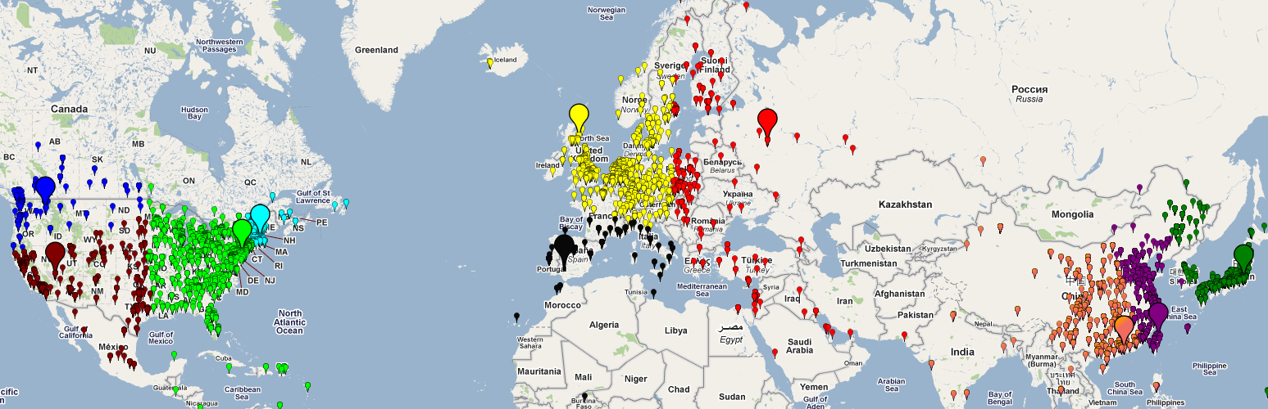
No Constraints
Equivalent to “Closest Node”
Requests per Replica

Slide 15
No Constraints
Equivalent to “Closest Node”
Impose 20% Cap
Requests per Replica

Slide 16
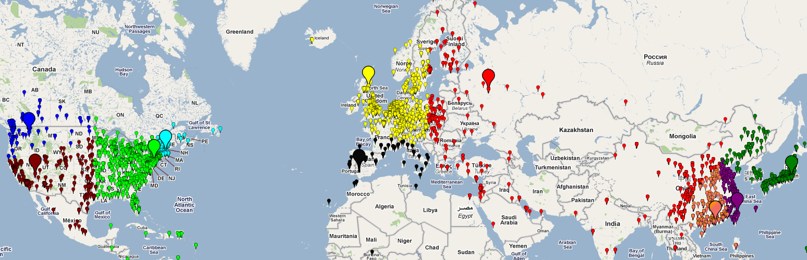
Cap as Overload Protection
Requests per Replica

Slide 17
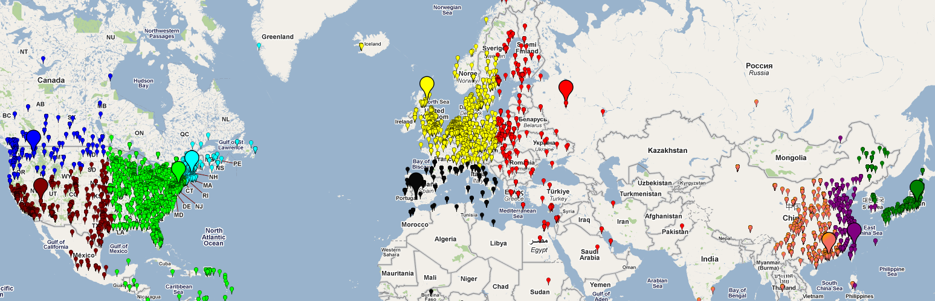
12 Hours Later…
Requests per Replica

Slide 18
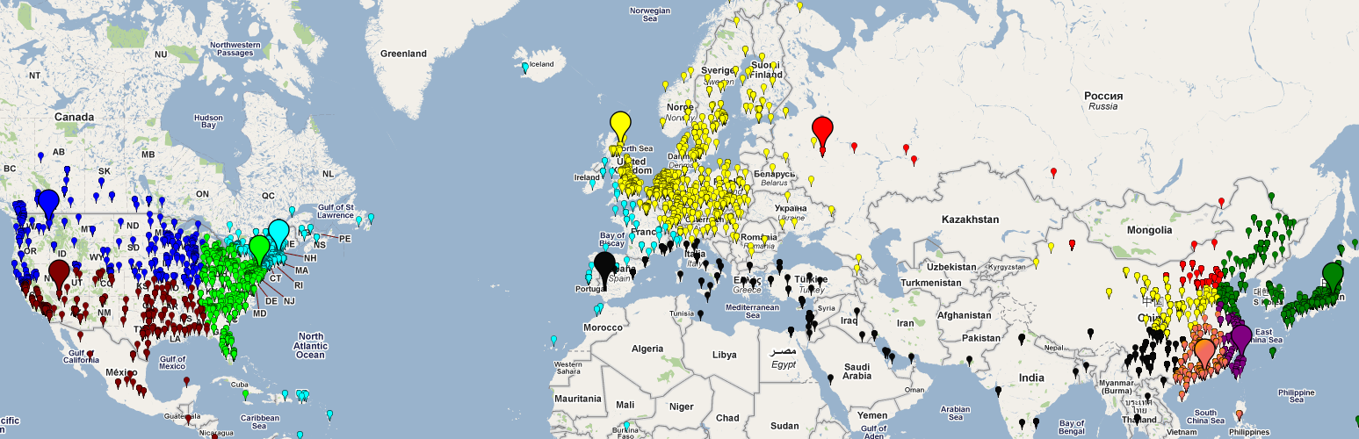
“Load Balance”
(split = 10%, tolerance = 5%)
Requests per Replica

Slide 19
“Load Balance”
(split = 10%, tolerance = 5%)
Trade-off network proximity & load distribution
Requests per Replica

Slide 20
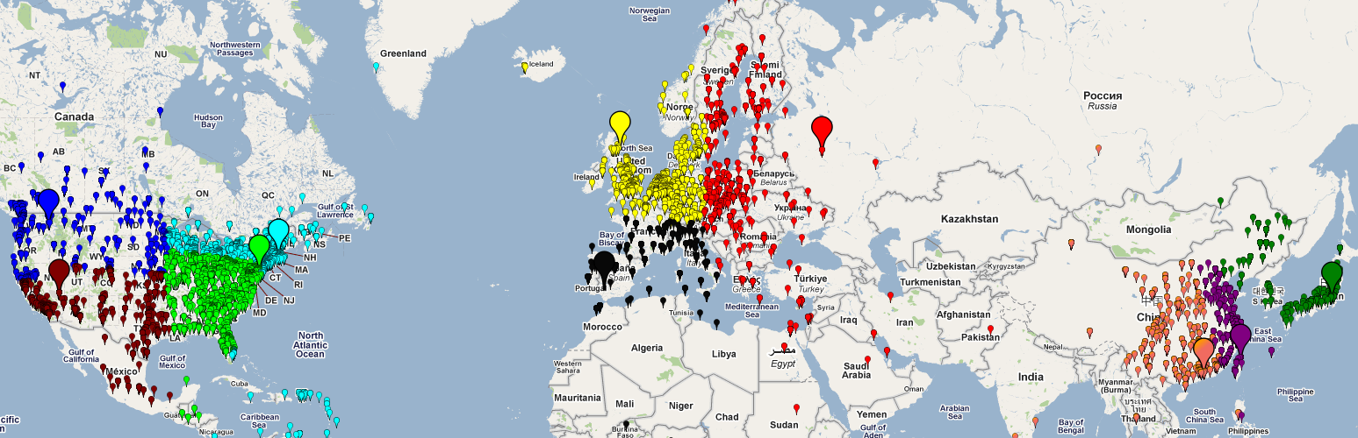
12 Hours Later…
Large range of policies by varying cap/weight
Requests per Replica

Slide 21
Outline
Server selection background
Constraint-based policy interface
Scalable optimization algorithm
Production deployment
Notes:
DONAR provides outsourced server selection:
We introduce a set of new, better primitives for policy expression.
We’ve developed a scalable internal algorithm to realize this interface.
We designed and deployed a fault-tolerant system to do this

Slide 22
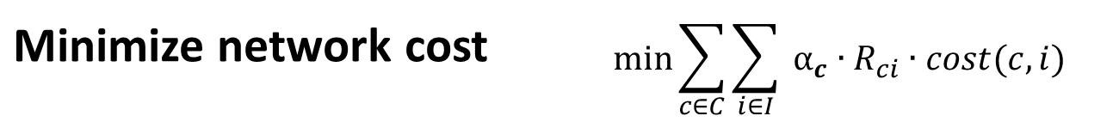
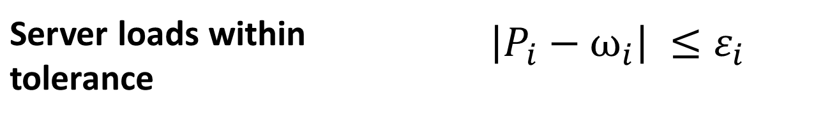

Optimization:
Policy Realization
Global LP describing “optimal” pairing
Clients: c ∈ C | Nodes: n ∈ N | Replica Instances: i ∈ I
Minimize network cost | $$\min{\sum_{c∈C}{\sum_{i∈I}{ {α_{c}∙R}_{ci}∙cost(c, i)}}}$$
s.t.
Server loads within tolerance | $$\left|P_{i}−ω_{i}\right| ≤ε_{i}$$
Bandwidth caps met | $$B_{i}<B∙P_{i}$$
Notes:
Flash this: We minimize the network distance subject to the constraints of our customer.

Slide 23
Optimization Workflow
Notes:
Make more clear this is for each service

Slide 24
Optimization Workflow
Per-customer!
Notes:
Make more clear this is for each service

Slide 25
Optimization Workflow
Continuously!
(respond to underlying traffic)

Slide 26
By The Numbers
 | 10¹ | 10² | 10³ | 10⁴
DONAR Nodes
Customers
replicas/customer
client groups/ customer
Problem for each customer:
10² * 10⁴ = 10⁶

Slide 27
Measure Traffic & Optimize Locally?
Mapping
Nodes
Service
Replicas
Notes:
Make this a “remember, nodes are distributed”

Slide 28
Not Accurate!
Client Requests
Mapping
Nodes
Service
Replicas
No one node sees
entire client population
Notes:
Just show partitioned clients

Slide 29
Aggregate at Central Coordinator?
Mapping
Nodes
Service
Replicas

Slide 30
Aggregate at Central Coordinator?
Mapping
Nodes
Service
Replicas
Share Traffic
Measurements
(10⁶)

Slide 31
Aggregate at Central Coordinator?
Mapping
Nodes
Service
Replicas
Optimize

Slide 32
Aggregate at Central Coordinator?
Mapping
Nodes
Service
Replicas
Return
assignments
(10⁶)

Slide 33
So Far
 | Accurate | Efficient | Reliable
Local only | No | Yes | Yes
Central Coordinator | Yes | No | No

Slide 34
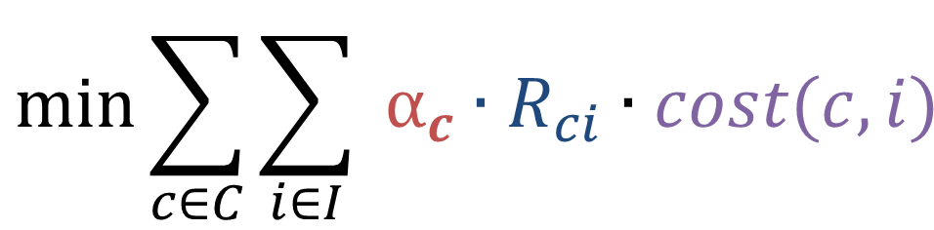
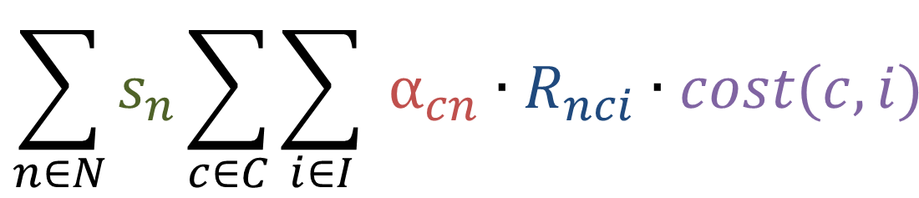



Decomposing Objective Function
Traffic from c
cost of mapping c to i
$$\min{\sum_{c∈C}{\sum_{i∈I}{ {α_{c}∙R}_{ci}∙cost(c, i)}}}$$
cost(c, i)
prob of mapping c to i
$$∀ clients$$
$$∀ instances$$
=
$$\sum_{n∈N}{s_{n}\sum_{c∈C}{\sum_{i∈I}{ {α_{cn}∙R}_{nci}∙cost(c, i)}}}$$
cost(c, i)
$$∀ nodes$$
Traffic to this node

Slide 35
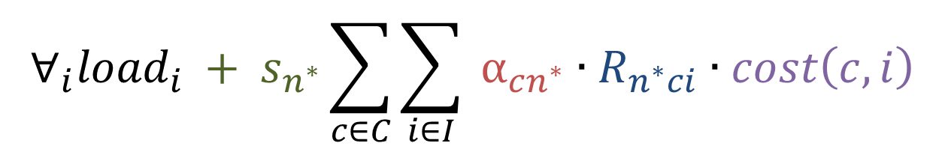
Decomposed Local Problem
For Some Node (n*)
load_{i} = f(prevailing load on each server + load I will impose on each server)
$${{∀_{i}load}_{i} + s}_{n^{∗}}\sum_{c∈C}{\sum_{i∈I}{ {α_{cn^{∗}}∙R}_{n^{∗}ci}∙cost\left(c, i\right)}}$$
min
Global load
information
Local distance
minimization

Slide 36
DONAR Algorithm
Solve local
problem
Mapping
Nodes
Service
Replicas

Slide 37
DONAR Algorithm
Solve local
problem
Mapping
Nodes
Service
Replicas
Share summary data
w/ others
(10²)

Slide 38
DONAR Algorithm
Mapping
Nodes
Service
Replicas
Solve local
problem

Slide 39
DONAR Algorithm
Mapping
Nodes
Service
Replicas
Share summary
data w/ others
(10²)

Slide 40
DONAR Algorithm
Mapping
Nodes
Service
Replicas
Provably converges to global optimum
Requires no coordination
Reduces message passing by 10⁴

Slide 41
Better!
 | Accurate | Efficient | Reliable
Local only | No | Yes | Yes
Central Coordinator | Yes | No | No
DONAR | Yes | Yes | Yes

Slide 42
Outline
Server selection background
Constraint-based policy interface
Scalable optimization algorithm
Production deployment
Notes:
DONAR provides outsourced server selection:
We introduce a set of new, better primitives for policy expression.
We’ve developed a scalable internal algorithm to realize this interface.
We designed and deployed a fault-tolerant system to do this

Slide 43



Production and Deployment
Publicly deployed 24/7 since November 2009
IP2Geo data from Quova Inc.
Production use:
  All MeasurementLab Services
  (incl. FCC Broadband Testing)
  CoralCDN
Services around 1M DNS requests per day

Slide 44
Systems Challenges
Network availability
Anycast with BGP
Reliable data storage
Chain-Replication with Apportioned Queries
Secure, reliable updates
Self-Certifying Update Protocol
Notes:
DONAR provides outsourced server selection:
We introduce a set of new, better primitives for policy expression.
We’ve developed a scalable internal algorithm to realize this interface.
We designed and deployed a fault-tolerant system to do this

Slide 45
CoralCDN Experimental Setup
split_weight = .1
tolerance = .02
Client Requests
DONAR Nodes
CoralCDN
Replicas
Notes:
VERSION B– Coral Setup B is better right?

Slide 46
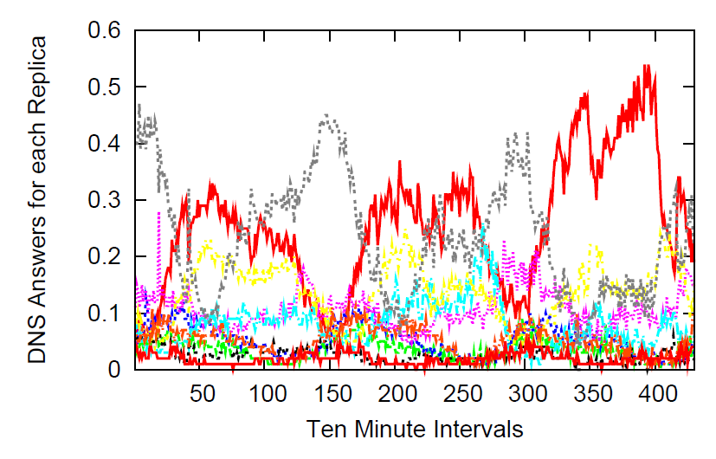
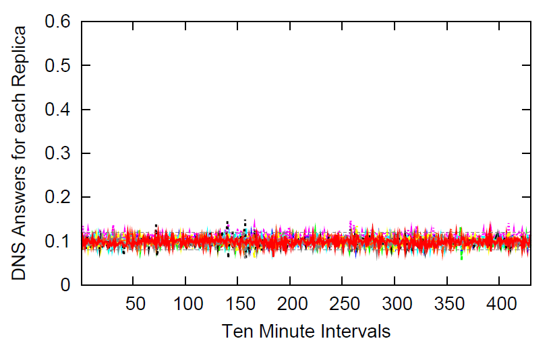
Results: DONAR Curbs Volatility
“Closest Node” policy
DONAR “Equal Split” Policy

Slide 47
Results: DONAR Minimizes Distance

Slide 48
Conclusions
Dynamic server selection is difficult
  Global constraints
  Distributed decision-making
Services reap benefit of outsourcing to DONAR
  Flexible policies
  General: Supports DNS & HTTP Proxying
  Efficient distributed constraint optimization
Interested in using?
  Visit http://www.donardns.org.

Slide 49
Questions?

Slide 50
Related Work (Academic and Industry)
Academic
  Improving network measurement
    iPlane: An informationplane for distributed services
    H. V. Madhyastha, T. Isdal, M. Piatek, C. Dixon, T. Anderson,
    A. Krishnamurthy, and A. Venkataramani, “,” in OSDI, Nov. 2006
  “Application Layer Anycast”
    OASIS: Anycast for Any Service
    Michael J. Freedman, Karthik Lakshminarayanan, and David Mazières
    Proc. 3rd USENIX/ACM Symposium on Networked Systems Design and Implementation
    (NSDI '06) San Jose, CA, May 2006.
Proprietary
  Amazon Elastic Load Balancing
  UltraDNS
  Akamai Global Traffic Management
Notes:
b

Slide 51
Doesn’t [Akamai/UltraDNS/etc] Already Do This?
Existing approaches use alternative, centralized formulations.
Often restrict the set of nodes per-service.
Lose benefit of large number of nodes (proxies/DNS servers/etc).
Notes:
b

