Slide 1
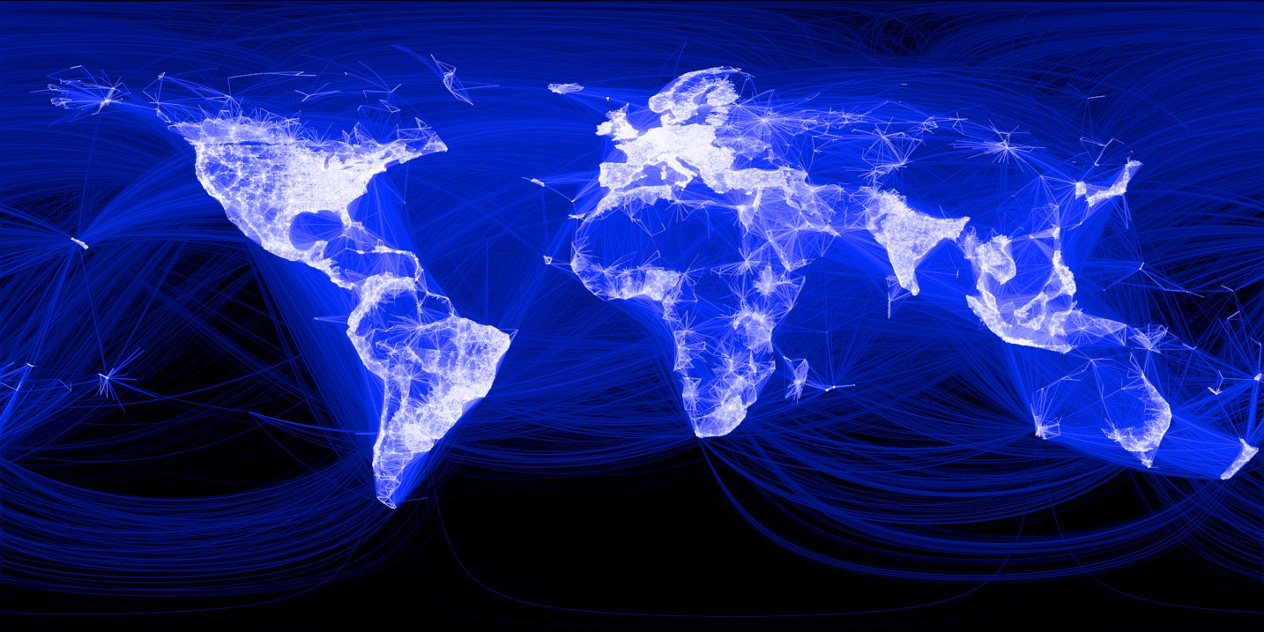
Notes:
The Internet is a global “network of networks” that interconnects billions of computers and people, delivering more than 100 billion gigabytes of data each month. In our lifetimes, the Internet has transformed how we communicate, conduct business, form and sustain relationships, vote and govern, and even how we wage war.

Slide 2
Notes:
Yet, we hear nearly every day about serious Internet outages, and we experience the Internet’s frailty so often in our daily lives. From hacked digital cameras launching denial of service attacks, to configuration mistakes taking down entire cloud services. From video streams grinding to a halt, to bank web sites becoming unreachable.

Slide 3
Notes:
How much does it matter? Studies show that people will visit a web site less often if the downloads take a quarter of a second longer than a close competitor’s site, causing lost revenue for search engines, news sites, and more. And, some companies lose tens of thousands of dollars for every minute of a denial-of-service attack, with a total cost of multiple billions of dollars per year.

Slide 4
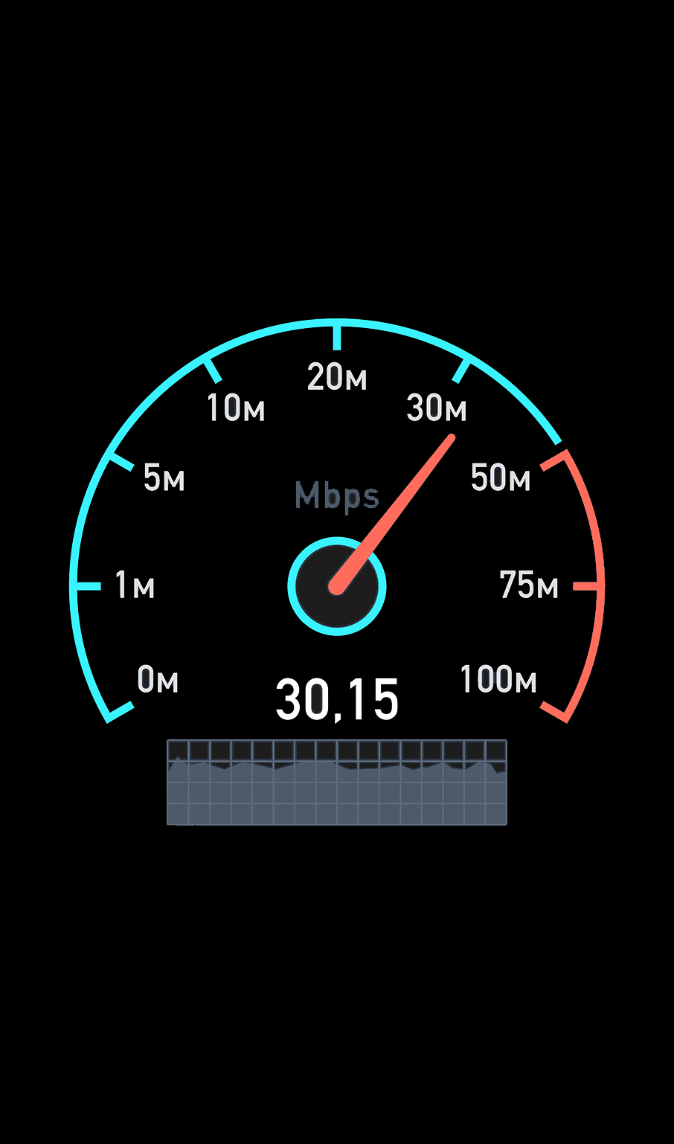
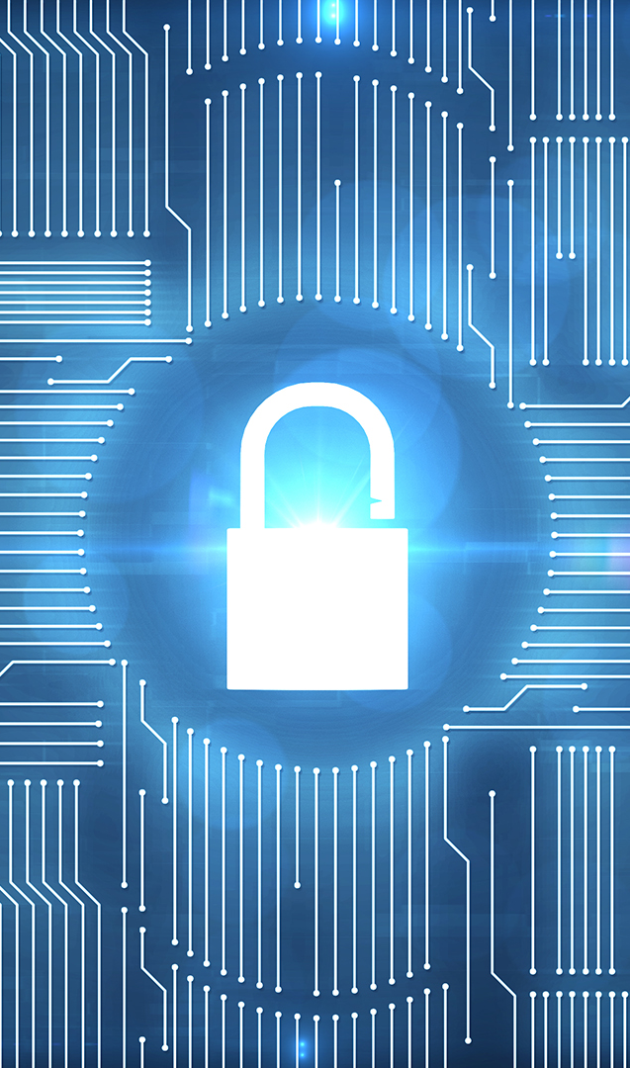
security
Performance
Security
Reliability
Notes:
We need a global communications infrastructure that is truly worthy of society’s trust. An Internet that quickly identifies congested links, and routes around them to improve performance. An Internet that detects cyberattacks, and blocks them before they do serious harm and incur significant cost. In short, an Internet with good performance, security, and reliability.

Slide 5
link
switch
Notes:
We need self-driving networks. Computer networks that can “sense” – with network devices (switches) that continuously monitor themselves and the traffic they carry. And computer networks that can “react” – with switches that automatically adapt their operation to improve performance, security, and reliability, without human intervention.

Slide 6
+
=
machine
learning
programmable
switch
intelligent
switch
Notes:
Self-driving networks are tantalizingly possible, by bringing together two exciting technologies: (i) machine-learning techniques that can convert measurements of network traffic and performance into true situational awareness and (ii) programmable network switches that can adapt how they collect and analyze data, and how they direct traffic.

Slide 7

packet
transfer
Notes:
Yet, self-driving networks will need to analyze and control network traffic at unprecedented speed and scale. A link in the core of the Internet carries traffic for hundreds of thousands of data transfers at a time. Each transfer is divided into multiple small “packets” of data. On a high-speed link, a new “packet” arrives every few nanoseconds.

Slide 8
sketch
packets
Notes:
To deliver traffic at high speeds, switches perform only limited “processing” (to compute statistics and make decisions) and have limited “memory” (to store results). The switches must compute statistics as the packets fly by, and cannot store information about every “transfer”, shown here by different colors. The switches can only maintain a small “sketch” of the traffic.

Slide 9
heavy
hitter
5
Notes:
My lab invents ways to analyze Internet traffic efficiently on programmable switches. We can identify the “heavy hitter” transfers -- like the green packets contributing half of the traffic -- with just a few operations per packet and very little memory. The switch can then block or slow the offending traffic, to make room for other transfers.

Slide 10
attack
victim
many distinct senders
Notes:
Similarly, we pinpoint ”distributed denial-of-service” attacks where many computers send traffic to the same unsuspecting victim. Our techniques enable the switches to estimate the number of different senders contacting the same destination, flagging only the outliers, so the switches can automatically block the malicious traffic to protect the victim machine.

Slide 11



best path
Notes:
And, we enable the switches to continuously monitor the performance of the paths through the network so they can automatically learn which path offers the best performance and automatically use it for each new data transfer. This enables large computational jobs in data centers to finish more quickly, and leads to faster and higher-quality video downloads.

Slide 12
P4 Language Consortium
www.p4.org
Notes:
These and other techniques are a set of “building blocks” for self-driving networks that can sense, and then react, by themselves. We realize these algorithms using a new programming language, called P4, that a group of us designed to enable innovation in network devices. The P4 consortium has more than 60 industry members, and many new networking devices support the language.

Slide 13

sophistication
efficiency
Notes:
Going further, we will push the limits of the machine-learning techniques that run directly in the switches, so self-driving networks can grow smarter over time. These techniques must strike a careful balance between sophistication and efficiency, to operate at “Internet speed” and “Internet scale”, while continually improving network performance, security, and reliability.

Slide 14
Notes:
We envision a future where the Internet is as transparent as the air we breathe. Where the many networks underlying the ‘net simply “work”, without requiring tremendous human effort and without the devastating and expensive slowdowns, outages, and security breaches we see far too often today.

Slide 15
Notes:
We believe that, with the right combination of machine-learning techniques and programmable network switches, we can build and deploy self-driving networks -- and create an Internet truly worthy of society’s trust -- within our lifetimes.

