Slide 1
Bamboozling Certificate Authorities with BGP
Henry Birge-Lee, Yixin Sun, Anne Edmundson, Jennifer Rexford, Prateek Mittal
Notes:
Expand acronym in the title.

Slide 2
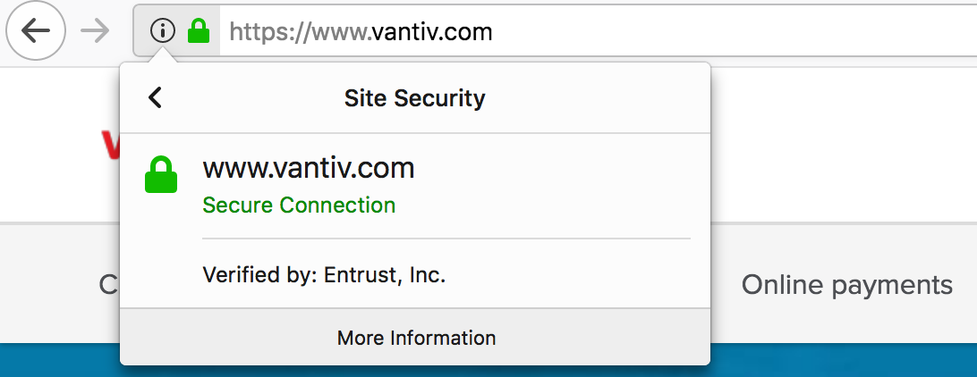
Digital certificates as a root of trust
Root of trust on the internet
Bootstraps trust on first time connections
The keys to all web encryption

Slide 3
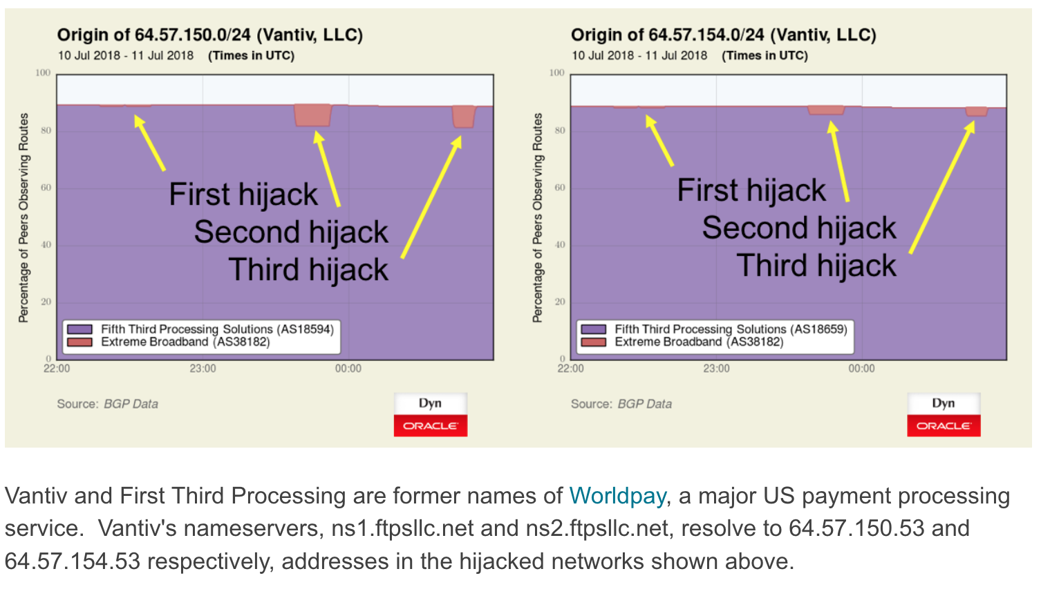
Doug Madory, BGP / DNS Hijacks Target Payment Systems https://blogs.oracle.com/internetintelligence/bgp-dns-hijacks-target-payment-systems
Notes:
Add slide title. Say BGP hijack. Need a takeaway text on this slide.

Slide 4
Border Gateway Protocol (BGP) attacks compromise this root of trust
Doug Madory, BGP / DNS Hijacks Target Payment Systems https://blogs.oracle.com/internetintelligence/bgp-dns-hijacks-target-payment-systems
Notes:
Focus on the transition.

Slide 5
Overview
Domain Control Validation
BGP Attacks
Quantifying Vulnerability
Countermeasures
Takeaways

Slide 6
Domain Control Verification
Server at example.com
Certificate Authority
Could I get a certificate for example.com?
(Certificate Signing Request)
Owner of example.com

Slide 7
Domain Control Verification
Server at example.com
Upload <content> to example.com/verify.html
(Domain Control Verification Challenge)
Certificate Authority
Owner of example.com

Slide 8
Domain Control Verification
Server at example.com
Server modifications
Certificate Authority
Owner of example.com

Slide 9
Domain Control Verification
Server at example.com
HTTP GET example.com/verify.html
Certificate Authority
I did it!
Owner of example.com

Slide 10
Domain Control Verification
Server at example.com
HTTP 200 OK: <content>
Certificate Authority
Here is your certificate
Owner of example.com

Slide 11
Where BGP Comes In
Server at example.com
If an adversary can see this request it can generate a response
HTTP GET example.com/verify.html
HTTP 200 OK: <content>
Adversary’s server
Certificate Authority
I did it!
Adversary posing as owner of example.com
Notes:
Consider how exactly BGP comes in. Adversaries can launch BGP attacks tot spoof a response.

Slide 12
Overview
Domain Control Validation
BGP Attacks
Quantifying Vulnerability
Countermeasures
Takeaways

Slide 13
Original BGP route to victim
AS 1
Certificate Authority
AS containing
example.com
AS 2
AS 3
AS 4
Adversary

Slide 14
Original BGP route to victim
I own 2.2.2.0/23
AS 1
Certificate Authority
AS containing
example.com
AS 2
AS 3
AS 4
Adversary

Slide 15
BGP route to victim under sub-prefix attack
I own 2.2.2.0/23
AS 1
Certificate Authority
AS containing
example.com
AS 2
AS 3
AS 4
I own sub-prefix 2.2.2.0/24
Adversary

Slide 16
BGP route to victim under sub-prefix attack
I own 2.2.2.0/23
AS 1
Certificate Authority
AS containing
exmaple.com
HTTP GET example.com/verify.html
goes to adversary
AS 2
AS 3
AS 4
I own sub-prefix 2.2.2.0/24
Adversary

Slide 17
BGP route to victim under sub-prefix attack
I own 2.2.2.0/23
AS 1
Certificate Authority
AS containing
example.com
Routers prefer more specific announcements
Global visibility
Connectivity broken
Not very stealthy
AS 2
AS 3
AS 4
I own sub-prefix 2.2.2.0/24
Adversary

Slide 18
A local (equally-specific prefix) attack
I own 2.2.2.0/23
AS 5
AS 1
AS containing
example.com
AS 3
AS 4
Certificate Authority
I own 2.2.2.0/23
Adversary
A. Gavrichenkov. Breaking HTTPS with BGP hijacking. Black Hat USA Briefings, 2015

Slide 19
A local (equally-specific prefix) attack
I own 2.2.2.0/23
AS 5
AS 1
AS containing
example.com
Unaffected portion
Hijacked portion
AS 3
AS 4
Certificate Authority
I own 2.2.2.0/23
Adversary
A. Gavrichenkov. Breaking HTTPS with BGP hijacking. Black Hat USA Briefings, 2015

Slide 20
A local (equally-specific prefix) attack
I own 2.2.2.0/23
AS 5
AS 1
AS containing
example.com
Equally specific announcements compete for traffic
Announcement localized
Local broken connectivity
Potentially stealthy
AS 3
AS 4
Certificate Authority
I own 2.2.2.0/23
Adversary
A. Gavrichenkov. Breaking HTTPS with BGP hijacking. Black Hat USA Briefings, 2015

Slide 21
A local (equally-specific prefix) attack
I own 2.2.2.0/23
AS 1
Certificate Authority
AS containing
example.com
Equally specific announcements compete for traffic
Announcement localized
Local broken connectivity
Potentially stealthy
Not all ASes can perform
AS 2
AS 3
AS 4
I own 2.2.2.0/23
Adversary
A. Gavrichenkov. Breaking HTTPS with BGP hijacking. Black Hat USA Briefings, 2015

Slide 22
AS path poisoning
I own 2.2.2.0/23
AS 1
Certificate Authority
AS containing
example.com
AS 2
AS 3
AS 4
I can get to 2.2.2.0/24 through AS 4
Adversary

Slide 23
AS path poisoning
I own 2.2.2.0/23
AS 1
Certificate Authority
AS containing
example.com
Everyone sees announcement but looks less suspicious
Connectivity preserved
Almost any AS can perform
Very stealthy
Perfect setup to intercept traffic with certificate
AS 2
AS 3
AS 4
I can get to 2.2.2.0/24 through AS 4
Adversary

Slide 24
Ethical framework for launching real-world attacks
Hijack only our own prefixes
Domains run on our own prefixes
No real users attacked
Approached trusted CAs for certificates

Slide 25
Results from real world attacks
 | Let’s Encrypt | GoDaddy | Comodo | Symantec* | GlobalSign
Time to issue certificate | 35 seconds | < 2 min | < 2 min | < 2 min | < 2 min
Human interaction | No | No | No | No | No
Multiple Vantage Points | Not yet | No | No | No | No
Validation Method Attacked | HTTP | HTTP | Email | Email | Email
*At time of experiments Symantec was still a trusted CA
Notes:
Mention covers two thirds of CA market!!!!!!!
In your speech, can mention that these 5 CA control XX market share etc (or are the top 5 CAs etc if thats true)
Highlight some aspects of the slide in color for emphasis
I typically have a key “take away” pop up box that appears in an animation, summarizing the main point in such “Results slides”

Slide 26
Results from real world attacks
 | Let’s Encrypt | GoDaddy | Comodo | Symantec | GlobalSign
Time to issue certificate | 35 seconds | < 2 min | < 2 min | < 2 min | < 2 min
Human interaction | No | No | No | No | No
Multiple Vantage Points | No | No | No | No | No
Validation Method Attacked | HTTP | HTTP | Email | Email | Email
All studied CAs were vulnerable
*At time of experiments Symantec was still a trusted CA
Notes:
In your speech, can mention that these 5 CA control XX market share etc (or are the top 5 CAs etc if thats true)
Highlight some aspects of the slide in color for emphasis
I typically have a key “take away” pop up box that appears in an animation, summarizing the main point in such “Results slides”

Slide 27
Additional Attacks
More targets:
Authoritative DNS servers
Mail servers
Attacking CA prefixes:
Reverse (victim domain -> CA) traffic also vulnerable
Certificate Authority
DNS
Certificate Authority
Notes:
Add BGP attacker to blackhat icons.

Slide 28
Overview
Domain Control Validation
BGP Attacks
Quantifying Vulnerability
Countermeasures
Takeaways

Slide 29
Quantifying Vulnerability
How many domains are vulnerable?
How many adversaries can launch attacks?

Slide 30
Quantifying Vulnerability
How many domains are vulnerable?
How many adversaries can launch attacks?
1.8 million certificates via Certificate Transparency
Common names resolved to IPs
Recorded the BGP routes used for IPs at time of signing

Slide 31
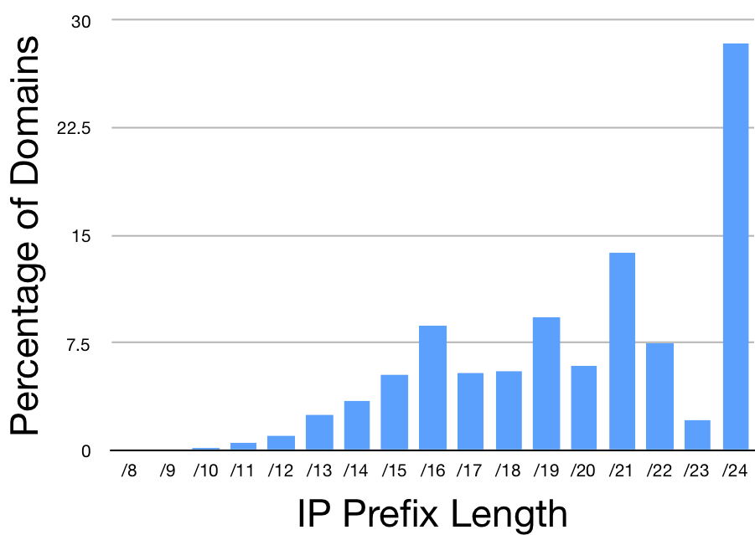
Vulnerability of domains: sub-prefix attacks
Any AS can launch
Only prefix lengths less than /24 vulnerable

Slide 32
Vulnerability of domains: sub-prefix attacks
Any AS can launch
Only prefix lengths less than /24 vulnerable (filtering)
28% of Domains Unaffected
72% of Domains Vulnerable

Slide 33
Resilience to equally-specific prefix attacks
I own 2.2.2.0/23
AS 5
AS 1
AS containing
exmaple.com
Unaffected portion
Hijacked portion
AS 3
AS 4
Certificate Authority
Affected
I own 2.2.2.0/23
Adversary

Slide 34
Resilience to equally-specific prefix attacks
I own 2.2.2.0/23
AS 1
Certificate Authority
Resilient
AS containing
exmaple.com
Unaffected portion
Hijacked portion
AS 2
AS 3
AS 4
I own 2.2.2.0/23
Adversary
Notes:
An equally-specific prefix attack will not be effective in all cases. Depending on the topological relationship between the CA, victim, and attacker, sometimes a CA is resilient to the attack.

Slide 35
Resilience to equally-specific prefix attacks
I own 2.2.2.0/23
AS 1
Certificate Authority
Resilient
AS containing
exmaple.com
Unaffected portion
Hijacked portion
AS 2
AS 3
AS 4
Probability a CA will be resilient to attacks on a domain
I own 2.2.2.0/23
Adversary
Notes:
Consider referencing counter-raptor and the original DSN paper.

Slide 36
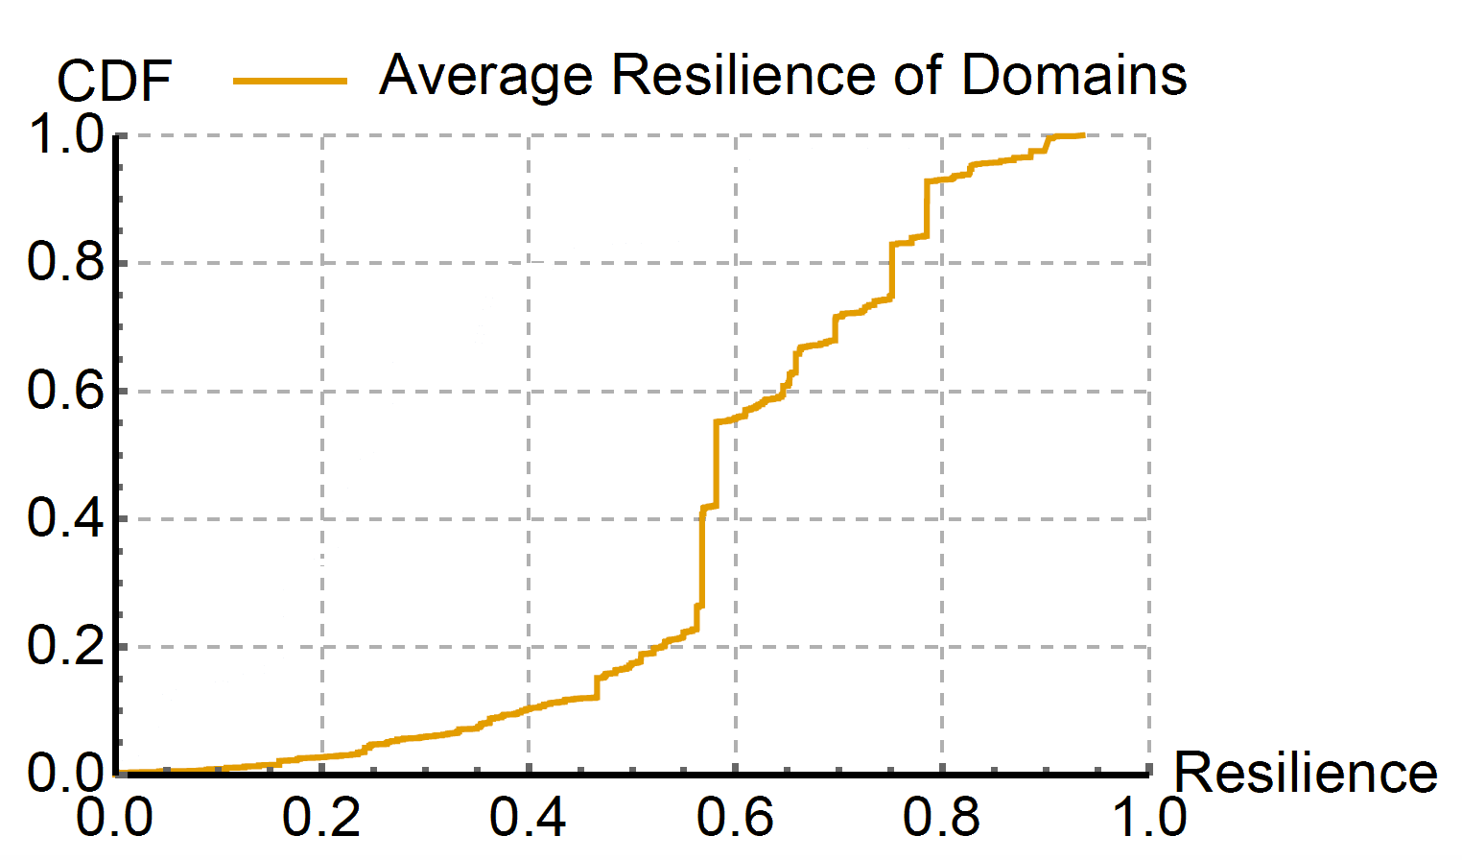
Resilience of domains assuming random CA
Notes:
Consider Assuming all ASes can be adversaries.

Slide 37
Resilience of domains assuming random CA
Median
Median resilience is .57
43% chance of attack viability
Notes:
Add emphasis on key phrases in color. BGPsec: our work serves as motivation for BGPsec.
Can add here that you are engaging with Symantec and LetsEncrypt + potentially an open source community effort etc.

Slide 38
Choosing an affected CA
I own 2.2.2.0/23
AS 1
CA 1
AS containing
example.com
Unaffected portion
Hijacked portion
AS 3
AS 4
CA 2
Around 100 CAs
Any one can sign any for domain
I own 2.2.2.0/23
Adversary

Slide 39
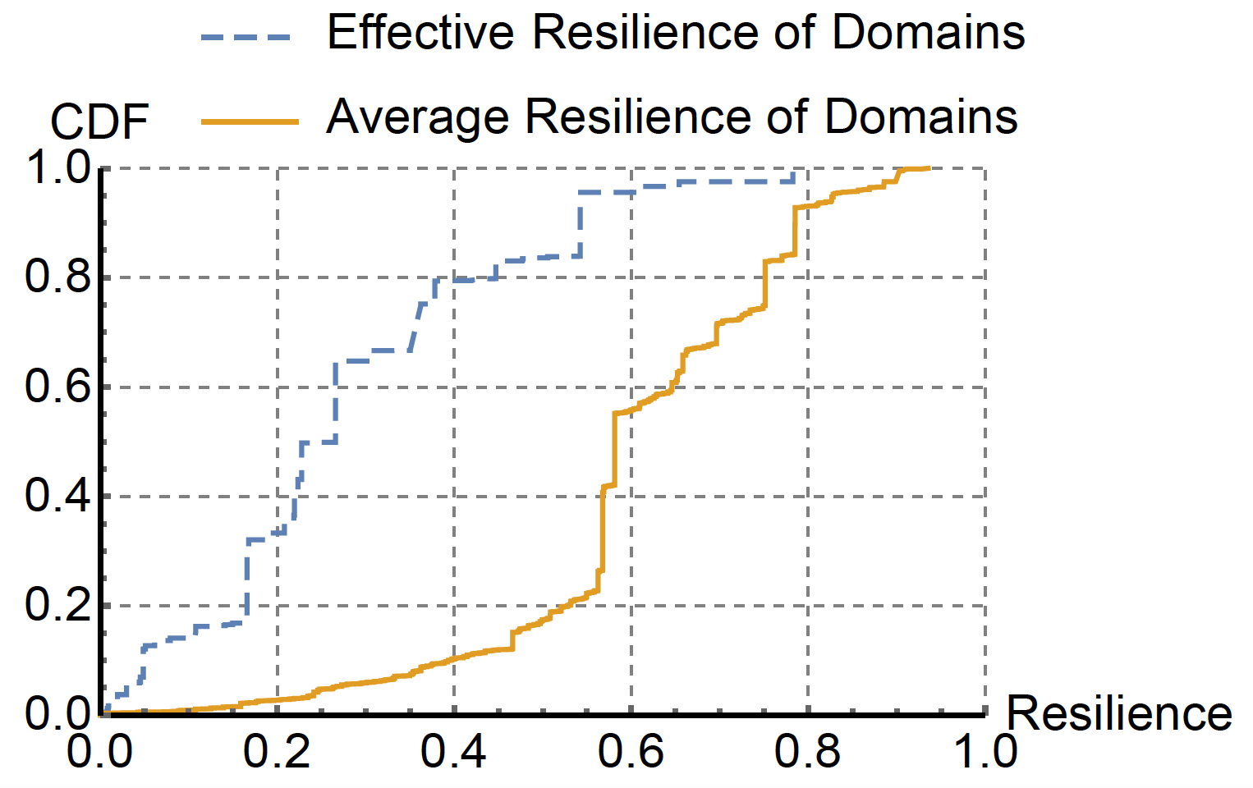
Vulnerability of Domains: Equally-specific attacks
Notes:
Mention CAA records in the presentation

Slide 40
Vulnerability of Domains: Equally-specific attacks
Median resilience drops from .57 to .25
Median
Notes:
Mention the chance of attack now goes to 75%

Slide 41
Overview
Domain Control Validation
BGP Attacks
Quantifying Vulnerability
Countermeasures
Takeaways

Slide 42
Multiple Vantage Points
I own 2.2.2.0/23
AS 5
AS 1
AS containing
exmaple.com
Unaffected portion
Hijacked portion
AS 3
AS 4
Certificate Authority
I own 2.2.2.0/23
Adversary
Notes:
Consider circling two components of the internet that are developed.

Slide 43
Multiple Vantage Points
I own 2.2.2.0/23
AS 1
Remote Vantage Point
AS containing
exmaple.com
Unaffected portion
Hijacked portion
AS 3
AS 4
Certificate Authority
I own 2.2.2.0/23
Adversary
Notes:
Consider circling two components of the internet that are developed.

Slide 44
Multiple Vantage Points
I own 2.2.2.0/23
AS 1
Remote Vantage Point
AS containing
exmaple.com
Unaffected portion
Hijacked portion
AS 3
AS 4
Certificate Authority
Only sign certificate if all vantage points and CA agree
I own 2.2.2.0/23
Adversary
Notes:
Might want to mention that multiple vantage points also protects against ASes that happen to be on the route between a CA and a victim.

Slide 45
Multiple Vantage Points
Key factor influencing Let’s Encrypts staging deployment
Full deployment coming soon
3 Remote Vantage Points in AS 16509
1
2
3
Data Center in AS 13649
Notes:
Add emphasis on key phrases in color. BGPsec: our work serves as motivation for BGPsec.
Can add here that you are engaging with Symantec and LetsEncrypt + potentially an open source community effort etc.

Slide 46
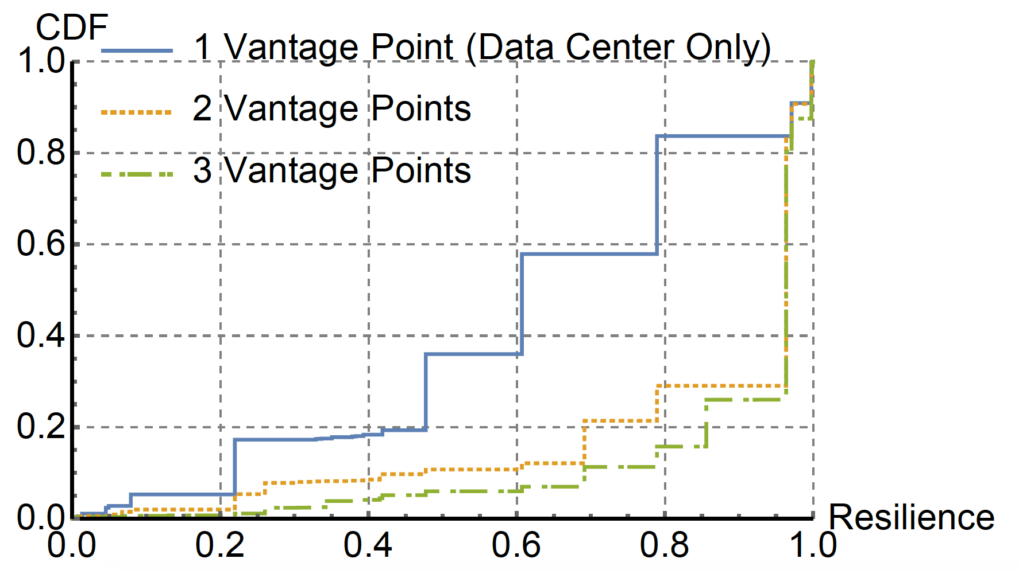
Resilience Improvement of Multiple Vantage Points
Resilience computed using Let’s Encrypt data center and optimally located additional vantage points
Notes:
Mention CAA records in the presentation

Slide 47
Resilience Improvement of Multiple Vantage Points
Resilience computed using Let’s Encrypt data center and optimally located additional vantage points
Median resilience improves from .60 to .95
Median
Notes:
Mention CAA records in the presentation

Slide 48
Other Defenses
CAs:
BGP Monitoring
CA Prefix Length
CA Resilience
Domains:
CAA DNS Records
DNSSEC
Notes:
Explain DNS as Domain Name Service. Please see paper for more details.

Slide 49
Overview
Domain Control Validation
BGP Attacks
Quantifying Vulnerability
Countermeasures
Takeaways

Slide 50
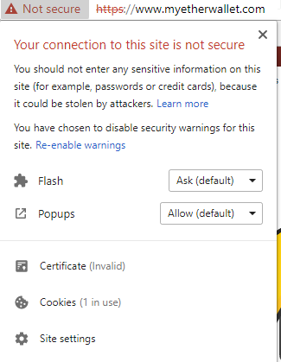
Takeaways

Slide 51
Takeaways
Next BGP phishing attack the malicious certificate might be trusted!
Notes:
Move to after demo

Slide 52
Takeaways
CAs bootstrap trust on the internet through digital certificates
The majority of domains and CAs are vulnerable
CAs must implement countermeasures soon
Secure routing (i.e., BGPsec, RPKI, SCION) is still important even with end-to-end encryption
Thanks to support from
More information at https://secure-certificates.princeton.edu/

Slide 53
Takeaways
Questions?
CAs bootstrap trust on the internet through digital certificates
The majority of domains and CAs are vulnerable
CAs must implement countermeasures soon
Secure routing (i.e., BGPsec, RPKI, SCION) is still important even with end-to-end encryption
Thanks to support from
More information at https://secure-certificates.princeton.edu/

