Slide 1
Open Networking Via Open Source Software
Jennifer Rexford
Princeton University

Slide 2
Open Networking is on the Move
Clear advantages
Disaggregation reduces vendor lock-in
Open interfaces democratize innovation
A perfect storm
Merchant silicon switching chipsets
OpenFlow standard interface
Large cloud providers with big, unique needs
Real deployments
Early adopters: large cloud providers
Next wave in progress: carriers and large enterprises

Slide 3
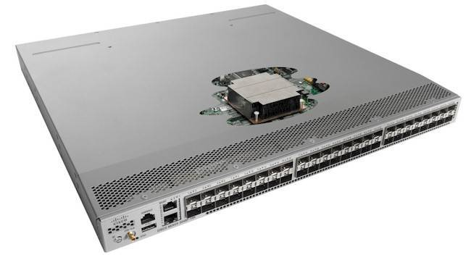
What Should be Open Source?
Necessary but non-differentiating features
App1
App2
E.g., CORD, BGP
Controller
E.g., ONOS, Open DayLight
Control interface
E.g., OpenFlow, P4
Switch OS
E.g., Open Network Linux
E.g., Broadcom, Marvel, Intel, Barefoot
As one layer becomes solid, the next layer can be commodity, too!

Slide 4
This is an Old Story in the IT Industry
Software | Open | Closed
Smartphone | 75% | 25%
Tablet | 62% | 38%
Data-center servers | 70% | 30%
Mainframes | 60% | 40%
Supercomputers | 99% | 1%
Web browsers | 63% | 37%
Public web sites | 67% | 33%
And the large “customers” of networking equipment are more sophisticated users, who want more control and customization.
2014 statistics

Slide 5
A Way Forward
Good open-source software doesn’t just happen
Identify the right problems to solve at the right time
Get from proof-of-concept prototypes to production code
Create a strong developer community with industry engagement
Promising signs
CORD, ONOS, and Open DayLight, and more
Upcoming merger of ONF and ON.Lab
P4 consortium
To the ONUG community
Join the ongoing conversations
Push your compelling use cases
Contribute to creating and using open-source software

