Slide 1
Networks That Do What They’re Told
Jennifer Rexford
Princeton University

Slide 2

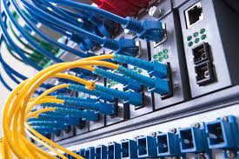
Networking Holy Grail: Intent-Based Management
Tell the network what to do
  At a high level
  In a declarative way
  For the network as a whole
And the network simply does it
  At a low level
  With specific mechanisms
  Across many network devices

Slide 3
Why Has This Been So Hard for So Long?
The network is not designed to be managed
  Limited visibility into traffic, performance, etc.
  Hard-to-tune protocols and mechanisms on devices
Bolting-on network management
  Measure: read whatever “dials” are available
  Analyze: try to infer what you cannot see
  Adapt: tune whatever “knobs” are available
What could go wrong? ;)
analyze
measure
adapt

Slide 4



Why I am Optimistic: Deep Programmability
DoS Mitigation
Overlay Virtualization
Load
Balancing
Traffic Engineering
…
SDN Controller
vSwitch
DPDK
User space
NIC
NIC
Kernel stack
XDP/eBPF
5G Mobile
Network

Slide 5
Adding New “Dials”
Traffic
Performance
Cyberattacks
Failures
Signal strength
<Your measurement here>

Slide 6

Adding New “Knobs”
Drop
Mark
Rate-limit
Reroute
Hand-off
<your knob here>

Slide 7
Designing the Network Control Loop
Analyze
Measure
(dials)
Adapt
(knobs)

Slide 8
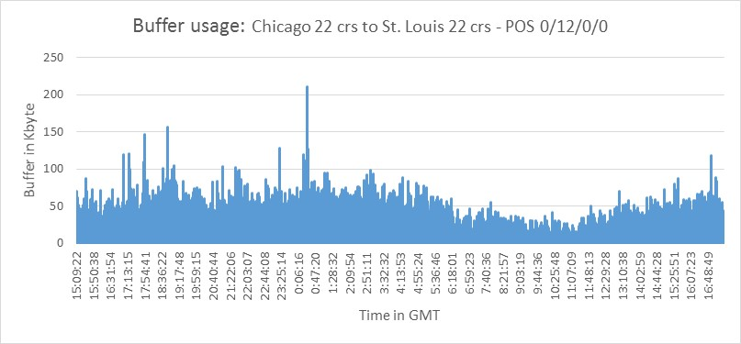
Example #1: Microbursts
5x
Microbursts
3x
Queue Length
1x
16:00:00
0:00:00
8:00:00
16:00:00
Time in day (24h)
Small timescale traffic bursts
  Long queues caused by incast, attacks, etc.
  Lead to high packet delay and loss
  … despite low average link utilization

Slide 9
Example #1: Microburst Measurement
Data-plane measurement and analysis
  Backlog in the queue
  A flow’s own contribution to the queue
55%
10%
ConQuest: https://opennetworking.org/p4/conquest-flow-level-queue-analysis-in-p4/

Slide 10
Example #1: Microburst Mitigation
Data-plane adaptation
  Drop or mark an arriving packet probabilistically
  Based on its flow’s contribution to the queue
55%
10%

Slide 11
Example #2: Distributed Denial-of-Service Attacks
DDoS attacks
  DNS reflection attack
  SYN flooding
  HTTP flooding
  Slowloris attack
Overwhelm the victim
  Exhausting network and server resources
DNS
DNS
. . .
👺
Attacker
😵
Victim

Slide 12
Example #2: DDoS Detection
Data-plane measurement and analysis
  Identify suspected victim destinations (key DstIP)
  … receiving traffic from distinct senders (attribute SrcIP)
  … in excess of a threshold (threshold T)
Key
select DstIP where distinct(SrcIP) > T
Attribute
Threshold
BeauCoup: https://blog.apnic.net/2021/01/07/beaucoup-answering-many-network-traffic-queries-one-memory-update-at-a-time/

Slide 13

Example #2: DDoS Mitigation
Data-plane adaptation
  Drop or rate-limit packets to suspected victims
  Run stateful firewall
  for suspected victims
  Pushback upstream toward the senders
DNS
DNS
. . .
👺
Attacker

Slide 14
Example #3: Path Performance
Network path diversity
Load balancing to achieve good performance
  Track the performance (load, loss, delay) of paths
  Split traffic effectively over the multiple paths

Slide 15
Example #3: Path Performance Monitoring
Data-plane tracking of path performance
  E.g., lowest maximum link utilization
  E.g., minimum end-to-end latency or loss
Probes along reverse path
30%
10%
30%
25%
30%
20%
50%
10%
10%
20%
50%

Slide 16
Example #3: Performance-Aware Load Balancing
Data-plane adaptation to direct traffic over the best path
  Sending packets in the forward direction
  … along the path with the best performance
25%
30%
20%
10%
20%
50%
Contra: "A programmable system for performance-aware routing” (NSDI’20)

Slide 17

Enabler: Programmable Data Planes
p4.org
Parser
Registers
Deparser
Memory
Match-
Action
Table
ALU
Stages

Slide 18
Challenges: Resource Limitations
Limited
depth
Limited
# bits
Limited
# rules
Limited # registers
and # of accesses
Limited ALU
operations
Parser
Registers
Deparser
Memory
Match-
Action
Table
ALU
Stages

Slide 19


Solution: Compact Data Structures
Approximate analysis is fine
  Microbursts: size estimate for just the large flows
  DDoS: rough count for large #s of distinct sources
  Path performance: rough estimates for best paths
Data structures can fit in data-plane registers
  Sketch (e.g., Bloom filter, count-min sketch, etc.)
  Small hash table (e.g., cache of the popular keys)

Slide 20
Back to Example #1: Microburst Mitigation
For each flow, how many packets are in the queue?
P4 data structure challenges
  Updating on packet arrival and departure
  Per-flow state (key and count)
Key | Count
 | 1
 | 5
 | 1
 | 1
 | 2
 | 1

Slide 21
Approximate Answers
For each flow, how many packets are in the queue?
Approximation is fine
  Just the current packet
  Just if the packet belongs to a big flow
  Just a rough count of the traffic volume
  Just a rough sense of the time window

Slide 22
Approximate Counting: Sketch
Compact data structures
  With limited memory and processing
  … at the expense of lower accuracy
Estimate per-flow counts per snapshot
  With accurate estimates for large flows
Count-Min Sketch
  C columns indexed by hash functions
  Increment hash_{i}(flowid) in column I
  Estimate is the min of the C counts
Count-Min Sketch [CM ‘05]
+1
B Buckets
+1
+1
f
C columns

Slide 23
Approximate Time: Multiple Snapshots
Divide time into windows
Count the traffic in each snapshot
  One count-min sketch per snapshot
  Aggregate the counts (e.g., 2 + 3 packets)
  Retire old snapshots, and start new ones
2 green
3 green

Slide 24

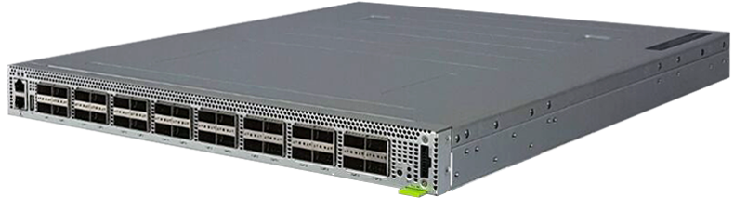
ConQuest in Action on the Princeton Campus
Internet2
Performance symptoms
  Big neuroscience data transfers
  High loss with low average load
  Router with limited measurements
Microburst analytics on Tofino
  Microbursts on a small timescale
  Caused by PerfSONAR probes
Deployment in AT&T backbone
Network TAPs
Mirrored
traffic
Neuroscience
Institute
Tofino
See https://p4campus.cs.princeton.edu/ web site for more details!

Slide 25
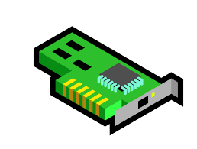

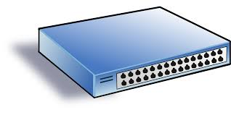
The Pieces are Gradually Coming Together
Expressive programming languages
Programmable
network devices
Efficient data structures

Slide 26
Grand Challenge: Synthesize the Control Loop
High-level goals
Distributed software
Compiler
Controller
vSwitch
Switch OS
Switch OS
vSwitch
control
loop
NIC
NIC
NIC
switch
switch
NIC

Slide 27
Thank You
jrex@princeton.edu
https://www.cs.princeton.edu/~jrex/
To learn more
ConQuest: https://www.cs.princeton.edu/~jrex/papers/conquest19.pdf
BeauCoup: https://www.cs.princeton.edu/~jrex/papers/beaucoup20.pdf
Contra: https://www.cs.princeton.edu/~jrex/papers/contra20.pdf
P4Campus: https://p4campus.cs.princeton.edu/

