Slide 1


NextG Networks That Do What They’re Told
Jennifer Rexford
Princeton University
prontoproject.org

Slide 2


NextG Convergence: End-to-End
Wireless communication
Computer networking
Cloud computing
NIC
NIC
5G Mobile
Network

Slide 3




Programmability and Open-Source Software
DoS Mitigation
Overlay Virtualization
Load
Balancing
Traffic Engineering
…
SDN Controller
vSwitch
DPDK
User space
NIC
NIC
Kernel stack
XDP/eBPF
5G Mobile
Network

Slide 4
Programmable Closed-Loop Network Control
Analyze
Measure
(dials)
Adapt
(knobs)

Slide 5
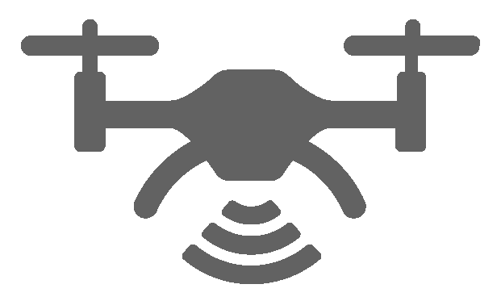

Example: Mitigating Microbursts in the ONF Aether Pod
SD-Fabric Control
INT
Control
5G SD-Core UPF Control
ONOS (Highly Available)
ONOS (Highly Available)
ONOS (Highly Available)
5G SD-Core UPF
DoS attack: edge application causes unexpected congestion
Without closed-loop control: disrupts the drone flight
Motion Capture
Command Control
Edge Application
prontoproject.org

Slide 6
Thank You
jrex@cs.princeton.edu
https://www.cs.princeton.edu/~jrex/
To learn more
ConQuest mitigation of microbursts: https://www.cs.princeton.edu/~jrex/papers/conquest19.pdf
P4Campus testbed: https://p4campus.cs.princeton.edu/
Pronto project: https://prontoproject.org/
ONF Aether platform: https://opennetworking.org/aether/
Magma overview: https://www.cs.princeton.edu/~jrex/papers/magma23.pdf

