Slide 1





Pronto: Verifiable, Closed-Loop Control of 5G Networks
Jennifer Rexford
With Stanford (Sachin Katti, Nick McKeown), Cornell (Nate Foster), and the Open Networking Foundation (Guru Parulkar, Larry Peterson, Oguz Sunay)

Slide 2




Programmability Top-to-Bottom and End-to-End
BGP
Overlay Virtualization
Load
Balancing
Traffic Engineering
…
SDN Controller
DPDK
DPDK
User space
User space
Kernel stack
NIC
NIC
Kernel stack
XDP/eBPF
XDP/eBPF

Slide 3

Programmability Top-to-Bottom and End-to-End
Specified Behavior
Compile
Overlay Virtualization
BGP
Load
Balancing
Traffic Engineering
…
SDN Controller
Partition
Compile
Compile
Compile
DPDK
DPDK
User space
User space
Kernel stack
NIC
NIC
Kernel stack
XDP/eBPF
XDP/eBPF

Slide 4
Programmability Enables Closed-Loop Control
Analyze
Measure
(dials)
Adapt
(knobs)
Traffic, performance, attacks, failures, etc.
Drop, mark, rate-limit, reroute, etc.

Slide 5
Programmability Enables Network Verification
Two approaches...
Static: analyze network programs to check important properties prior to deployment (e.g., reject a data-plane configuration that creates a routing loop)
Dynamic: instrument network programs to automatically enforce important properties (e.g., reject a packet that would violate slice isolation)

Slide 6

Pronto’s Premise
Networks, for the first time, will be
  Programmable top-to-bottom
  Programmable end-to-end
  Defined entirely by software
This creates new possibilities
  Closed-loop network control
  Real-time verification and fixing
  Networks correct by construction
BGP
Overlay Virtualization
Load
Balancing
Traffic Engineering
…
SDN Controller
Because of open-source, we (the research community) get to take part.
5G is being redefined by software, too!
DPDK
DPDK
User space
User space
Kernel stack
NIC
NIC
Kernel stack
XDP/eBPF
XDP/eBPF
5G Mobile
Network

Slide 7
High Level Objectives
“We will create and deploy the first network—including 5G—under verifiable closed-loop control as an exemplar for others in government, industry, and education to replicate.”
“Pronto will be an operational network that is deployed in a production environment, carries real traffic, and runs innovative edge services.”
…and then we demonstrate new research ideas on top

Slide 8
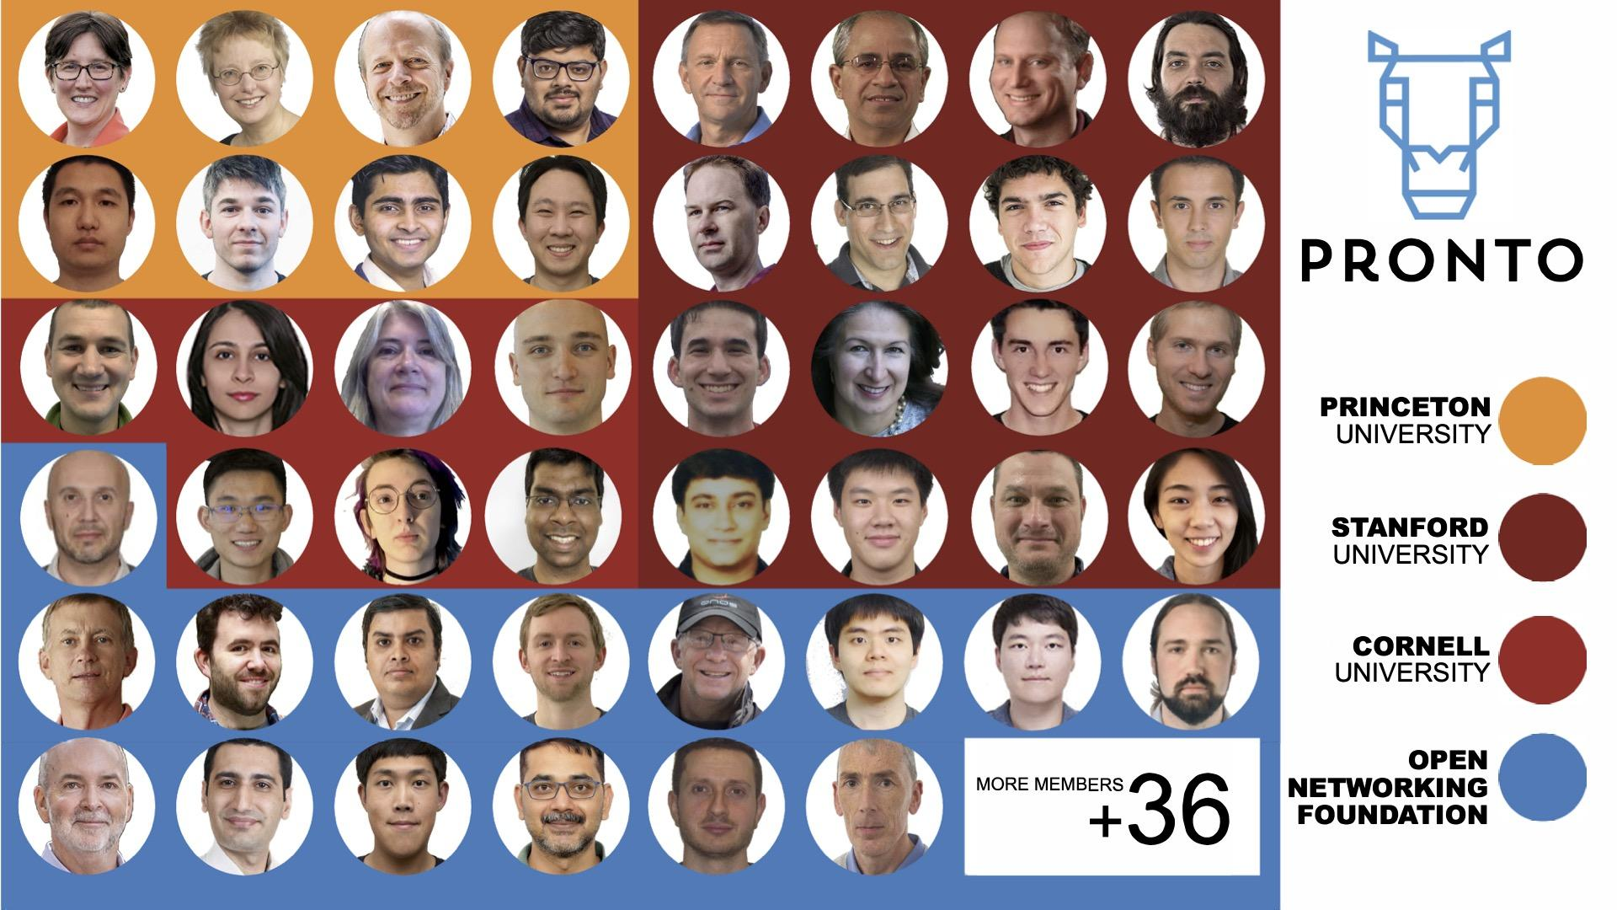

Slide 9
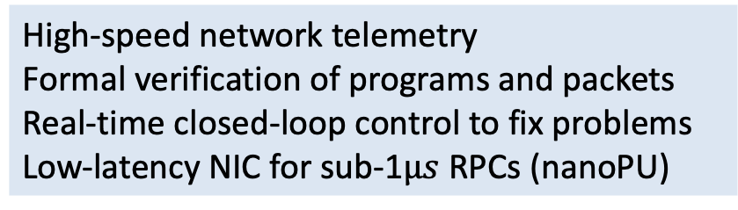
Pronto Summary
Enable network owners to make their networks programmable
Research
Deploy
Develop
Edge-controlled, programmable network at three universities and ONF, including Tofino switches, P4-NICs, servers
ONF open-source Aether platform

Slide 10
ONF Aether Platform https://opennetworking.org/aether/

Slide 11
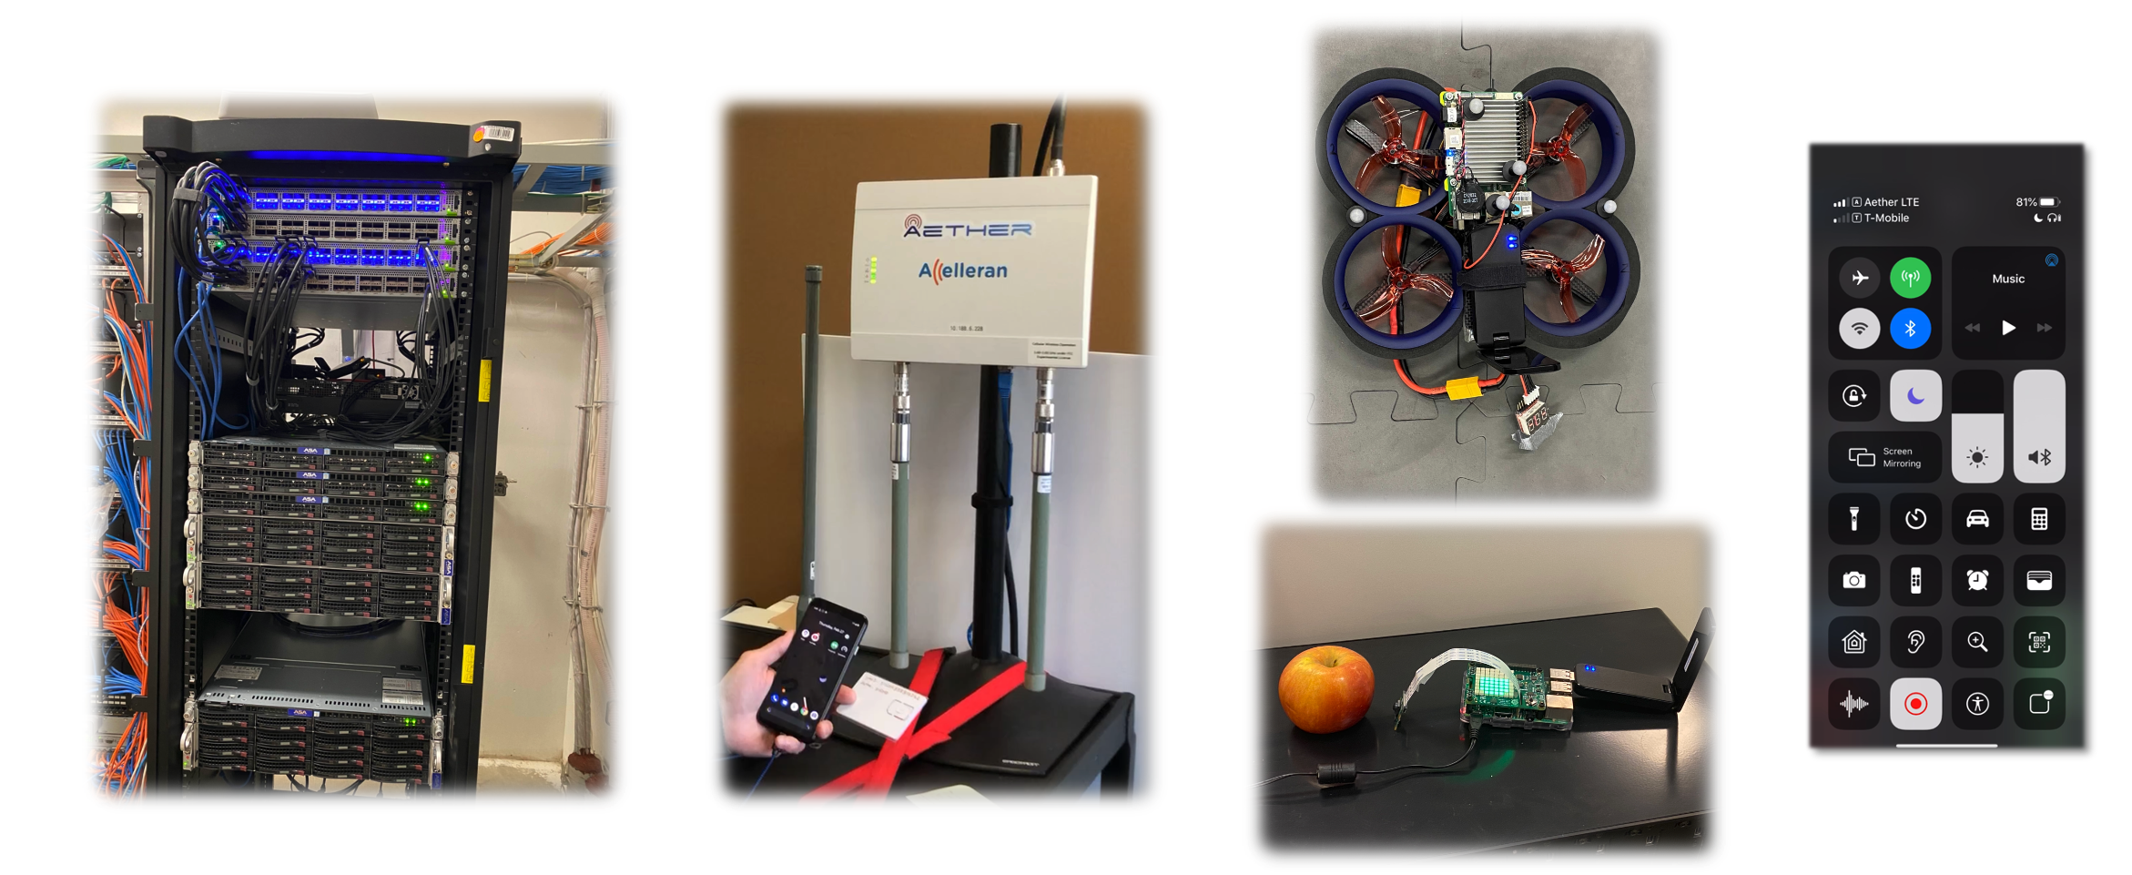
Aether is Operational
A multi-cloud platform for 4G/5G connectivity
A rack of 2x2 SDN fabric, CPU (and GPU) servers at each edge location forming the edge cloud
4G/5G small cells serving real traffic for Internet access and edge applications
Drones, IoT devices, and mobile phones as end-user devices

Slide 12






Aether Software Architecture: Current Status
Operational Platform
SD-Core
SDN Substrate
SD-RAN
Operational Platform
RAN Control
Fabric Control
4G/5G Core User Plane
Pronto Generation & Verification
µONOS SD-RAN Controller
ONOS
Telemetry
Collection & Analytics
Aether Management Platform (AMP)
fabric.p4
fabric.p4
Operational Control
Lifecycle Mgmt
Monitoring / Logging
Stratum
Stratum
Kubernetes
INT
INT
Tofino Switch
Tofino Switch
Aether Connectivity Control (ACC)
4G/5G Core Control Plane
fabric.p4
fabric.p4
Central Cloud
Stratum
Stratum
INT
INT
Tofino switch
Tofino switch
RAN
Aether Connected Edge
(ACE)

Slide 13
Aether has been operational since December 2019
Now running 2x2 Pods at Stanford, Princeton, Cornell
Intel
Ciena
Cornell
ONF
Google Cloud
US West
Princeton
Telefonica
Turk Telekom
Stanford
ONF
AT&T
NTT
Aether Management Platform (AMP)
Aether Connectivity Control (ACC)
Aether Connected Edge (ACE)

Slide 14
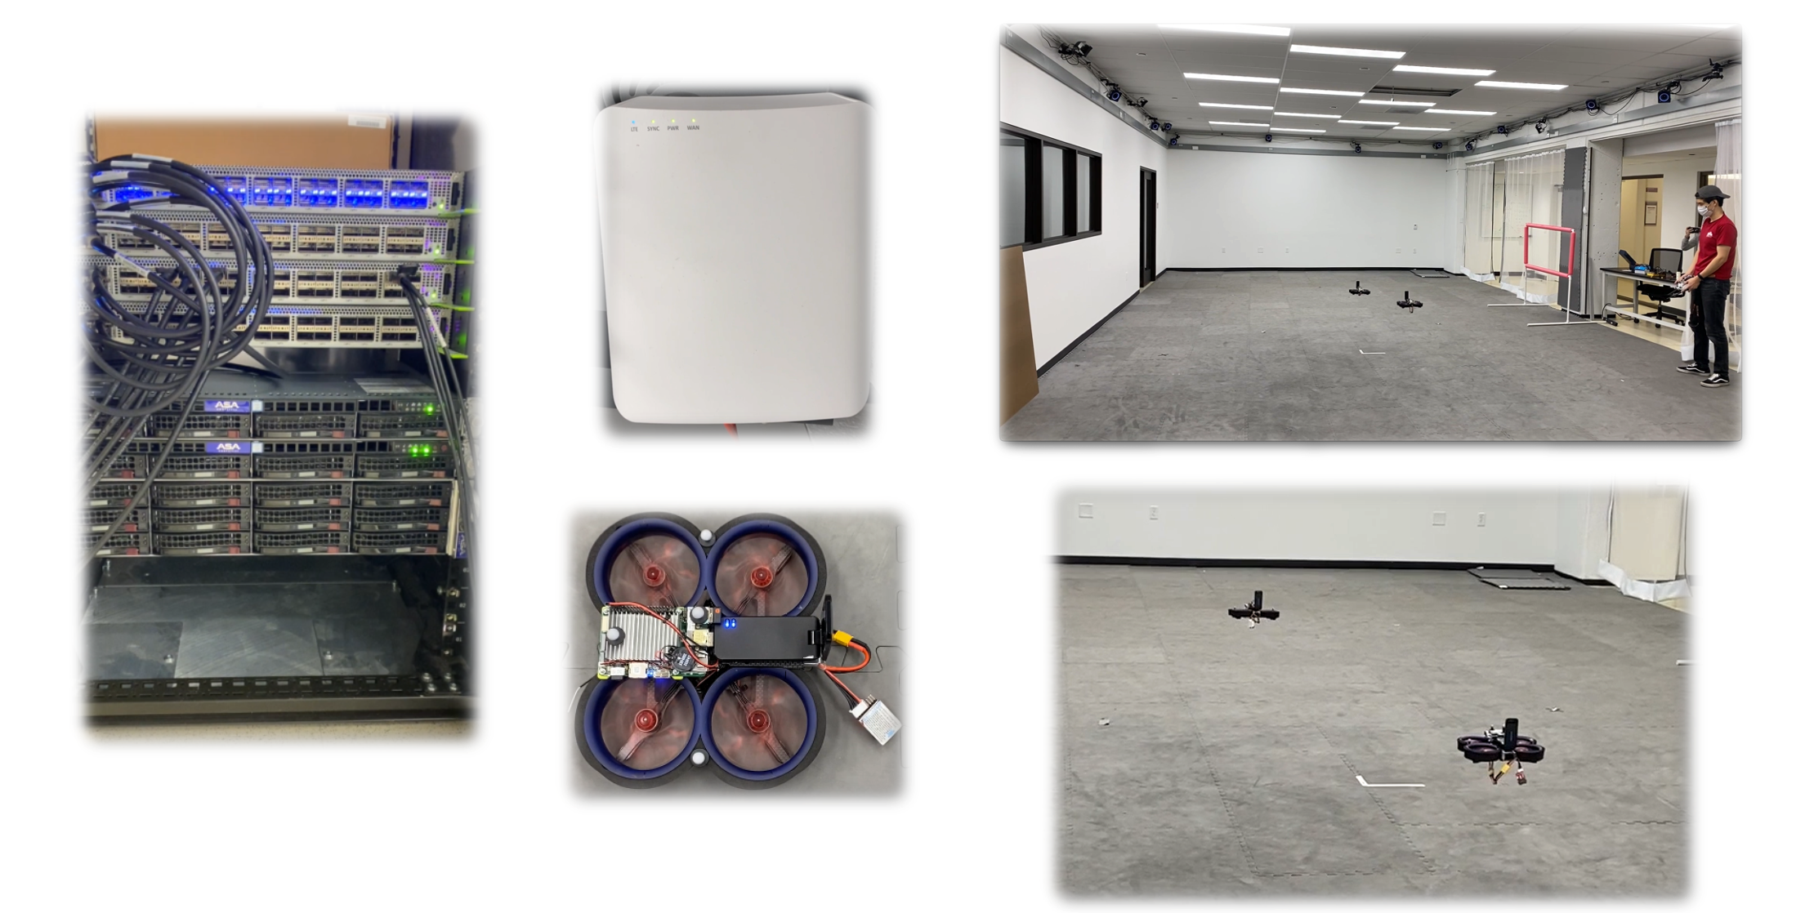
Aether Empowering Autonomous Drone
Flight Research at Stanford

Slide 15



Pronto at Stanford Flight Lab
Aether Management Platform
5G SD-Core Control
Drone location information
delivered to the Motion Capture app
SD-Fabric Control
INT
Control
5G SD-Core UPF Control
ONOS (Highly Available)
ONOS (Highly Available)
ONOS (Highly Available)
Telemetry Collection
Closed-Loop Control
Verification
Edge Cloud Platform
5G SD-Core UPF
Leveraging input from Motion Capture App,
The Command Control app makes decisions
for next waypoint location of each drone
and sends them to the drones via CBRS
small cell
Motion Capture
Command Control

Slide 16
Pronto Demonstrations
Deep programmability
Top-down and end-to-end programmable
Infrastructure: switches, NICs, 5G small cells
Platform: cloud automation, cloud management
Connectivity: 5G connectivity
New network capabilities
Fine-grained (packet-level) visibility
Closed-loop control
Run-time packet-level verification
Cloud managed
Under 1 sec reaction time
Operational resilience against maintenance, hardware and software failures, congestion, vulnerabilities, and attacks
Applied to production-grade 5G networks
Virtualized, disaggregated, SDN and distributed cloud-based, top-down and end-to-end programmable 5G networks

Slide 17
DEMONSTRATIONS OF PRONTO’S OPERATIONAL NETWORK
Introduction: https://youtu.be/KjdXEOUMnOI
Demo 1: Resolving hardware and software failures: https://youtu.be/CUdOSv0mUmM
Demo 2: Runtime software upgrades: https://youtu.be/K44KgMNFcZc
Demo 3: Detecting and blocking microburst congestion: https://youtu.be/XW_pgPMvuqw
Demo 4: Resiliency against DoS and exfiltration attacks: https://youtu.be/lLhffmr4YbY
Demo 5a: Automated deployment of the new Stanford edge: https://youtu.be/04sq4kQ6ySw
Demo 5b: Centralized management of all Pronto and Aether networks: https://youtu.be/FAVyonQMSuc

Slide 18
Closed-Loop Network Control
Joint work with Xiaoqi Chen, Shir Landau-Feibish, Joon Kim, Robert MacDavid, and John Sonchack

Slide 19
Real-Time Mitigation of Microbursts
SD-Fabric Control
INT
Control
5G SD-Core UPF Control
ONOS (Highly Available)
ONOS (Highly Available)
ONOS (Highly Available)
5G SD-Core UPF
DoS attack: edge application causes unexpected congestion
Without closed-loop control: disrupts the drone flight
Motion Capture
Command Control
Edge Application

Slide 20
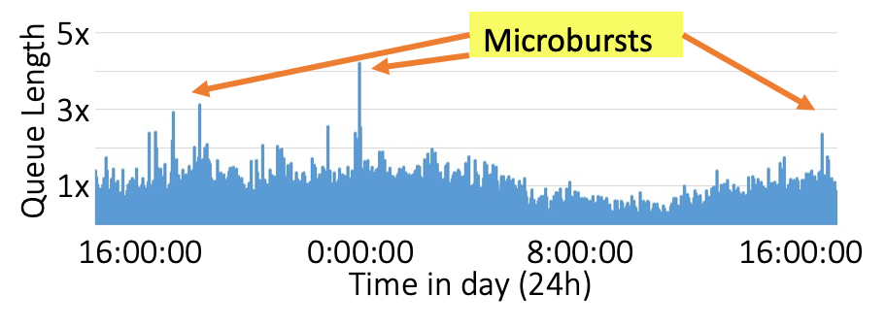
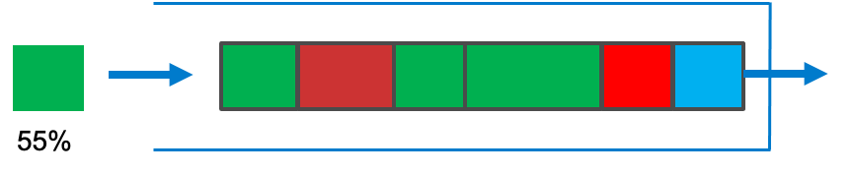
ConQuest: Alleviating Microbursts [CoNext’19]
Small timescale traffic bursts
  Clog the packet queues
  Cause packet delay and loss
Manage microbursts to handle
  Bursty workloads
  Shallow-buffer switches
  High link utilization
Closed-loop control
  Identify the responsible flows
  … and drop or rate-limit them
https://opennetworking.org/p4/conquest-flow-level-queue-analysis-in-p4/

Slide 21
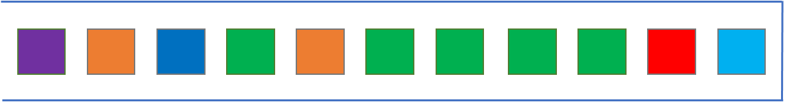
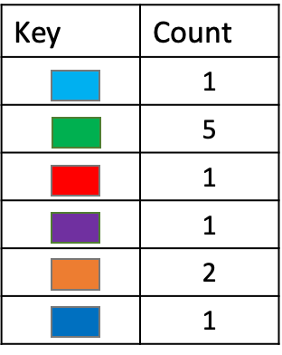
Detecting Heavy Flows in the Queue
For each flow, how many packets are in the queue?
Data-plane implementation challenges
  Updating on packet arrival and departure
  Per-flow state (key and count)

Slide 22
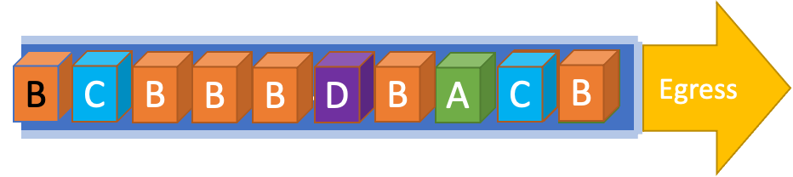

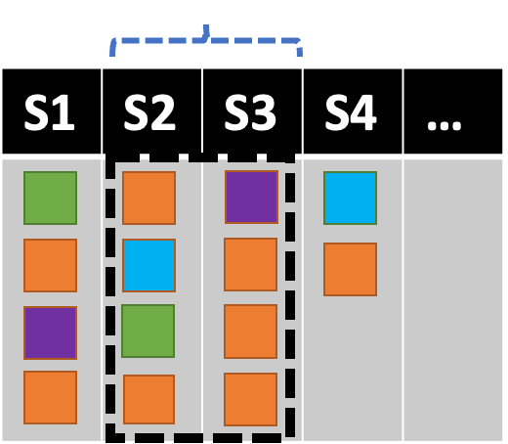
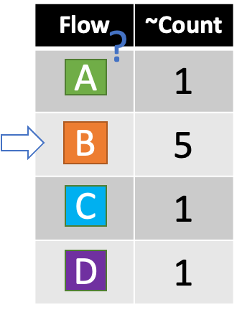
Updating Data Structure Once Per Packet
Slice traffic into time windows
Each snapshot records T=4 packets
Enqueued at time 5
Dequeued at time 14

Slide 23
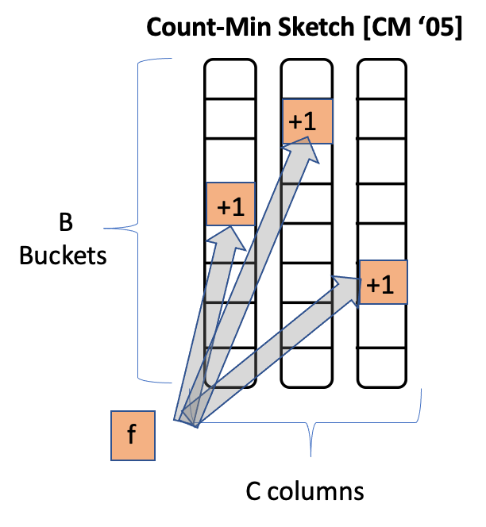
Avoiding Per-Flow State
Compact data structures
  With limited memory and processing
  … at the expense of loss in accuracy
Estimate per-flow counts per snapshot
  With accurate estimate for large flows
Count-Min Sketch per snapshot
  C columns indexed by hash functions
  Increment hash_{i}(flowid) in column i
  Estimate is the min of the C counts

Slide 24
Real-Time Mitigation of Microbursts
SD-Fabric Control
INT
Control
5G SD-Core UPF Control
ONOS (Highly Available)
ONOS (Highly Available)
ONOS (Highly Available)
Closed-loop control
ConQuest
5G SD-Core UPF
DoS attack: edge application causes unexpected congestion
Without closed-loop control: disrupts the drone flight
With closed-loop control: uninterrupted connectivity
Motion Capture
Command Control
Edge Application
https://youtu.be/XW_pgPMvuqw

Slide 25
Runtime Network Verification
Work by Nate Foster, Sundararajan Renganathan, Bruce Spang, Megan Jung, Guru Parulkar, Sachin Katti, and Nick McKeown

Slide 26


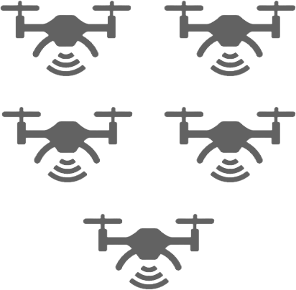
Real-Time Mitigation of Data Exfiltration
SD-Fabric Control
INT
Control
5G SD-Core UPF Control
ONOS (Highly Available)
ONOS (Highly Available)
ONOS (Highly Available)
5G SD-Core UPF
Exfiltration attack: introduce bug that broadcasts locations of drones
Without runtime verification: drone locations known by attacker
With runtime verification: drone locations only known by command/control application
Command Control
Motion Capture
https://youtu.be/lLhffmr4YbY

Slide 27
Runtime Verification
Idea: wrap switches with runtime monitors
Add checking logic to decide whether to accept or reject each packet
✔
❌

Slide 28
Network-Wide Runtime Verification
Can also apply this idea to the network as a whole
Checking function needs to be generalized to take a sequence of packets
Now it becomes easy to check network-wide reachability properties
✔
❌

Slide 29
Optimization: From Packets to Telemetry
Of course, keeping track of a sequence of packets would be expensive...
Instead, we can record just the data we need for checking as telemetry
✔
❌

Slide 30
Optimization: Inlining Checking Code
Inlining checking logic enables verifying at each hop rather than all at the end
Enables runtime enforcement of additional properties (e.g., loop freedom)
Can also reduce the amount of telemetry data that must be maintained
✔
✔
✔
✔
✔
❌
❌
❌
❌
❌

Slide 31
P4 Implementation of Slice Isolation
#include <core.p4>
#include <v1model.p4>
const bit<16> TYPE_IPV4 = 0x800;
const bit<16> TYPE_COLOR = 0x9999;
const bit<16> TYPE_SRCROUTING = 0x1234;
#define MAX_HOPS 9
/*************************************************************************
*********************** H E A D E R S ***********************************
*************************************************************************/
typedef bit<9> egressSpec_t;
typedef bit<48> macAddr_t;
typedef bit<32> ip4Addr_t;
header ethernet_t {
macAddr_t dstAddr;
macAddr_t srcAddr;
bit<16> etherType;
}
header srcRoute_t {
bit<1> bos;
bit<15> port;
}
header ipv4_t {
bit<4> version;
bit<4> ihl;
bit<8> diffserv;
bit<16> totalLen;
bit<16> identification;
bit<3> flags;
bit<13> fragOffset;
bit<8> ttl;
bit<8> protocol;
bit<16> hdrChecksum;
ip4Addr_t srcAddr;
ip4Addr_t dstAddr;
}
header color_t {
bit<8> packet_color;
bit<16> etherCType;
}
struct metadata {
bool first_hop;
bit<8> old_color;
}
struct headers {
ethernet_t ethernet;
color_t color;
srcRoute_t[MAX_HOPS] srcRoutes;
ipv4_t ipv4;
}
/*************************************************************************
*********************** P A R S E R ***********************************
*************************************************************************/
parser MyParser(packet_in packet,
out headers hdr,
inout metadata meta,
inout standard_metadata_t standard_metadata) {
state start {
transition parse_ethernet;
}
state parse_ethernet {
packet.extract(hdr.ethernet);
transition select(hdr.ethernet.etherType) {
TYPE_COLOR : parse_color;
TYPE_SRCROUTING: parse_srcRouting;
default: accept;
}
}
state parse_color {
packet.extract(hdr.color);
transition select(hdr.color.etherCType) {
TYPE_SRCROUTING : parse_srcRouting;
default: accept;
}
}
state parse_srcRouting {
packet.extract(hdr.srcRoutes.next);
transition select(hdr.srcRoutes.last.bos) {
1: parse_ipv4;
default: parse_srcRouting;
}
}
state parse_ipv4 {
packet.extract(hdr.ipv4);
transition accept;
}
}
/*************************************************************************
************ C H E C K S U M V E R I F I C A T I O N *************
*************************************************************************/
control MyVerifyChecksum(inout headers hdr, inout metadata meta) {
apply { }
}
/*************************************************************************
************** I N G R E S S P R O C E S S I N G *******************
*************************************************************************/
control MyIngress(inout headers hdr,
inout metadata meta,
inout standard_metadata_t standard_metadata) {
action drop() {
mark_to_drop(standard_metadata);
}
action srcRoute_nhop() {
standard_metadata.egress_spec = (bit<9>)hdr.srcRoutes[0].port;
hdr.srcRoutes.pop_front(1);
}
action srcRoute_finish() {
hdr.ethernet.etherType = TYPE_IPV4;
}
action update_ttl(){
hdr.ipv4.ttl = hdr.ipv4.ttl - 1;
}
action addColor() {
meta.first_hop = true;
hdr.color.setValid();
hdr.color.etherCType = hdr.ethernet.etherType;
hdr.ethernet.etherType = 0x9999;
}
action removeColor() {
hdr.ethernet.etherType = hdr.color.etherCType;
hdr.color.setInvalid();
}
table debug {
key = { hdr.srcRoutes[0].isValid() : exact;
hdr.color.isValid() : exact; }
actions = { }
}
apply {
debug.apply();
if (hdr.srcRoutes[0].isValid()) {
if (!hdr.color.isValid()) {
addColor();
}
if (hdr.srcRoutes[0].bos == 1) {
removeColor();
srcRoute_finish();
}
srcRoute_nhop();
if (hdr.ipv4.isValid()) {
update_ttl();
}
} else {
drop();
}
}
}
/*************************************************************************
**************** E G R E S S P R O C E S S I N G *******************
*************************************************************************/
control MyEgress(inout headers hdr,
inout metadata meta,
inout standard_metadata_t standard_metadata) {
action drop() {
mark_to_drop(standard_metadata);
}
action setColor(bit<8> switchColor) {
if (meta.first_hop) {
hdr.color.packet_color = switchColor;
} else {
meta.old_color = hdr.color.packet_color;
hdr.color.packet_color = switchColor;
}
}
table colors {
actions = { setColor; NoAction; }
default_action = NoAction();
}
apply {
colors.apply();
if (!meta.first_hop && meta.old_color != hdr.color.packet_color) {
drop();
}
}
}
/*************************************************************************
************* C H E C K S U M C O M P U T A T I O N **************
*************************************************************************/
control MyComputeChecksum(inout headers hdr, inout metadata meta) {
apply { }
}
/*************************************************************************
*********************** D E P A R S E R *******************************
*************************************************************************/
control MyDeparser(packet_out packet, in headers hdr) {
apply {
packet.emit(hdr.ethernet);
packet.emit(hdr.color);
packet.emit(hdr.srcRoutes);
packet.emit(hdr.ipv4);
}
}
/*************************************************************************
*********************** S W I T C H *******************************
*************************************************************************/
V1Switch(MyParser(), MyVerifyChecksum(), MyIngress(), MyEgress(), MyComputeChecksum(), MyDeparser()) main;
= Untrusted user code
= Trusted checking code

Slide 32
Aether Properties
Packets forwarded to leaf switch corresponding to configured subnets
Bridged packets to learned MAC address sent to corresponding output port
Packets processed by ECMP table only forwarded to infrastructure ports
All packets sent to ONOS controller are unmodified
VLAN bridging isolation
Service chain isolation
Loop freedom

Slide 33
Real-Time Mitigation of Data Exfiltration
SD-Fabric Control
INT
Control
5G SD-Core UPF Control
ONOS (Highly Available)
ONOS (Highly Available)
ONOS (Highly Available)
5G SD-Core UPF
Exfiltration attack: introduce bug that broadcasts locations of drones
Without runtime verification: drone locations known by attacker
With runtime verification: drone locations only known by command/control application
Command Control
Motion Capture
https://youtu.be/lLhffmr4YbY

Slide 34


Conclusions
Deep programmability
  Top to bottom
  End-to-end
Closed-loop control
  Measure, analyze, adapt
  Customized to the use case
Verification
  Runtime enforcement
  Optimizations to reduce overhead
Operational deployment
  ONF Aether platform
  Multiple deployment sites
prontoproject.org
aetherproject.org

