Slide 1

Closing the Network Control Loop
Jennifer Rexford

Slide 2



Programmability From Top-to-Bottom and End-to-End
DoS Mitigation
Overlay Virtualization
Load
Balancing
Traffic Engineering
…
SDN Controller
vSwitch
DPDK
User space
NIC
NIC
Kernel stack
XDP/eBPF
5G Mobile
Network

Slide 3


What Will Network Owner’s Do?
They will want to run their networks better!
What will network owners do
with this new flexibility?

Slide 4
Adding New “Dials”
Traffic
Performance
Cyberattacks
Failures
Signal strength
<Your measurement here>

Slide 5

Adding New “Knobs”
Drop
Mark
Rate-limit
Reroute
Hand-off
<your knob here>

Slide 6
Closed-Loop Control
Analyze
Measure
(dials)
Adapt
(knobs)

Slide 7
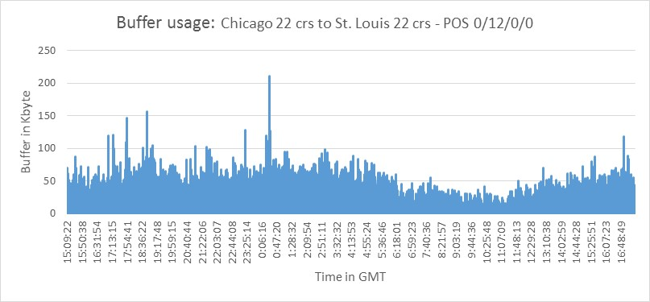
Example #1: Microbursts [ConQuest, CoNEXT’19]
5x
Microbursts
3x
Queue Length
1x
16:00:00
0:00:00
8:00:00
16:00:00
Time in day (24h)
Small timescale traffic bursts
  Long queues caused by incast, attacks, etc.
  Lead to high packet delay and loss
  … despite low average link utilization

Slide 8
Example #1: Microburst Measurement
Data-plane measurement and analysis
  Backlog in the queue
  A flow’s own contribution to the queue
55%
10%

Slide 9
Example #1: Microburst Mitigation
Data-plane adaptation
  Drop or mark an arriving packet probabilistically
  Based on its flow’s contribution to the queue
55%
10%

Slide 10
Example #2: DDoS Attacks [BeauCoup, SIGCOMM’20]
DNS
DNS
DDoS attacks
  DNS reflection attack
  SYN flooding
  HTTP flooding
  Slowloris attack
Overwhelm the victim
  Exhausting network and
  server resources
. . .
👺
Attacker
😵
Victim

Slide 11
Example #2: DDoS Detection
Data-plane measurement and analysis
  Identify suspected victim destinations (key DstIP)
  … receiving traffic from distinct senders (attribute SrcIP)
  … in excess of a threshold (threshold T)
Key
select DstIP where distinct(SrcIP) > T
Attribute
Threshold

Slide 12

Example #2: DDoS Mitigation
DNS
DNS
. . .
Data-plane adaptation
  Drop or rate-limit packets
  to suspected victims
  Run stateful firewall
  for suspected victims
  Pushback upstream
  toward the senders
👺
Attacker

Slide 13
Example #3: Path Performance [Contra, NSDI’20]
Network path diversity
Load balancing to achieve good performance
  Track the performance (load, loss, delay) of paths
  Split traffic effectively over the multiple paths

Slide 14
Example #3: Path Performance Monitoring
Data-plane tracking of path performance
  E.g., lowest maximum link utilization
  E.g., minimum end-to-end latency or loss
Probes along reverse path
30%
10%
30%
25%
30%
20%
50%
10%
10%
20%
50%

Slide 15
Example #3: Performance-Aware Load Balancing
Adaptation to direct traffic over the best path
  Sending packets in the forward direction
  … along the path with the best performance
25%
30%
20%
10%
20%
50%

Slide 16

Enabler: Programmable Data Planes
p4.org
Parser
Registers
Deparser
Memory
Match-
Action
Table
ALU
Stages

Slide 17
Challenges: Resource Limitations
Limited
depth
Limited
# bits
Limited
# rules
Limited # registers
and # of accesses
Limited ALU
operations
Parser
Registers
Deparser
Memory
Match-
Action
Table
ALU
Stages

Slide 18


Solution: Compact Data Structures
Approximate analysis is fine
  All flows → small number of large flows
  Exact metrics → approximate metrics
Data structures can fit in data-plane registers
  Sketch (e.g., Bloom filter, count-min sketch, etc.)
  Small hash table (e.g., cache of the popular keys)

Slide 19
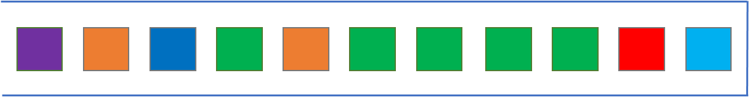
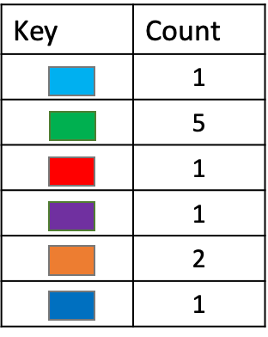
ConQuest: Detecting Heavy Flows in the Queue
For each flow, how many packets are in the queue?
Data-plane implementation challenges
  Updating on packet arrival and departure
  Per-flow state (key and count)

Slide 20
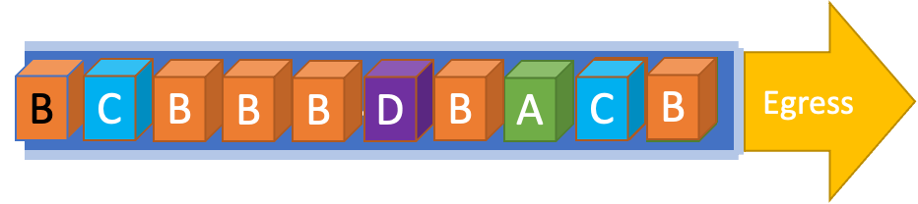

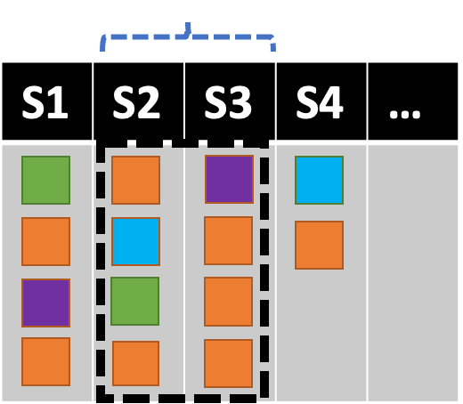
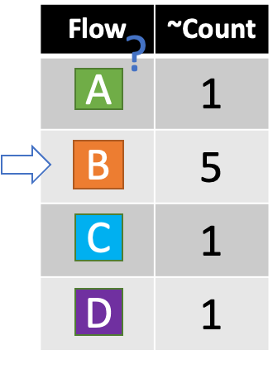
Updating Data Structure Once Per Packet
Slice traffic into time windows
Each snapshot records T=4 packets
Enqueued at time 5
Dequeued at time 14

Slide 21
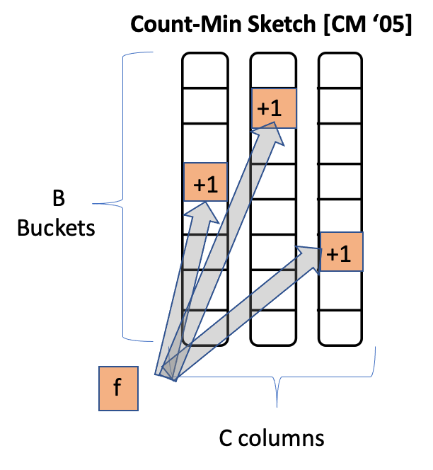
Avoiding Per-Flow State
Compact data structures
  With limited memory and processing
  … at the expense of loss in accuracy
Estimate per-flow counts
  With accurate estimate for large flows
Count-Min Sketch per snapshot
  C columns indexed by hash functions
  Increment hash_{i}(flowid) in column i
  Estimate is the min of the C counts

Slide 22
Grand Challenge
High-level goals
Distributed software
Compiler
Controller
vSwitch
Switch OS
Switch OS
vSwitch
control
loop
NIC
NIC
NIC
switch
switch
NIC

Slide 23
Conclusions
Network programmability
  Top-to-bottom
  End-to-end
Closed-loop network control
  Measure
  Analyze
  Adapt
Compact data structures
  Closing the control loop in the data plane
  … through approximate data structures

Slide 24
Lessons Learned
Grand challenges
  Networks worthy of society’s trust
Technology enablers
  Deep programmability
Interdisciplinary research
  Programming languages (expressiveness)
  Compact data structures (scarcity)
Prototype systems
  Learning by doing, evaluating under realistic conditions
Building community

Slide 25
References
ConQuest: Xiaoqi Chen, Shir Landau Feibish, Yaron Koral, Jennifer Rexford, Ori Rottenstreich, Steven A. Monetti, and Tzuu-Yi Wang, "Fine-grained queue measurement in the data plane," in ACM SIGCOMM CoNEXT Conference, December 2019.
BeauCoup: Xiaoqi Chen, Shir Landau-Feibish, Mark Braverman, and Jennifer Rexford, "BeauCoup: Answering many network traffic queries, one memory update at a time," in ACM SIGCOMM, August 2020.
Contra: Kuo-Feng Hsu, Ryan Beckett, Ang Chen, Jennifer Rexford, Praveen Tammana, and David Walker, "Contra: A programmable system for performance-aware routing," in USENIX Networked Systems Design and Implementation, February 2020.

