Slide 1

Securing our National Infrastructure
The network as an open-source programmable platform with verifiable closed-loop control
PI: Nick McKeown (Stanford)
Co-PIs: Jen Rexford (Princeton), Nate Foster (Cornell), Larry Peterson (ONF)
May 2020 – April 2023
https://prontoproject.org/

Slide 2


Programmability: Top-to-Bottom and End-to-End
BGP
Overlay Virtualization
Load
Balancing
Traffic Engineering
…
SDN Controller
DPDK
vSwitch
vSwitch
DPDK
User space
User space
Kernel stack
NIC
NIC
Kernel stack
XDP/eBPF
XDP/eBPF

Slide 3
Programmability: Top-to-Bottom and End-to-End
Specified Behavior
Compile
BGP
Overlay Virtualization
Load
Balancing
Traffic Engineering
…
SDN Controller
Partition
Compile
Compile
Compile
DPDK
vSwitch
vSwitch
DPDK
User space
User space
Kernel stack
NIC
NIC
Kernel stack
XDP/eBPF
XDP/eBPF

Slide 4
Programmability Enables Closed-Loop Control
Analyze
Measure
(dials)
Adapt
(knobs)
Traffic, performance, attacks, failures, etc.
Drop, mark, rate-limit, reroute, etc.

Slide 5

Pronto’s Premise
Networks, for the first time, will be
  Programmable end-to-end
  Specified top-to-bottom
  Defined entirely by software
This creates new possibilities
  To verify networks are “correct by construction”
  To measure and validate, in real time, against the network specification
  To correct bugs through closed-loop control
BGP
Overlay Virtualization
Load
Balancing
Traffic Engineering
…
SDN Controller
Because of open-source, we (the research community) get to take part.
5G is being redefined by software, too!
DPDK
vSwitch
vSwitch
DPDK
User space
User space
Kernel stack
NIC
NIC
Kernel stack
XDP/eBPF
XDP/eBPF
5G Mobile
Network

Slide 6
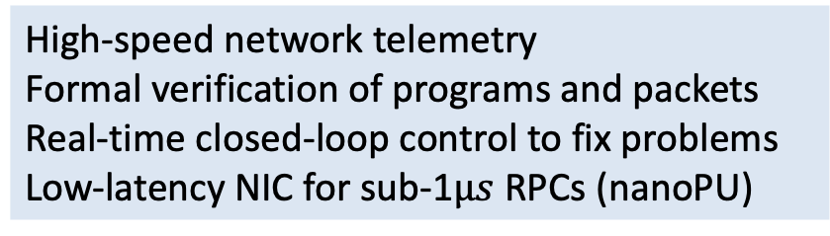
Pronto Summary
Enable U.S. ISPs and mobile operators to make their networks programmable
Research
High-speed network telemetry
Formal verification of programs and packets
Real-time closed-loop control to fix problems
Low-latency NIC for sub-1$μs$ RPCs (nanoPU)
Deploy
Develop
Edge-controlled, programmable network at three universities and ONF, including Tofino switches, P4-NICs, servers
ONF open-source Aether platform

Slide 7
High Level Objectives
“We will create and deploy the first network—including 5G—under verifiable closed-loop control as an exemplar for others in government, industry, and education to replicate.”
“Pronto will be an operational network that is deployed in a production environment, carries real traffic, and runs innovative edge services.”
…and then we demonstrate new research ideas on top

Slide 8
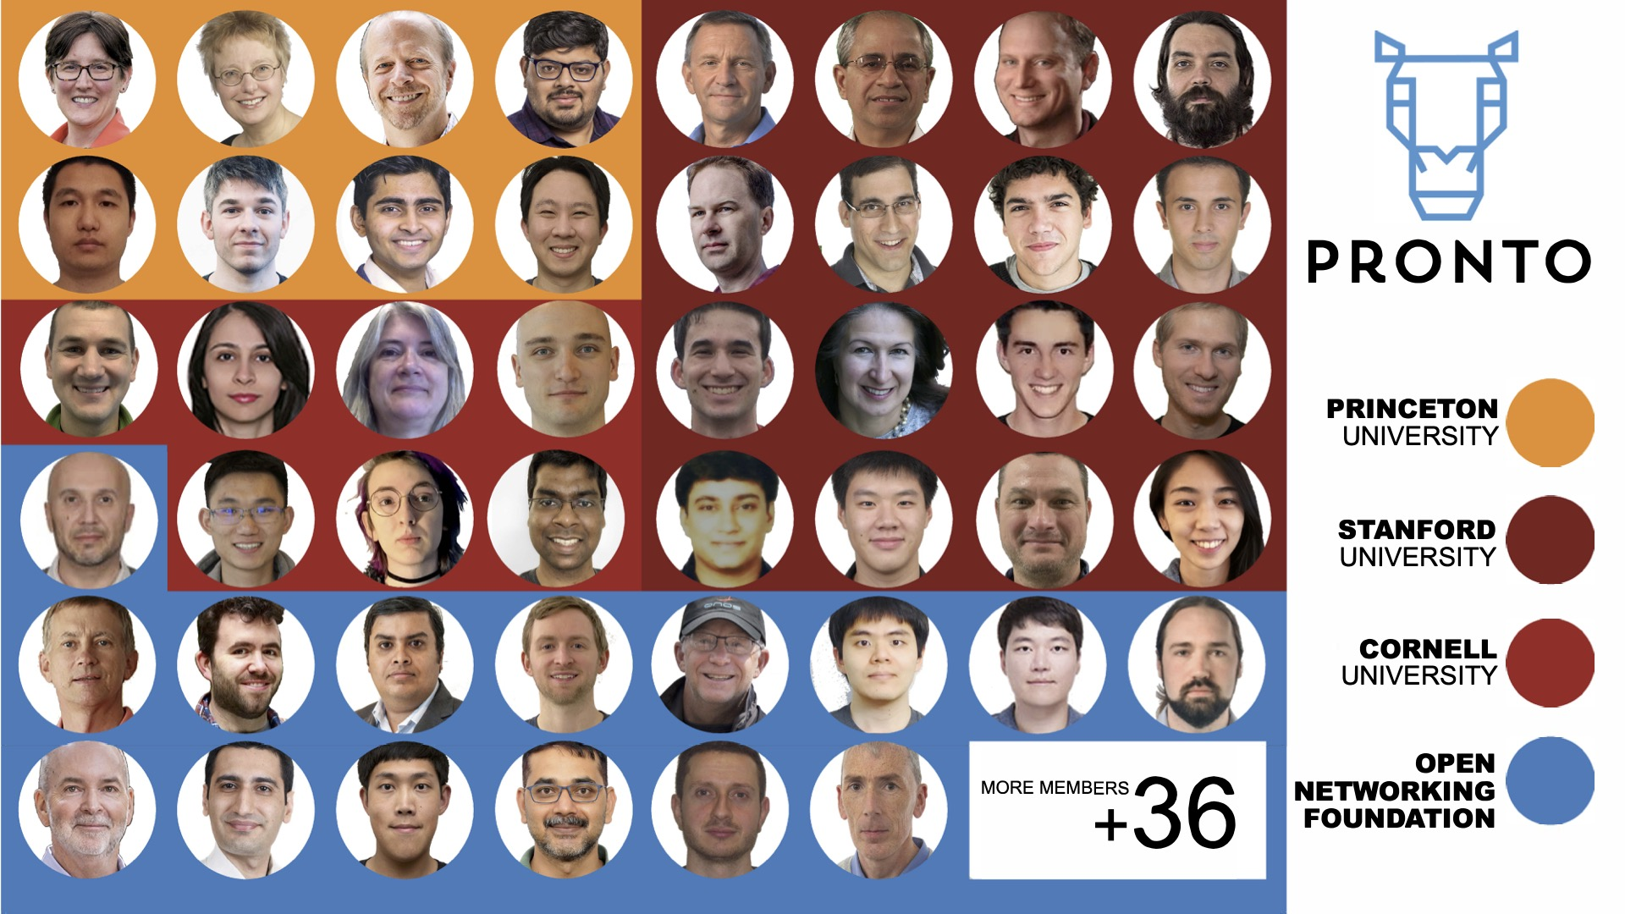

Slide 9



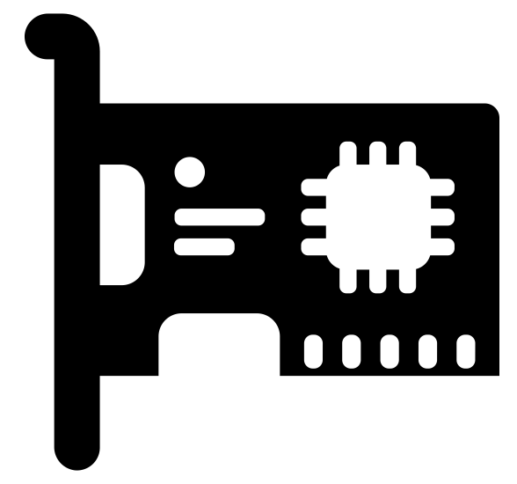

Pronto System
5G SD-RAN Control
Control App
Control App
5G SD-CORE Control
Control code
ONOS Control Plane
Contract
Generation & Verification
P4Runtime Contract
Dataplane code
NIC
5G RAN CU UP.p4
5G CORE UP.p4
NIC
P4 NIC
Stratum OS
Stratum OS
P4 NIC
PISA switch
PISA switch
Fine-Grained Measurement (INT)

Slide 10
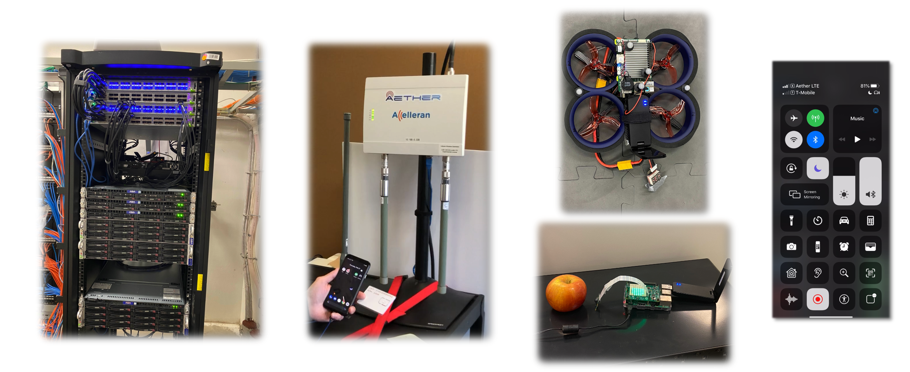
Aether is Now Operational
A pre-production grade, multi-cloud platform for 4G/5G connectivity
A rack of 2x2 SDN fabric, CPU (and GPU) servers at each edge location forming the edge cloud
4G/5G small cells serving real traffic for Internet access and edge applications
Drones, IoT devices, and mobile phones as end-user devices

Slide 11



Aether Software Architecture: Current Status
Operational Platform
SD-Core
SDN Substrate
SD-RAN
Operational Platform
Additional preliminary work for
future deliverables on multi-site
operationalization
RAN Control
Fabric Control
4G/5G Core User Plane
Pronto Generation & Verification
To be integrated in future quarters
µONOS SD-RAN Controller
ONOS
Telemetry
Collection & Analytics
Aether Management Platform (AMP)
fabric.p4
fabric.p4
Operational Control
Lifecycle Mgmt
Monitoring / Logging
Stratum
Stratum
Kubernetes
INT
INT
Tofino Switch
Tofino Switch
Aether Connectivity Control (ACC)
4G/5G Core Control Plane
fabric.p4
fabric.p4
Central Cloud
Stratum
Stratum
INT
INT
Tofino switch
Tofino switch
RAN
Aether Connected Edge
(ACE)

Slide 12
Aether has been operational since December ’19
Now running 2x2 Pods at Stanford, Princeton, Cornell
Intel
Ciena
Cornell
ONF
Google Cloud
US West
Princeton
Telefonica
Turk Telekom
Stanford
ONF
AT&T
NTT
Aether Management Platform (AMP)
Aether Connectivity Control (ACC)
Aether Connected Edge (ACE)

Slide 13
DEMONSTRATIONS OF PRONTO’S OPERATIONAL NETWORK
Introduction: https://youtu.be/KjdXEOUMnOI
Demo 1: Resolving hardware and software failures: https://youtu.be/CUdOSv0mUmM
Demo 2: Runtime software upgrades: https://youtu.be/K44KgMNFcZc
Demo 3: Detecting and blocking microburst congestion: https://youtu.be/XW_pgPMvuqw
Demo 4: Resiliency against DoS and exfiltration attacks: https://youtu.be/lLhffmr4YbY
Demo 5a: Automated deployment of the new Stanford edge: https://youtu.be/04sq4kQ6ySw
Demo 5b: Centralized management of all Pronto and Aether networks: https://youtu.be/FAVyonQMSuc

Slide 14
Pronto Demonstrations
Deep programmability
Top-down and end-to-end programmable
Infrastructure: switches, NICs, 5G small cells
Platform: cloud automation, cloud management
Connectivity: 5G connectivity
New network capabilities
Fine-grained (packet-level) visibility
Closed-loop control
Run-time packet-level verification
Cloud managed
Under 1sec reaction time
Operational resilience against maintenance, hardware and
software failures, congestion, vulnerabilities, and attacks
Applied to production-grade 5G networks
Virtualized, disaggregated, SDN and distributed cloud-based,
top-down and end-to-end programmable 5G networks

Slide 15
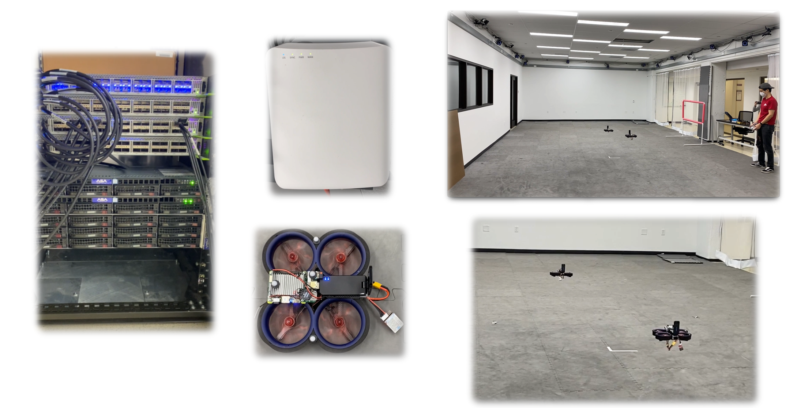
Aether Empowering Autonomous Drone Flight Research at Stanford

Slide 16



Pronto at Stanford Flight Lab
Aether Management Platform
5G SD-Core Control
Drone location information
delivered to the Motion Capture app
SD-Fabric Control
INT
Control
5G SD-Core UPF Control
ONOS (Highly Available)
ONOS (Highly Available)
ONOS (Highly Available)
Telemetry Collection
Closed-Loop Control
Verification
Edge Cloud Platform
5G SD-Core UPF
Leveraging input from Motion Capture App,
The Command Control app makes decisions
for next waypoint location of each drone
and sends them to the drones via CBRS
small cell
Motion Capture
Command Control

Slide 17
Graceful Handling of Failures and Software Upgrades
Aether Management Platform
5G SD-Core Control
SD-Fabric Control
INT
Control
5G SD-Core UPF Control
ONOS (Highly Available)
ONOS (Highly Available)
ONOS (Highly Available)
Telemetry Collection
Closed-Loop Control
Verification
Edge Cloud Platform
5G SD-Core UPF
Motion Capture
Command Control

Slide 18
Real-Time Mitigation of Microbursts
Aether Management Platform
5G SD-Core Control
SD-Fabric Control
INT
Control
5G SD-Core UPF Control
ONOS (Highly Available)
ONOS (Highly Available)
ONOS (Highly Available)
Fine-grained visibility based
closed-loop control
Telemetry Collection
Closed-Loop Control
Verification
Edge Cloud Platform
ConQuest
An edge application causes unexpected congestion,
effectively creating a DoS attack.
Without Pronto’s fine-grained visibility based closed-loop control,
this causes disruption to the drone flight.
5G SD-Core UPF
Motion Capture
Command Control
ConQuest automatically drops/rate-limits congesting traffic,
enabling uninterrupted connectivity service to drone operation.
Edge Application

Slide 19

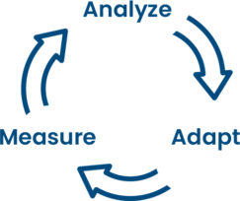

Conclusions
Deep programmability
  Top to bottom
  End to end
Closed-loop control
  Measure, analyze, and adapt
  Customized to the task at hand
Verification
  Detect and mitigate problems

Slide 20

How to learn more
prontoproject.org
aetherproject.org

