Slide 1
Higher-Order Telemetry in the Data Plane
Jennifer Rexford
Princeton University

Slide 2




Programmability Top-to-Bottom and End-to-End
DoS Mitigation
Overlay Virtualization
Load
Balancing
Traffic Engineering
…
Controller
vSwitch
DPDK
User space
NIC
NIC
Kernel stack
XDP/eBPF
5G Mobile
Network

Slide 3
Closing the Control Loop
Analyze
Measure
(dials)
Adapt
(knobs)
Traffic, performance, attacks, failures, etc.
Drop, mark, rate-limit, reroute, etc.

Slide 4
Key Enabler: Network Telemetry
Analyze
Measure
(dials)
Adapt
(knobs)
Traffic, performance, attacks, failures, etc.
Drop, mark, rate-limit, reroute, etc.

Slide 5


Data-Plane Telemetry Today
Counts based on network identifiers
“67,845 bytes between 1.2.3.4 and 5.6.7.8”
Path measurements of individual packets
“Queueing delay of 25 msec from 1.2.3.4 to 5.6.7.8”

Slide 6
Higher-Order Telemetry in the Data Plane
End-to-end performance for network services
“50 msec round-trip time to Netflix”
In the data plane for efficiency, privacy, and direct action!

Slide 7

Higher-Order Data-Plane Telemetry: Performance
From traffic counts to end-to-end performance
  Traffic counts: # bytes, # packet losses, …
  Performance: round-trip-time
  Challenge: join a packet with its ACK
Example use cases
  Service Level Agreement violations
  BGP interception attacks
  CDN replica selection
  Video QoE inference

Slide 8

Higher-Order Data-Plane Telemetry: Names
From network identifiers to high-level names
  Identifiers: IP addresses, TCP/UDP port numbers, …
  Names: domain names (e.g., *.netflix.com)
  Challenge: join DNS response with subsequent data packets
Example use cases
  Traffic volume by site name or class
  Intrusion Detection System bypass
  IoT device fingerprinting
  DNS tunneling detection
www.netflix.com

Slide 9
Data-Plane Challenges
Limited parsing depth
Limited number of registers
Registers and processing divided across stages
Parser
Registers
Deparser
Memory
Match-
Action
Table
ALU
Stages

Slide 10

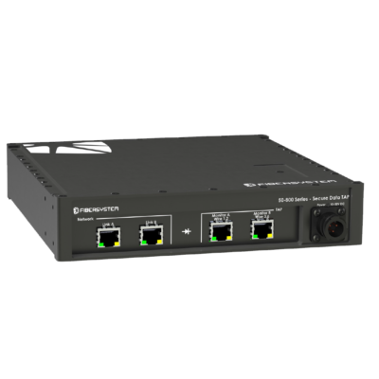

Round-Trip Time Monitoring
Server
SYN
ACK
SEQ
SYN/ACK
SEQ
ACK
……
ACK
...
Vantage Point
Client
Handshake RTT
Per-packet RTT
Continuous per-packet RTT

Slide 11


RTT Challenges: Correctness and Efficiency
Packet retransmission
Packet reordering
Multiple packets in flight
Packets never ACKed
Long round-trip times
SYN floods and port scans
Many active connections
…
Vagaries of
TCP traffic
Data-plane limitations

Slide 12

Matching a Packet With its ACK
Server
eACK = SEQ# + len
ACK# == eACK?
Data (SEQ)
ACK
Client
200 ms
s→d, 10000, 1500
Flow ID, expected ACK | Timestamp
Insert into table
300 ms
{sIP, sPort, dIP, dPort}, 11500
200
300 - 200 = 100 ms
d→s, 11500
Match, sample, delete
Packet table

Slide 13
Ensuring Correctness
Flow table
  Track sequence number range for valid samples
  Avoid taking inappropriate RTT measurements
Packet Table
Flow Table
Flow ID, expected ACK | Timestamp
Flow ID | Measurement Range
300 ms
{sIP, sPort, dIP, dPort}, 11500
200
s→d, 10000, 1500
{sIP, sPort, dIP, dPort}
[8000, 11500]

Slide 14
Ensuring Efficiency
Reducing memory pressure
  Lazy eviction of packets that never produce RTT samples
  Lazy eviction of inactive flows from flow table
  No RTT samples for handshake packets (e.g., SYN flood)
Packet Table
Flow Table
400 ms
Flow ID, expected ACK | Timestamp
Flow ID | Measurement Range
s*→d*, 10000, 1500
{s*IP, s*P, d*IP, d*P}
[3000, 5000]
Hash collision
{sIP, sPort, dIP, dPort}, 11500
200
{sIP, sPort, dIP, dPort}
[18000, 22500]
Recirculate
(and perhaps evict!)

Slide 15
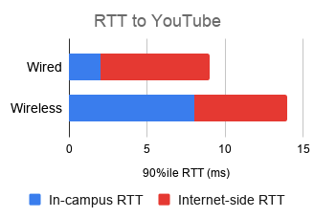



Round-Trip Time Monitoring in the Wild
Princeton campus traffic (p4campus.cs.princeton.edu)
  Collects vast majority of viable RTT samples (vs. tcptrace)
Prototype in progress on the Intel Tofino switch
Evaluating practical use cases
Campus WiFi performance
Detecting BGP interceptions

Slide 16
Network Telemetry by Domain Name

Slide 17
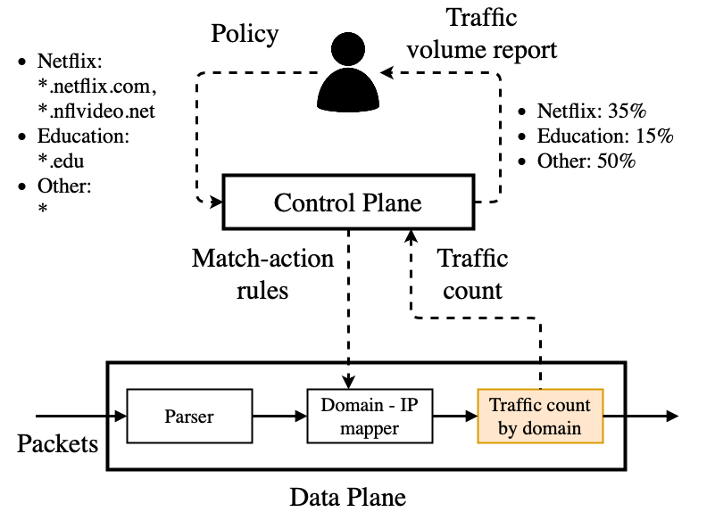
Network Telemetry by Domain Name

Slide 18


DNS Response Message and Application Traffic
DNS
“Address of www.netflix.com?”
“www.netflix.com is 5.6.7.8”
1.2.3.4
Data traffic between 1.2.3.4 and 5.6.7.8
5.6.7.8

Slide 19
DNS Telemetry Monitoring Challenges
Long domain names
Variable-length names
Browser DNS caching
Long-lived application sessions
Many clients and services
Vagaries of DNS
and applications
Data-plane limitations

Slide 20
Storing DNS Response Data
match-action rules
DNS Response Map
P
a
r
s
e
r
Domain Name | dID
*.netflix.com | 0
*.nflvideo.net | 0
*.edu | 1
* | 2
(cIP, sIP) | Time | dID
1.2.3.4, 5.6.7.8 | 101 | 0
Client: 1.2.3.4
Name: www.netflix.com
Time: 101
Server: 5.6.7.8
Limits on domain name parsing
<15char>.<15char>.<15char>.<15char>
(four parts, each at most 15 characters)
Domain IDs: Never store the domain names in DNS responses!
Lazy eviction of stale
DNS Response data
(100 sec timeout)

Slide 21
Counting Data Traffic by Service
DNS Response Map
Traffic Statistics
Client: 1.2.3.4
Server: 5.6.7.8
Time: 103
Length: 243 bytes
P
a
r
s
e
r
(cIP, sIP) | Time | dID
1.2.3.4, 5.6.7.8 | 101 103 | 0
Packets | Bytes
0+1 | 0+243
0
1
2
3
Maintaining freshness!
Counting traffic by service!

Slide 22




Tofino Prototype and Deployment
Tofino prototype (github.com/jkim117/Meta4)
  Parses up to four 15-byte name labels
  100-second DNS response timeout
  2-stage, 2¹⁶ entry DNS response table
Princeton deployment highlights
  8-11am: 33% Skype/Microsoft Teams
  3-3:15pm: 16% Steam Games, 12% Facebook
  DNS tunneling and IoT device fingerprinting use cases

Slide 23
Conclusion
Network telemetry
  Enables the network “control loop”
Higher-order telemetry
  Performance (e.g., RTT)
  Services (e.g., domain names)
Enables a rich set of use cases
Possible in high-speed data planes!

Slide 24
Thank You!
Learn More
X. Chen, H. Kim, J. Aman, W. Chang, M. Lee, J. Rexford, “Measuring TCP round-trip time in the data plane,” ACM SIGCOMM Workshop on Secure Programmable Network Infrastructure, SPIN 2020.
https://p4campus.cs.princeton.edu/pubs/rtt20_paper.pdf
S. Sengupta, H. Kim, J. Rexford, “Fast and accurate passive round-trip time measurement in the data plane,” May 2021.
https://p4campus.cs.princeton.edu/pubs/P4-RTT.pptx
J. Kim, H. Kim, J. Rexford, “Analyzing traffic by domain name in the data plane,” May 2021.
https://p4campus.cs.princeton.edu/pubs/Meta4_sigconf-latest.pdf
Jennifer Rexford
http://www.cs.princeton.edu/~jrex

