Slide 1

Toward Self-Driving Networks
Jennifer Rexford

Slide 2
Self-Driving Network
Complete control loop
Examples
  Direct traffic over the paths with the best performance
  Block or slow heavy-hitter flows
  Block or slow flows responsible for microbursts in packet queues
Now possible in the data plane!
analyze
measure
control

Slide 3
PISA: Protocol Independent Switch Architecture
Programmer declares which
headers are recognized
Programmer declares what tables are
needed and how packets are processed
Match+Action
Memory
ALU
Programmable
Parser
All stages are identical – makes PISA a good “compiler target”
Notes:
PISA chips are also built around a pipeline. But in PISA, all the pipeline stages are all IDENTICAL. They initially don’t know anything about protocols – they are sitting waiting to receive instructions from the compiler.
The basic operations of each stage is called “Match + Action” – In each stage, there is a set of memories which match on headers,
Depending on the match, an action is applied to the header by an ALU. And then the header is passed to the next stage, and so on.
A PISA chip is initially blank – it doesn’t know about any protocols.
The P4 programmer tells the programmable parser what packet headers it should recognize.
If a new header is developed, we add it to the set of headers the parser recognizes.
Let’s take a closer look at how a packet is processed …..

Slide 4
P4 Programming Language
action ipv4_forward(macAddr_t dstAddr, egressSpec_t port) {
standard_metadata.egress_spec = port;
hdr.ethernet.srcAddr = hdr.ethernet.dstAddr;
hdr.ethernet.dstAddr = dstAddr;
hdr.ipv4.ttl = hdr.ipv4.ttl - 1;
}
table ipv4_lpm {
key = { hdr.ipv4.dstAddr: lpm; }
actions = { ipv4_forward, drop; }
size = 1024;
default_action = drop();
}
apply {
if (hdr.ipv4.isValid()) {ipv4_lpm.apply(); }
}
High-level goals
  Reconfigurability in the field
  Protocol independence
  Target independence
Declarative language
  Specify packet pipeline
  Headers, parsing, metadata
  Tables, actions, control flow

Slide 5
The P4 Community is Growing
P4 Language Consortium (p4.org)
  ~100 members (~75 companies)
  Working groups (language, API,
  architecture, and applications)
  P4 language and related specs
  Open-source software and tutorials
  P4 workshops and developer days
P4-capable devices

Slide 6
But, a Constrained Computational Model
Small amount of memory
registers
registers
Limited # of bits
Packet
parser
headers
metadata
Match | Action
m1 | a1
Match | Action
m1 | a1
. . .
Limited computation
Pipelined computation
Match-action
tables
Match-action
tables

Slide 7
Design compact data structures and streaming algorithms

Slide 8
Hop-by-Hop Utilization-aware Load-balancing Architecture
HULA
Naga Katta, Mukesh Hira, Changhoon Kim,
Anirudh Sivaraman, and Jennifer Rexford
http://conferences.sigcomm.org/sosr/2016/papers/sosr_paper67.pdf

Slide 9
HULA Multipath Load Balancing
S2
ToR 10
ToR 1
Data
S1
S3
S4
Load balancing entirely in the data plane
  Collect real-time, path-level performance statistics
  Group packets into “flowlets” based on time & headers
  Direct each new flowlet over the current best path

Slide 10
Path Performance Statistics
Best-hop table
Best Next-Hop | Path Utilization
S3 | 50%
S4 | 10%
… | …
Dest ToR
0
1
Probe
…
Probe
S1
S3
Data
Data
S4
Using the best-hop table
  Update the best next-hop upon new probes
  Assign a new flowlet to the best next-hop

Slide 11
Flowlet Routing
Flowlet table
Dest ToR | Timestamp | Next-Hop
ToR 10 | 1 | S2
ToR 0 | 17 | S4
… | … | …
0
h(flowid)
1
…
S1
S3
Data
Data
S4
Using the flowlet table
  Update the next hop if enough time has elapsed
  Update the timestamp to the current time
Forward the packet to the chosen next hop

Slide 12
Putting it all Together Using P4
data
packet
Best Next-Hop | Path Utilization
S3 | 50%
S4 | 10%
… | …
Dest ToR
0
1
…
current best next-hop S3
Dest ToR | Timestamp | Next-Hop
ToR 10 | 1 | S2
ToR 0 | 17 | S4
… | … | …
0
Update next-hop (if enough time elapsed) and time
h(flowid)
1
…
chosen next-hop

Slide 13
Heavy Hitter Detection
Entirely in the Data Plane
HashPipe
Vibhaalakshmi Sivaraman, Srinivas Narayana, Ori Rottenstreich, S. Muthukrishnan, and Jennifer Rexford
https://conferences.sigcomm.org/sosr/2017/papers/sosr17-heavy-hitter.pdf

Slide 14

Heavy-Hitter Detection
Heavy hitters
  The k largest trafic flows
  Flows exceeding threshold T
Space-saving algorithm
  Table of (key, value) pairs
  Evict the key with the minimum value
Id | Count
K1 | 4
K2 | 2
K3 | 7
K4 | 10
K5 | 1
K6 | 5
New Key K7
Table scan

Slide 15
Approximating the Approximation
Evict minimum of d entries
  Rather than minimum of all entries
  E.g., with d = 2 hash functions
Id | Count
K1 | 4
K2 | 2
K3 | 7
K4 | 10
K5 | 1
K6 | 5
Multiple memory accesses
New Key K7

Slide 16
Approximating the Approximation
Divide the table over d stages
  One memory access per stage
  Two different hash functions
New Key K7
Id | Count
K1 | 4
K2 | 2
K3 | 7
Id | Count
K4 | 10
K5 | 1
K6 | 5
Going back to the first table

Slide 17
Approximating the Approximation
Rolling minimum across stages
  Avoid recirculating the packet
  … by carrying the minimum along the pipeline
Id | Count
K1 | 4
K2 | 10
K3 | 7
Id | Count
K4 | 2
K5 | 1
K6 | 5
Id | Count
K1 | 4
K7 | 1
K3 | 7
Id | Count
K2 | 10
K5 | 1
K6 | 5
New Key K7
(K2, 10)

Slide 18
P4 Prototype and Evaluation
Hash on packet header
Packet metadata
Register arrays
Id | Count
K1 | 4
K2 | 10
K3 | 7
Id | Count
K4 | 2
K5 | 1
K6 | 5
New Key K7
(K2, 10)
Conditional updates to compute minimum
High accuracy with overhead proportional to # of heavy hitters

Slide 19
Catching the Microburst
Culprits With Snappy
Xiaoqi Chen, Shir Landau Feibish, Yaron Koral, Jennifer Rexford, and Ori Rottenstreich
http://www.cs.princeton.edu/~jrex/papers/snappy18.pdf

Slide 20
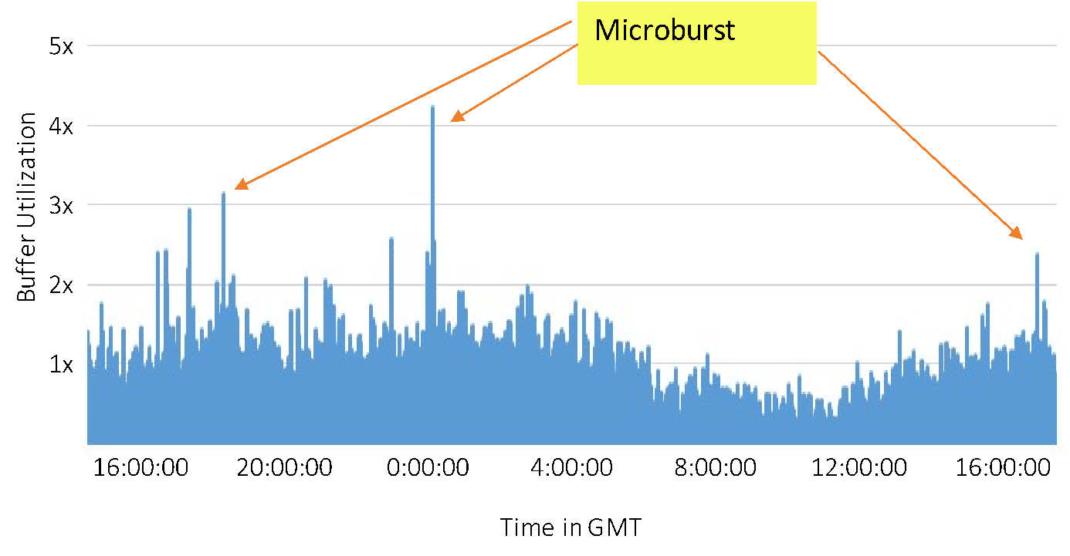
Short-Lived Spikes in Buffer Occupancy

Slide 21
Microbursts are Expensive
Microbursts cause performance degradation
  Packet loss
  Packet delay
But, simultaneously want to have
  Support bursty workloads
  Use low-cost switches (with shallow buffers)
  Maintain high link utilization
Only possible by micromanaging the microbursts!

Slide 22
Detecting Heavy Flows in the Queue
For each flow, how many packets are in the queue?
Data structure challenges
  Per-flow state (key and count)
  Updating on packet arrival and departure
Key | Count
 | 1
 | 5
 | 1
 | 1
 | 2
 | 1

Slide 23
Multiple, Approximate Snapshots of the Queue
Count-Min Sketch [CM ‘05]
Avoiding per-flow state
  Approximate data structure (e.g., Count-Min)
  Packet checks its flow’s status, and acts
Avoiding updates on packet departure
  Packet’s departure time is known at arrival time
  Implicitly handle departures in small batches
+1
B Buckets
+1
+1
f
C columns

Slide 24
Multiple Snapshots Across the Pipeline
length
Snap 3:
write
Snap 2:
Read
Snap 1:
Read
Snap h:
Read

Slide 25
Conclusion
Self-driving networks
  Integrate measure, analyze, and control
  Implement directly in the network devices
Enabled by programmable switches
  Parsing, processing, and state
Approximate data structures
  Good accuracy with limited resources
  Enables a ``control loop” inside the network

