Slide 1
Discovering Your Research Taste
Jennifer Rexford
Princeton University
Notes:
Finding your research taste, that elusive essence that makes you and your research distinctive.

Slide 2
Research is Exciting
We get to pick
  What problems we work on
  How we work on them
  Who we work with
And everything keeps changing
  Fast research progress in the field
  New technology enablers and business drivers
But, how do we decide what to do?

Slide 3
Every researcher is a bit weird
Drawn to different kinds of research problems,
and different ways of solving them
Notes:
Everyone is a bit weird.
Drawn to different kinds of research problems.
And different ways of solving them.

Slide 4
Grad school and postdocs are a great time…
… to discover your weirdness
Notes:
What I love most about the last year of graduate school.
Piecing the parts of the thesis together.
Preparing the job talk.
An opportunity for the student (and me!) to reflect and synthesize.
And realize what they bring to the problem that is uniquely them.

Slide 5
And to hone your weirdness
And resist distractions
Notes:
And ideally there is time to focus on honing that shtick.
Develop skills (deep dive) in a particular direction.
Applying programming languages to networking?
And resist temptation to work in all different directions.

Slide 6
My Journey

Slide 7
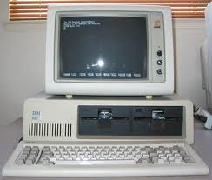
Programming Computers
Programmability enables innovation, and changes who gets to innovate!
But who creates the computer?
High school in Virginia
Programming computers

Slide 8
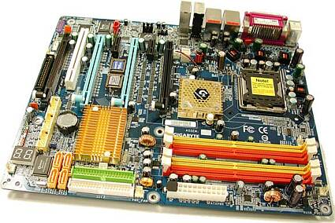
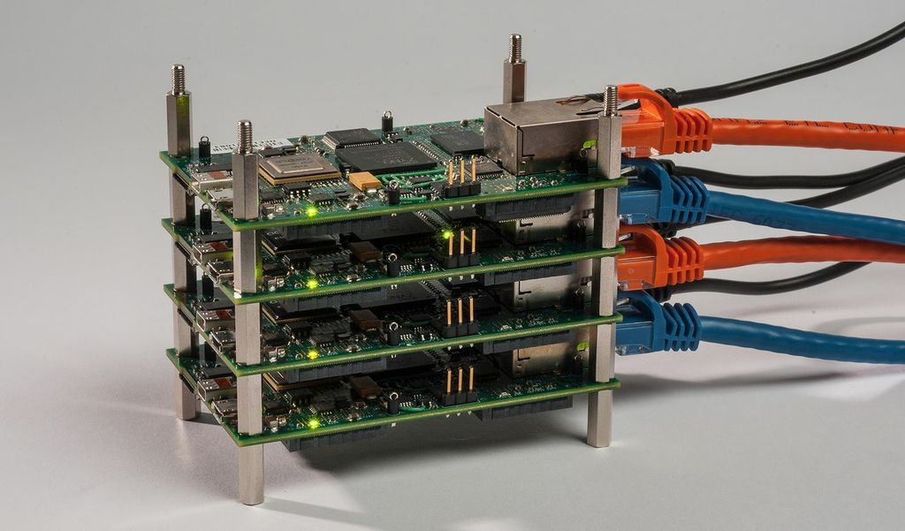
Making Computers Work (Together)
College at Princeton
How computers work
Graduate school at U. Michigan
Multiple computers working together
Notes:
Always interested in configurability/programmability. Instruction sets. Programmable communication inside parallel machines. Building real things.

Slide 9
Toward the End of Grad School
Parallel computing
  Running synthetic applications
  Most commercial efforts were failing
  (Perhaps I should have been more patient!)
Internet was just starting to take off
  Tremendous innovation and excitement
  A global network of interconnected computers
  Opportunities for the real data I so wanted
Notes:
Building real applications that leverage parallelism was harder than people expected.
And individual processors continued getting faster and better, often outstripping the gains from parallelism.

Slide 10


Internet Research
Researcher at AT&T
Making the Internet run better
(giving more control to network operators)
Professor at Princeton
Designing a better Internet
(making the network programmable)
Notes:
At AT&T, got to see real network operators and their struggles. Working the night shift in the operations center. Learning lots of domain details,
And collaborating with world experts in so many fields.

Slide 11
Rethinking Network Management
How to better manage the underlying network?
Management Platform
Network Devices
How to design networks that are easier to manage?

Slide 12
My Research Taste
Making the Internet infrastructure better
  More flexible, performant, reliable, secure, etc.
Empowering the network administrator
  Better abstractions, tools, protocols, and language
Learning and synthesizing domain details
  Protocols, operational practices, measurements, …
Interdisciplinary collaborations
  Programming languages, game theory, optimization theory, streaming algorithms, distributed systems, …
what
how/
who
Notes:
Need a picture. This seems like a laundry list.

Slide 13
Stable Internet Routing Without Global Coordination
+
$$$
= ???
Joint work with Lixin Gao (UMass-Amherst)

Slide 14

What is an Internet?
A “network of networks”
  Networks run by different institutions
Autonomous System (AS)
  Collection of routers run by a single institution
  With a clearly defined routing policy
ASes have different goals
  Different views of which paths are good
Interdomain routing is what reconciles those views
  To compute end-to-end paths through the Internet

Slide 15

Autonomous Systems (ASes)
Path: 6, 5, 4, 3, 2, 1
4
3
5
2
7
6
1
Web server
Client
Around 50,000 ASes today…

Slide 16
Border Gateway Protocol (BGP)
ASes exchange reachability information
  Destination: block of IP addresses
  AS path: sequence of ASes along the path
Policies “programmed” by network operators
  Path selection: which path to use?
  Path export: which neighbors to tell?
“I can reach d via AS 1”
“I can reach d”
1
2
3
data traffic
data traffic
d

Slide 17
Stable Paths Problem (SPP) Model
Routing policy and path selection
  Each AS has a ranking of the permissible paths
  Pick highest-ranked path consistent with neighbors
Flexibility is not free
  Global system may not converge to stable assignment
  Depending on the way the ASes rank their paths
2
2 3 d
2 d
1 2 d
1 d
d
1
3 1 d
3 d
3

Slide 18
Ways to Achieve Global Stability
Detect conflicting rankings of paths?
  Computationally intractable (NP-hard)
  Requires global coordination
Restrict the policy programming languages?
  In what way?
  How to require this globally?
Rely on economic incentives?
  Policies driven by business relationships
  Identify sufficient local conditions for global stability

Slide 19
Bilateral Business Relationships
Provider-Customer
  Customer pays provider for access to the Internet
Peer-Peer
  Peers carry traffic between their respective customers
Valid paths: “6 4 3 d” and “8 5 d”
Invalid paths: “6 5 d” and “1 4 3 d”
Valid paths: “1 2 d” and “7 d”
Invalid path: “5 8 d”
1
2
3
4
d
5
6
Provider-Customer
Peer-Peer
7
8

Slide 20
Act Locally, Prove Globally
Global topology
  Provider-customer relationship graph is acyclic
  Peer-peer relationships between any pairs of ASes
Route export
  Do not export routes learned from a peer or provider
  … to another peer or provider
Route selection
  Prefer routes through customers
  … over routes through peers and providers
Guaranteed to converge to unique, stable solution

Slide 21
Rough Sketch of the Proof
Two phases
  Walking up the customer-provider hierarchy
  Walking down the provider-customer hierarchy
1
2
3
4
d
5
6
Provider-Customer
Peer-Peer
7
8

Slide 22
Tying Back to Research Taste
Making the Internet infrastructure better
  Think of the Internet as a single, stable network
Empowering the network administrator
  Design patterns and reasoning about stability
Learning and synthesizing domain details
  Routing protocol, operational practices, incentives
Interdisciplinary collaboration
  Game theory

Slide 23
Programming Languages for Programmable Networks
Joint with David Walker (Princeton) and Nate Foster (Cornell)
Notes:
Always frustrated at AT&T that networks were so difficult to configure. Thinking at the level of individual devices, and low-level commands, rather than network-wide and higher-level policies. We made configuration tools that tried to bridge the gap, but sometimes the limitations of the underlying protocols and mechanisms got in the way. When I came to Princeton, I became interested in more “clean slate” approaches, though hopefully still with the chance of seeing the light of day.

Slide 24
Networks are Too Hard to Manage
Traditional networks are complex
  Configure individual devices
  … using low-level configuration interfaces
Better tools can help
  Network-wide visibility and analysis
  Automation of low-level configuration
Protocols and mechanisms get in the way
  Limited visibility
  Infeasible policies
  Transient disruptions
Notes:
Better tools: I worked on this a lot at AT&T, and it was useful, but still somewhat limited and often required “unnatural acts” to coax the existing protocols and mechanisms into doing the network operators’ bidding.

Slide 25



Software Defined Networks
control plane: distributed algorithms
data plane: packet processing

Slide 26
Software Defined Networks
decouple control and data planes

Slide 27
Software Defined Networks
decouple control and data planes
by providing open standard API

Slide 28

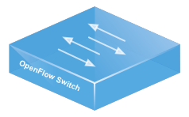
Simple, Open Data-Plane API
Prioritized list of rules
  Pattern: match packet header bits
  Actions: drop, forward, modify, send to controller
  Priority: disambiguate overlapping patterns
  Counters: #bytes and #packets
srcip=1.2.*.*, dstip=3.4.5.* → drop
srcip=*.*.*.*, dstip=3.4.*.* → forward(2)
3. srcip=10.1.2.3, dstip=*.*.*.* → send to controller

Slide 29
(Logically) Centralized Controller
Controller Platform

Slide 30
Protocols ➔ Applications
Controller Application
Controller Platform

Slide 31


Server Load Balancing
Pre-install load-balancing policy
Split traffic based on source IP
10.0.0.1
src=0*,
dst=1.2.3.4
10.0.0.2
src=1*,
dst=1.2.3.4

Slide 32
Example SDN Applications
Seamless mobility and migration
Server load balancing
Dynamic access control
Using multiple wireless access points
Energy-efficient networking
Blocking denial-of-service attacks
Adaptive traffic monitoring
Network virtualization
Steering traffic through middleboxes
<Your app here!>

Slide 33


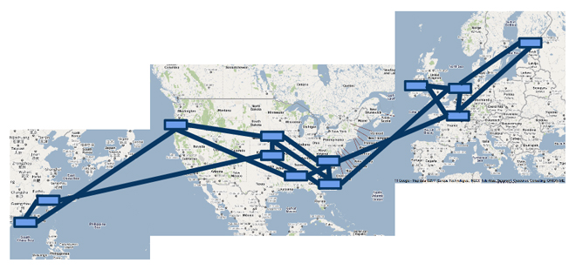

A Major Trend in Networking
Entire backbone
runs on SDN
Bought for $1.2 x 10⁹
(mostly cash)

Slide 34



Programming SDNs
The Good
  Network-wide visibility
  Direct control over the switches
  Simple data-plane abstraction
The Bad
  Low-level programming interface
  Functionality tied to hardware
  Explicit resource control
The Ugly
  Non-modular, non-compositional
  Programmer faced with challenging distributed programming problem
Images by Billy Perkins

Slide 35
Network Control Loop
Compute Policy
Read
state
Write
policy
OpenFlow
Switches

Slide 36
Language-Based Abstractions
Module Composition
SQL-like query language
Consistent updates
OpenFlow
Switches

Slide 37
Combining Many Networking Tasks
Monolithic application
Monitor + Route + FW + LB
Controller Platform
Hard to program, test, debug, reuse, port, …
Notes:
But, real networks perform a wide variety of tasks
Routing, network monitoring, firewalls, server load balancing, etc.

Slide 38
Modules Affect the Same Traffic
Each module partially specifies the handling of the traffic
Monitor
Route
FW
LB
Controller Platform
How to combine modules into a complete application?

Slide 39
Policy as a Function
Input: a located packet
  Packet header fields (e.g., src and dst IP)
  Packet’s location (e.g., switch and port)
Output: a set of located packets
  Empty set: drop (or count)
  Single element at new location: forwarding
  Multiple elements: multicast
Enables reasoning about composition
See recent work on NetKat (boolean algebra plus regular expressions)

Slide 40
Parallel Composition
dstip = 1.2.3.4 → fwd(1)
dstip = 3.4.5.6 → fwd(2)
srcip = 5.6.7.8 → count
Monitor on source
+
Route on destination
Controller Platform
srcip = 5.6.7.8, dstip = 1.2.3.4 → fwd(1), count
srcip = 5.6.7.8, dstip = 3.4.5.6 → fwd(2), count
srcip = 5.6.7.8 → count
dstip = 1.2.3.4 → fwd(1)
dstip = 3.4.5.6 → fwd(2)
Notes:
From ICFP’11 and POPL’12

Slide 41
Sequential Composition
srcip = 0*, dstip=1.2.3.4 → dstip=10.0.0.1
srcip = 1*, dstip=1.2.3.4 → dstip=10.0.0.2
dstip = 10.0.0.1 → fwd(1)
dstip = 10.0.0.2 → fwd(2)
Load Balancer
>>
Routing
Controller Platform
srcip = 0*, dstip = 1.2.3.4 → dstip = 10.0.0.1, fwd(1)
srcip = 1*, dstip = 1.2.3.4 → dstip = 10.0.0.2, fwd(2)
Notes:
Load balancer splits traffic sent to public IP address over multiple replicas, based on client IP address, and rewrites the IP address

Slide 42
Reading State: Query Language
Applications read state
  Traffic counters in switches
  Packets sent to the controller
Minimize controller overhead
  Filter using high-level patterns
  Limit the amount of data
Controller platform
  Installs rules
  Reads counters
  Handles packets
Learning Host Location
Select(packets)
GroupBy([srcmac])
SplitWhen([inport])
Limit(1)
Traffic Monitoring
Select(bytes)
Where(inport:2)
GroupBy([dstmac])
Every(60)

Slide 43


Writing Policies: Consistent Updates
Transition from policy P₁ to P₂
  Security: new access control lists
  Routing: new shortest paths
Transient policy violations
  Packets in flight during the change
  Loops, blackholes, unauthorized traffic
Consistent update semantics
  Packets experience either P₁ or P₂
  … but never a mixture of the two
CHANGE
We Can Believe In

Slide 44
Tying Back to Research Taste
Making the Internet infrastructure better
  More programmable, with an “app” ecosystem
Empowering the network administrator
  Higher-level programming and composition
Learning and synthesizing domain details
  Switch hardware, OpenFlow, important “apps”
Interdisciplinary collaboration
  Programming languages

Slide 45
Stepping Back
Picking the right research problem
  Important topics
  Up your alley
  Let’s you collaborate with great people
Discovering your taste
  Introspecting about what most excites you
  … and what you find lacking in other works
  Creating opportunities to hone your craft
  ... and work with people who help you grow

