Slide 1

Internet Resilience:
Global Network, Global Risks
Jennifer Rexford and Nick Feamster
Computer Science

Slide 2
The Rise of the Stupid Network
Power (and Programmability) at the Edge

Slide 3



Telephone Network
Smart Network
Dumb Terminals

Slide 4



Internet
Dumb Network
Smart Terminals

Slide 5

Best-Effort Packet Delivery Service
Best-effort delivery
  Packets may be lost
  Packets may be corrupted
  Packets may be delivered out of order
source
destination
IP network

Slide 6
Power at the Edge
End-to-End Principle
Whenever possible, communications protocol operations should be defined to occur at the end-points of a communications system.
Programmability
With programmable end hosts, new network services can be added at any time, by anyone.
And then end hosts became powerful and ubiquitous….

Slide 7

End-Host Control: Double-Edged Sword
Democratizes Innovation
Creates Vulnerabilities

Slide 8
Act Locally, Impact Globally
A Network of Networks

Slide 9
50,000+ Separate Networks
4
3
5
2
7
6
1

Slide 10
Cooperation and Competition
4
3
5
2
7
6
1
Web server
Client

Slide 11
Federated Systems
Routing
  Getting from here to there
  Border Gateway Protocol (BGP)
Naming
  Mapping human-readable names to addresses
  Domain Name System (DNS)
Many dependencies on different organizations

Slide 12
The Heart is an Open Door

Slide 13
Open Everything
Open standards
  Easy to join the Internet
Open-source software
  Easy to use and extend building blocks
Trust (but not verify)
  Presumption of honest participation

Slide 14
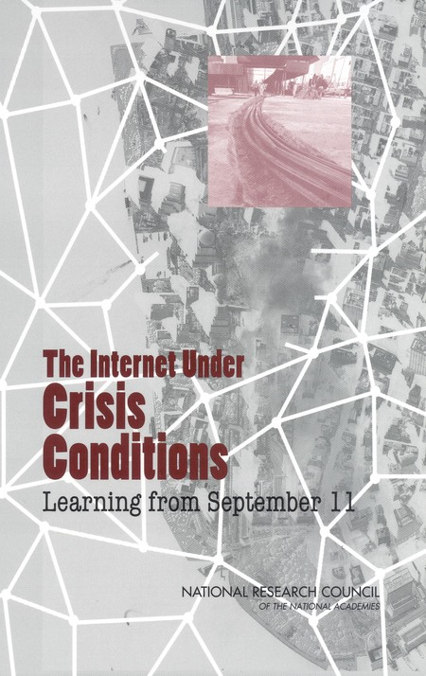
The Internet Under
Crisis Conditions
Learning from September 11

Slide 15
Anecdotes from 9/11
Increase in demand
  2500% growth in demand for CNN site
  1300% growth in cell phone demand
  Getting out the “I’m okay” word
Scaling the CNN web site
  A web page in a packet
  Repurposing other Turner servers
  Enlisting content distribution services
Better than average routing stability!

Slide 16
Anecdotes from 9/11
Hidden dependencies
  DNS server for South Africa
  Authentication server for Florida ISP
Poor disaster planning
  Correlated failures in co-location sites
  Network operators relying on 1-800 numbers
  Holland Tunnel access for fuel for generators

Slide 17
But the Internet Wasn’t Under Attack That Day…

