Slide 1

States on a (Data) Plane
Jennifer Rexford

Slide 2
Traditional data planes are stateless

Slide 3



Software Defined Networks (SDN)
  Program your network from
  a logically central point!
Notes:
SDN is a new network architecture that allows networks to be programmed from a logically central point called a controller. The operator writes a program on top of the controller to decide, given the global view of the network, what the network behavior should be and how packets should be forwarded. The controller then communicates to each individual switch how it should forward packets to realize the desired behavior specified by the program.

Slide 4
OpenFlow Rule Tables
Prio
match
action
1
dstip = 10.0.0.1
outport ← 1
2
dstip = 10.0.0.2
drop
…
…
…

Slide 5
Two-Tiered Programming Model
Stateless data-plane rules
  Process each packet independently
  State updates are limited to traffic counters
Stateful control-plane program
  Store and update state in the controller application
  Adapt by installing new rules in the switches
Forces packets to go to the controller…
or greatly limits the set of applications

Slide 6
Emerging switches have stateful data planes

Slide 7

Local State on Data Plane
Key
Value
H2
5
H1
99
…
…
Notes:
Local state can be a set of register, an array that can be indexed.
For the sake of example, we show state here as a key-value store, where the key can come from packet header fields.

Slide 8
Local State on Data Plane
Key
Value
H2
5
H1
100
…
…
Notes:
The packet comes in and can affect the local state in certain ways

Slide 9
Local State on Data Plane
Key
Value
match
action
H2
5
value = 100
drop
H1
100
…
…
…
…
Notes:
The local state can affect how packet is processed in certain ways

Slide 10
Local State on Data Plane
Programmatic control over local state
  P4, POF, OpenState, Open vSwitch
Plus other important features
  Programmable packet parsing
  Simple arithmetic and boolean operations
  Traffic statistics (delays, queue lengths, etc.)
Simple stateful network functions can be offloaded to the data plane!
Notes:
Local state has been there, in a limited and customized way though.
Proposals for switch interfaces that expose programatic control over this local state, basically, the controller can define how state affects packet and how packet affects state
Subsume a variety of functionality that normally relegated to middleboxes
too low-level for the operator of a big network
Imagine a network operator that has to think about all these small pieces of local state on the switches across the network and use them to implement a stateful network function efficiently.
difficult to manage stateful distributed systems correctly and efficiently

Slide 11
Hop-by-Hop Utilization-aware Load-balancing Architecture
HULA
Naga Katta, Mukesh Hira, Changhoon Kim,
Anirudh Sivaraman, and Jennifer Rexford
http://conferences.sigcomm.org/sosr/2016/papers/sosr_paper67.pdf

Slide 12
HULA Multipath Load Balancing
S2
ToR 10
ToR 1
Data
S1
S3
S4
Load balancing entirely in the data plane
  Collect real-time, path-level performance statistics
  Group packets into “flowlets” based on time & headers
  Direct each new flowlet over the current best path

Slide 13
Path Performance Statistics
Best-hop table
Best Next-Hop | Path Utilization
S3 | 50%
S4 | 10%
… | …
Dest ToR
0
1
Probe
…
Probe
S1
S3
Data
Data
S4
Using the best-hop table
  Update the best next-hop upon new probes
  Assign a new flowlet to the best next-hop

Slide 14
Flowlet Routing
Flowlet table
Dest ToR | Timestamp | Next-Hop
ToR 10 | 1 | S2
ToR 0 | 17 | S4
… | … | …
0
h(flowid)
1
…
S1
S3
Data
Data
S4
Using the flowlet table
  Update the next hop if enough time has elapsed
  Update the timestamp to the current time
Forward the packet to the chosen next hop

Slide 15
Putting it all Together
data
packet
Best Next-Hop | Path Utilization
S3 | 50%
S4 | 10%
… | …
Dest ToR
0
1
…
current best next-hop S3
Dest ToR | Timestamp | Next-Hop
ToR 10 | 1 | S2
ToR 0 | 17 | S4
… | … | …
0
Update next-hop (if enough time elapsed) and time
h(flowid)
1
…
chosen next-hop

Slide 16
Plenty of Other Applications
Stateful firewall
DNS tunnel detection
SYN flood detection
Elephant flow detection
DNS amplification attack detection
Sidejack detection
Heavy-hitter detection
…

Slide 17
But, how to best write these stateful apps?

Slide 18
SNAP: Stateful Network-Wide Abstractions for Packet Processing
Mina Tahmasbi Arashloo, Yaron Koral, Michael Greenberg, Jennifer Rexford, and David Walker
http://www.cs.princeton.edu/~jrex/papers/snap16.pdf

Slide 19
Writing Stateful Network Apps is Hard
Low-level switch interface
  Multiple stages of match-action processing
  Registers/arrays for maintaining state
Multiple switches
  Placing the state
  Routing traffic through the state
Multiple applications
  Combining forwarding, monitoring, etc.

Slide 20




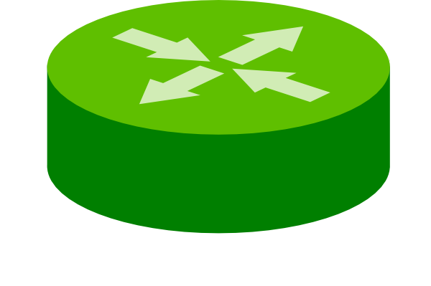

Snap Language
+
;
Hardware independent
One Big Stateful Switch (OBSS)
Composition
OBSS
Notes:
General abstraction of state, not dependent on how the underlying hardware implements it

Slide 21

Stateless Packet Processing
A function that specifies
  How to process each packet on a one-big-switch
  Based on its fields
E.g., NetKat
input packet
set of packets
Function

Slide 22


Stateful Packet Processing
A function that specifies
  How to process each packet on a one-big-switch
  Based on its fields and the program state
  Where state is an array indexed by header fields
input packet
set of packets
SNAP
current state
Program
updated state

Slide 23
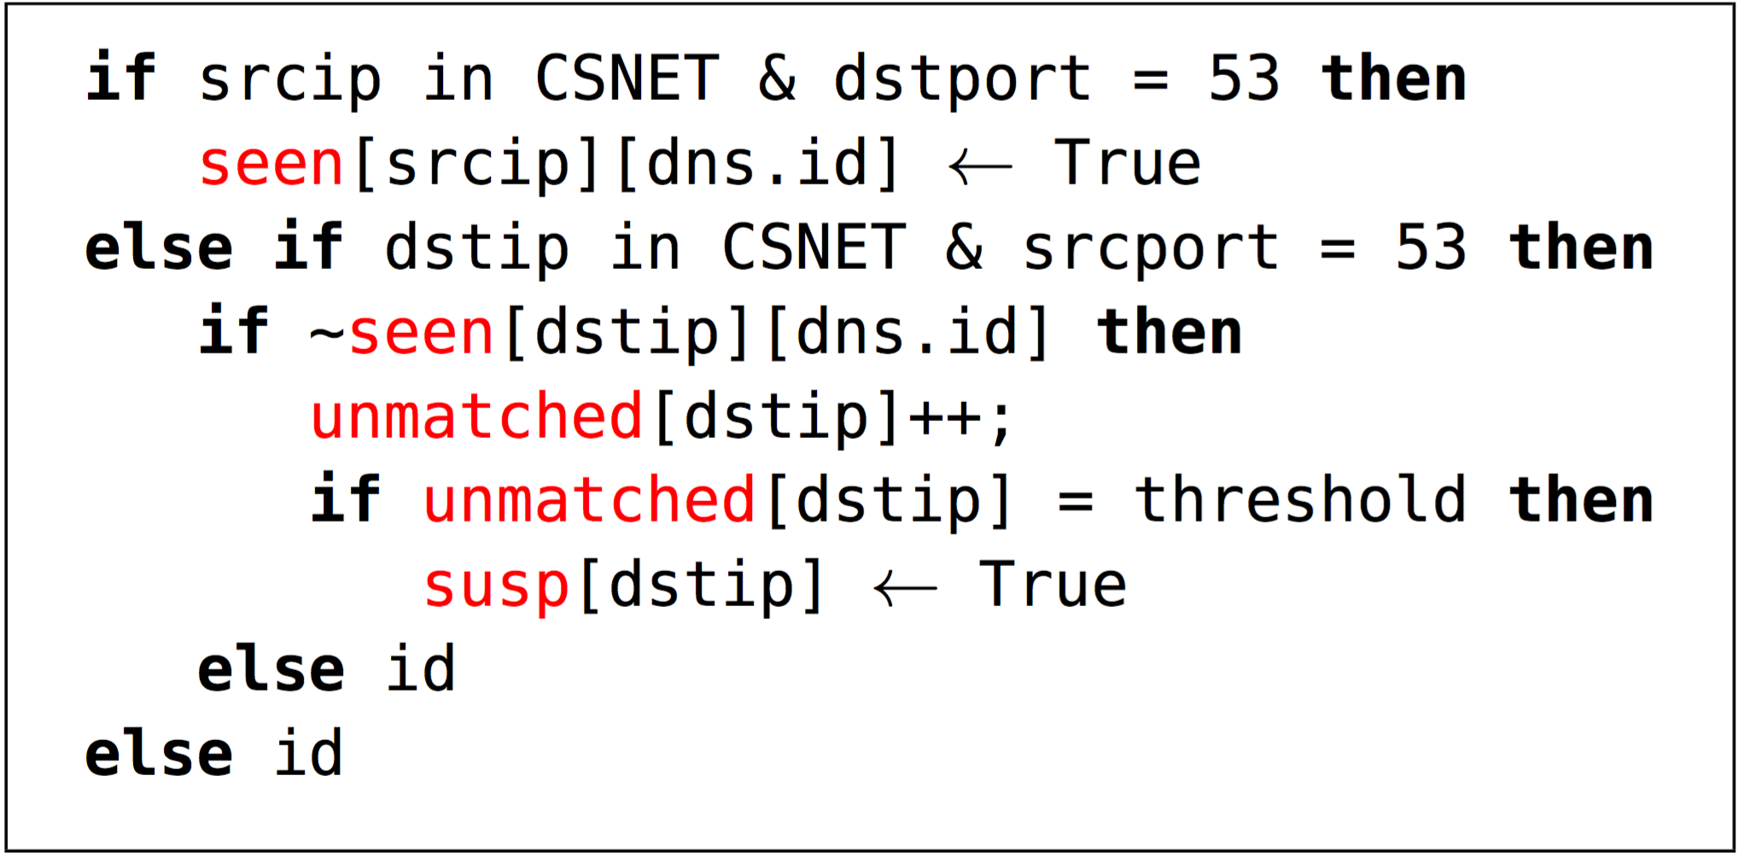
Example Snap App: DNS Reflection
Seen: Keep track of DNS requests by client and DNS identifier
Unmatched: Count DNS responses that don’t match prior requests
Susp: Suspected victims receive many unmatched responses

Slide 24
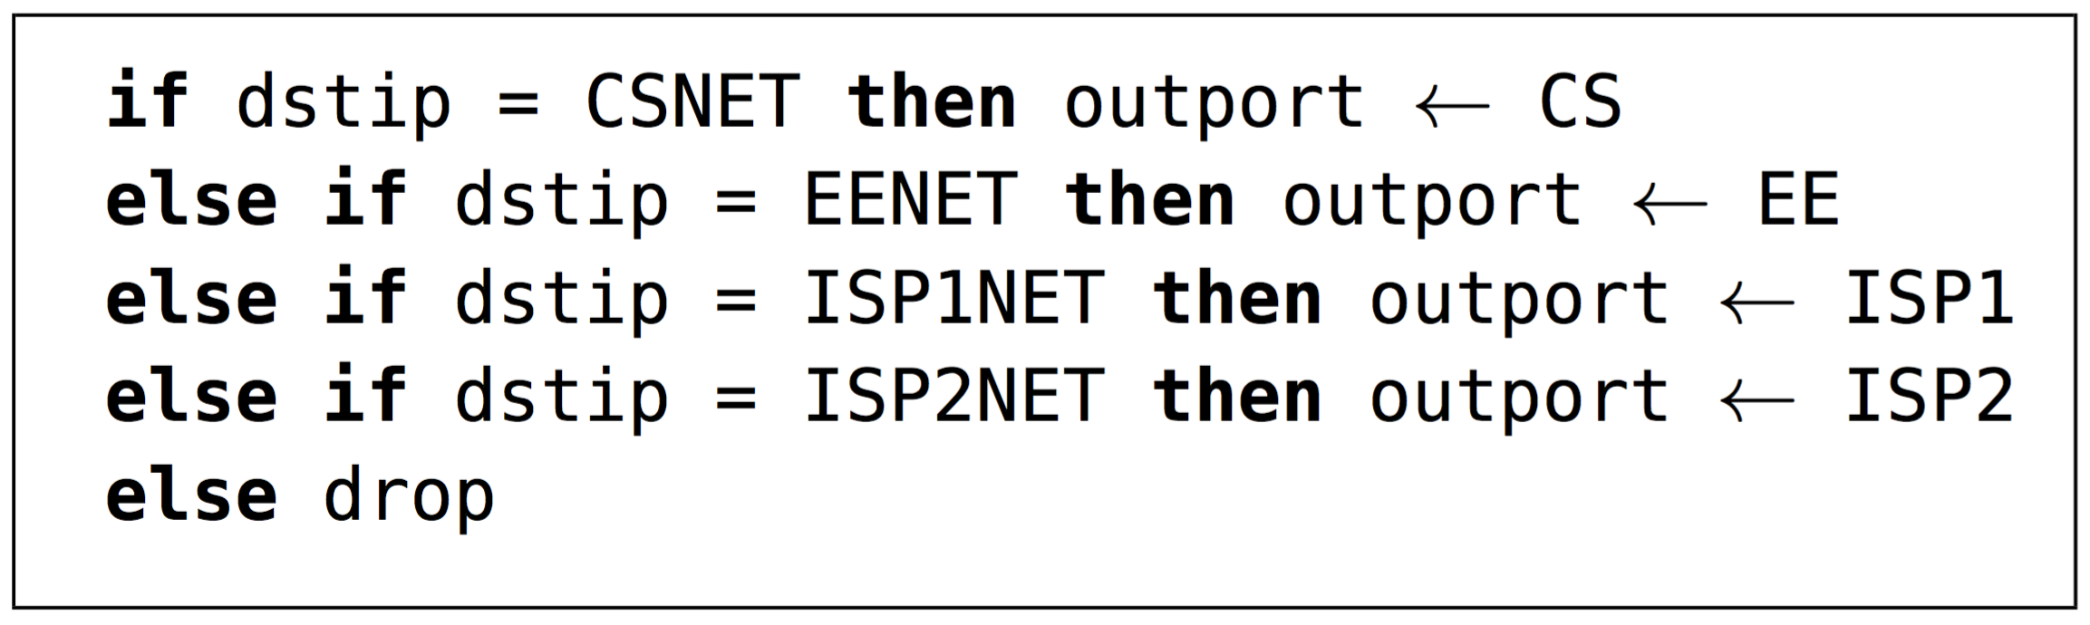
Example Snap App: Stateless Forwarding
ISP1
CS
ISP2
EE

Slide 25
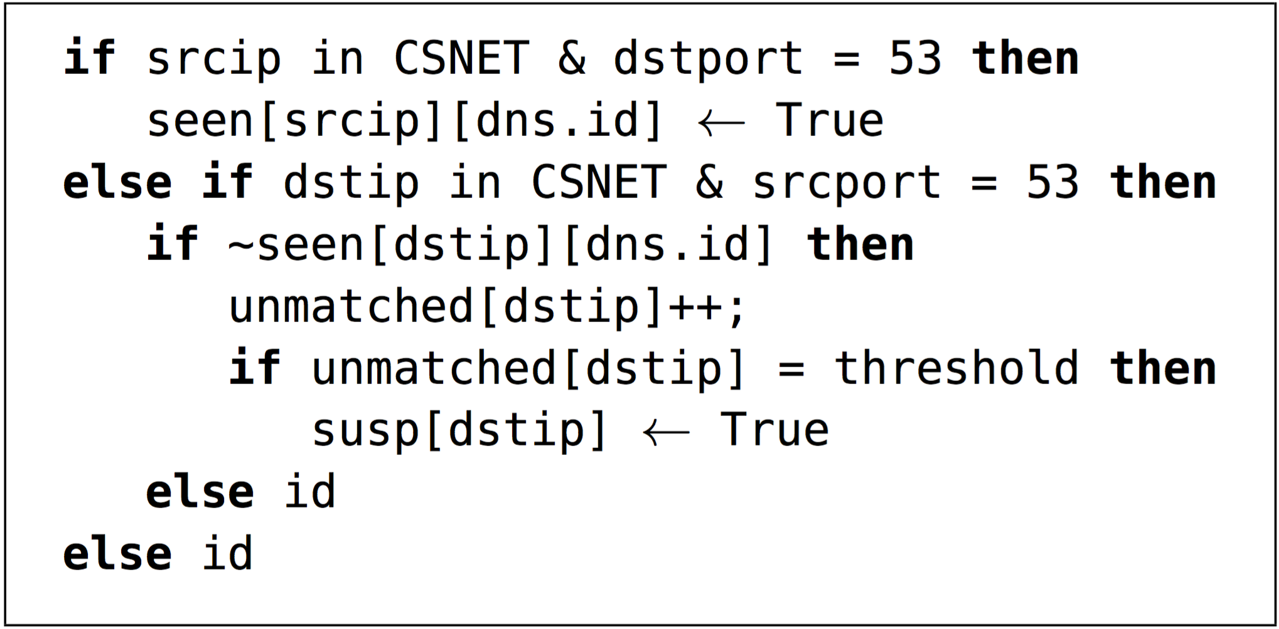
Composition
;

Slide 26
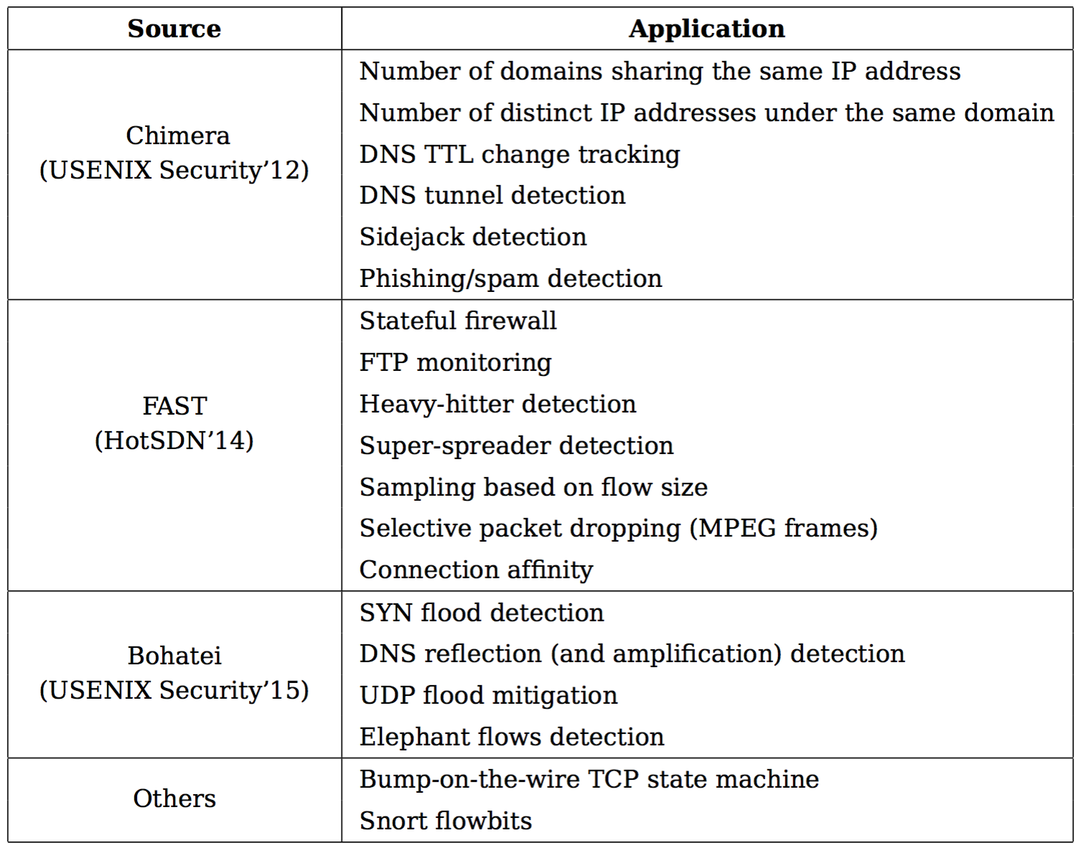
Snap Applications

Slide 27
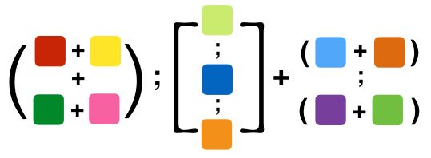
Snap Compiler
Composition of multiple apps
Snap Compiler
State placement and routing

Slide 28
Snap Compiler
Identify State Dependencies
Translate to Intermediate Representation (xFDD)
Identify mapping from packets to state variables
Optimally distribute the xFDD
Generate rules per switch

Slide 29
Intermediate Representation: xFDDs
Canonical representation of a program
Composable
Easily partitioned
Simplify program analysis

Slide 30
Extended Forwarding Decision Diagrams (xFDDs)
Intermediate node: test on header fields and state
Leaf: set of action sequences
Three kinds of tests
  field = value
  field1 = field2
  state_var[e1] = e2
dstip = 10.0.0.1
srcip = dstip
s[srcip] = 2
{s[dstip] ← 2}
{drop}
Notes:
Specifies how incoming packets should be process just the same way as a snap program does.

Slide 31
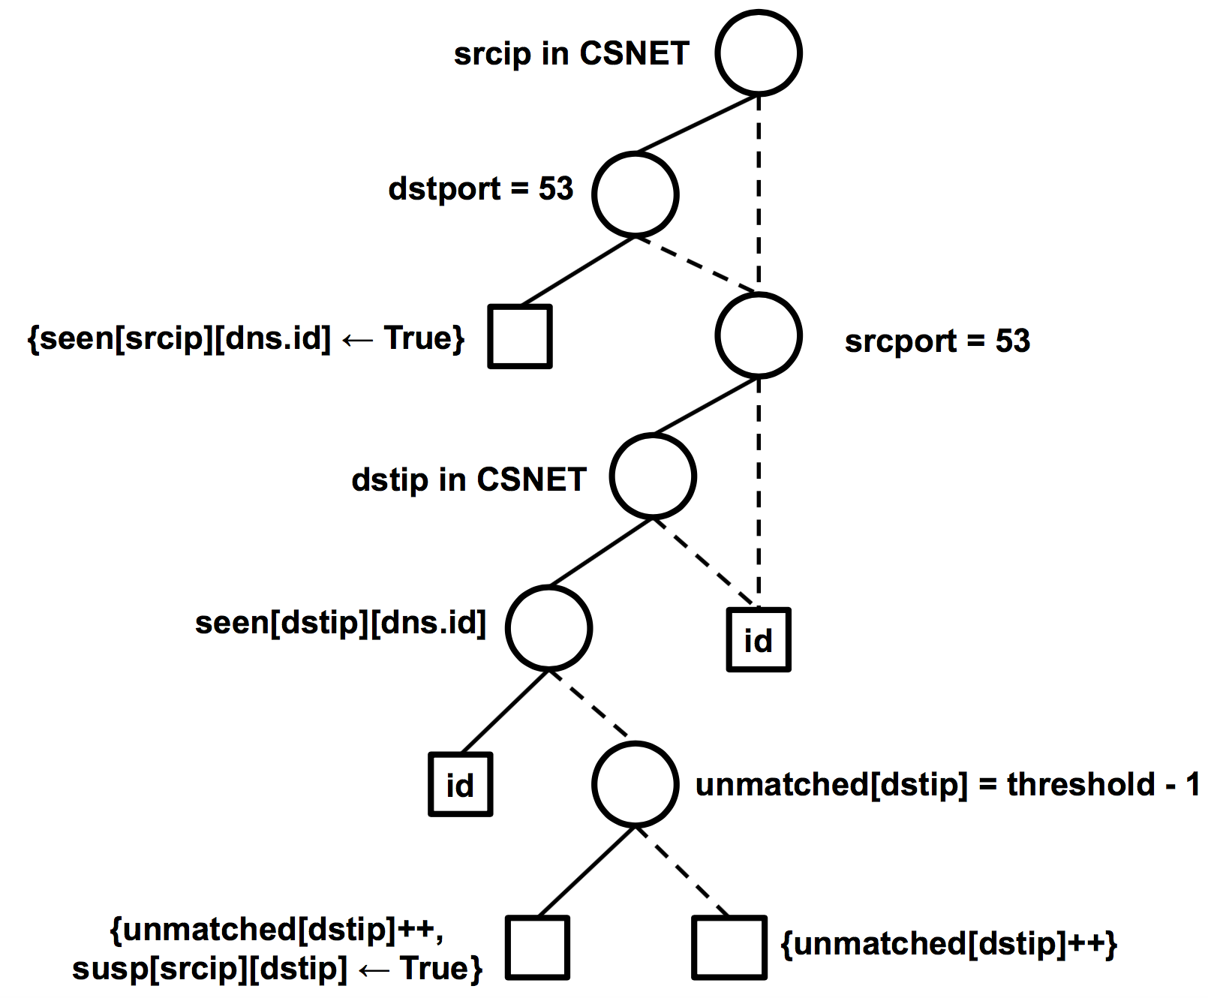
xFDD for DNS Reflection Detection

Slide 32
Optimally Distribute the xFDD
Dependency
Graph
MILP
Packet-State
Mapping
Output
State placement
Routing
Traffic
Matrix
CS

Slide 33
See SIGCOMM’16 paper for prototype, experiments, etc.
http://www.cs.princeton.edu/~jrex/papers/snap16.pdf

Slide 34
More Fun With State
Extending Snap
  More operations, e.g., field ← state[index]
  Sharding and replication of state
  Faster compilation
Richer computational model
  Limits on computation per packet
  Different memory (array, hash table, key-value store)
  Hash collisions, delays in adding new keys, etc.
More stateful applications!

Slide 35
Conclusion
Emerging switches have stateful data planes
  Can run simple network functions
  … within and across switches!
Standard interfaces
  E.g., P4 (p4.org)
Raises many new algorithmic challenges
  New computational model
  Compact data structures (e.g., sketches)
  Working within hardware limitations

