Slide 1
Creating Technology to Change the World
Jennifer Rexford
Chair of Computer Science
Princeton University

Slide 2
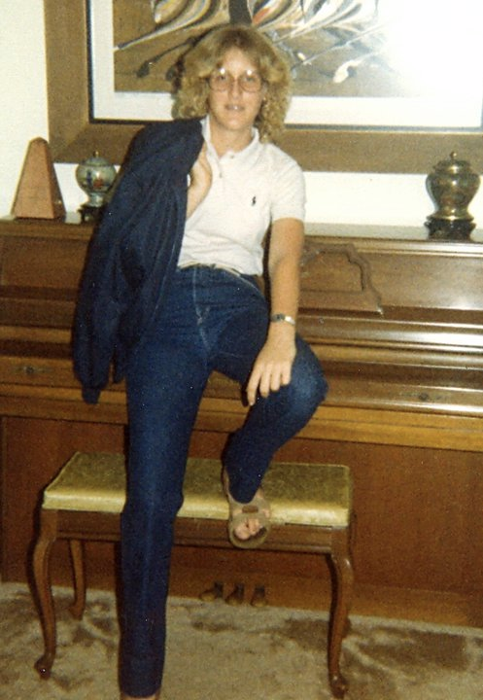

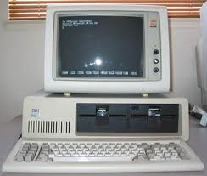
Flash Back to 1984
Notes:
Programming enables innovation… Then I wondered who gets to pick what the computer can do…

Slide 3
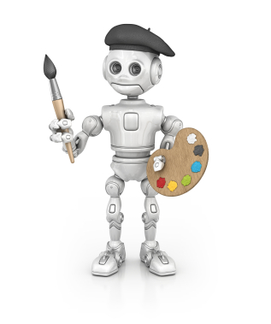
Computers let you create new things!
But who creates the computer?

Slide 4
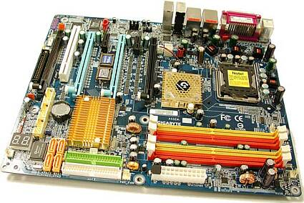
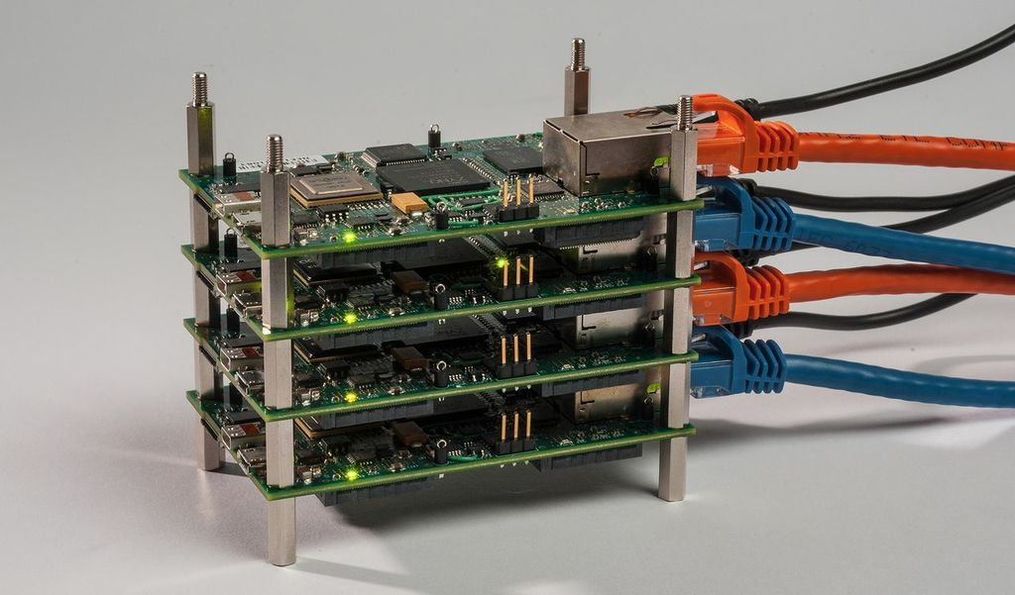
Studying Engineering
College at Princeton
How computers work
Graduate school at U. Michigan
Multiple computers working together

Slide 5


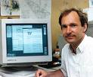
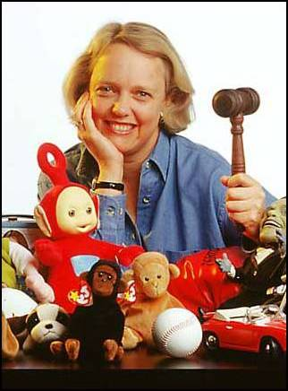
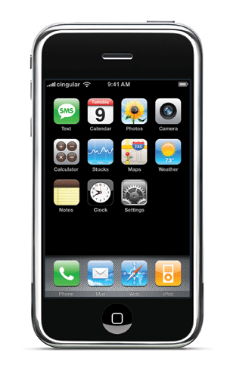
Internet Enables Creativity
Tim Berners-Lee
CERN Researcher
World Wide Web
Shawn Fanning
Northeastern freshman
Napster
iPhone
apps
Meg Whitman
E-Bay

Slide 6


Internet Research
Researcher at AT&T
Making the Internet run better
Professor at Princeton
Designing a better Internet

Slide 7
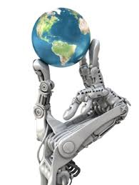
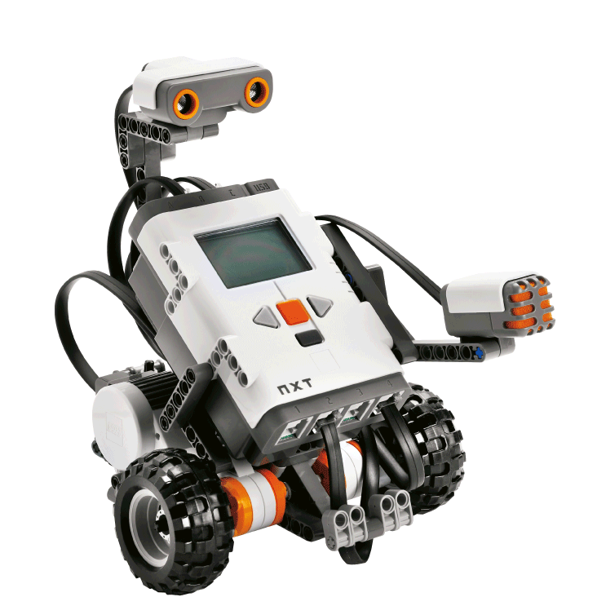
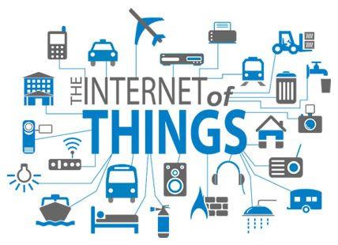
What’s Next?
Connecting networks of computers to the real world!
That’s where you come in!

Slide 8
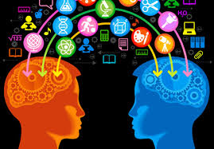

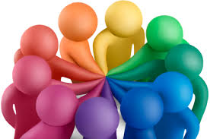
What I Love About My Job
Learn new stuff all the time
Work on cool technical problems
Work with fun, smart people

Slide 9


What I Love About My Job
Have real impact on the world today
Hopefully have bigger impact in the future

Slide 10
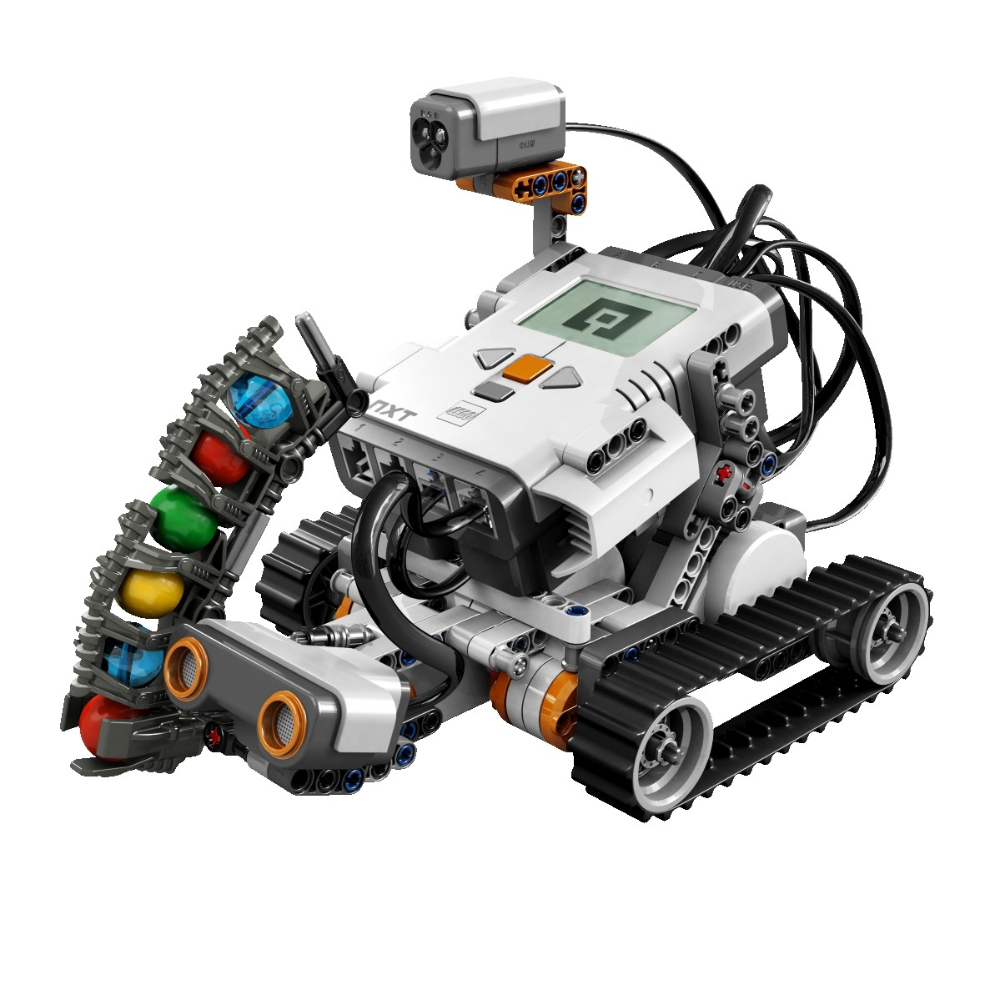


Have Fun!
Your generation
  Decide how computers affect the real world
Bringing together
  Technology
  Creativity
  Teamwork
  Taking risk
Have fun!

