Slide 1
Software-Defined Networks
Jennifer Rexford
Princeton University
http://frenetic-lang.org
Joint work with the research groups of David Walker (Princeton), Nate Foster (Cornell), and Arjun Guha (Umass)

Slide 2
The Internet Enables Innovation
… in end-host applications

Slide 3
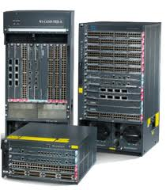
Inside the ‘Net: A Different Story…
Closed equipment
Software bundled with hardware
Vendor-specific interfaces
Over specified
Slow protocol standardization
Few people can innovate
Equipment vendors write the code
Long delays to introduce new features

Slide 4
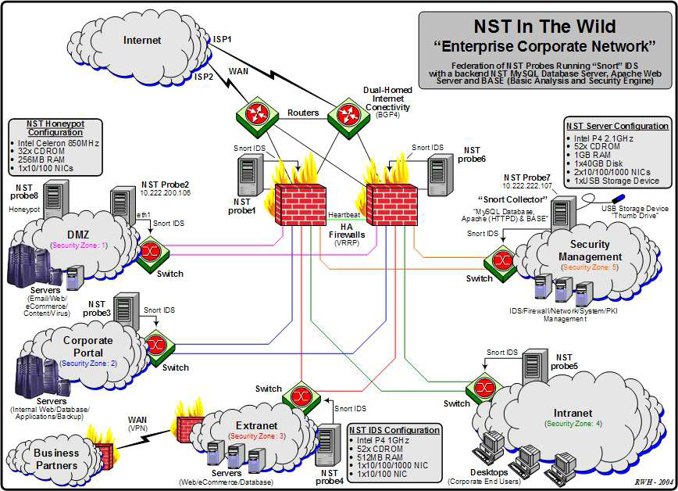
Do We Need Innovation Inside?
Many boxes (routers, switches, firewalls, …), with different interfaces.
Notes:
Enterprise network.

Slide 5
Software Defined Networks
control plane: distributed algorithms
data plane: packet processing

Slide 6
Software Defined Networks
decouple control and data planes

Slide 7
Software Defined Networks
decouple control and data planes by providing open standard API

Slide 8
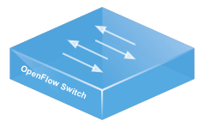
Simple, Open Data-Plane API
Prioritized list of rules
Pattern: match packet header bits
Actions: drop, forward, modify, send to controller
Priority: disambiguate overlapping patterns
Counters: #bytes and #packets
src=1.2.*.*, dest=3.4.5.* → drop
src = *.*.*.*, dest=3.4.*.* → forward(2)
3. src=10.1.2.3, dest=*.*.*.* → send to controller

Slide 9
(Logically) Centralized Controller
Controller Platform

Slide 10
Protocols ➔ Applications
Controller Application
Controller Platform

Slide 11
Example SDN Applications
Seamless mobility and migration
Server load balancing
Dynamic access control
Using multiple wireless access points
Energy-efficient networking
Blocking denial-of-service attacks
Adaptive traffic monitoring
Network virtualization
Steering traffic through middleboxes
<Your app here!>

Slide 12
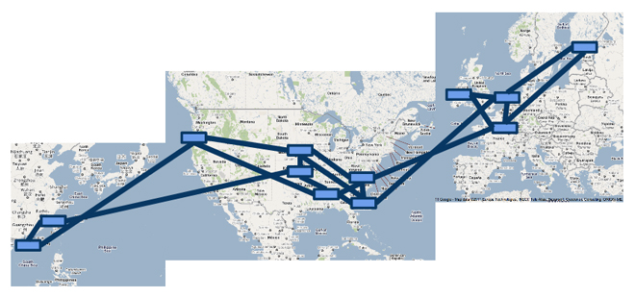
A Major Trend in Networking
Entire backbone
runs on SDN
Bought for $1.2 x 10⁹
(mostly cash)

Slide 13
SDN makes it possible to program the network…
… but it does not make it easy

Slide 14
Network Control Loop
Compute Policy
Read
state
Write
policy
OpenFlow
Switches

Slide 15
Language-Based Abstractions
Module Composition
SQL-like query language
Consistent updates
OpenFlow
Switches

Slide 16
Combining Many Networking Tasks
Monolithic application
Monitor + Route + FW + LB
Controller Platform
Hard to program, test, debug, reuse, port, …
Notes:
But, real networks perform a wide variety of tasks
Routing, network monitoring, firewalls, server load balancing, etc.

Slide 17
Modular Controller Applications
A module for each task
Monitor
Route
FW
LB
Controller Platform

Slide 18
Parallel Composition
dstip = 1.2.3.4 → fwd(1)
dstip = 3.4.5.6 → fwd(2)
srcip = 5.6.7.8 → count
Monitor on source
+
Route on destination
Controller Platform
srcip = 5.6.7.8, dstip = 1.2.3.4 → fwd(1), count
srcip = 5.6.7.8, dstip = 3.4.5.6 → fwd(2), count
srcip = 5.6.7.8 → count
dstip = 1.2.3.4 → fwd(1)
dstip = 3.4.5.6 → fwd(2)
Notes:
From ICFP’11 and POPL’12

Slide 19
Sequential Composition
srcip = 0*, dstip=1.2.3.4 → dstip=10.0.0.1
srcip = 1*, dstip=1.2.3.4 → dstip=10.0.0.2
dstip = 10.0.0.1 → fwd(1)
dstip = 10.0.0.2 → fwd(2)
Load Balancer
>>
Routing
Controller Platform
srcip = 0*, dstip = 1.2.3.4 → dstip = 10.0.0.1, fwd(1)
srcip = 1*, dstip = 1.2.3.4 → dstip = 10.0.0.2, fwd(2)
Notes:
Load balancer splits traffic sent to public IP address over multiple replicas, based on client IP address, and rewrites the IP address

Slide 20
Abstract Topology: Load Balancer
Present an abstract topology
Information hiding: limit what a module sees
Protection: limit what a module does
Abstraction: present a familiar interface
Abstract view
Real network
20

Slide 21
Reading State: Query Language
Applications read state
Traffic counters in switches
Packets sent to the controller
Minimize controller overhead
Filter using high-level patterns
Limit the amount of data
Controller platform
Installs rules
Reads counters
Handles packets
Learning Host Location
Select(packets)
GroupBy([srcmac])
SplitWhen([inport])
Limit(1)
Traffic Monitoring
Select(bytes)
Where(inport:2)
GroupBy([dstmac])
Every(60)

Slide 22
Writing Policies: Consistent Updates
Transition from policy P₁ to P₂
Security: new access control lists
Routing: new shortest paths
Transient policy violations
Packets in flight during the change
Loops, blackholes, unauthorized traffic
Consistent update semantics
Packets experience either P₁ or P₂
… but never a mixture of the two
CHANGE
We Can Believe In

Slide 23
Conclusion
SDN is exciting
Enables innovation
Simplifies management
Rethinks networking
SDN is happening
Practice: industry traction, cool apps
Principles: higher-level abstractions
Great opportunity
Practical impact
Strong foundations

