Slide 1
Programming Abstractions for Software-Defined Networks
Jennifer Rexford
Princeton University
http://frenetic-lang.org

Slide 2

The Internet: A Remarkable Story
Tremendous success
  From research experiment
  to global infrastructure
Brilliance of under-specifying
  Network: best-effort packet delivery
  Hosts: arbitrary applications
Enables innovation
  Apps: Web, P2P, VoIP, social networks, …
  Links: Ethernet, fiber optics, WiFi, cellular, …

Slide 3
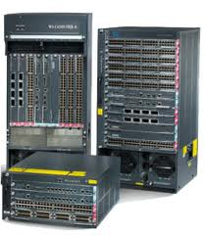
Inside the ‘Net: A Different Story…
Closed equipment
  Software bundled with hardware
  Vendor-specific interfaces
Over specified
  Slow protocol standardization
Few people can innovate
  Equipment vendors write the code
  Long delays to introduce new features

Slide 4
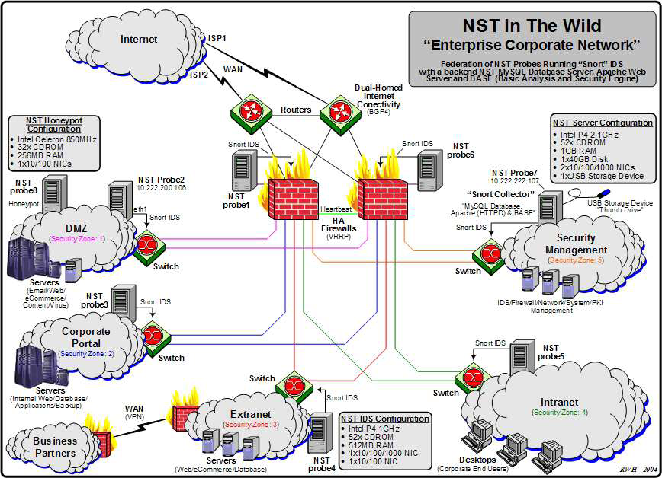
Do We Need Innovation Inside?
Many boxes (routers, switches, firewalls, …), with different interfaces.
Notes:
Enterprise network.

Slide 5



Software Defined Networks
control plane: distributed algorithms
data plane: packet processing

Slide 6
Software Defined Networks
decouple control and data planes

Slide 7
Software Defined Networks
decouple control and data planes
by providing open standard API

Slide 8

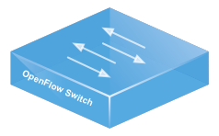
Simple, Open Data-Plane API
Prioritized list of rules
  Pattern: match packet header bits
  Actions: drop, forward, modify, send to controller
  Priority: disambiguate overlapping patterns
  Counters: #bytes and #packets
src=1.2.*.*, dest=3.4.5.* → drop
src = *.*.*.*, dest=3.4.*.* → forward(2)
3. src=10.1.2.3, dest=*.*.*.* → send to controller

Slide 9
(Logically) Centralized Controller
Controller Platform

Slide 10
Protocols ➔ Applications
Controller Application
Controller Platform

Slide 11
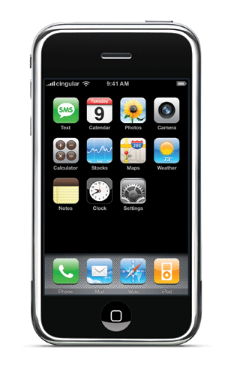

Seamless Mobility
See host sending traffic at new location
Modify rules to reroute the traffic

Slide 12
Server Load Balancing
Pre-install load-balancing policy
Split traffic based on source IP
10.0.0.1
src=0*,
dst=1.2.3.4
10.0.0.2
src=1*,
dst=1.2.3.4

Slide 13
Example SDN Applications
Seamless mobility and migration
Server load balancing
Dynamic access control
Using multiple wireless access points
Energy-efficient networking
Blocking denial-of-service attacks
Adaptive traffic monitoring
Network virtualization
Steering traffic through middleboxes
<Your app here!>

Slide 14


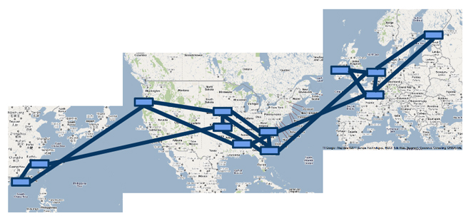

A Major Trend in Networking
Entire backbone
runs on SDN
Bought for $1.2 x 10⁹
(mostly cash)

Slide 15
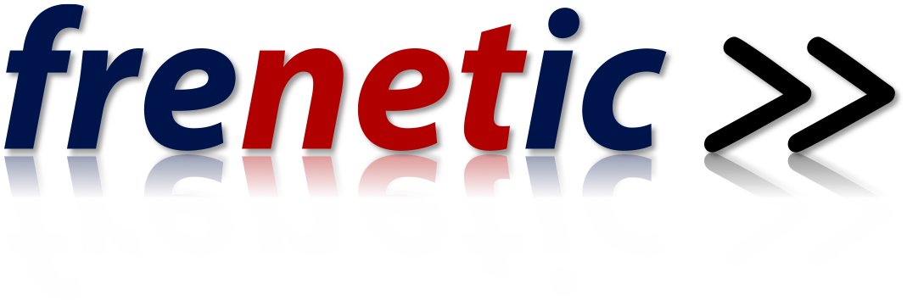
Programming SDNs
http://frenetic-lang.org
Joint work with the research groups of Nate Foster (Cornell), Arjun Guha (UMass-Amherst), and David Walker (Princeton)

Slide 16



Programming SDNs
The Good
  Network-wide visibility
  Direct control over the switches
  Simple data-plane abstraction
The Bad
  Low-level programming interface
  Functionality tied to hardware
  Explicit resource control
The Ugly
  Non-modular, non-compositional
  Programmer faced with challenging distributed programming problem
Images by Billy Perkins

Slide 17
Network Control Loop
Compute Policy
Read
state
Write
policy
OpenFlow
Switches

Slide 18
Language-Based Abstractions
Module Composition
SQL-like query language
Consistent updates
OpenFlow
Switches

Slide 19
Computing Policy
Parallel and Sequential Composition
Topology Abstraction
[POPL’12, NSDI’13]

Slide 20
Combining Many Networking Tasks
Monolithic application
Monitor + Route + FW + LB
Controller Platform
Hard to program, test, debug, reuse, port, …
Notes:
But, real networks perform a wide variety of tasks
Routing, network monitoring, firewalls, server load balancing, etc.

Slide 21
Modular Controller Applications
A module for each task
Monitor
Route
FW
LB
Controller Platform
Easier to program, test, and debug
Greater reusability and portability

Slide 22
Beyond Multi-Tenancy
Each module controls a different portion of the traffic
...
Slice 1
Slice 2
Slice n
Controller Platform
Relatively easy to partition rule space, link
bandwidth, and network events across modules
Notes:
Simple case: multi-tenancy
Each module controls a different subset of the traffic
Relatively easy to partition traffic, rule space, and bandwidth resources
We want to write a single application out of modules that affect the handling of same traffic

Slide 23
Modules Affect the Same Traffic
Each module partially specifies the handling of the traffic
Monitor
Route
FW
LB
Controller Platform
How to combine modules into a complete application?

Slide 24
Parallel Composition
dstip = 1.2.3.4 → fwd(1)
dstip = 3.4.5.6 → fwd(2)
srcip = 5.6.7.8 → count
Monitor on source
+
Route on destination
Controller Platform
srcip = 5.6.7.8, dstip = 1.2.3.4 → fwd(1), count
srcip = 5.6.7.8, dstip = 3.4.5.6 → fwd(2), count
srcip = 5.6.7.8 → count
dstip = 1.2.3.4 → fwd(1)
dstip = 3.4.5.6 → fwd(2)
Notes:
From ICFP’11 and POPL’12

Slide 25
Sequential Composition
srcip = 0*, dstip=1.2.3.4 → dstip=10.0.0.1
srcip = 1*, dstip=1.2.3.4 → dstip=10.0.0.2
dstip = 10.0.0.1 → fwd(1)
dstip = 10.0.0.2 → fwd(2)
Load Balancer
>>
Routing
Controller Platform
srcip = 0*, dstip = 1.2.3.4 → dstip = 10.0.0.1, fwd(1)
srcip = 1*, dstip = 1.2.3.4 → dstip = 10.0.0.2, fwd(2)
Notes:
Load balancer splits traffic sent to public IP address over multiple replicas, based on client IP address, and rewrites the IP address

Slide 26
Dividing the Traffic Over Modules
Predicates
  Specify which traffic traverses which modules
  Based on input port and packet-header fields
Web traffic
dstport = 80
Load Balancer
>>
Routing
Non-web
dstport != 80
Monitor
+
Routing

Slide 27

Abstract Topology: Load Balancer
Present an abstract topology
  Information hiding: limit what a module sees
  Protection: limit what a module does
  Abstraction: present a familiar interface
Abstract view
Real network
27

Slide 28
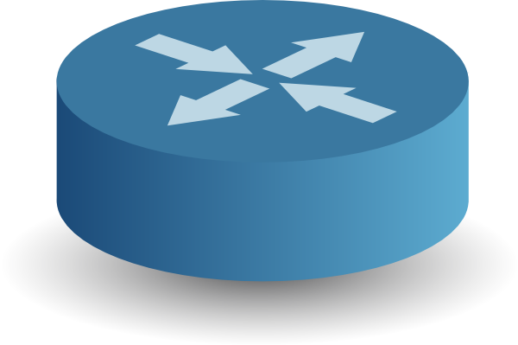
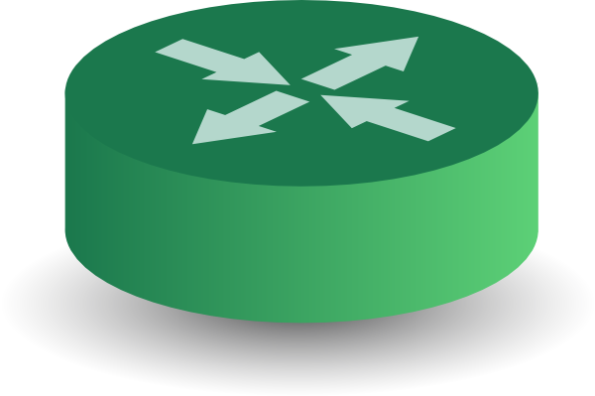
Abstract Topology: Gateway
Ethernet
Gateway
IP Core
Ethernet
IP Core
Left: learning switch on MAC addresses
Middle: ARP on gateway, plus simple repeater
Right: shortest-path forwarding on IP prefixes

Slide 29
High-Level Architecture
M1
M2
M3
Main
Program
Controller Platform

Slide 30
Reading State
SQL-Like Query Language
[ICFP’11]

Slide 31
From Rules to Predicates
Traffic counters
  Each rule counts bytes and packets
  Controller can poll the counters
Multiple rules
  E.g., Web server traffic except for source 1.2.3.4
Solution: predicates
  E.g., (srcip != 1.2.3.4) && (srcport == 80)
  Run-time system translates into switch patterns
1. srcip = 1.2.3.4, srcport = 80
2. srcport = 80

Slide 32
Dynamic Unfolding of Rules
Limited number of rules
  Switches have limited space for rules
  Cannot install all possible patterns
Must add new rules as traffic arrives
  E.g., histogram of traffic by IP address
  … packet arrives from source 5.6.7.8
Solution: dynamic unfolding
  Programmer specifies GroupBy(srcip)
  Run-time system dynamically adds rules
1. srcip = 1.2.3.4
2. srcip = 5.6.7.8
1. srcip = 1.2.3.4

Slide 33
Suppressing Unwanted Events
Common programming idiom
  First packet goes to the controller
  Controller application installs rules
packets

Slide 34
Suppressing Unwanted Events
More packets arrive before rules installed?
  Multiple packets reach the controller
packets

Slide 35
Suppressing Unwanted Events
Solution: suppress extra events
  Programmer specifies “Limit(1)”
  Run-time system hides the extra events
not seen by
application
packets

Slide 36
SQL-Like Query Language
Get what you ask for
  Nothing more, nothing less
SQL-like query language
  Familiar abstraction
  Returns a stream
  Intuitive cost model
Minimize controller overhead
  Filter using high-level patterns
  Limit the # of values returned
  Aggregate by #/size of packets
Traffic Monitoring
Select(bytes) *
Where(in:2 & srcport:80) *
GroupBy([dstmac]) *
Every(60)
Learning Host Location
Select(packets) *
GroupBy([srcmac]) *
SplitWhen([inport]) *
Limit(1)

Slide 37
Path Queries
Many questions span multiple switches
  Troubleshooting performance problems
  Diagnosing a denial-of-service attack
  Collecting the “traffic matrix”
Path queries as regular expressions
  E.g., all packets that go from switch 1 to 2
    (sw=1) ^ (sw=2)
  E.g., all packets that avoid firewall FW
    (sw=1) ^ (sw != FW)* ^ (sw=2)
http://www.cs.princeton.edu/~jrex/papers/pathquery14.pdf

Slide 38
Writing State
Consistent Updates
[SIGCOMM’12]

Slide 39

Avoiding Transient Disruption
Invariants
No forwarding loops
No black holes
Access control
Traffic waypointing

Slide 40
Installing a Path for a New Flow
Rules along a path installed out of order?
  Packets reach a switch before the rules do
packets
Must think about all possible packet and event orderings.

Slide 41
Update Consistency Semantics
Per-packet consistency
  Every packet is processed by
  … policy P1 or policy P2
  E.g., access control, no loops
  or blackholes
Per-flow consistency
  Sets of related packets are processed by
  … policy P1 or policy P2,
  E.g., server load balancer, in-order delivery, …
P1
P2

Slide 42
Policy Update Abstraction
Simple abstraction
  Update entire configuration at once
Cheap verification
  If P1 and P2 satisfy an invariant
  Then the invariant always holds
Run-time system handles the rest
  Constructing schedule of low-level updates
  Using only OpenFlow commands!
P1
P2

Slide 43
Two-Phase Update Algorithm
Version numbers
  Stamp packet with a version number (e.g., VLAN tag)
Unobservable updates
  Add rules for P2 in the interior
  … matching on version # P2
One-touch updates
  Add rules to stamp packets
  with version # P2 at the edge
Remove old rules
  Wait for some time, then
  remove all version # P1 rules

Slide 44
Update Optimizations
Avoid two-phase update
  Naïve version touches every switch
  Doubles rule space requirements
Limit scope
  Portion of the traffic
  Portion of the topology
Simple policy changes
  Strictly adds paths
  Strictly removes paths

Slide 45
Frenetic Abstractions
Policy Composition
Consistent
Updates
SQL-like
queries
OpenFlow
Switches

Slide 46
Software-Defined eXchange (SDX)
http://noise-lab.net/projects/software-defined-networking/sdx/
Joint work with groups of Nick Feamster
and Russ Clark at Georgia Tech

Slide 47

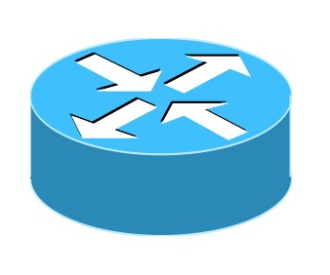
Internet eXchange Points (IXPs)
Where multiple networks meet
  To exchange traffic
Netflix
Google
IXP
Comcast

Slide 48

Internet eXchange Points (IXPs)
Where networks meet
  To exchange traffic and routing information
Route
Server
Netflix
Google
IXP
BGP
session
Comcast

Slide 49
IXPs Today
Many IXPs
  300+ world-wide
  80+ in North America
Some are quite large
  Carry more traffic than tier-1 ISPs
  Connect many peers (e.g., 600+ at AMS-IX)
Frontline of today’s peering wars
  E.g., video delivery to “eyeball” networks
  OpenIX initiative in the U.S.

Slide 50
SDN Enables Innovation at IXPs
Application-specific peering
  Video traffic via Comcast, non-video via AT&T
Inbound traffic engineering
  Divide traffic by sender or application
Server load balancing
  Select data center to handle request
Redirection through middleboxes
  E.g., transcoding, caching, monitoring, etc.
Dropping of attack traffic
  Blocking unwanted traffic in middle of Internet

Slide 51
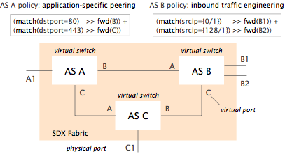
Virtual Switch Abstraction

Slide 52
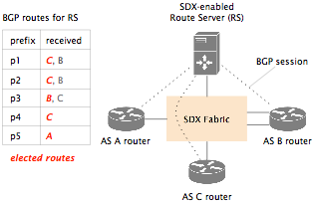
Working with Interdomain Routing
Select among the
routes BGP allows
match(dstport=80) >> fwd(B)
match(dstport=443) >> fwd(C)
Applied only for prefixes
Applied only for prefixes
p1, p2, p3
p1, p2, p3, p4

Slide 53
SDX Controller Architecture
App
A
App
A
App
C
App
B
SDX Runtime
Frenetic Runtime

Slide 54
Overcoming Scalability Challenges
BGP routing
  500,000 IP prefixes
  Frequent route changes
  Hundreds of participating networks
Compilation time
  Most IP prefixes are stable
  React quickly, and optimize in background
Switch table size
  Group IP prefixes with the same policy
  Tag related packets at the border routers

Slide 55
SDX Today
SDX platform
  Scalable runtime system
  Several example “apps”
  Experiments running “in the wild”
Beginnings of operational deployments
  Our work with ColoAtl, Internet2, and ESnet
  NSF program to encourage SDX deployments
  Google Cardigan project in NZ and Australia

Slide 56
Try Out the Software
Pyretic
  Python-based language and run-time system
  http://www.frenetic-lang.org/pyretic/
  Used in the SDX project, and Coursera SDN MOOC
  Software development lead by Princeton
Frenetic-OCaml
  OCaml-based language and run-time system
  https://github.com/frenetic-lang/frenetic
  Software development led by Cornell and UMass-Amherst
SDX
  Pyretic-based runtime system for exchange points
  http://noise-lab.net/projects/software-defined-networking/sdx/
  Software development led by GA Tech and Princeton

Slide 57
Related Work
Programming languages
  FRP: Yampa, FrTime, Flask, Nettle
  Streaming: StreamIt, CQL, Esterel, Brooklet, GigaScope
  Network protocols: NDLog
OpenFlow
  Language: FML, SNAC, Resonance
  Controllers: ONIX, POX, Floodlight, Nettle, FlowVisor
  Testing: Mininet, NICE, FlowChecker, OF-Rewind, OFLOPS
OpenFlow standardization
  http://www.openflow.org/
  https://www.opennetworking.org/

Slide 58
Conclusion
SDN is exciting
  Enables innovation
  Simplifies management
  Rethinks networking
SDN is happening
  Practice: APIs and industry traction, cool apps
  Principles: higher-level abstractions
Great opportunity
  Practical impact on future networks
  Placing networking on a strong foundation

